Slide 1

NE Drought Conditions CARC Update: July 22, 2021
Brian Fuchs
National Drought Mitigation Center
University of Nebraska-Lincoln
School of Natural Resources

Slide 2
Regional Climatic and Drought Conditions…

Slide 3
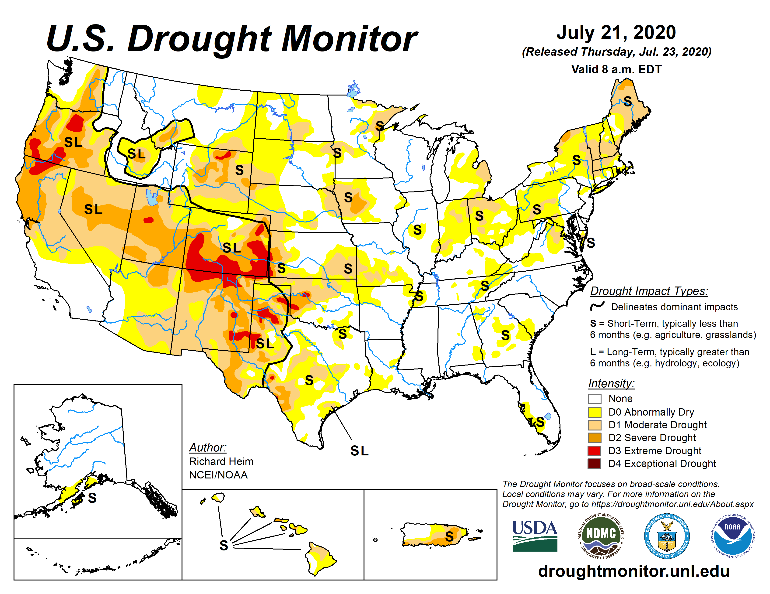
Last year at this time…..

Slide 4
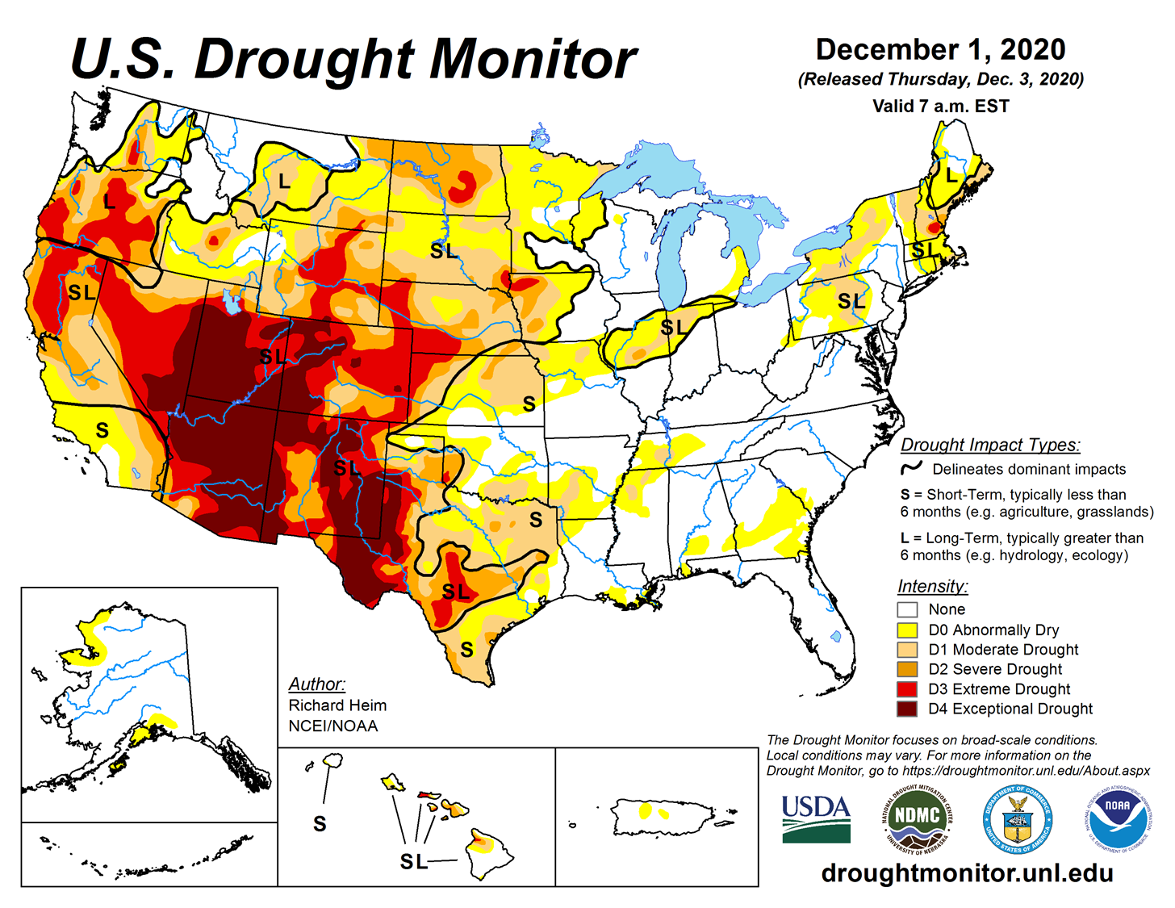
Last CARC Meeting…..

Slide 5
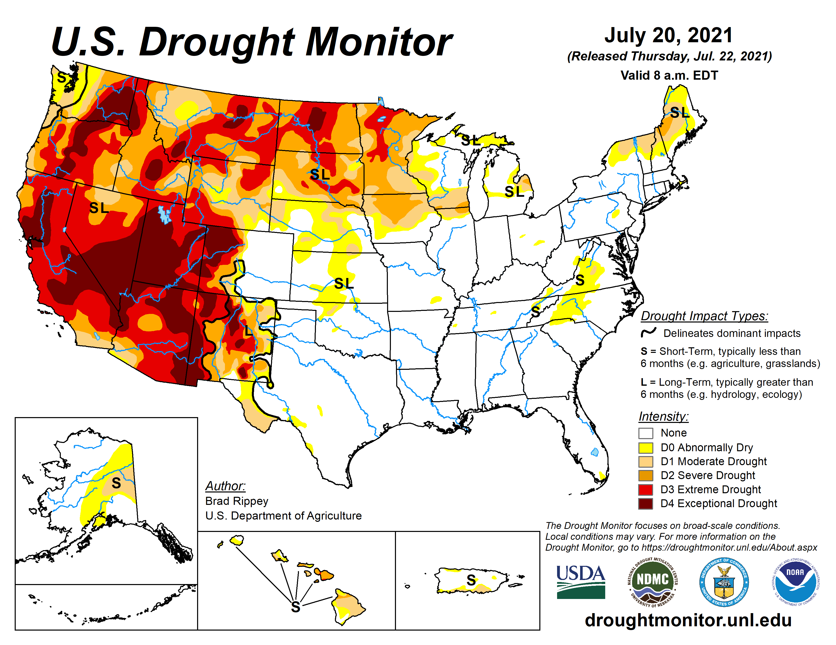

Slide 6
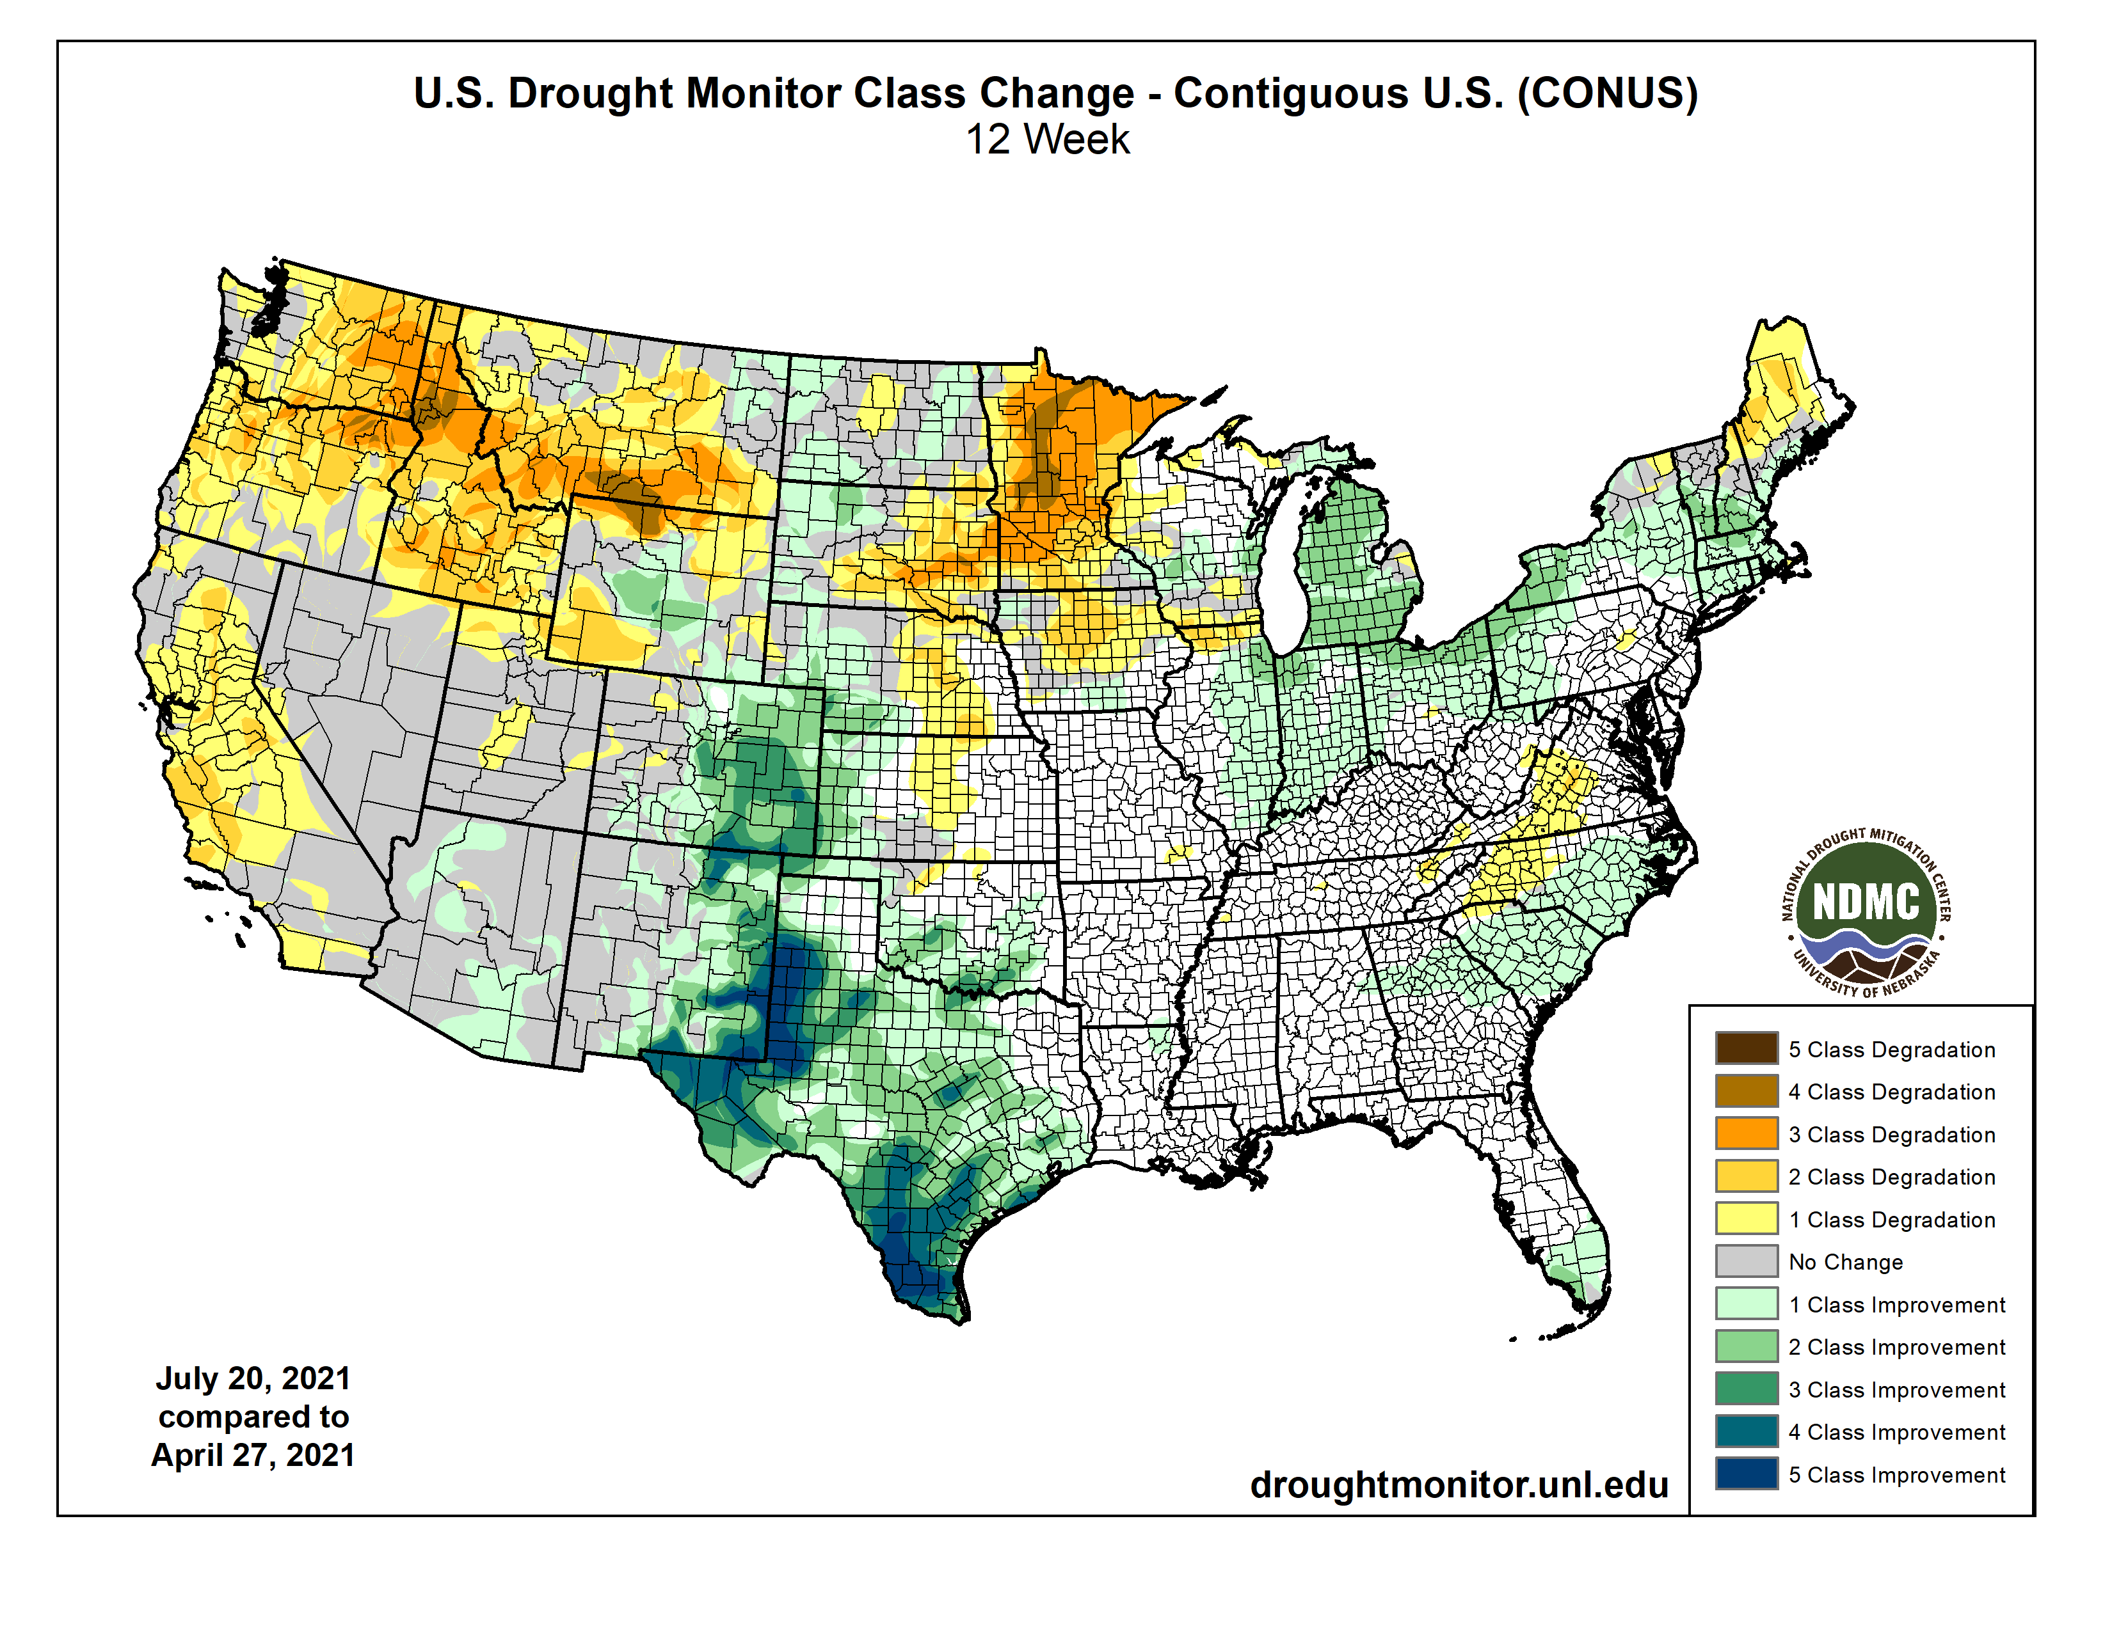

Slide 7
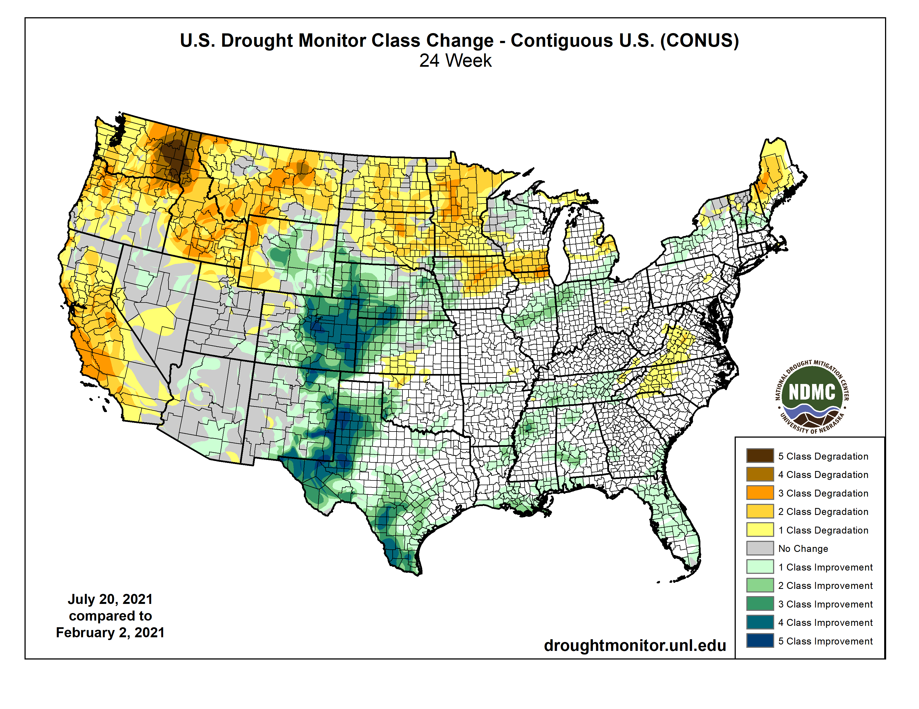

Slide 8
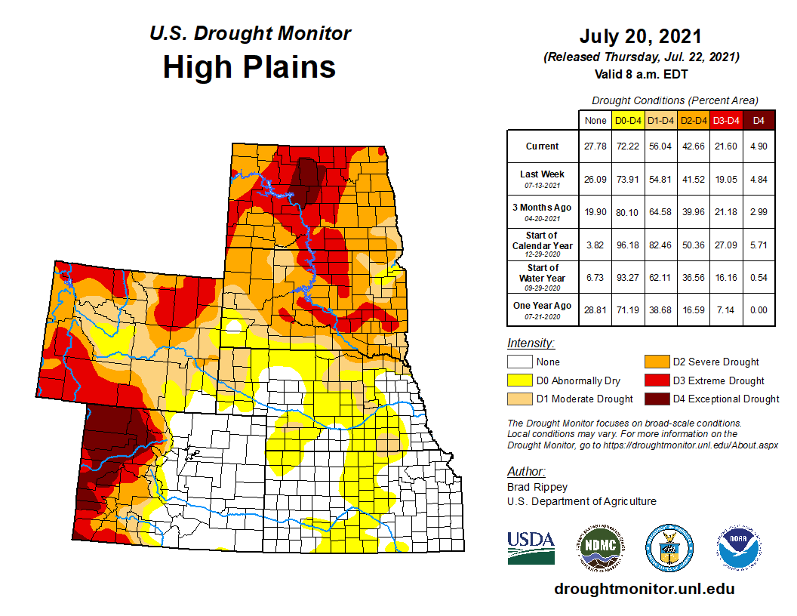


Slide 10
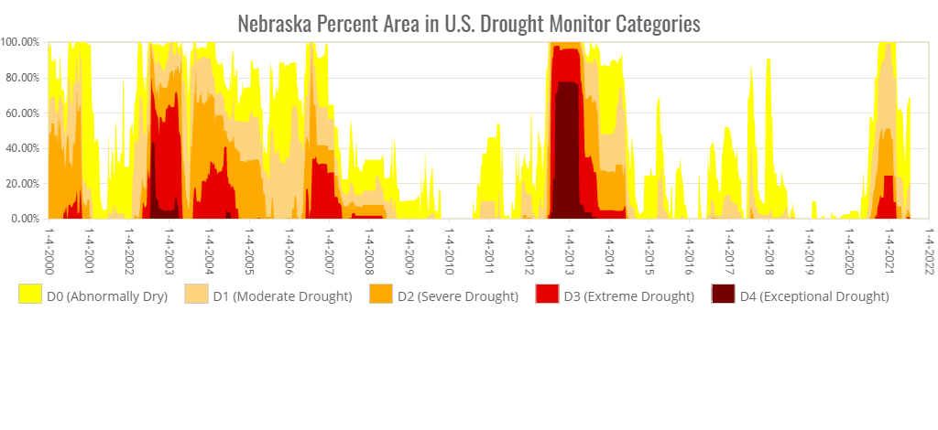
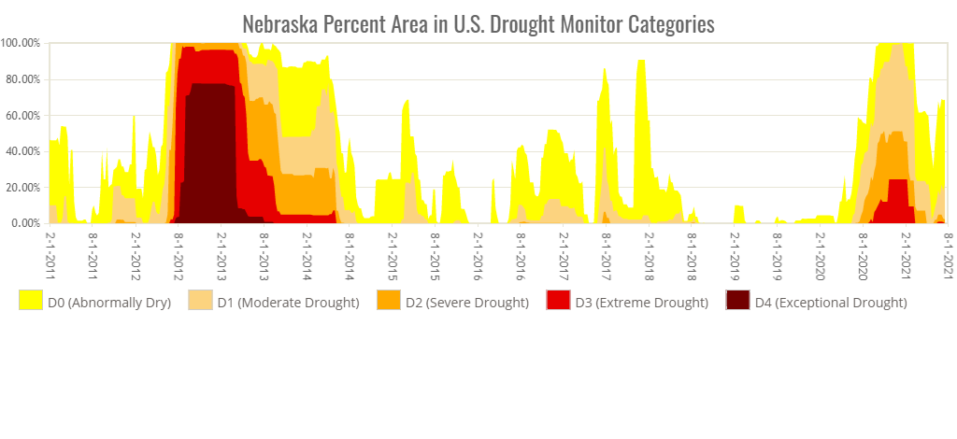
2021 is the first year that we have seen Extreme Drought (D3) in Nebraska since the summer of 2014.

Slide 11
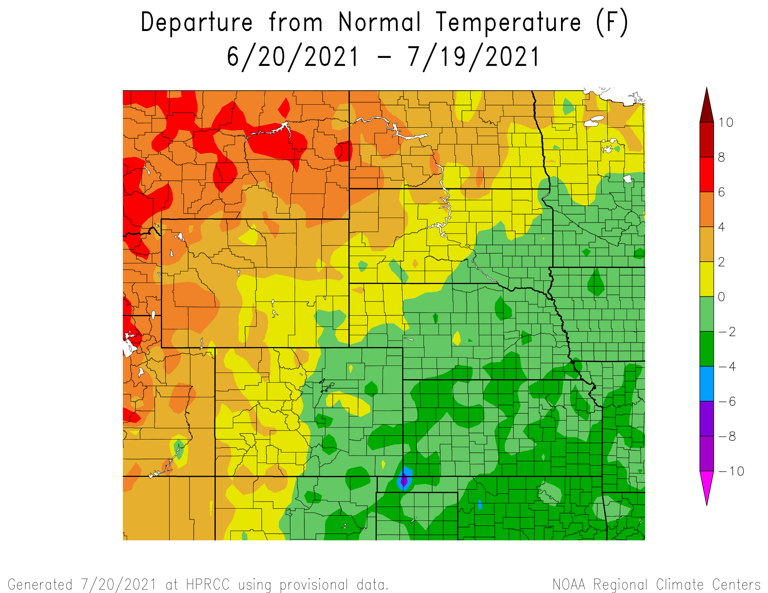
Departure from Normal Temperatures over the last 30 days

Slide 12
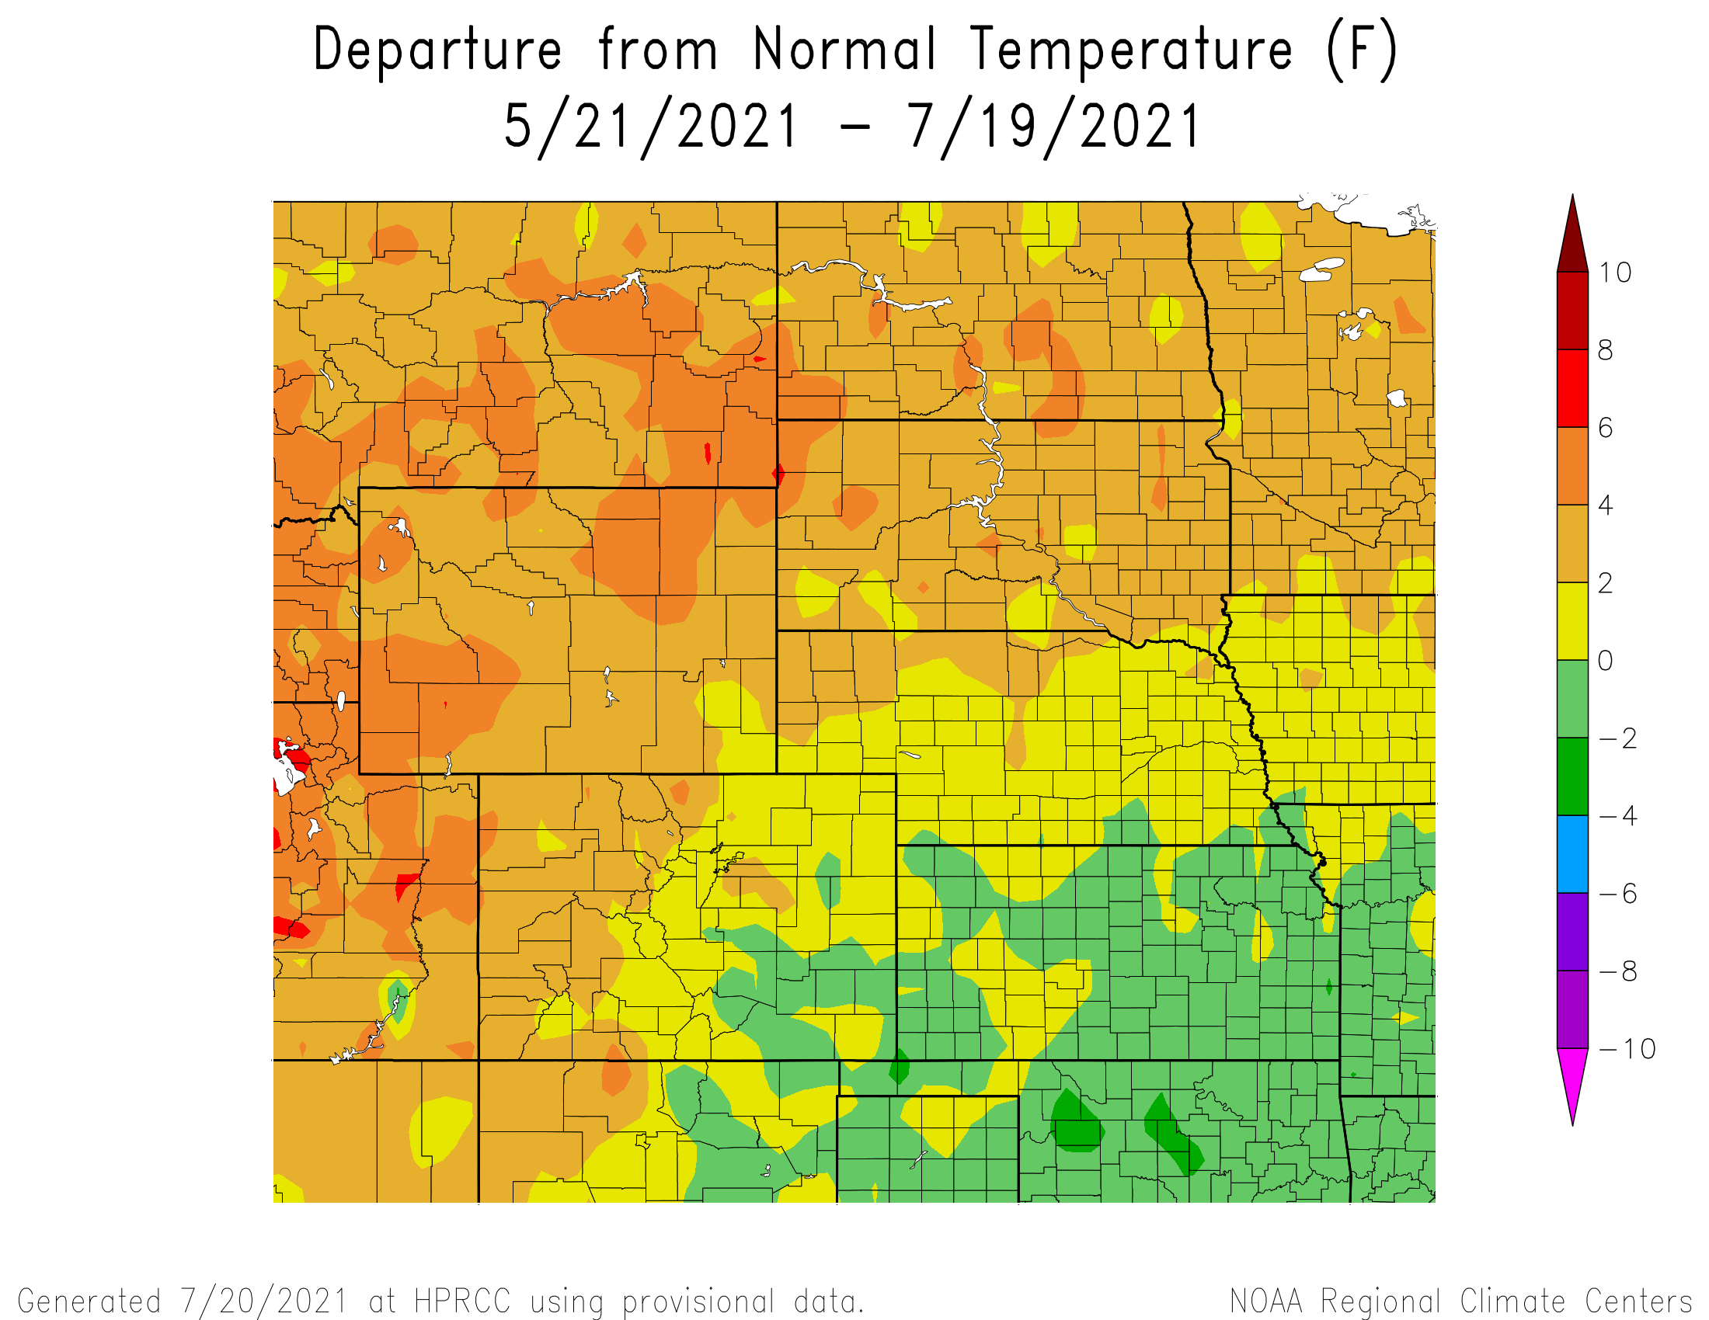
Departure from Normal Temperatures over the last 60 days

Slide 13
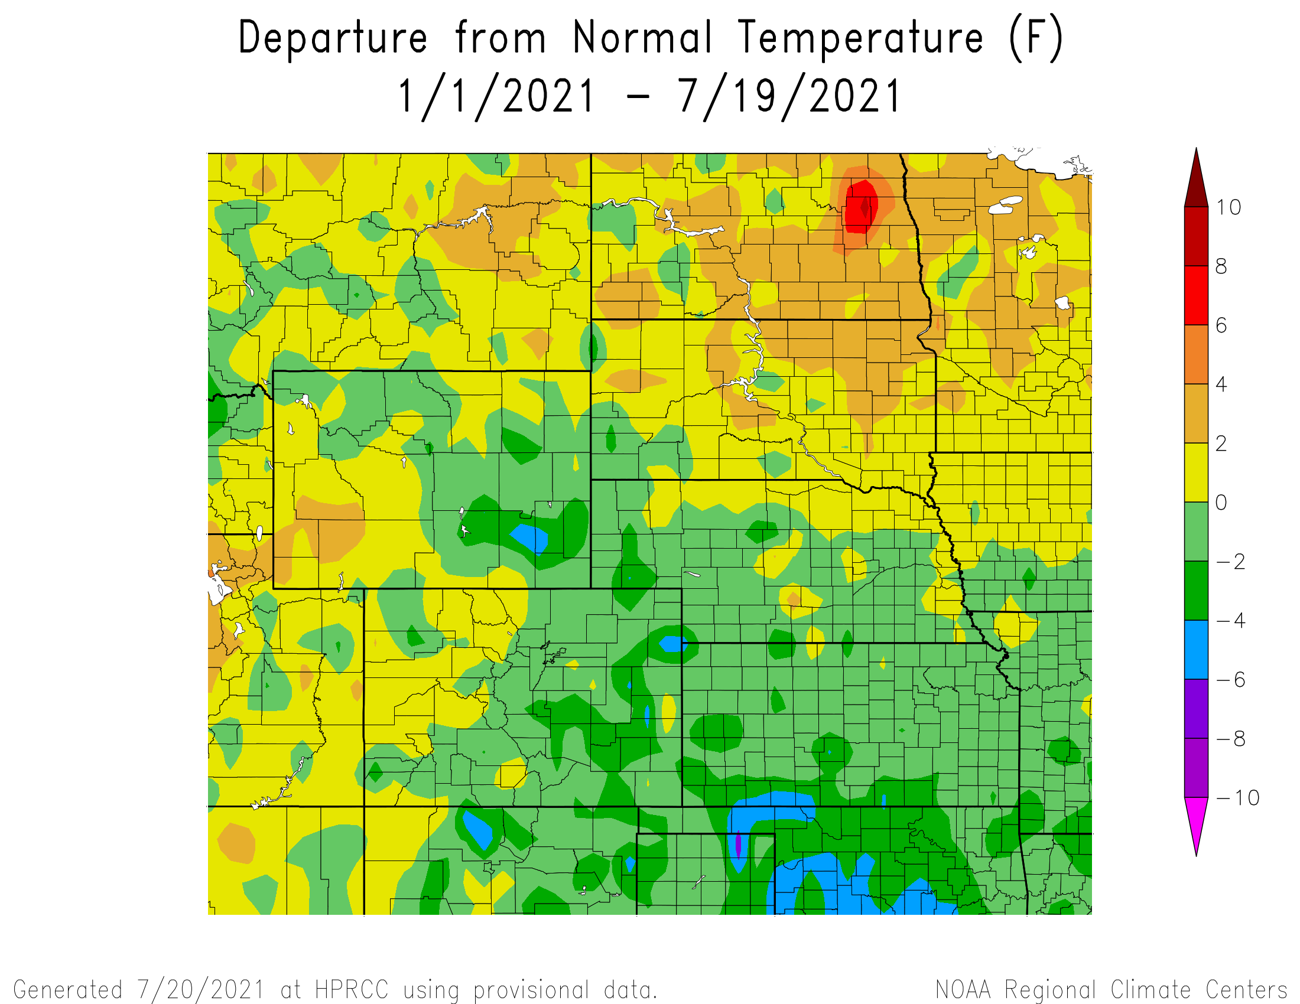
Departure from Normal Temperatures for the Calendar Year

Slide 14
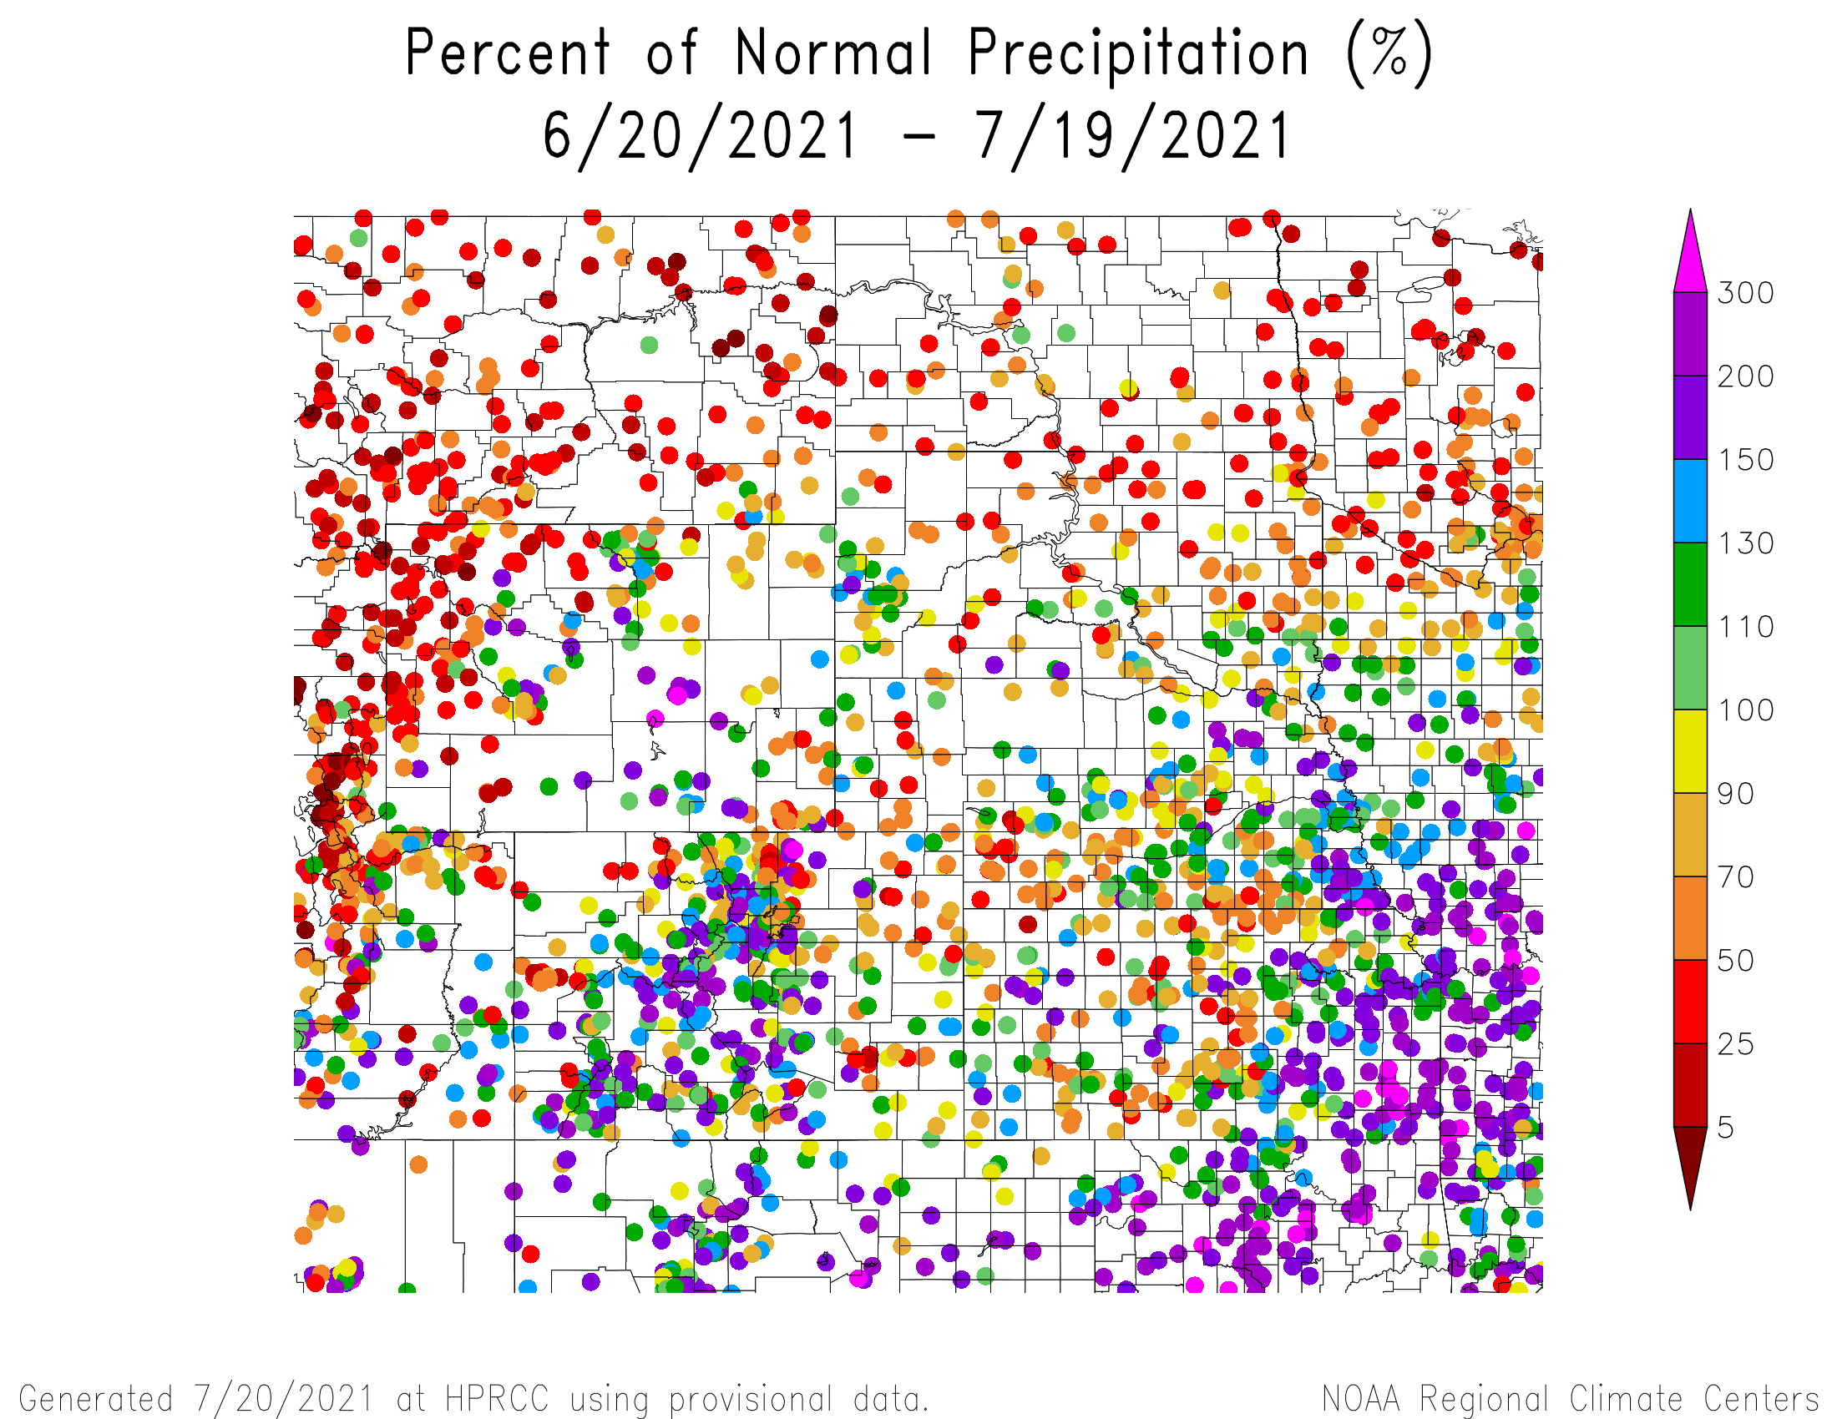
Percent of Normal Precipitation over the last 30 days

Slide 15
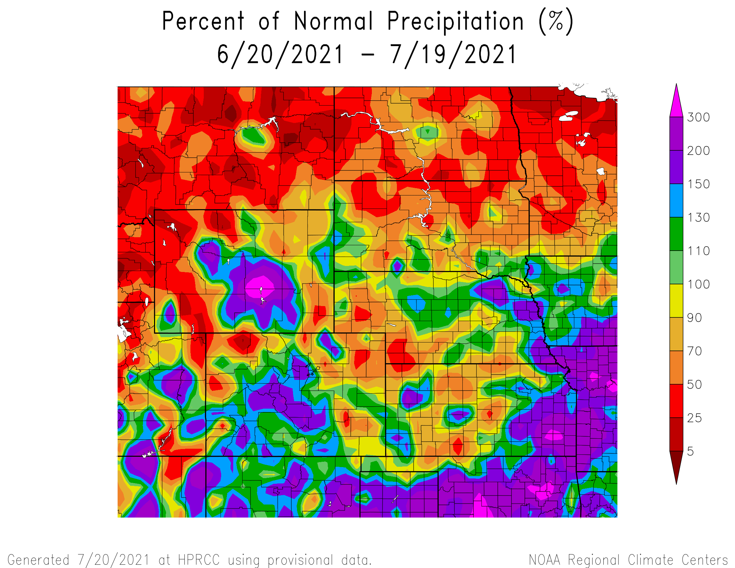
Percent of Normal Precipitation over the last 30 days

Slide 16
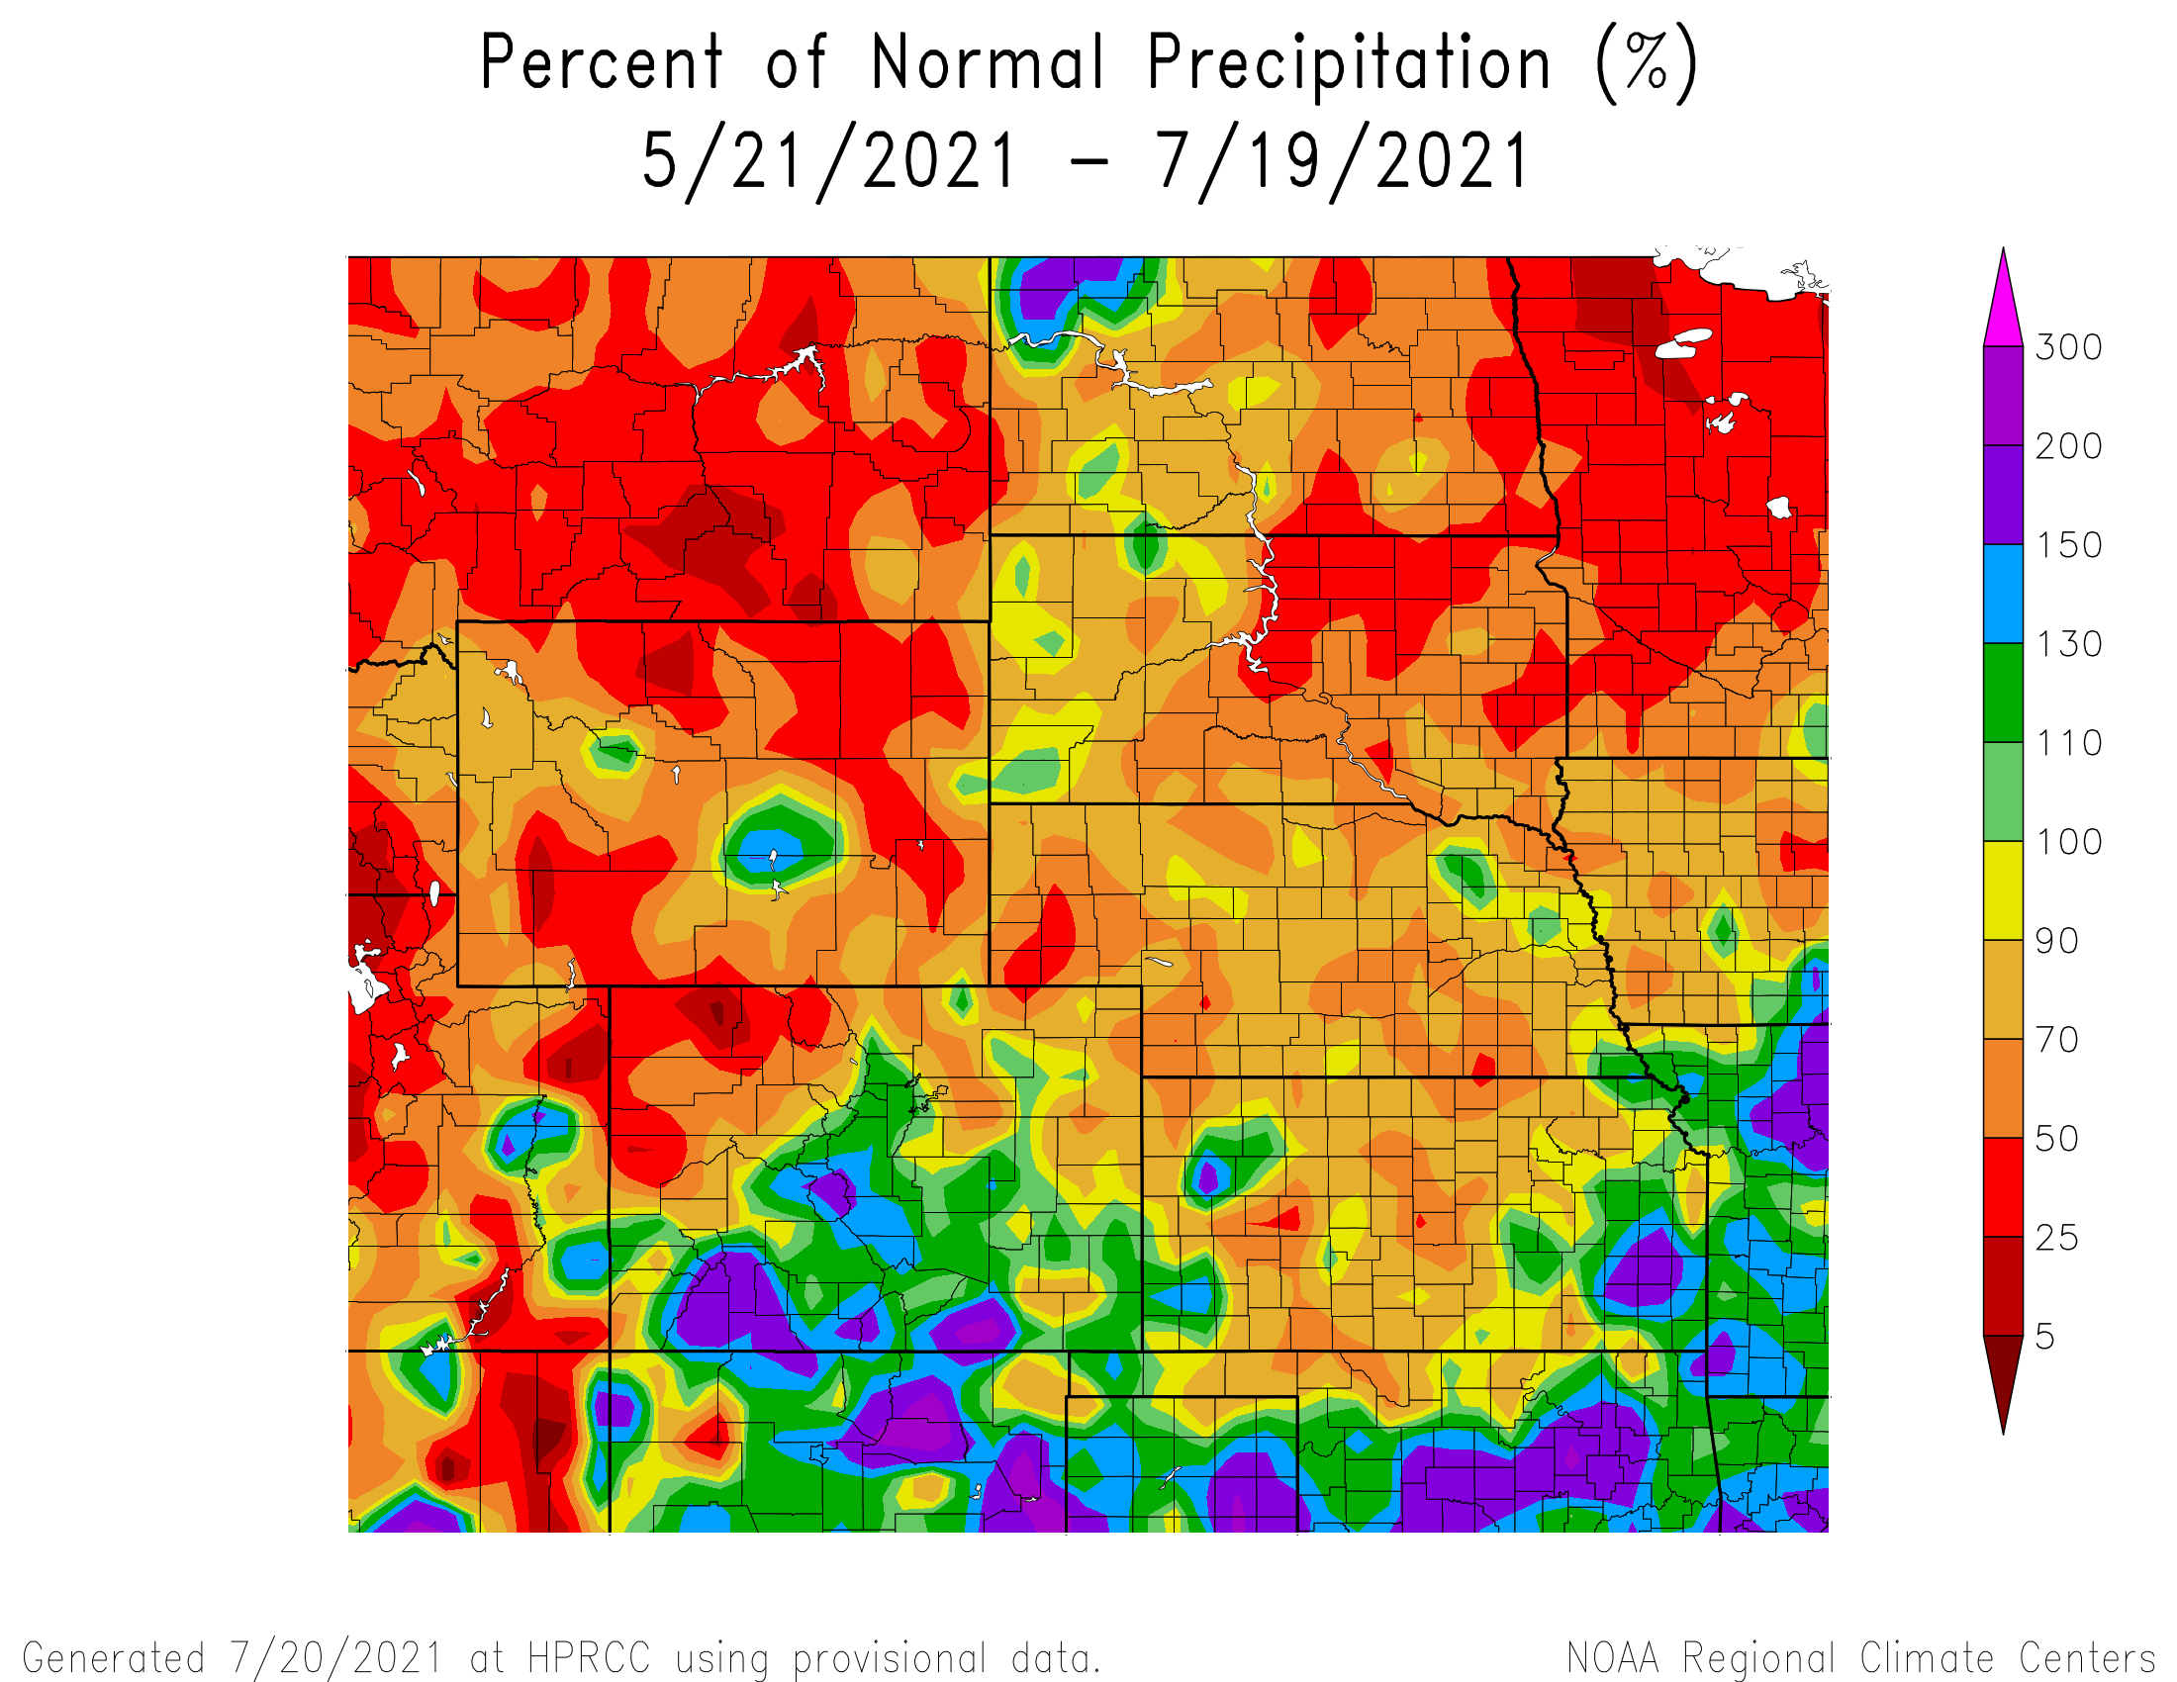
Percent of Normal Precipitation over the last 60 days

Slide 17
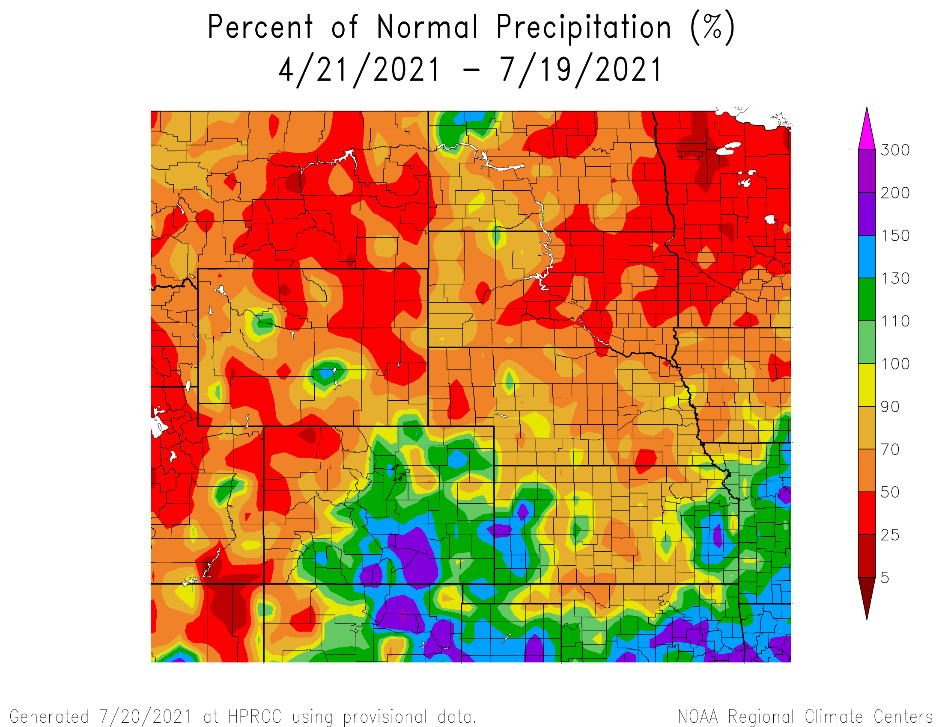
Percent of Normal Precipitation over the last 90 days

Slide 18
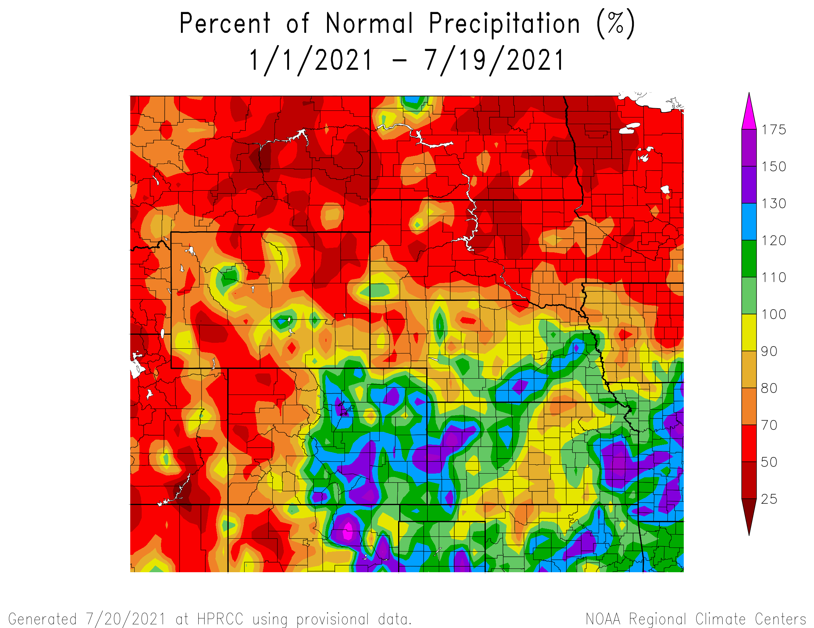
Percent of Normal Precipitation for the calendar year

Slide 19
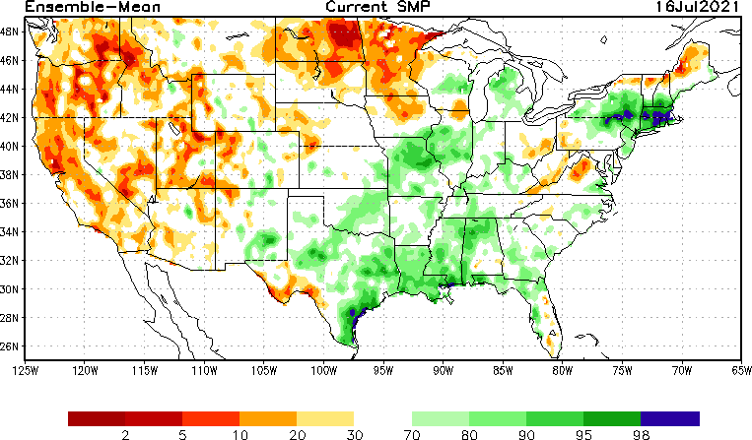
NLDAS Soil Moisture Model: Current Soil Moisture Anomaly

Slide 20
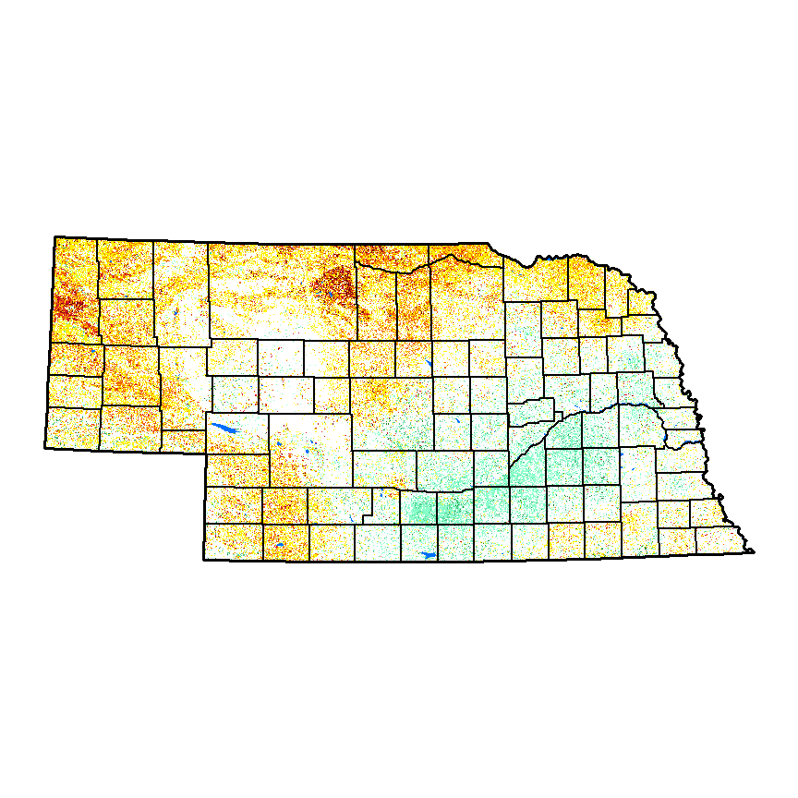
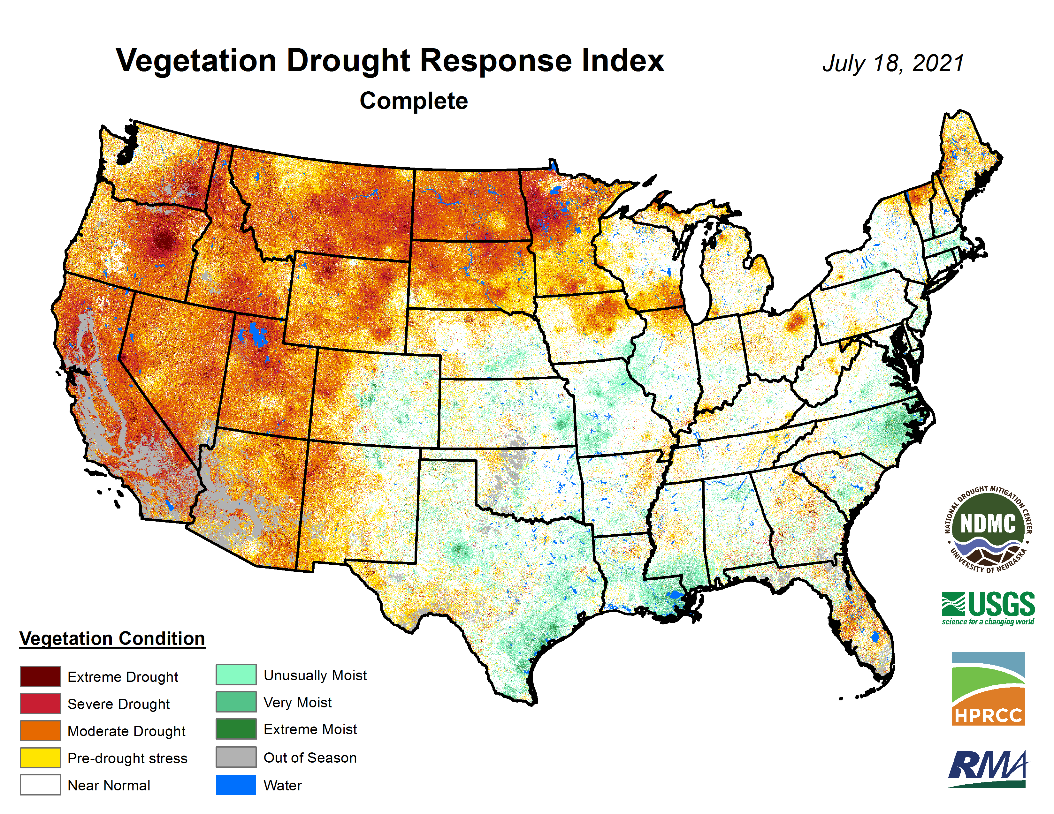
NDMC’s Vegetation Drought Response Index (VegDri)

Slide 21
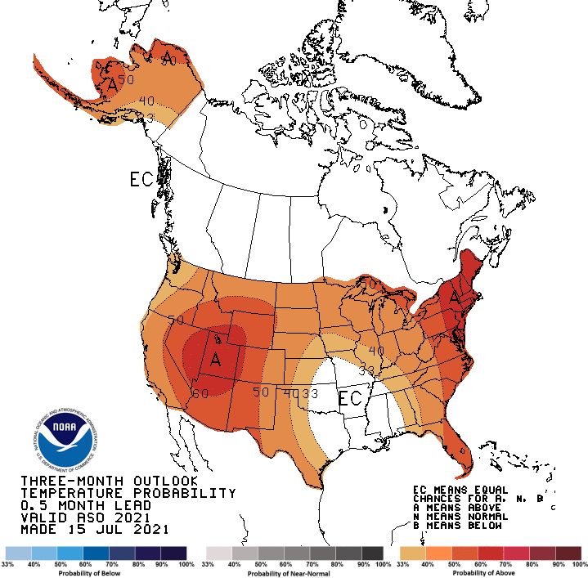
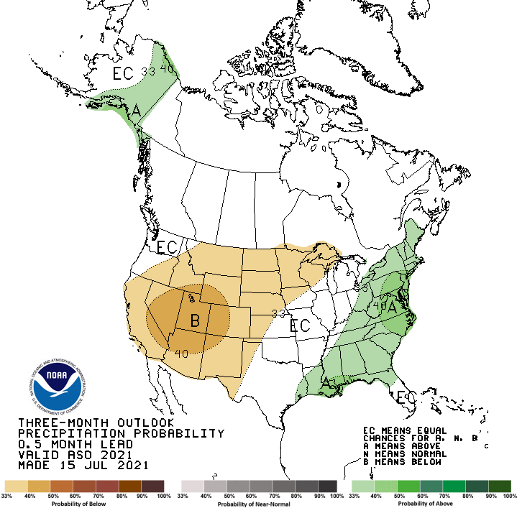
3-Month Outlook

Slide 22
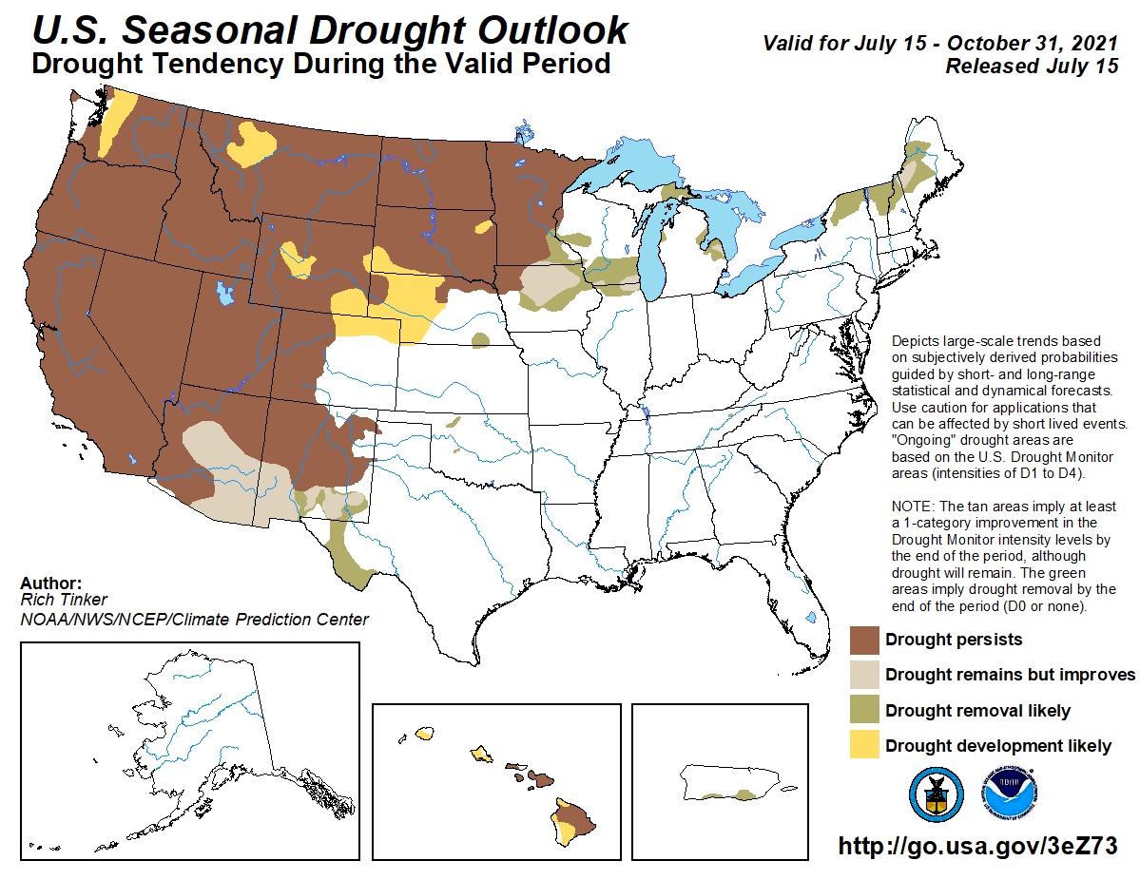

Slide 23
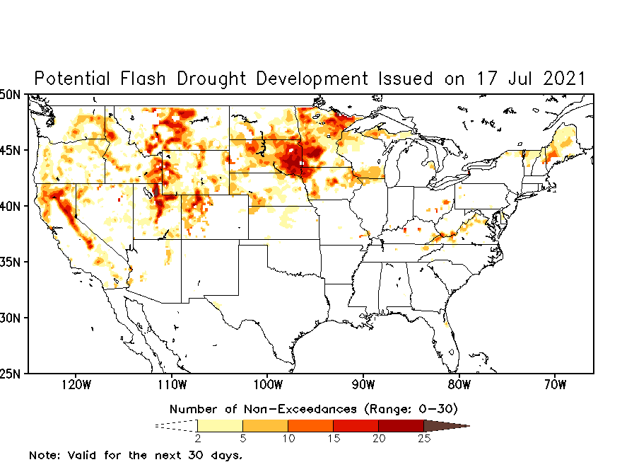
Experimental “Flash Drought” outlook tool

Slide 24
Climate/Drought Summary
Temperatures that have been cooler than normal recently (last 30 days), near normal at 60 days and near-normal to slightly below normal for the calendar year has been favorable with the spotty summer thunderstorms from allowing widespread drought to develop.
Nebraska has had some very wet months and very dry months so far this year and the annual totals to date show how spotty the precipitation has been with some areas well above normal and others well below normal. Local conditions will vary drastically depending on if rains were received or not.
Nebraska is currently showing 21.77 percent of the state in drought. Most of the drought is moderate drought (D1) with some severe drought (D2) in the northeast. This compares to early January when 100% of the state was in drought with over half in D2.
The seasonal drought outlook that goes through the end of October has western Nebraska having drought develop or persisting during this time while eastern Nebraska looks to be in a more favorable position to keep drought at a minimum.

Slide 25
Nebraska Water Supply Update…

Slide 26
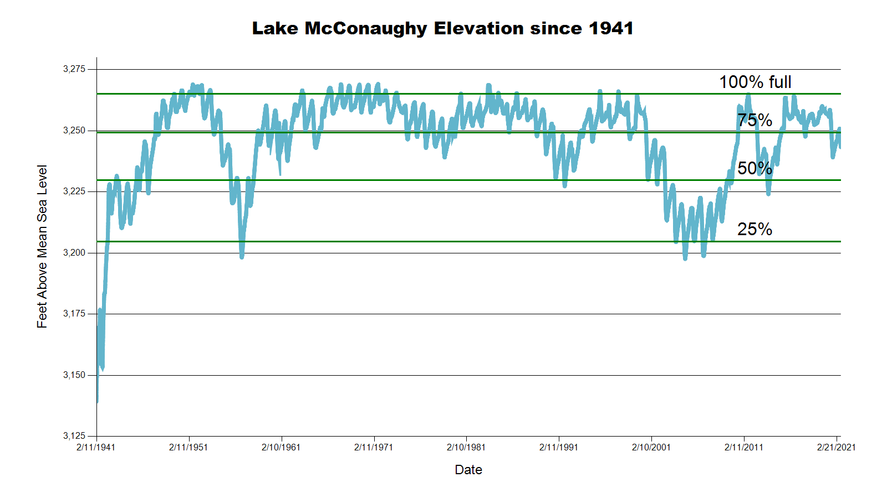
3243.3 feet 66.7% Full
3243.4 feet 68.8% Full
December 2020 CARC meeting
SOURCE: CNPPID www.cnppid.com

Slide 27
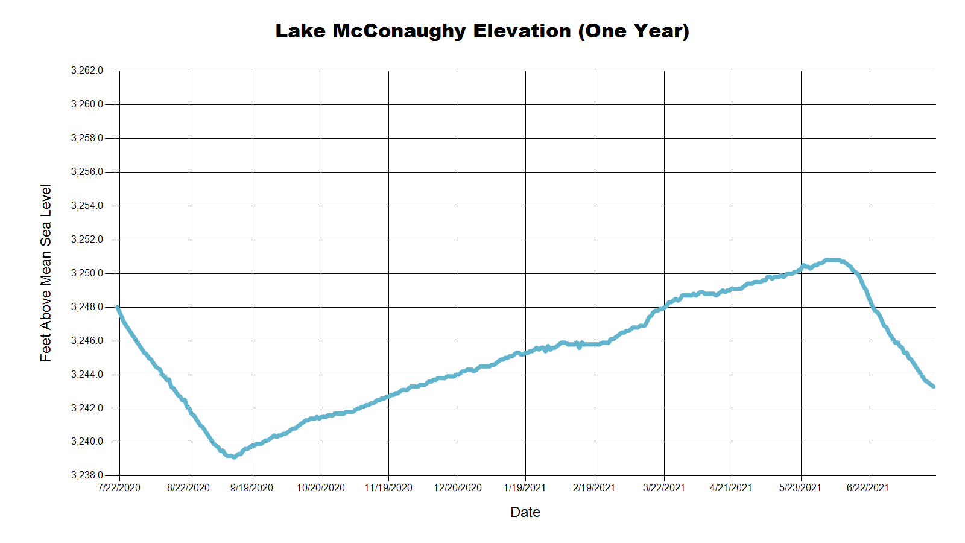
3246.3 Feet
70.7% of Max
July 2020
3243.4 Feet
68.8% of Max
December 2020
3243.3 Feet
68.7% of Max
July 2021
SOURCE: CNPPID www.cnppid.com

Slide 28
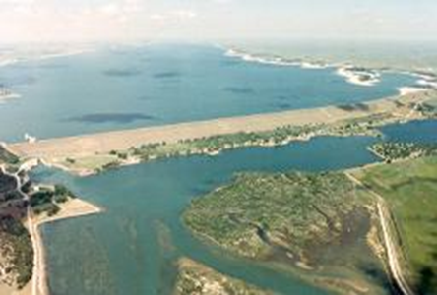
July 2021 CARC Meeting
SOURCE: CNPPID www.cnppid.com

Slide 29
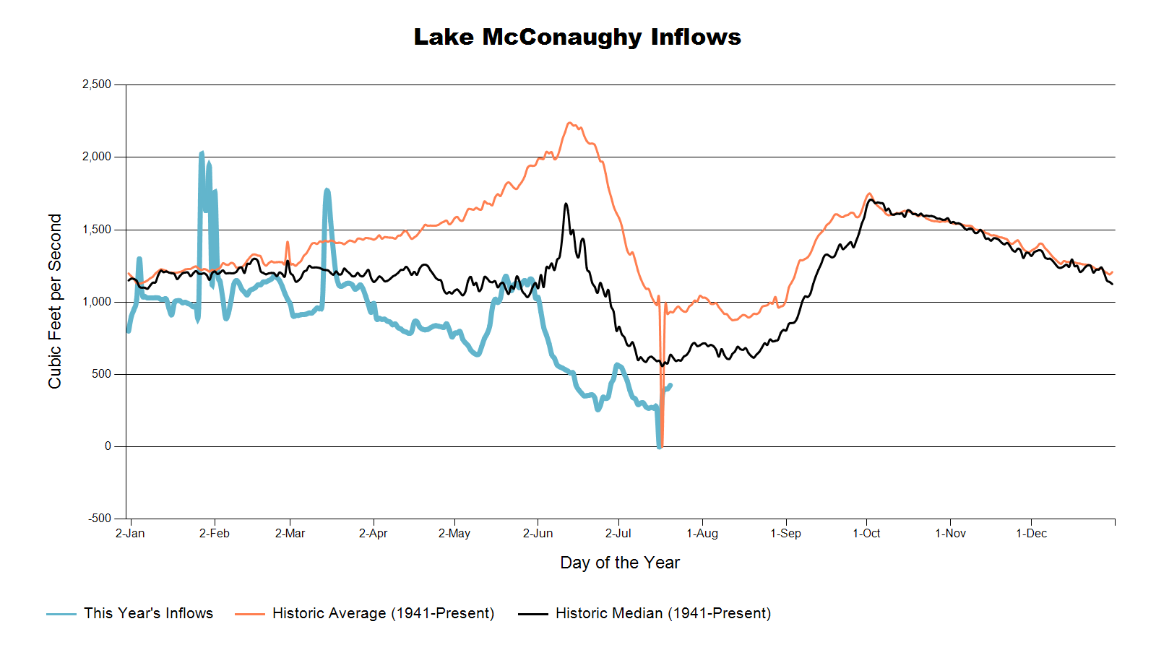

Slide 30
Lake McConaughy
Civil engineer Tyler Thulin reported that Lake McConaughy’s elevation as of Tuesday morning was 3245.7 feet (69.9 percent capacity). Current inflows were about 400 cubic feet per second (cfs) with releases around 2,550 cfs. He added that outflows were down 1,025 cfs from two weeks ago after releases from the Environmental Account of water in the reservoir ended last week. Irrigation and Water Services Manager Scott Dicke reported that the Holdrege area has received 7.80 inches of rain since May 1, which is one inch below average. He added that releases from Elwood Reservoir could begin this week unless the area receives precipitation.
SOURCE: CNPPID News Release, July 6, 2021
www.cnppid.com

Slide 31
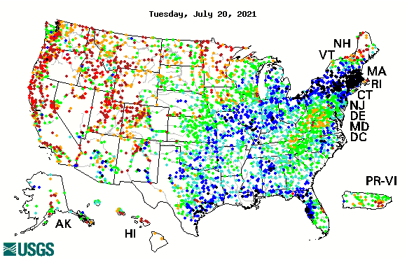

14-day average streamflow compared to historical streamflow for the day of year

Slide 32
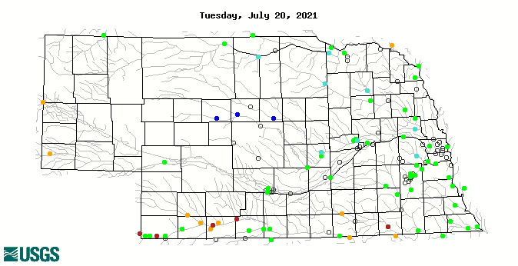
14-day average streamflow compared to historical streamflow for the day of year
95th Percentile
21st Percentile
57th Percentile
10thPercentile
14th Percentile
5thPercentile

Slide 33
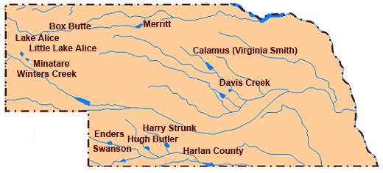
Republican River Basin
Hugh Butler: 54.7%(49.9%) of conservation pool
Enders: 21.1% (19.9%) of conservation pool
Harry Strunk: 86.3%(67.2%) of conservation pool
Swanson: 57.7% (49.4%) of conservation pool
*values in red are from the last CARC meeting in December 2020.
Source: BOR http://www.usbr.gov/gp/lakes_reservoirs

Slide 34
Republican River Basin
Harlan County Current Conditions
Conservation Pool is 94.7% full (88.0%)
297,486 Acre-Feet in storage compared to 276,399 Acre-Feet (AF) of water in storage during December 2020
Last year at this time, 310,538 AF was in storage (July 2020)
Historical average storage for this time of the year is 313,006 AF
*values in red are from the last CARC meeting in December 2020
Source: BOR http://www.usbr.gov/gp/lakes_reservoirs/

Slide 35
Water Supply Summary
Lake McConaughy is currently 66.7 percent of capacity and has been slowly dropping since the start of the irrigation season and the surge for the environmental account.
The Republican River basin reservoirs are higher than they were in December 2020 as water levels increased since last winter’s CARM meeting and irrigation being normal so far.
Harlan County Reservoir is holding about 21,087 acre-feet more water now than in December 2020.
Harlan County is holding about 84,480 acre-feet less water than the historical average for this time of year.

Slide 36
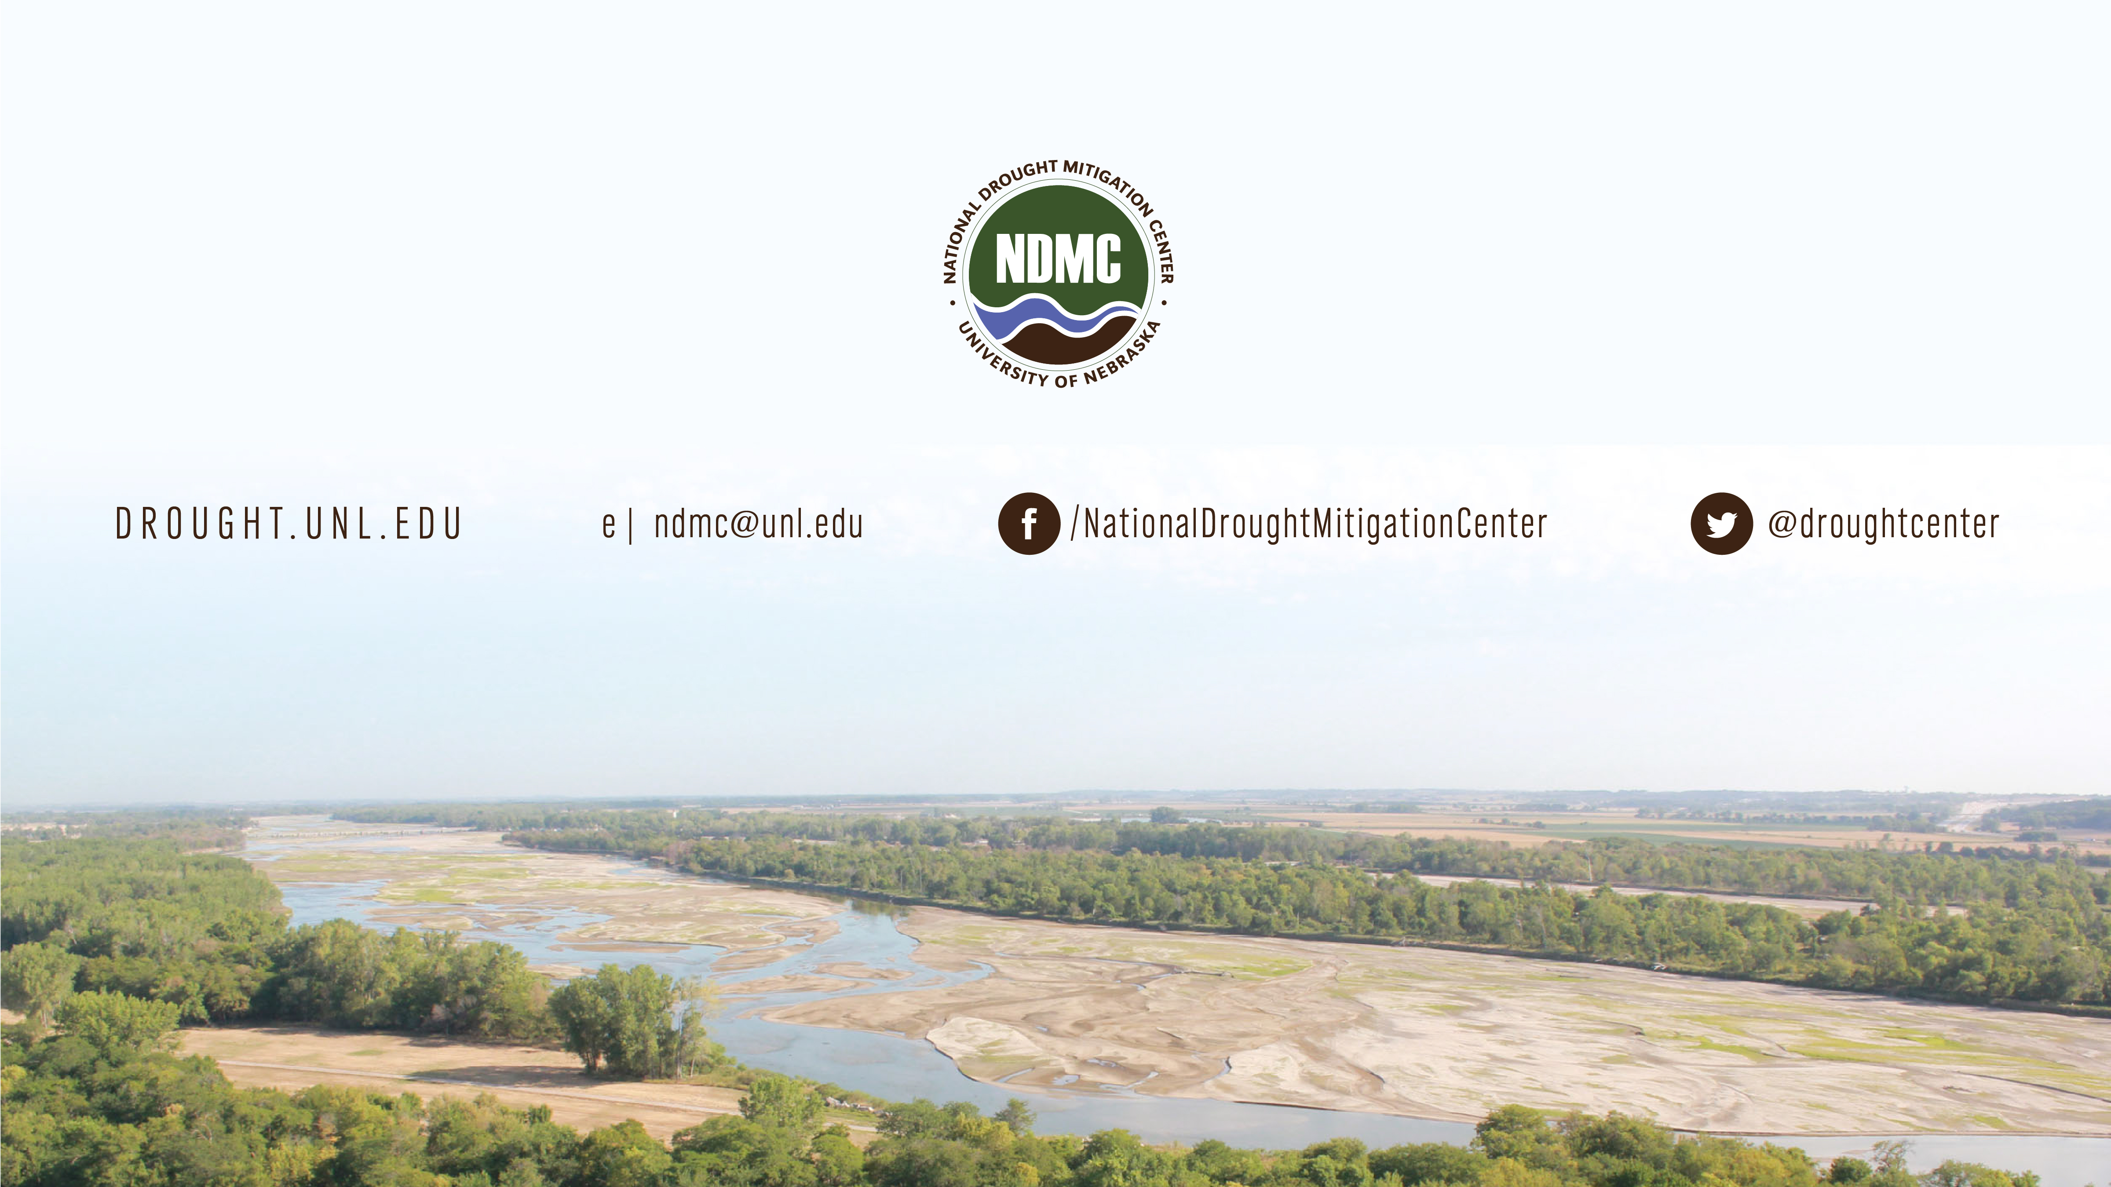
Brian Fuchs
bfuchs2@unl.edu
402-472-6775
National Drought Mitigation Center
School of Natural Resources
University of Nebraska-Lincoln

