Slide 1

NE Drought Conditions CARC Update:July 29, 2020
Brian Fuchs
National Drought Mitigation Center
University of Nebraska-Lincoln
School of Natural Resources

Slide 2
Regional Climatic and Drought Conditions…

Slide 3
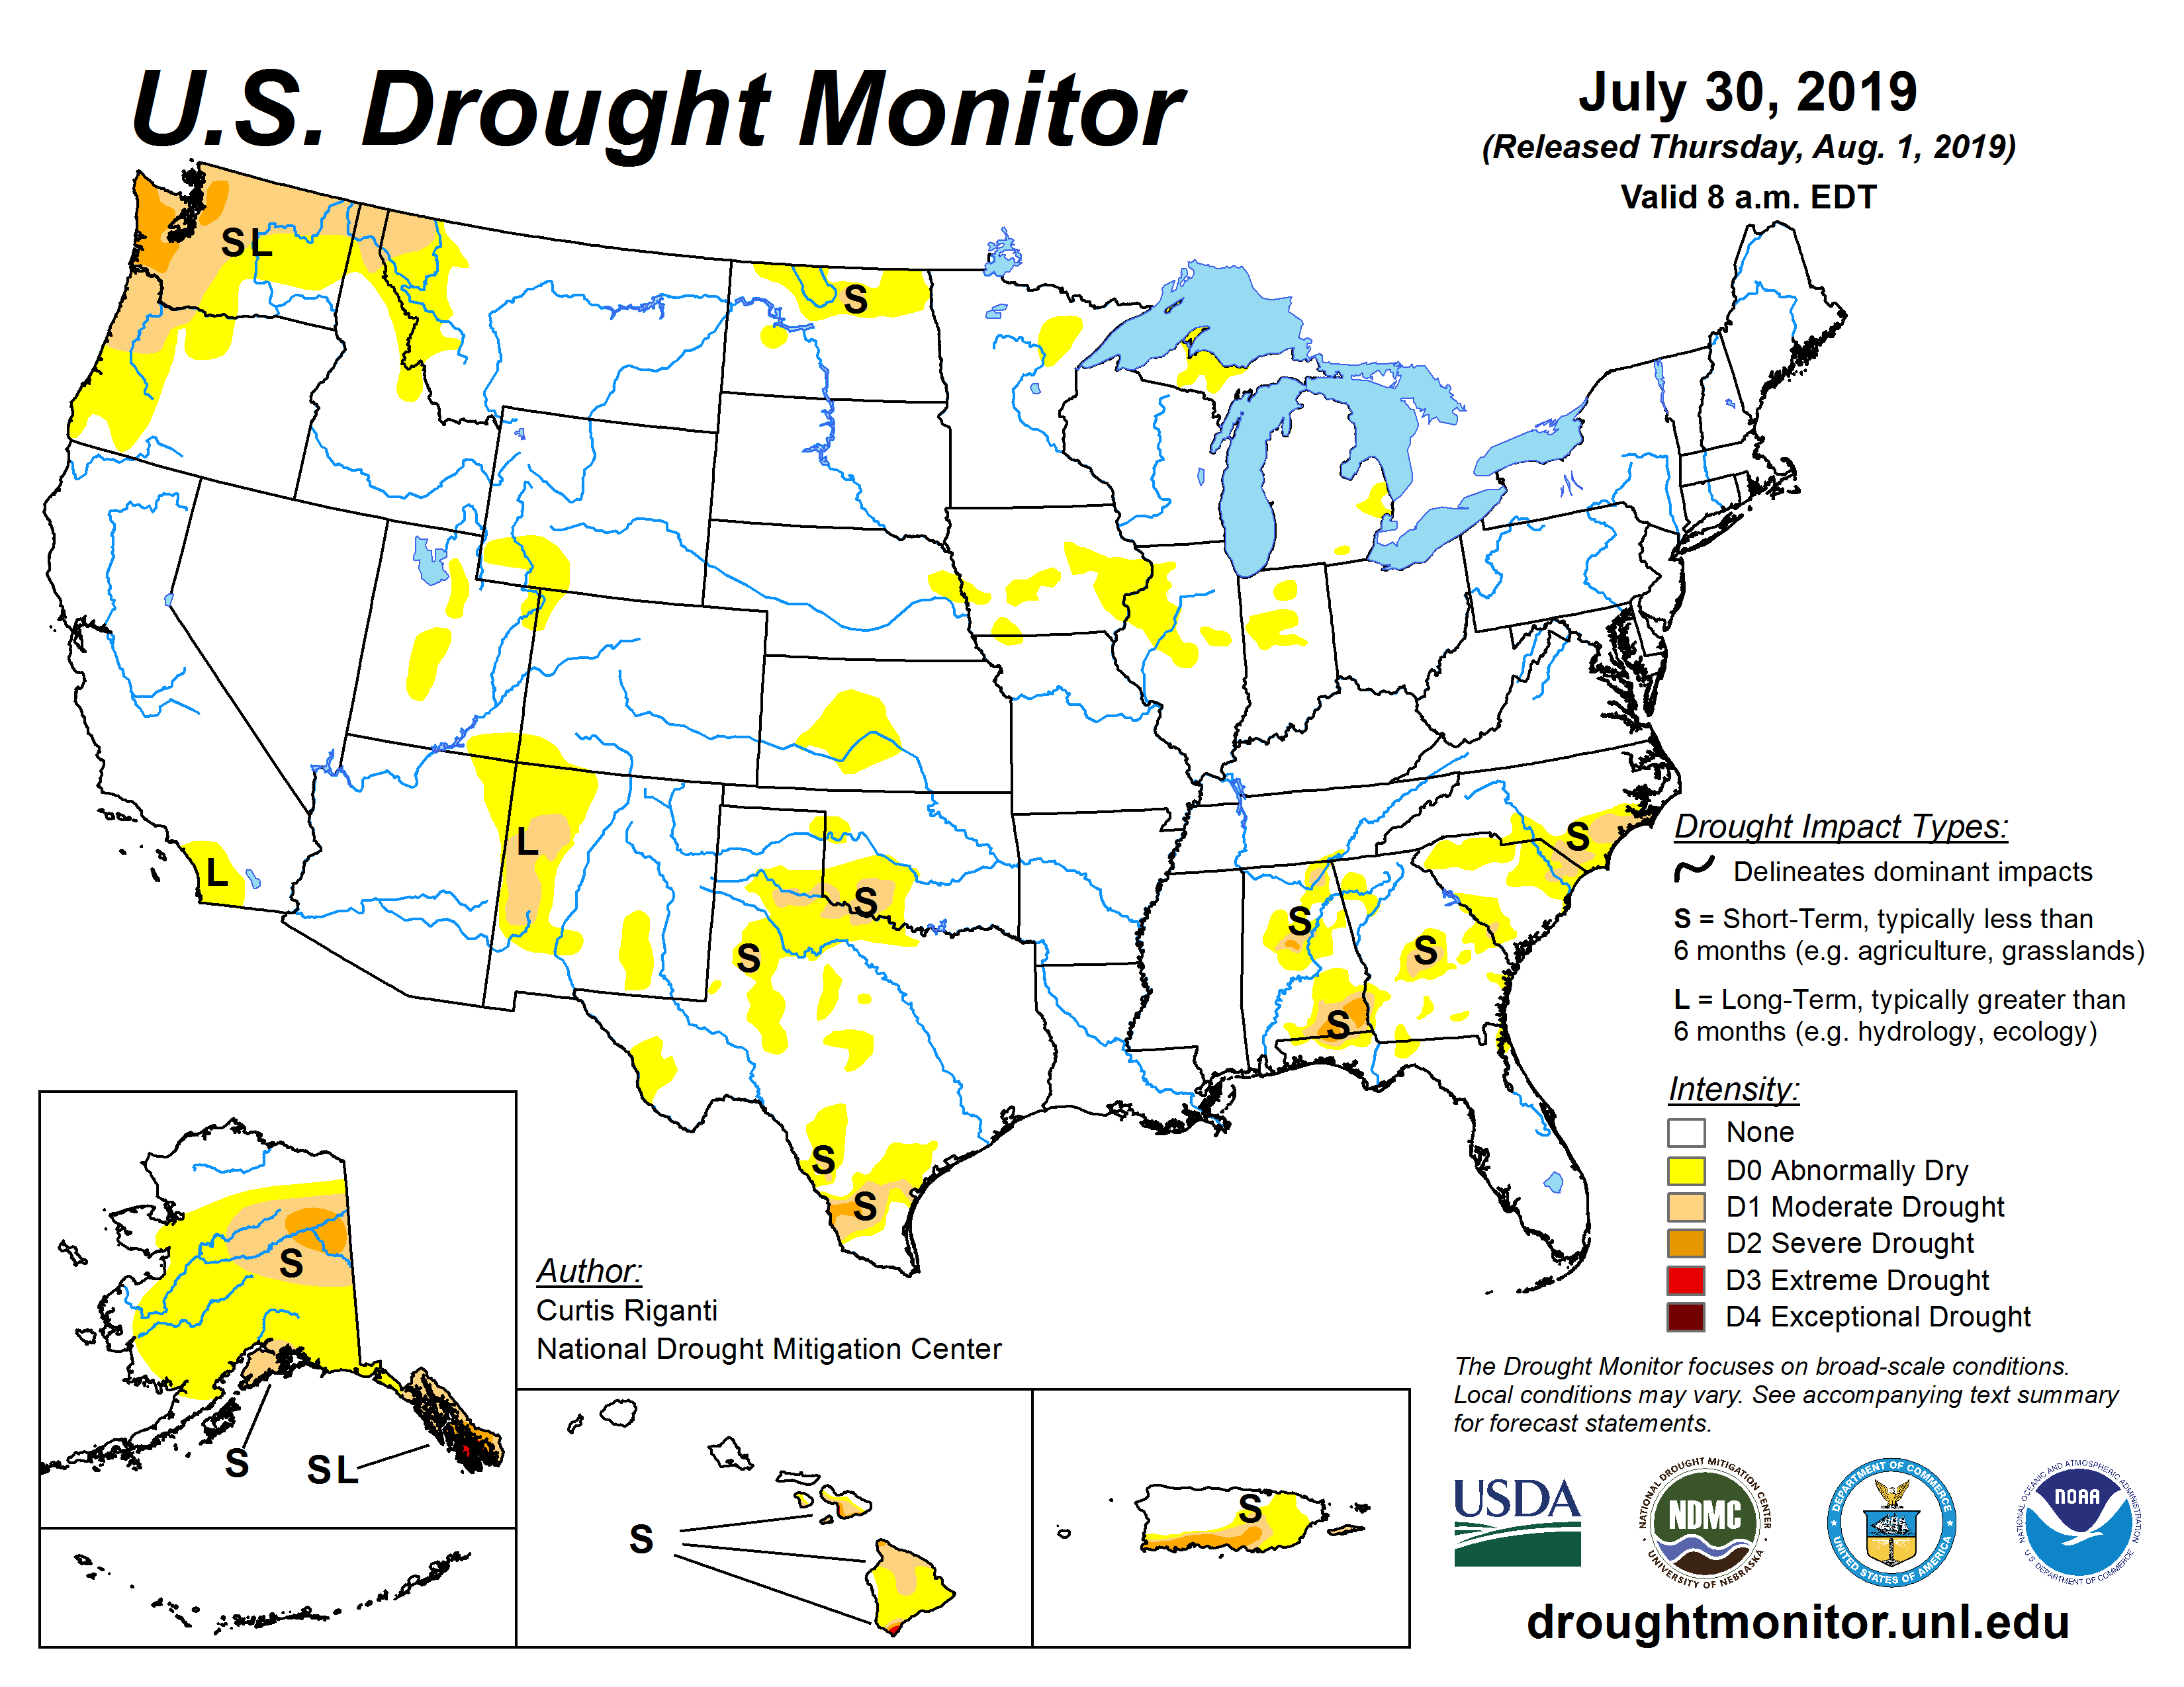
Last year at this time…..

Slide 4
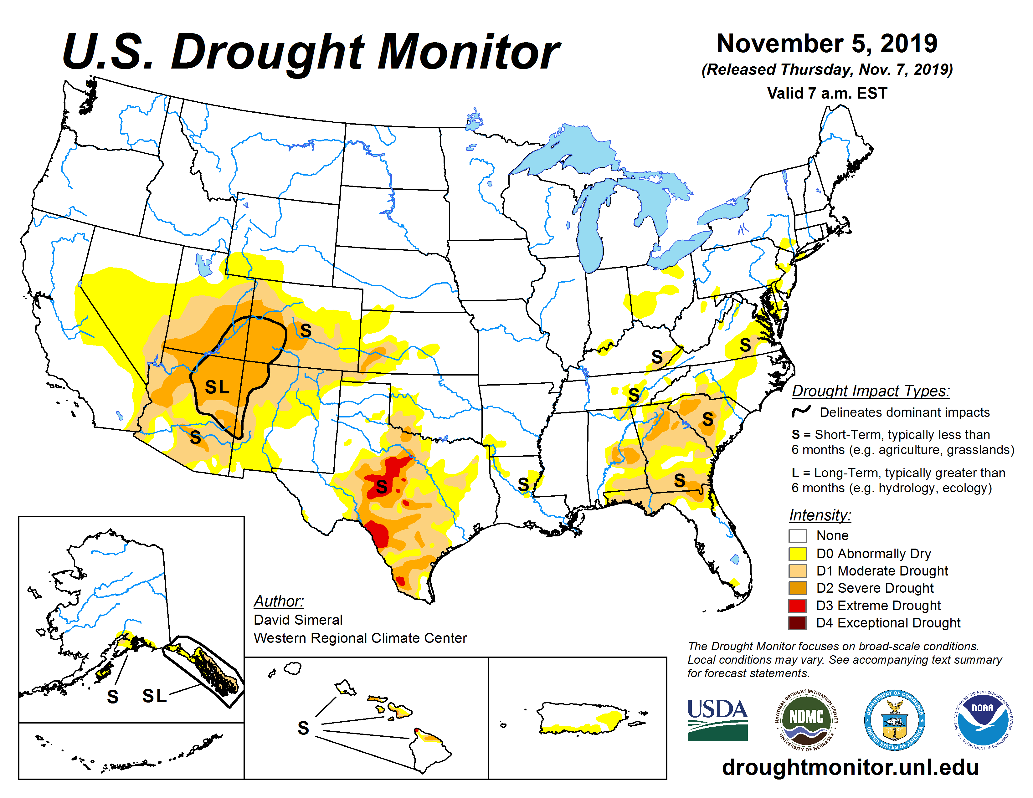
Last CARC Meeting…..

Slide 5
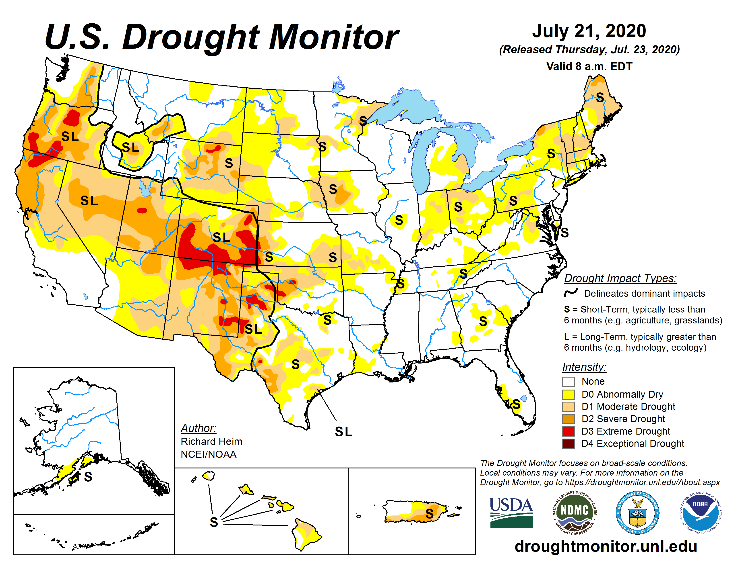

Slide 6
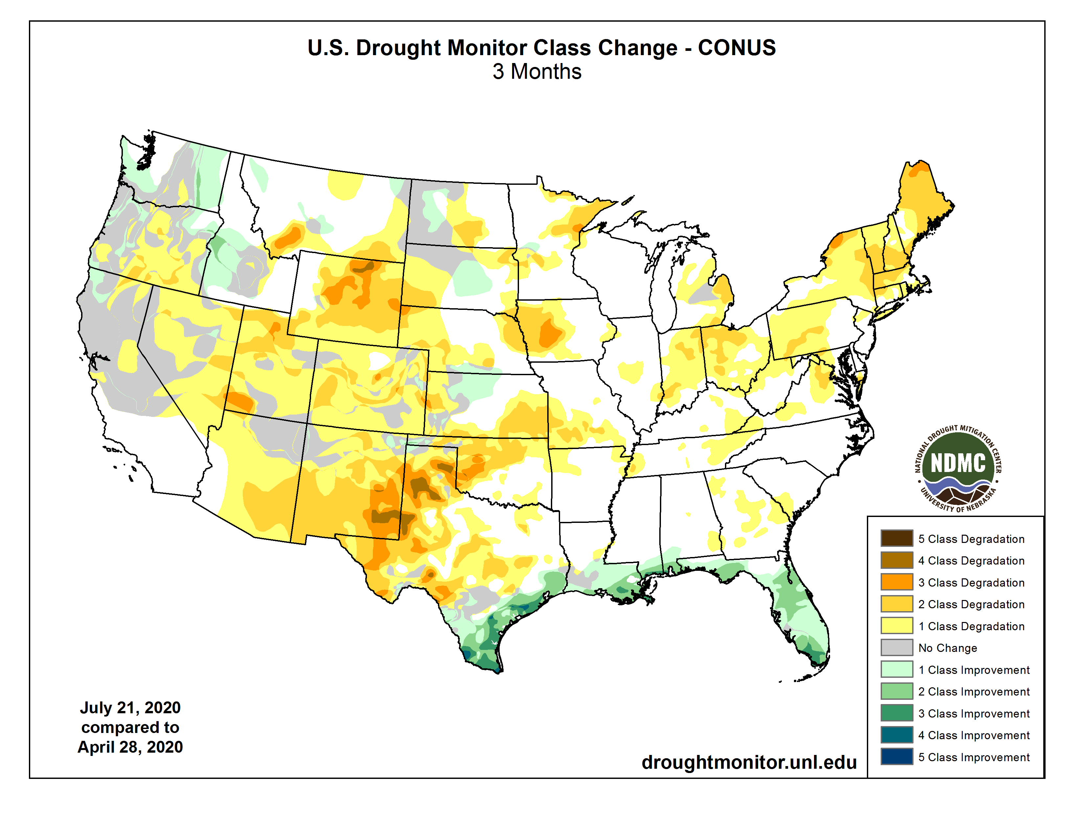

Slide 7
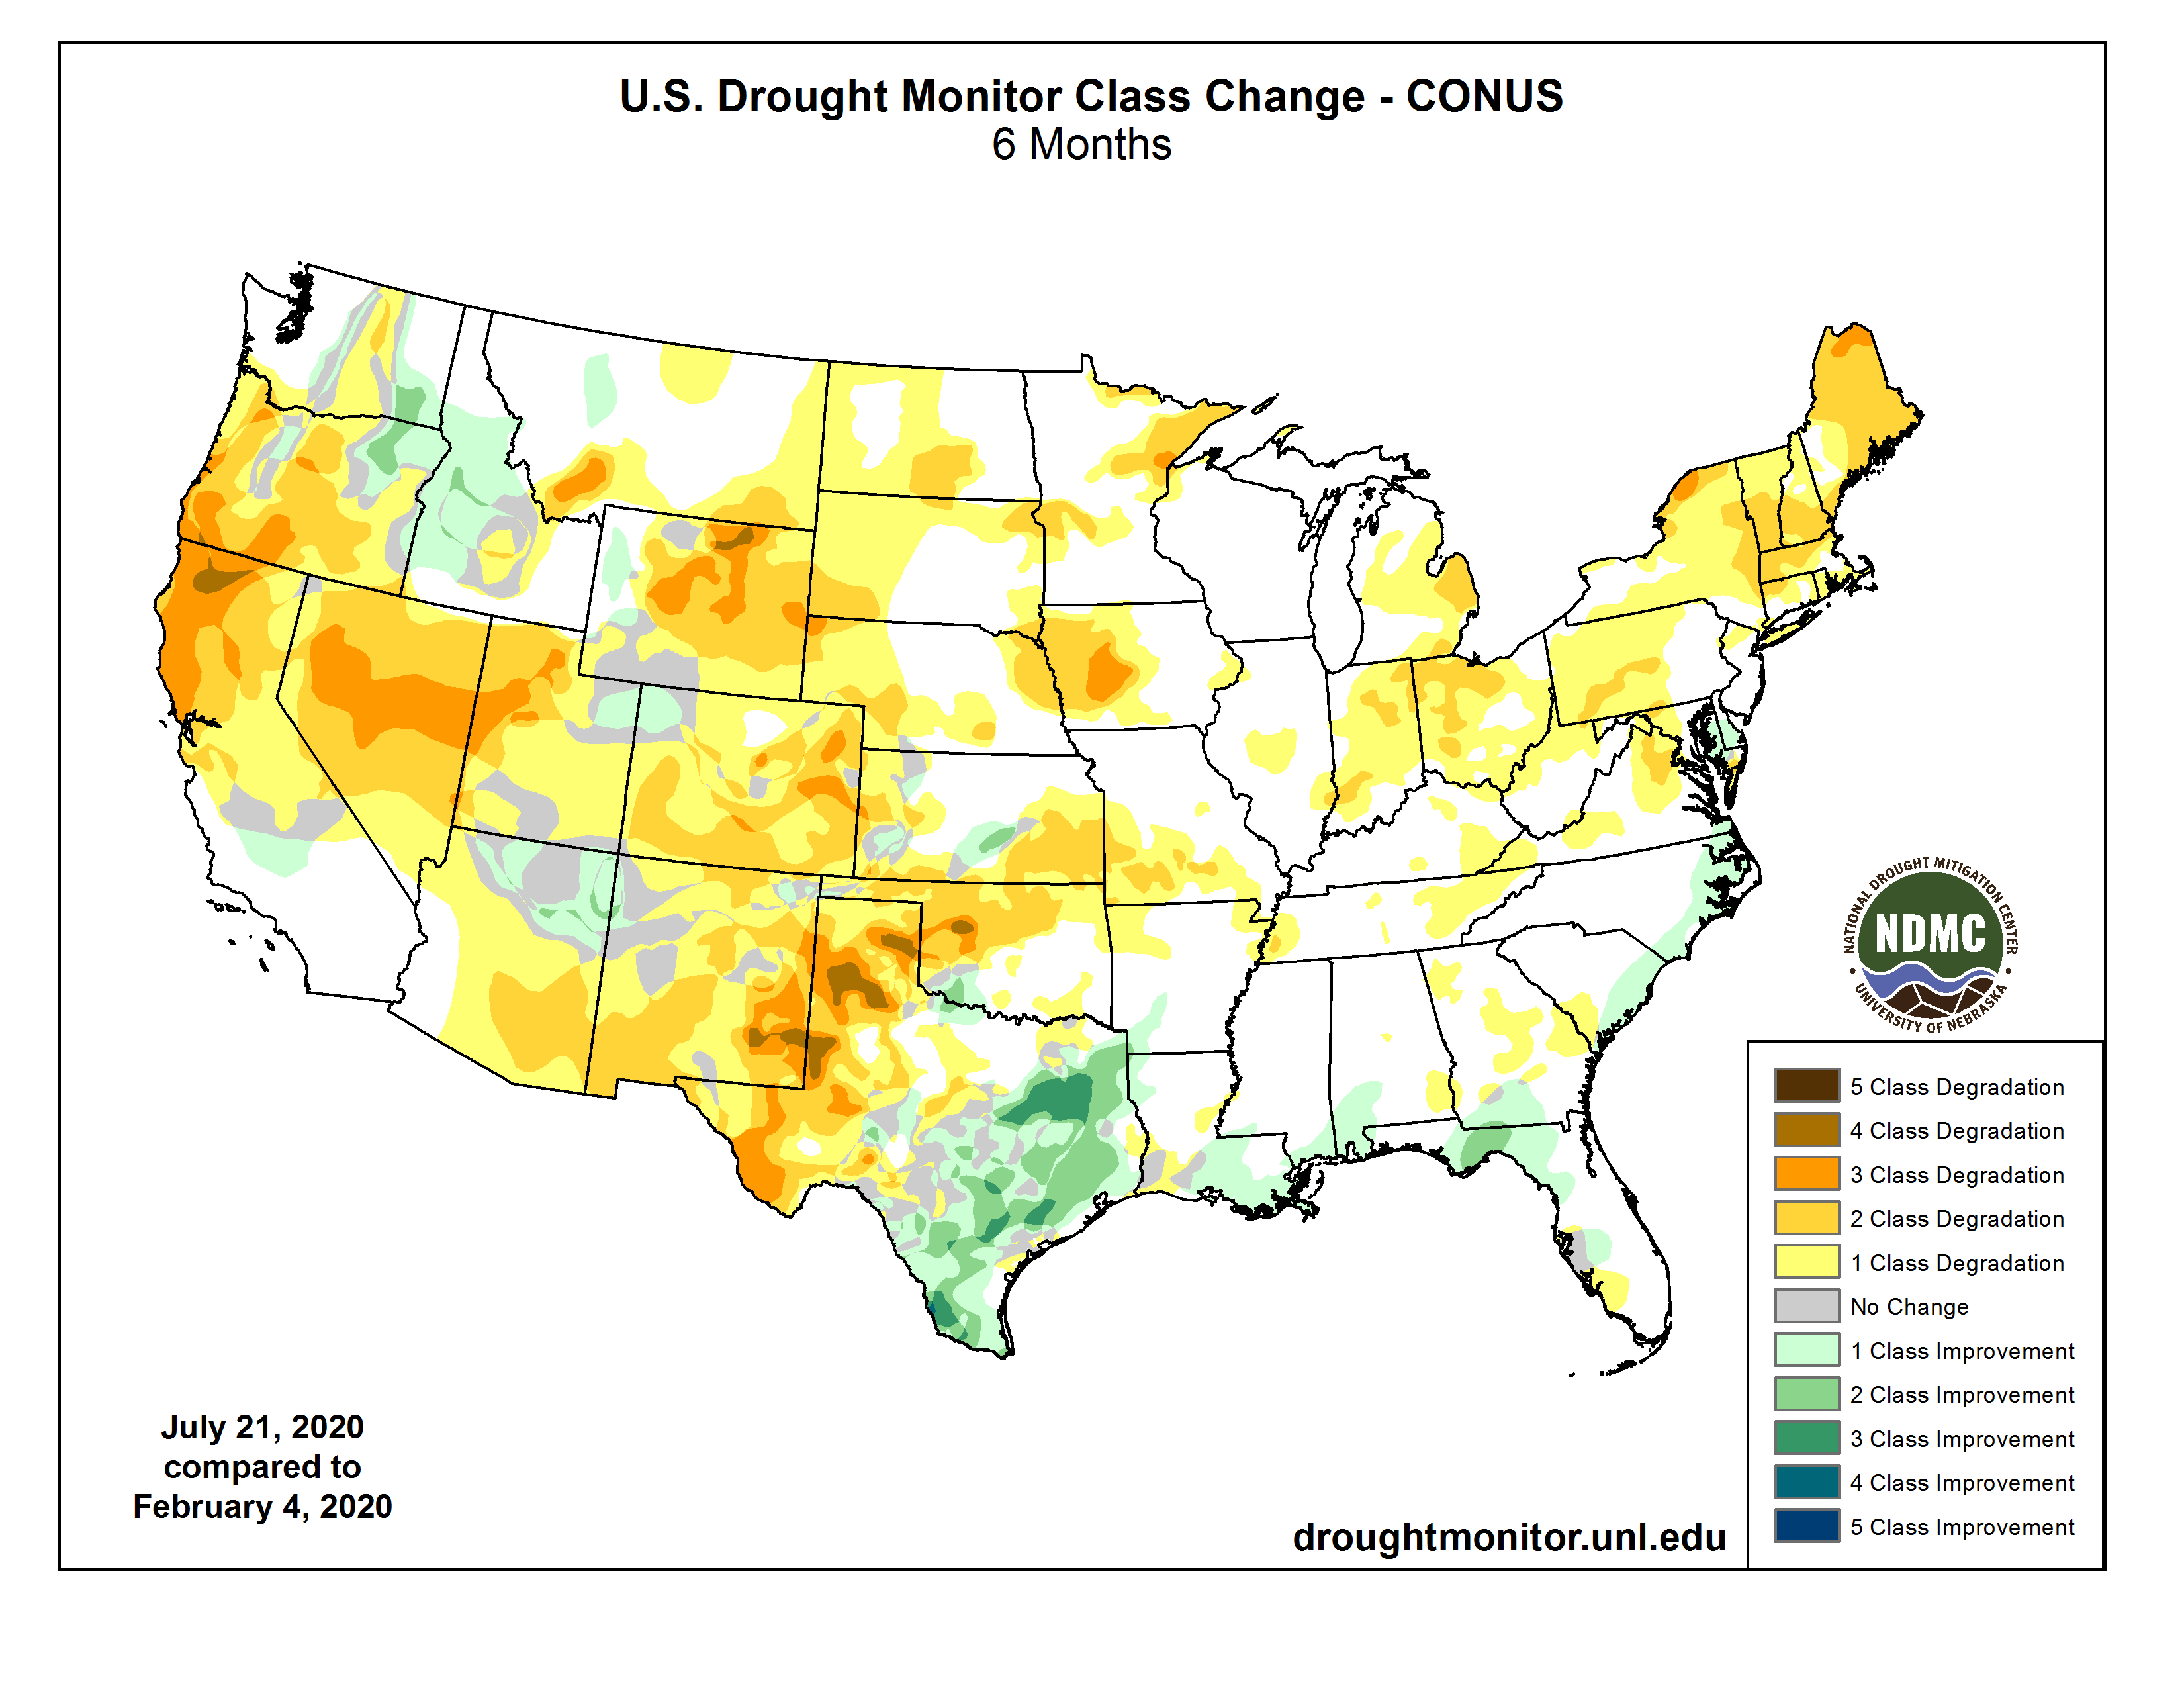

Slide 8
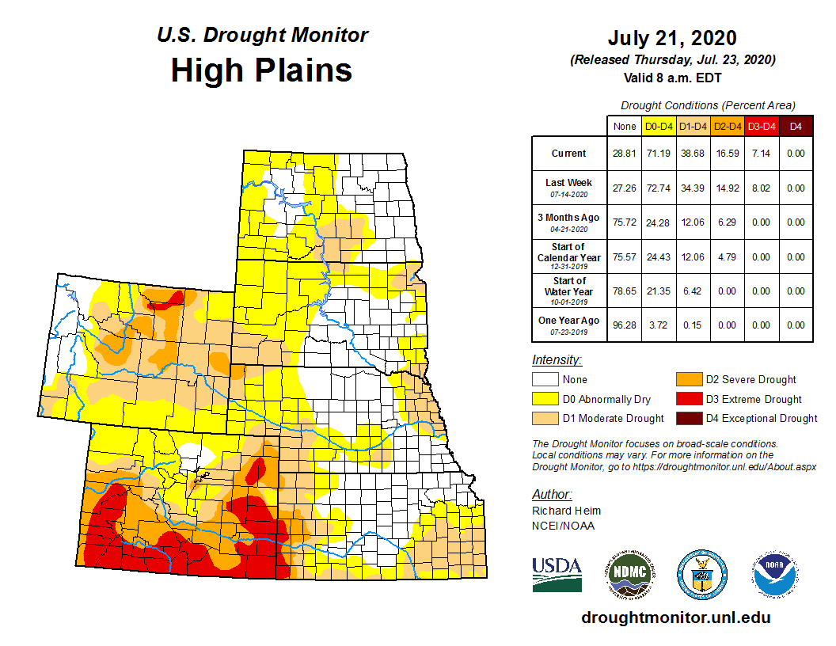


Slide 9
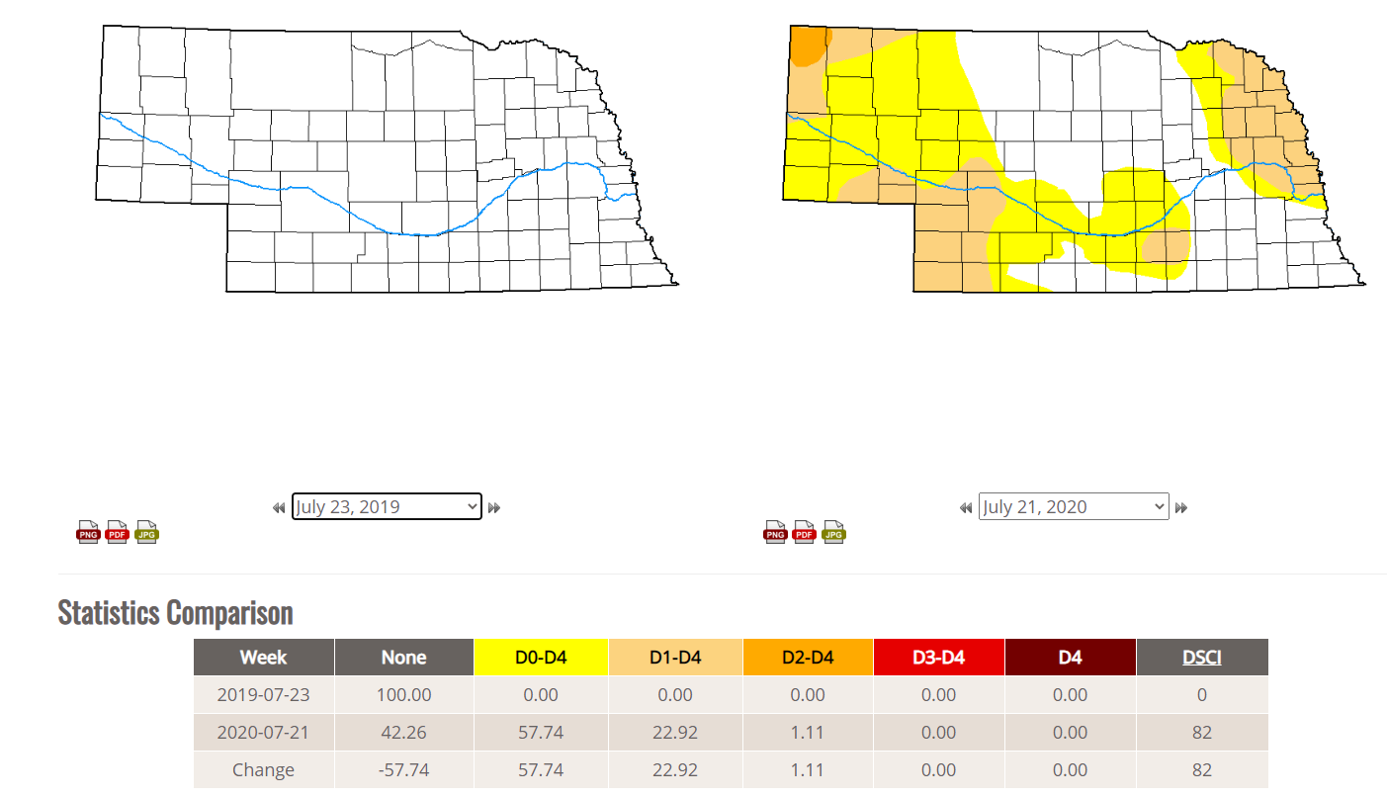

Slide 10
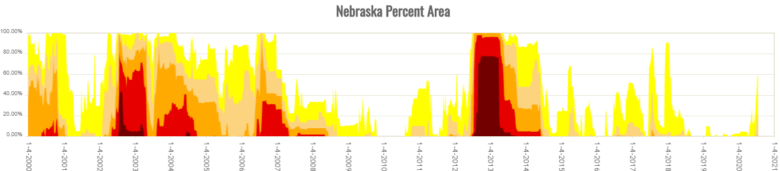
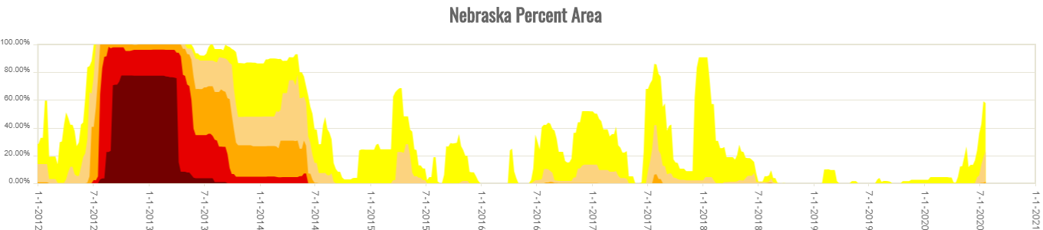
History is showing that Nebraska traditionally does not go this long between drought episodes, when is the next one ?

Slide 11
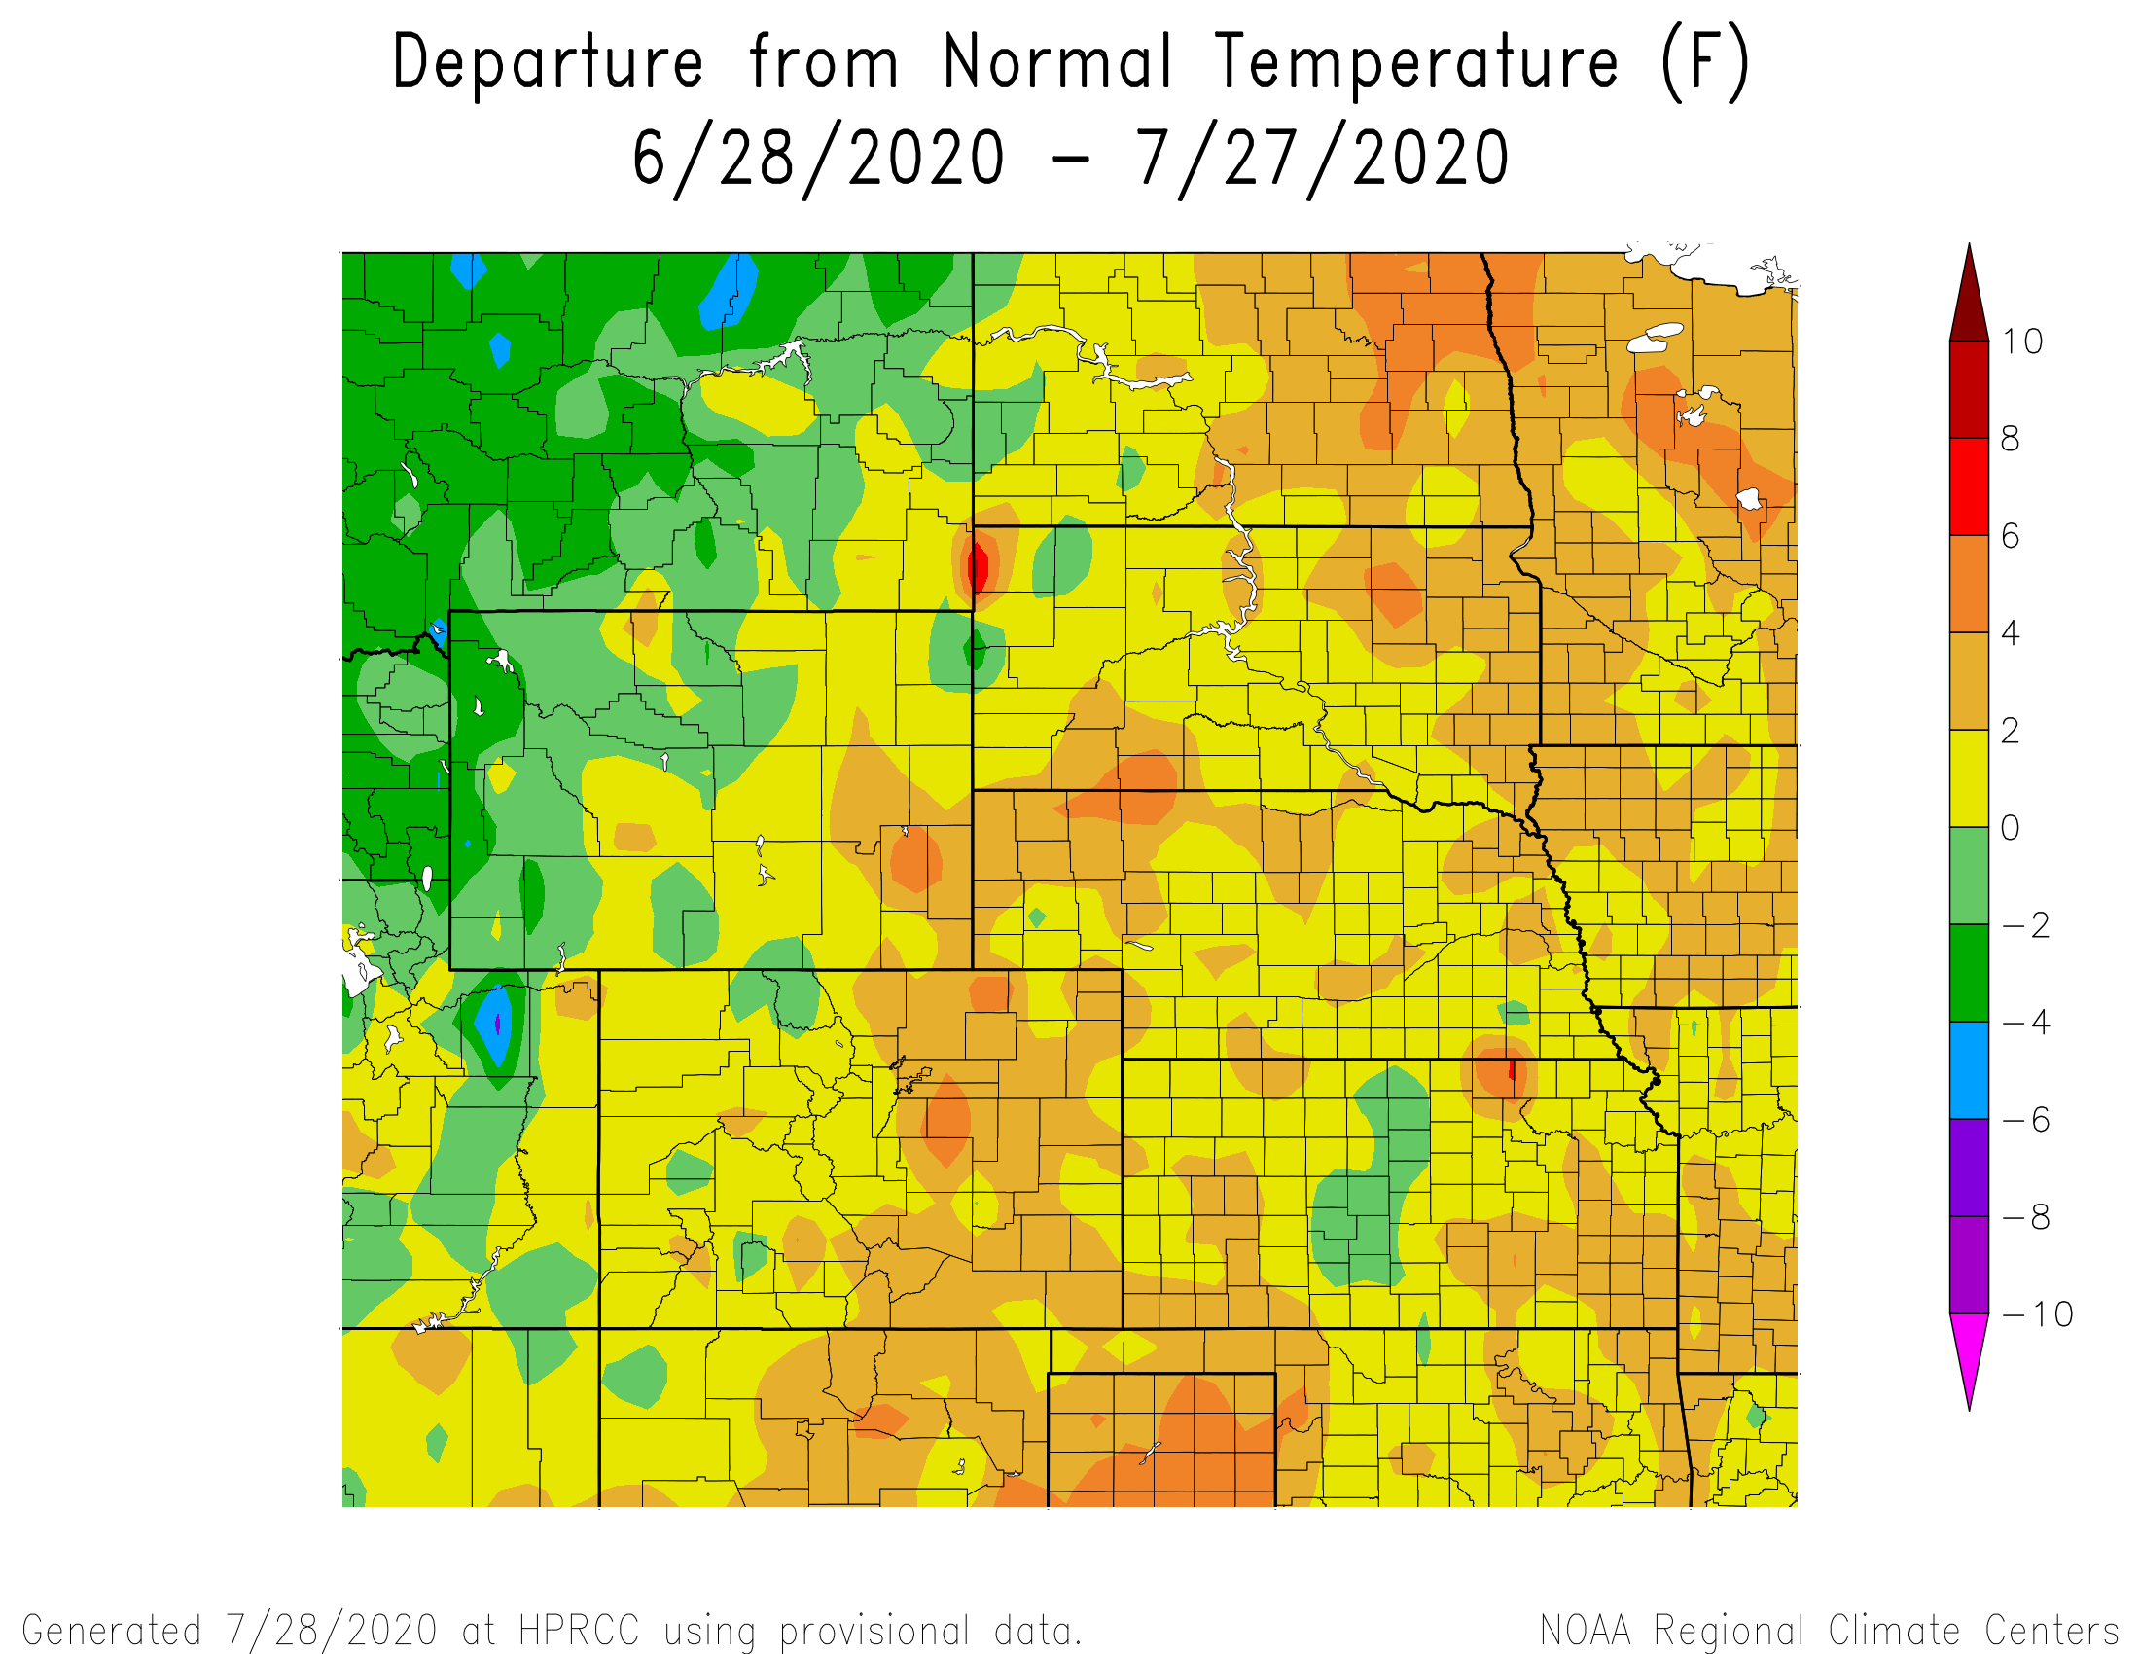
Departure from Normal Temperatures over the last 30 days

Slide 12
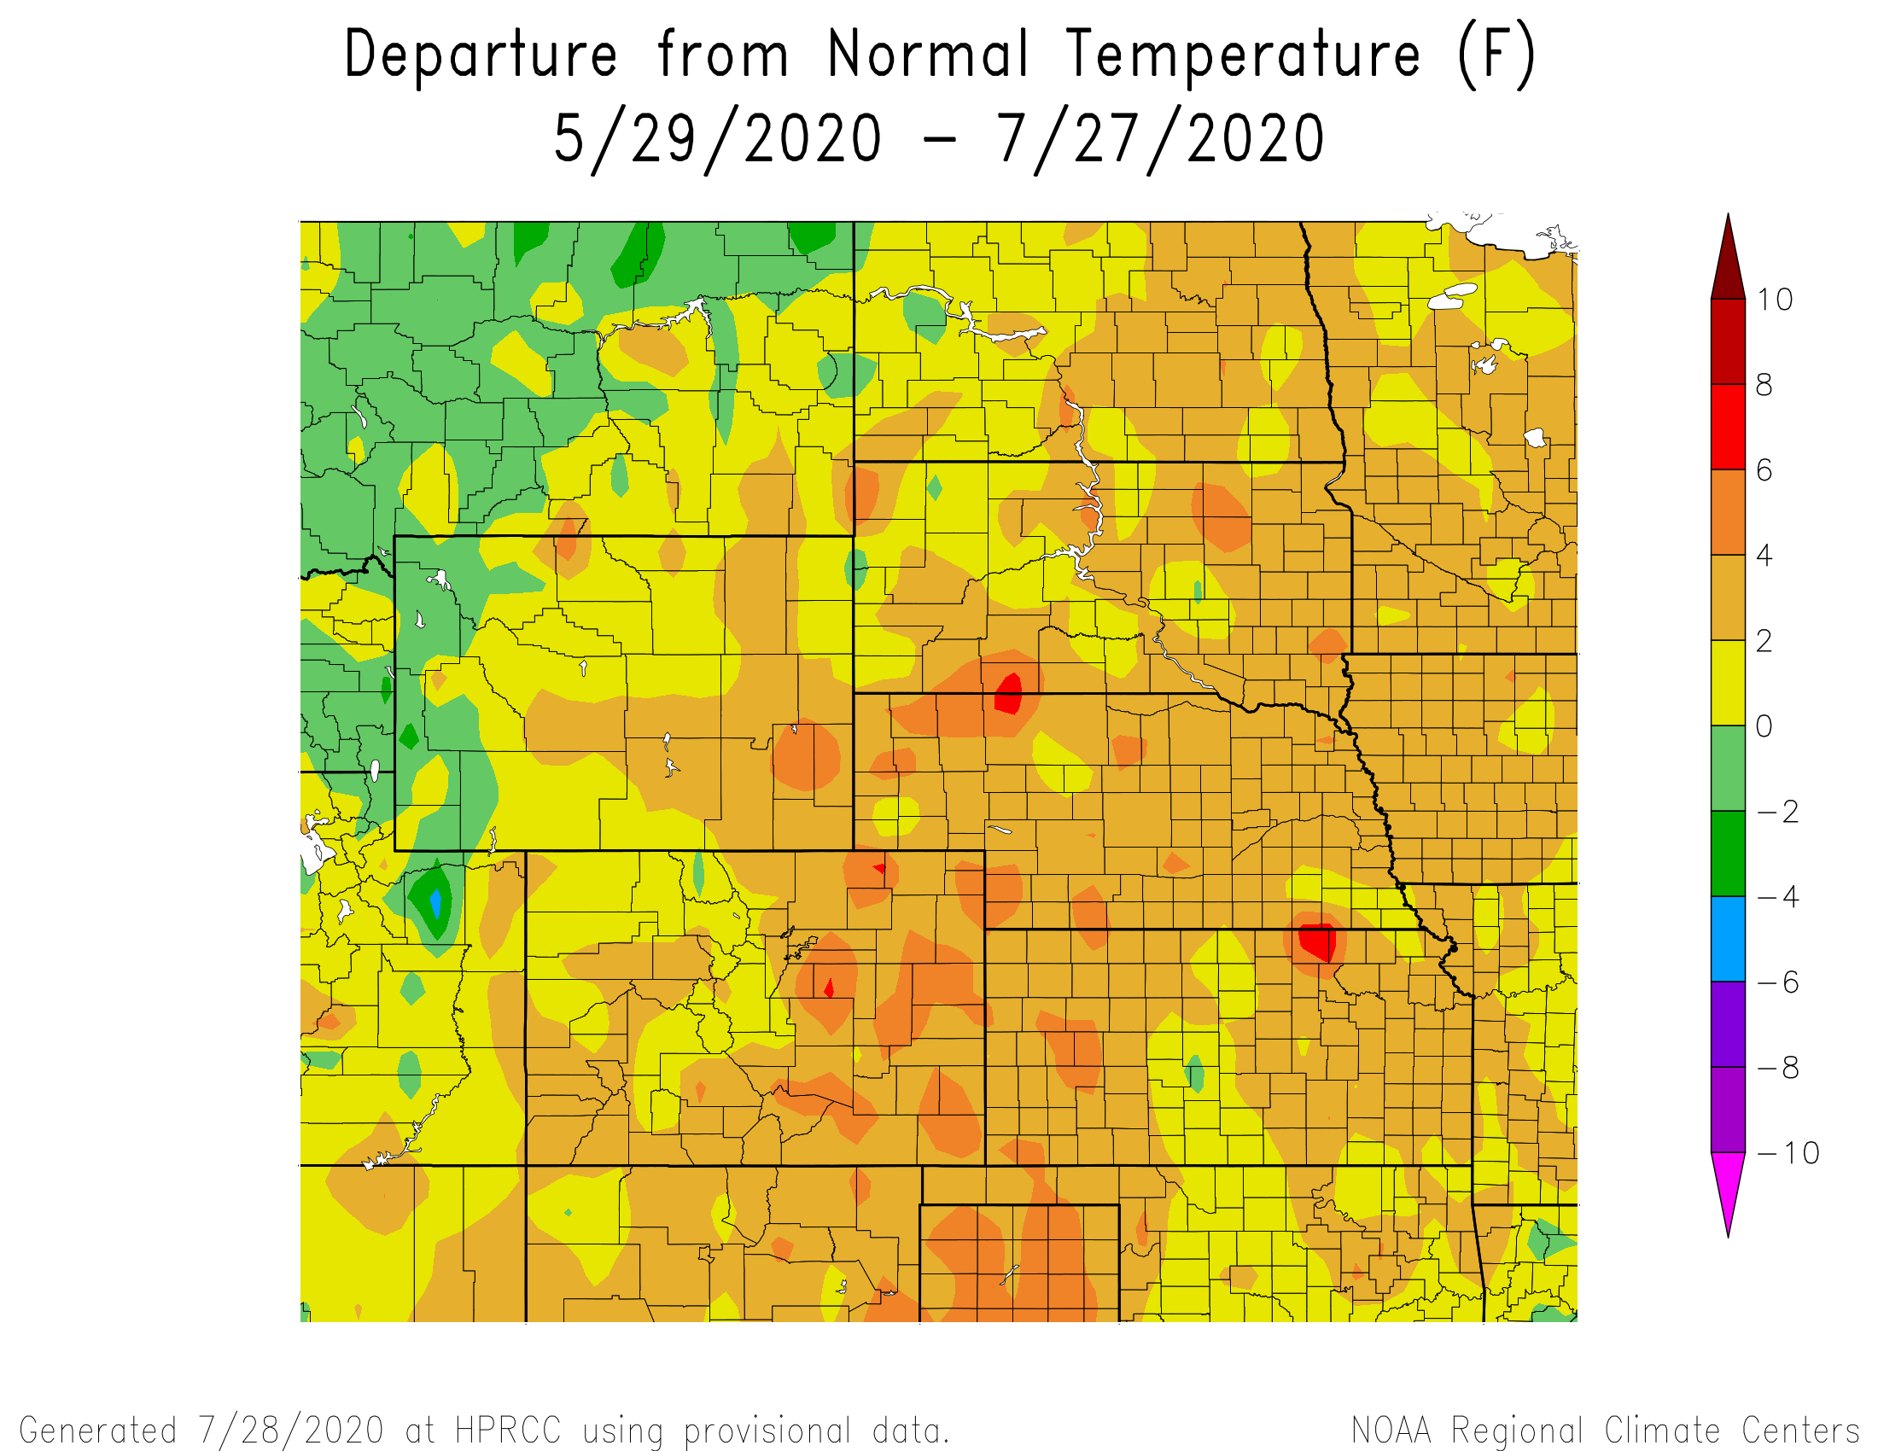
Departure from Normal Temperatures over the last 60 days

Slide 13
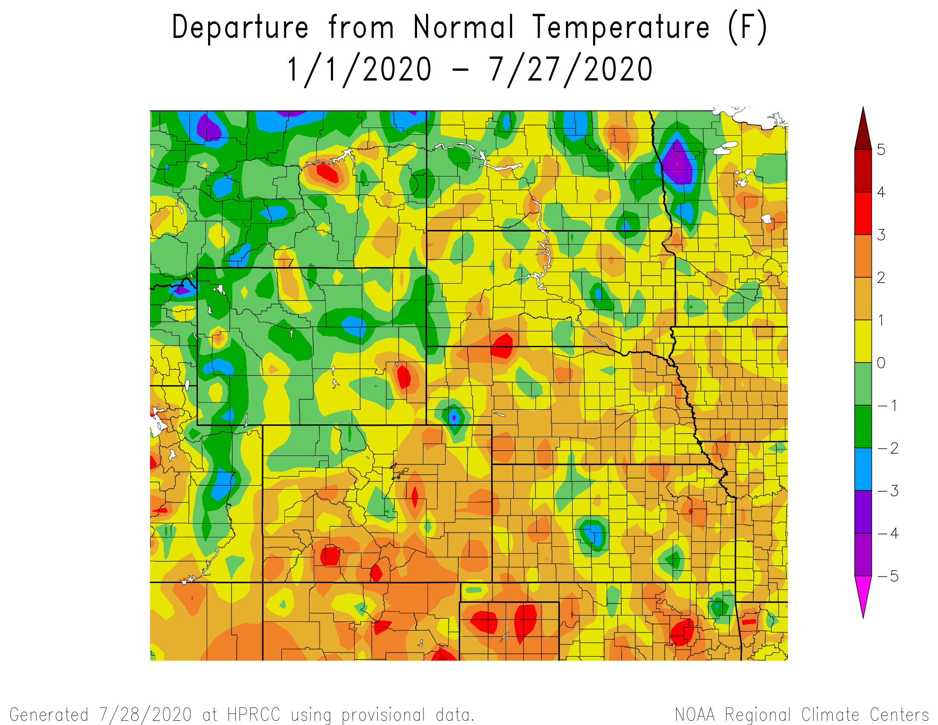
Departure from Normal Temperatures for the Calendar Year

Slide 14
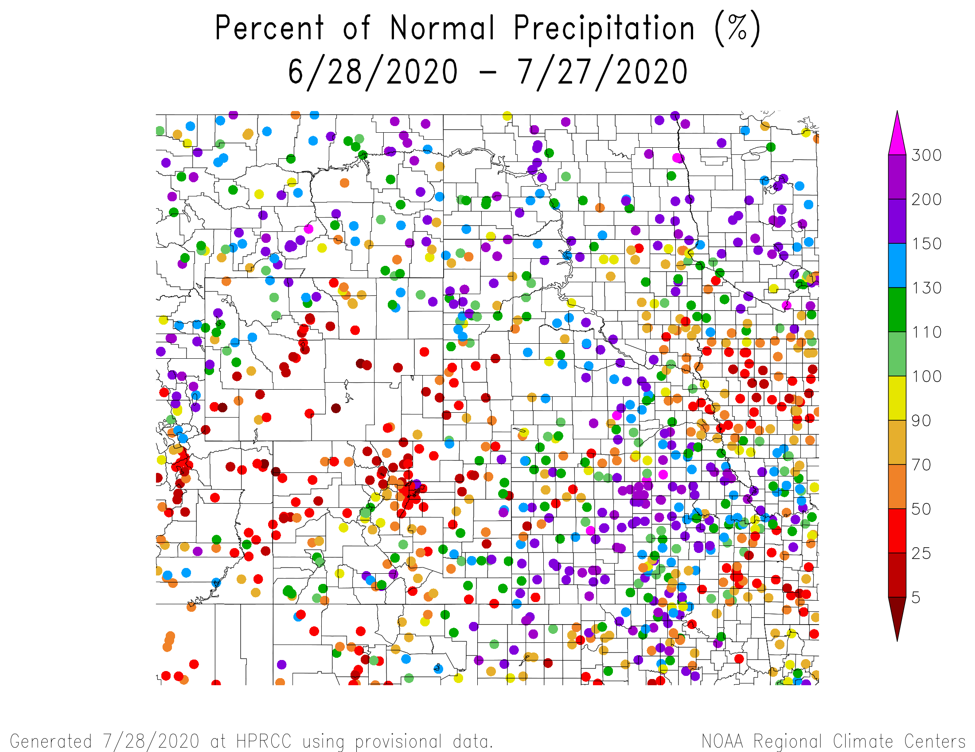
Percent of Normal Precipitation over the last 30 days

Slide 15
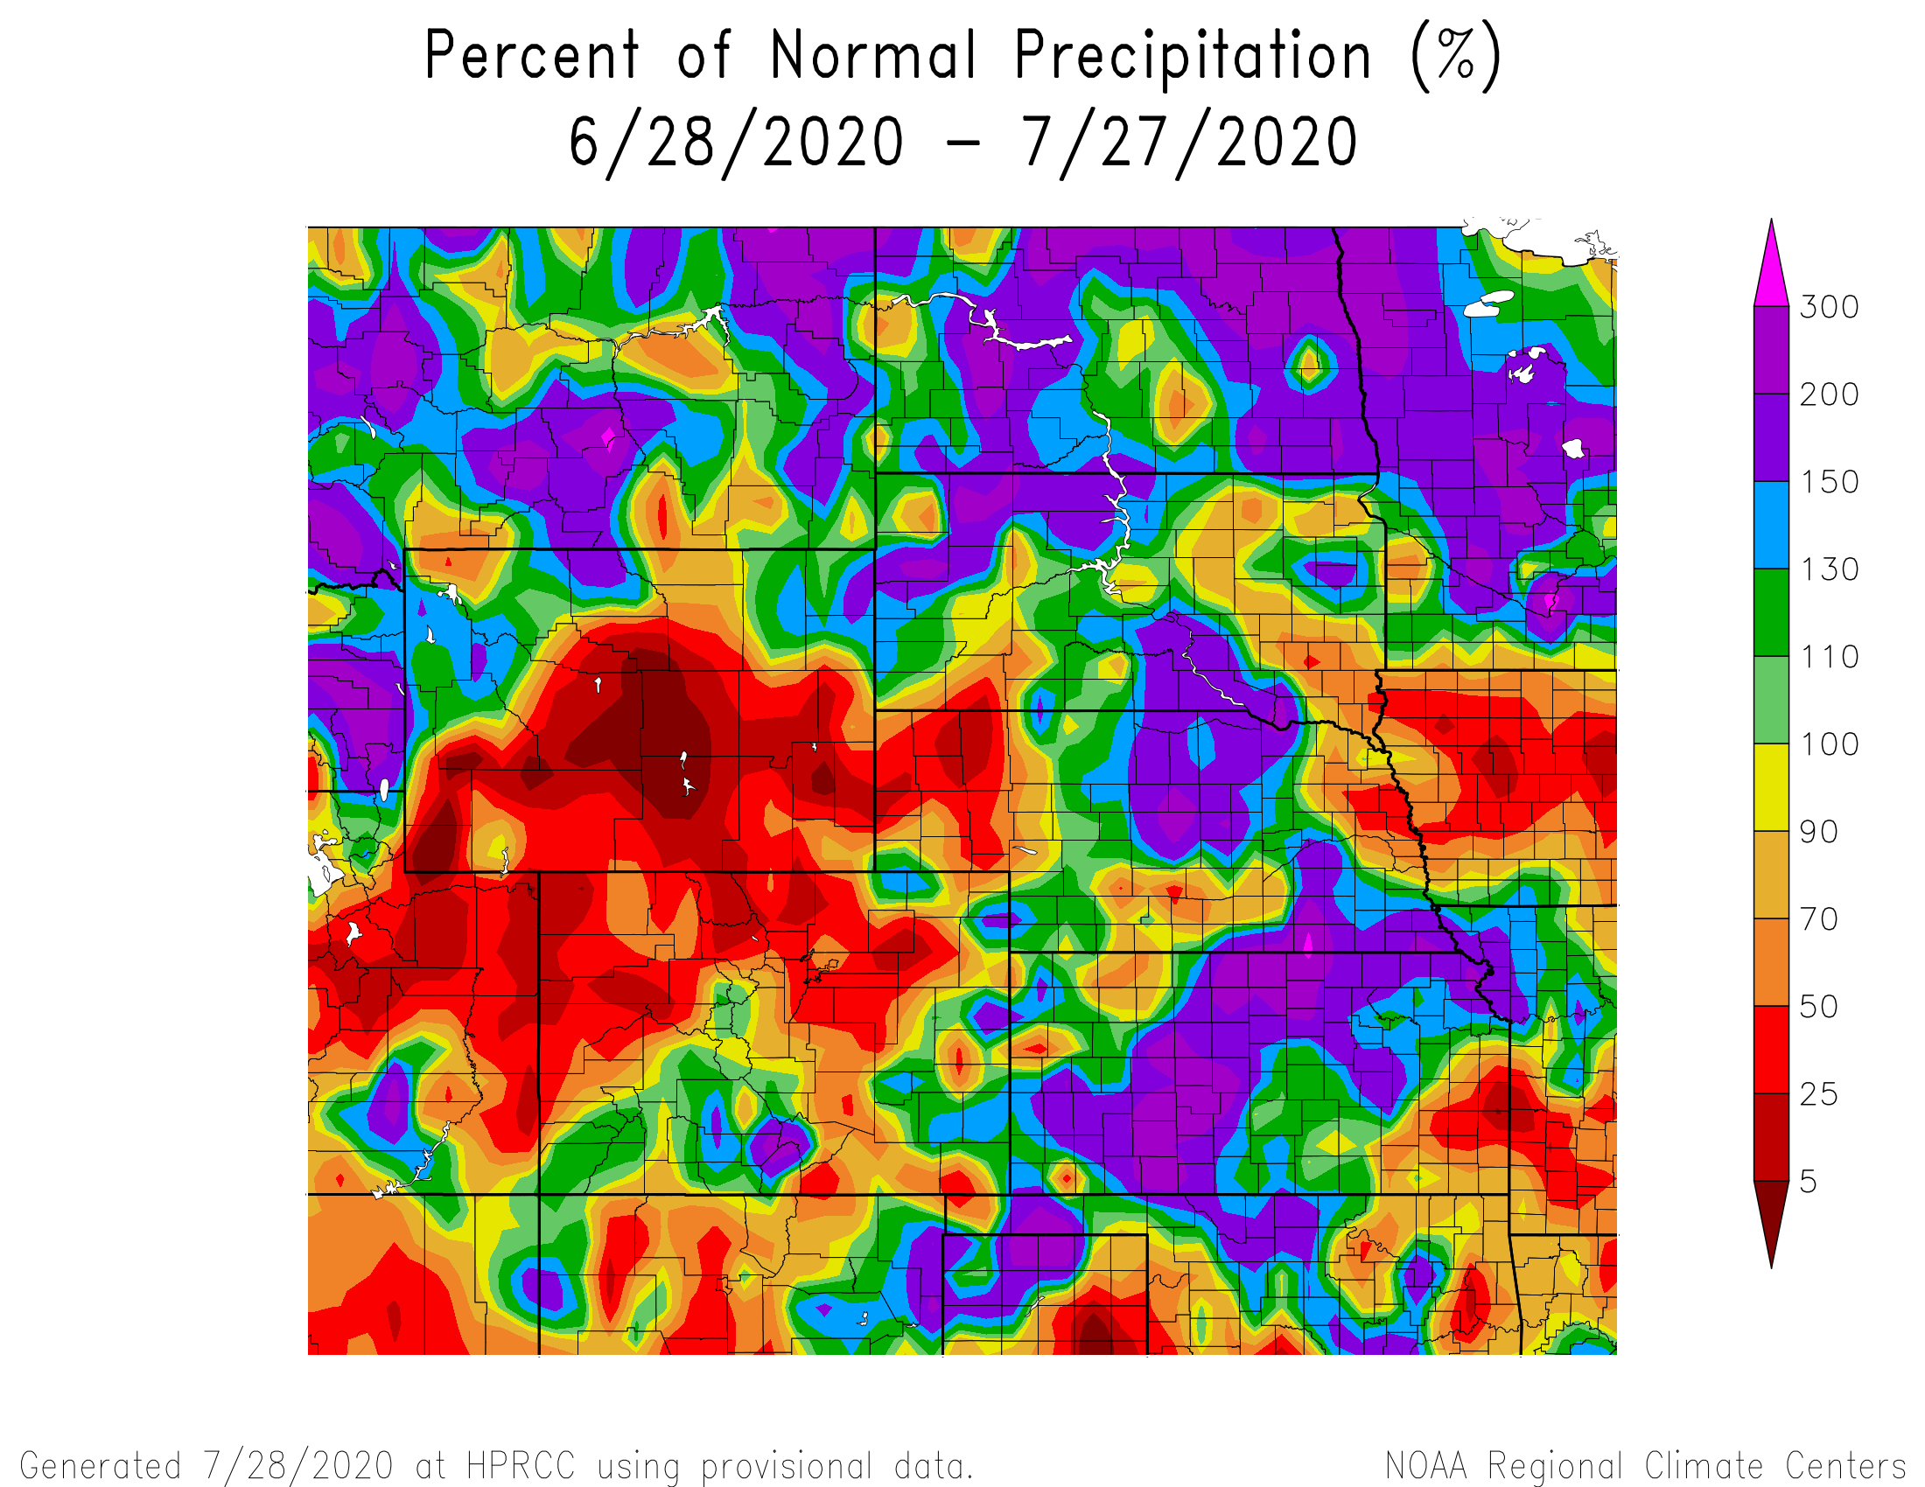
Percent of Normal Precipitation over the last 30 days

Slide 16
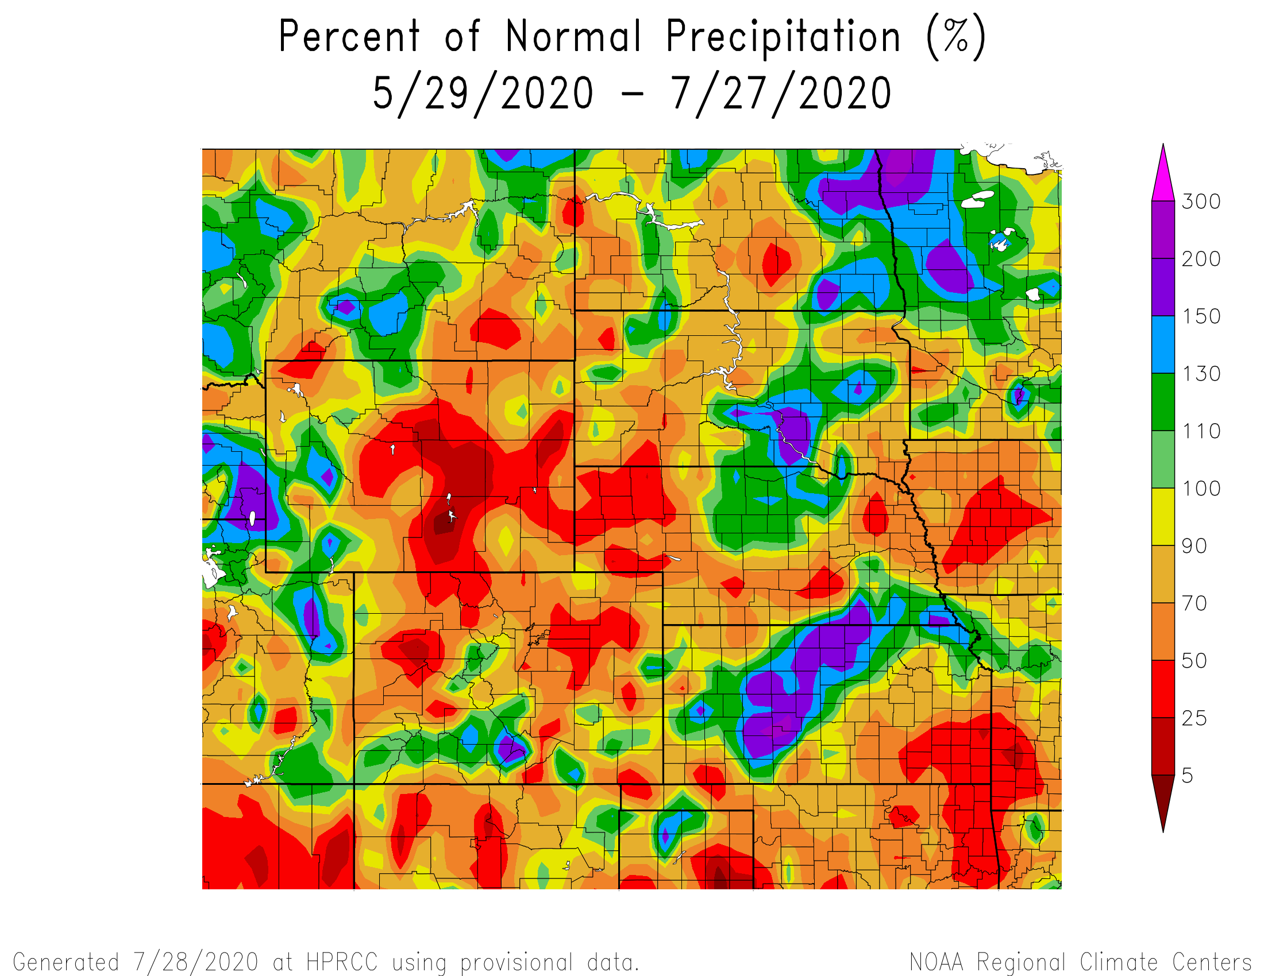
Percent of Normal Precipitation over the last 60 days

Slide 17
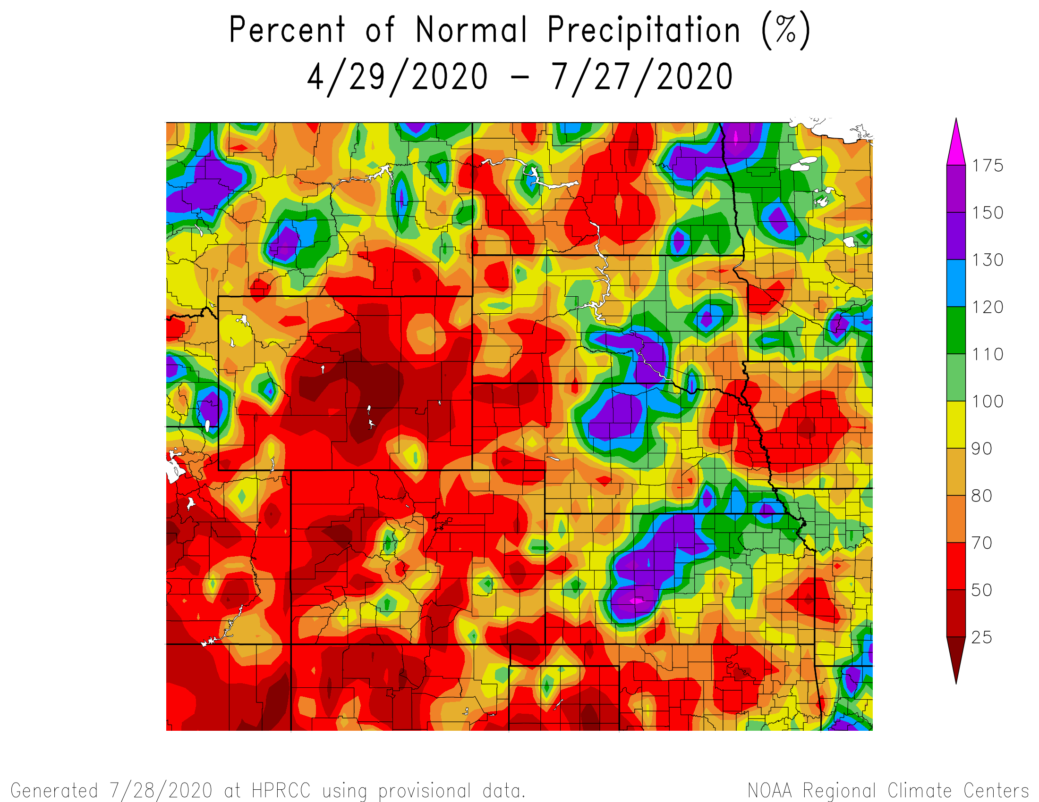
Percent of Normal Precipitation over the last 90 days

Slide 18
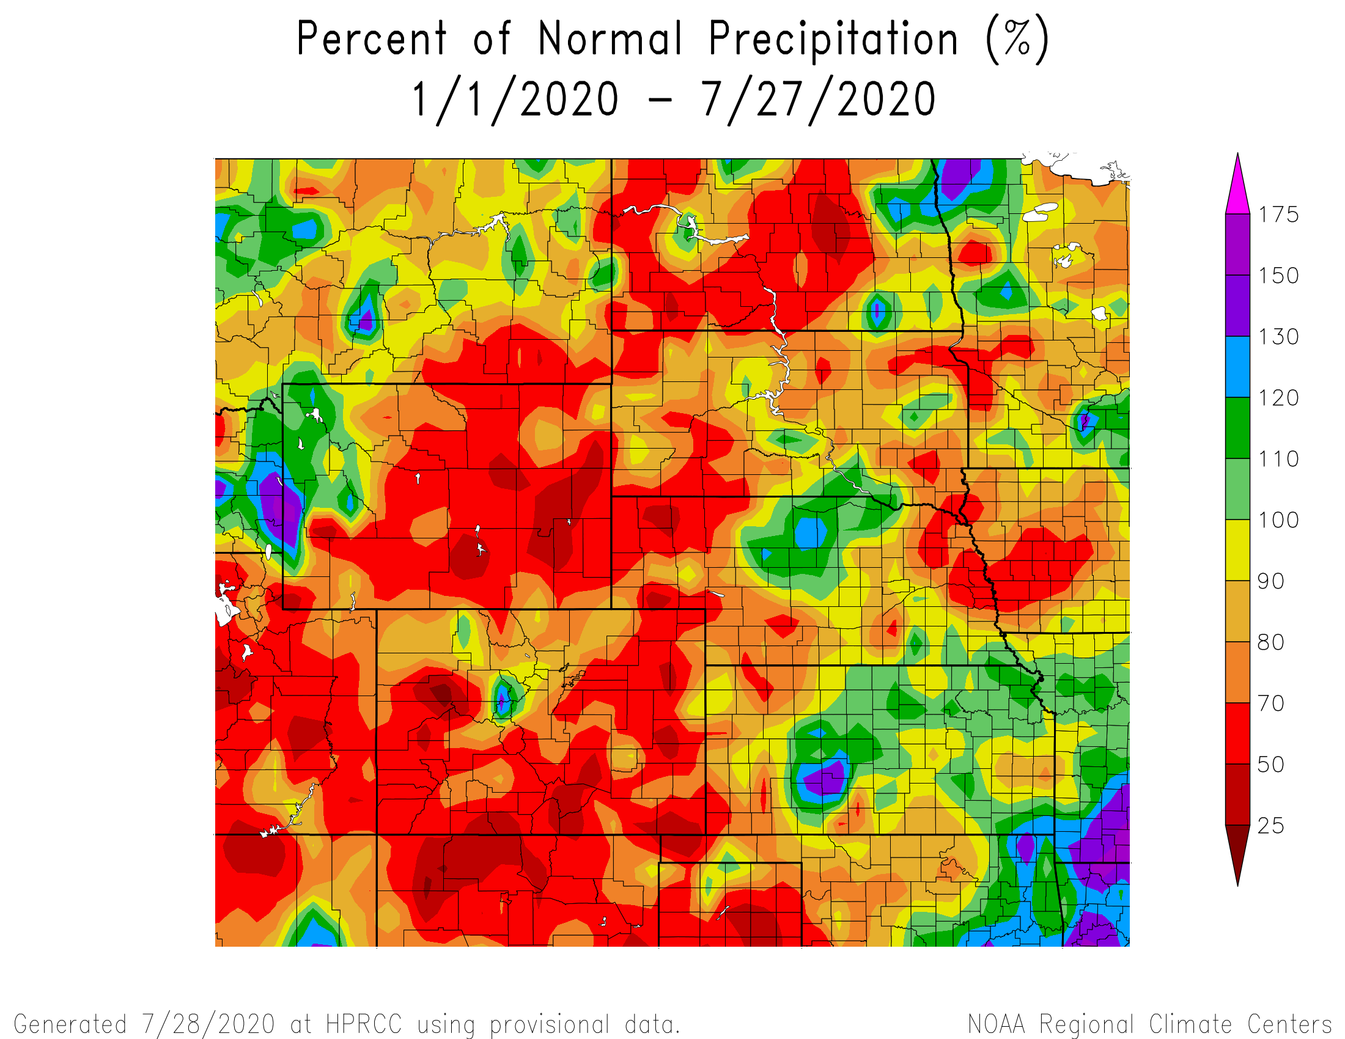
Percent of Normal Precipitation for the calendar year

Slide 19
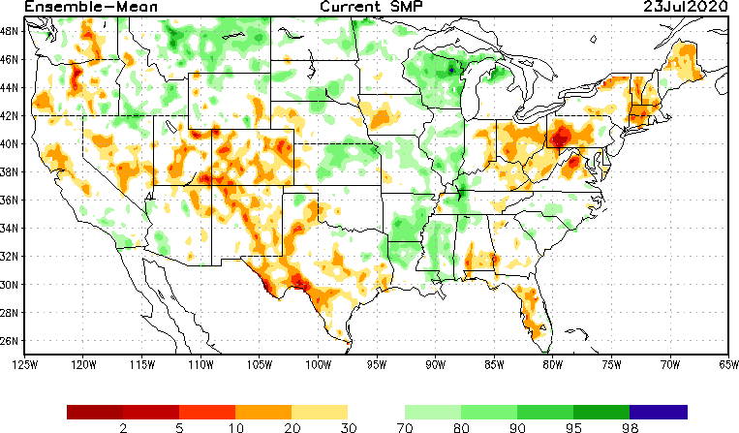
NLDAS Soil Moisture Model: Current Soil Moisture Anomaly

Slide 20
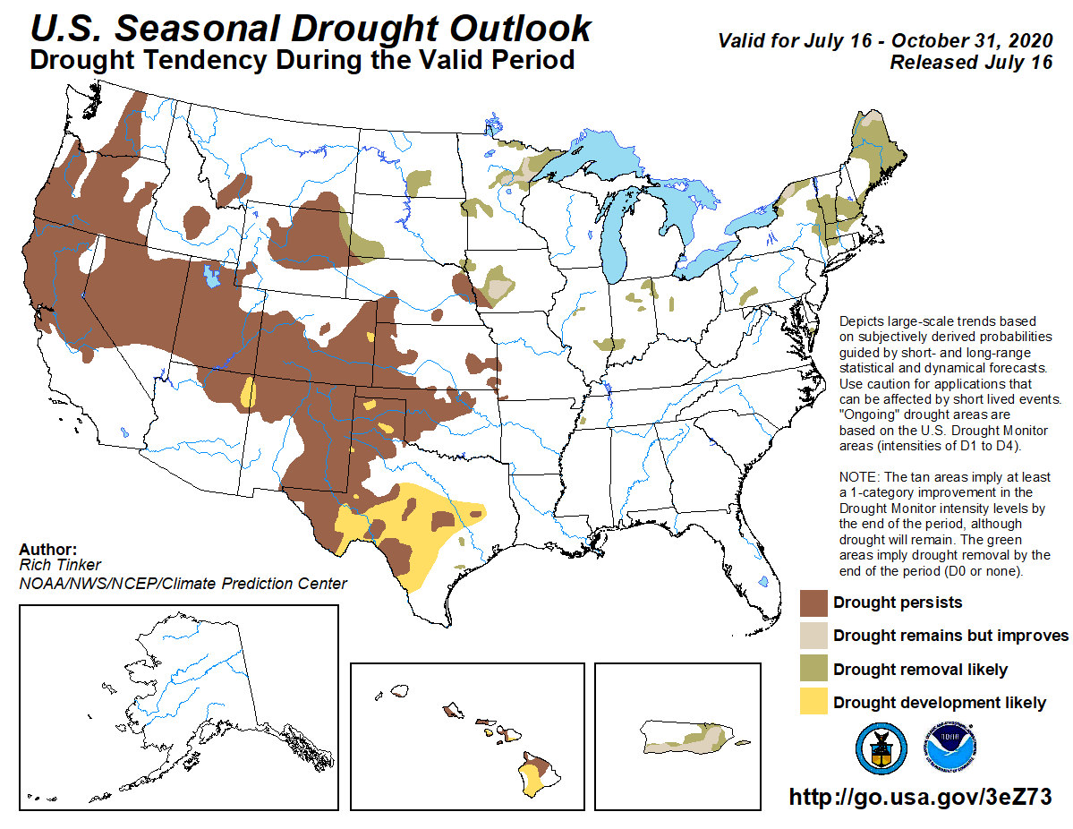

Slide 21
Climate/Drought Summary
Warmer than normal conditions have dominated the state and region recently with regional temperatures averaging about 2-4 degrees F above normal the last 60 days.
Almost the entire state of Nebraska has recorded below normal precipitation for 2020 so far with areas of northcentral Nebraska the anomaly with areas 4 inches above normal.
Nebraska is currently showing 22.92 percent of the state in drought and this has been trending upwards over the last 3 months. Most of the drought is moderate (D1) with some pockets of severe in the Panhandle.
The seasonal drought outlook has drought persisting in Nebraska through the end of October in the areas that are currently in drought. Some improvements could be seen in the far northwest part of the state as well as the extreme northeast.

Slide 22
Nebraska Water Supply Update…

Slide 23
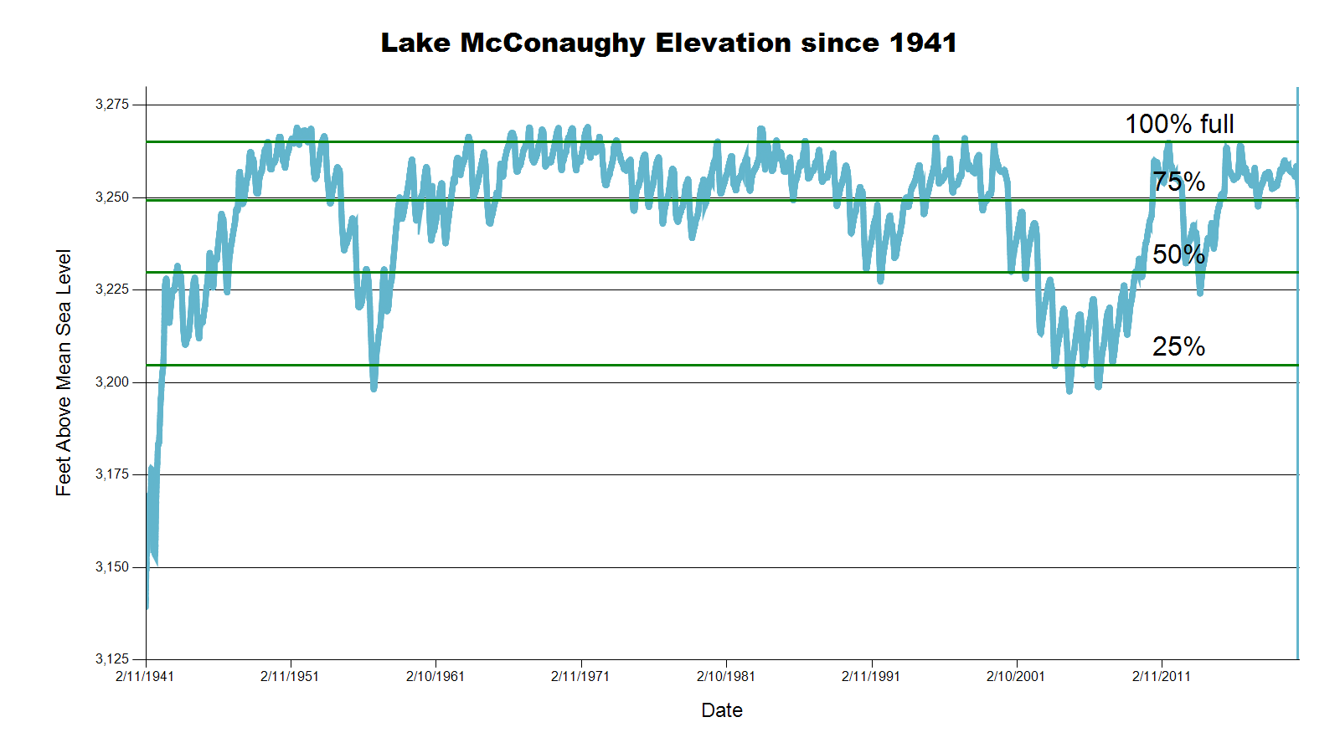
3246.3 feet 70.7% Full
3257.7 Feet
88% of Max
November 2019 CARC meeting
SOURCE: CNPPID www.cnppid.com

Slide 24
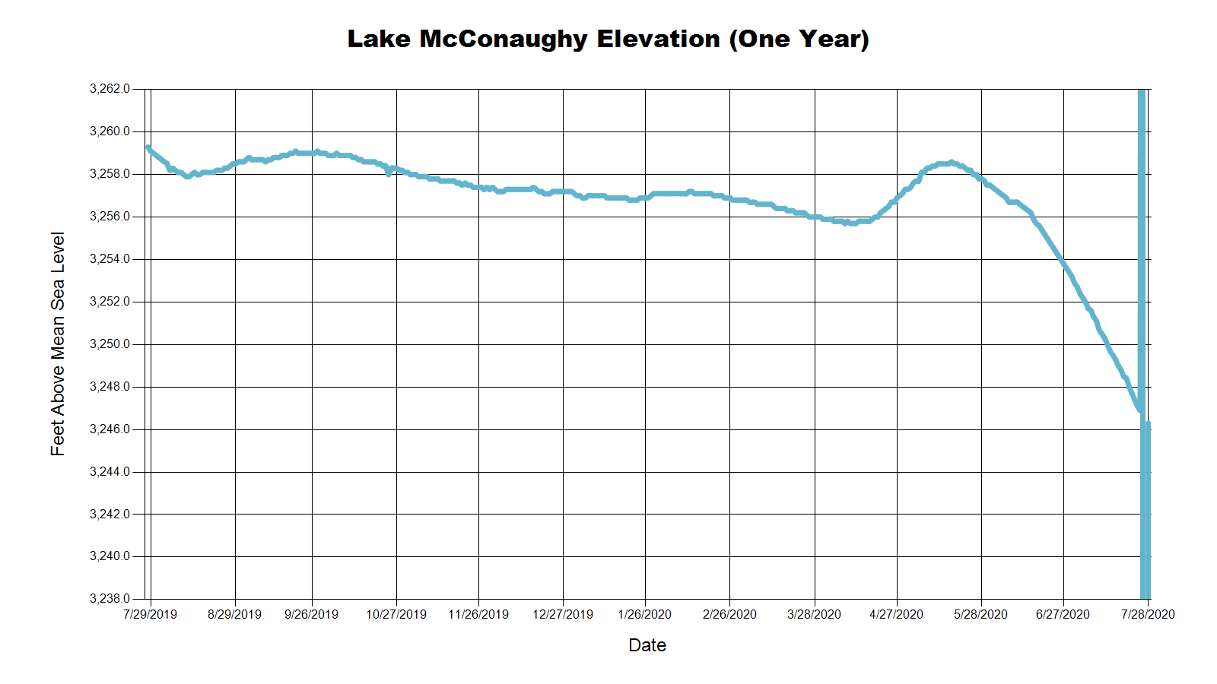
3258.0 Feet
88.0% of Max
June 2019
3257.7 Feet
88.0% of Max
November 2019
3246.3 Feet
70.7% of Max
July 2020
SOURCE: CNPPID www.cnppid.com

Slide 25
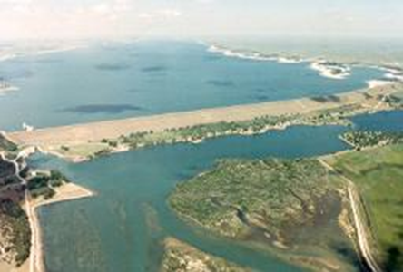
July 2020 CARC Meeting
SOURCE: CNPPID www.cnppid.com

Slide 26
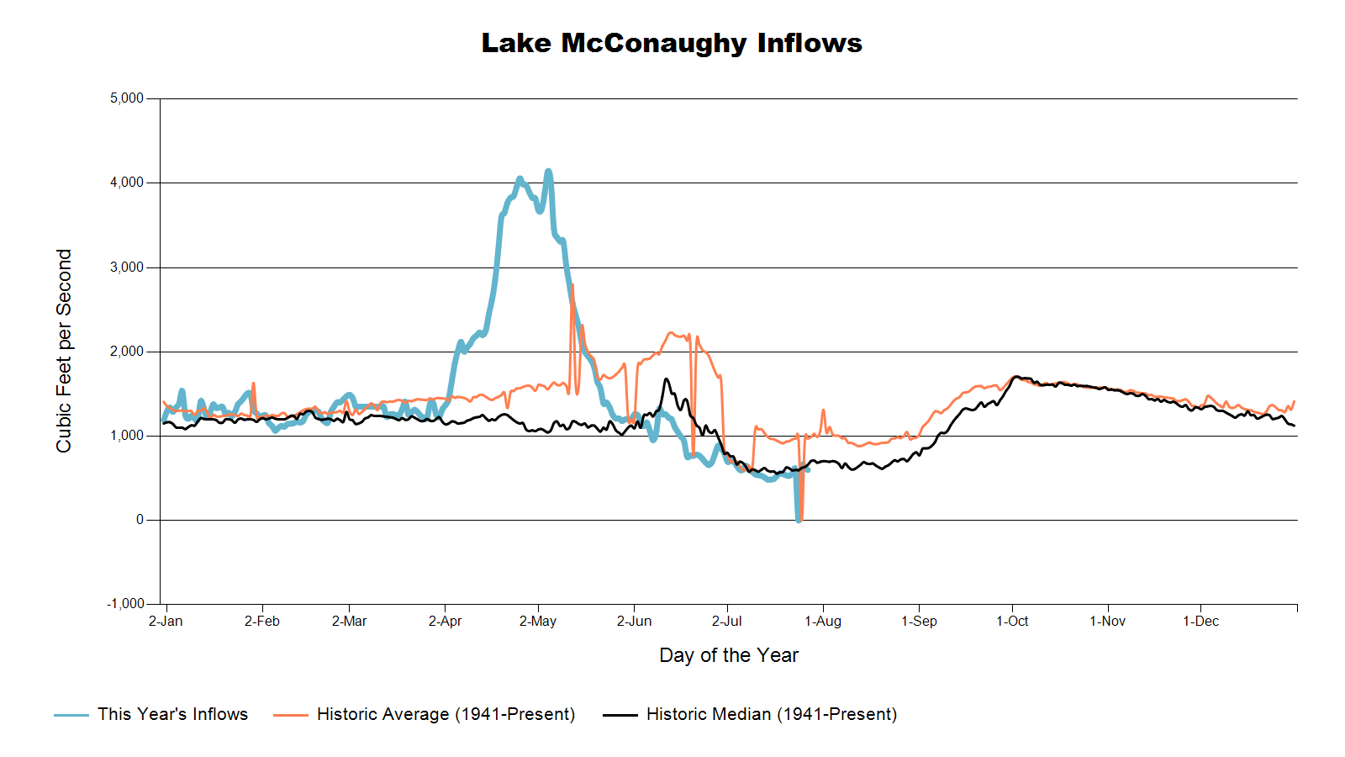

Slide 27
Lake McConaughy
Civil Engineer Tyler Thulin reported that Lake McConaughy is at elevation 3,251.7 feet above sea level, or 78.4 percent capacity and dropping quickly as irrigation demands grow. Inflows to the lake are currently around 600 cubic feet per second (cfs) while outflow is holding steady around 3,750 cfs. Thulin roughly estimated that the lake could possibly drop up to 15 feet from current levels, if high irrigation demands continue through the end of the season. Currently, about 450 cfs of that outflow is being released to the river from the Environmental Account.
SOURCE: CNPPID News Release, July 7, 2020
www.cnppid.com

Slide 28
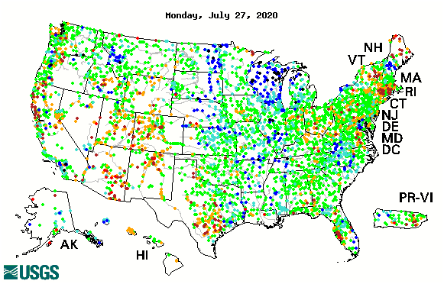

14-day average streamflow compared to historical streamflow for the day of year

Slide 29
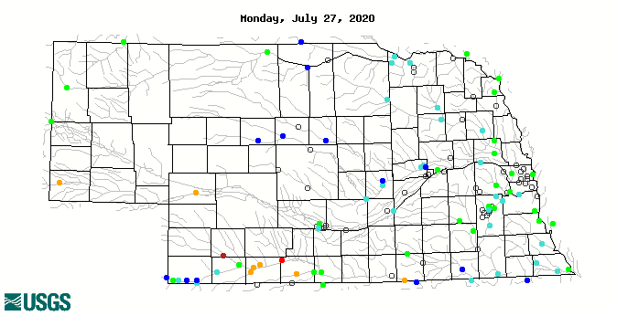
14-day average streamflow compared to historical streamflow for the day of year
95th Percentile
78th Percentile
22nd Percentile
7thPercentile
1st Percentile
17thPercentile

Slide 30
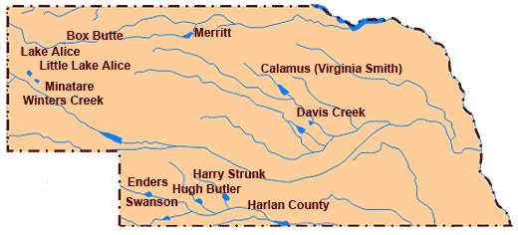
Republican River Basin
Hugh Butler: 59.0%(59.8%) of conservation pool
Enders: 22.5% (22.1%) of conservation pool
Harry Strunk: 74.2%(93.8%) of conservation pool
Swanson: 57.4% (51.9%) of conservation pool
*values in red are from the last CARC meeting in November 2019.
Source: BOR http://www.usbr.gov/gp/lakes_reservoirs

Slide 31
Republican River Basin
Harlan County Current Conditions
Conservation Pool is 98.7% full (100.00%)
309,877 Acre-Feet in storage compared to 405,099 Acre-Feet (AF) of water in storage during November 2019
Last year at this time, 495,240 AF was in storage (July 2019)
Historical average storage for this time of the year is 267,457 AF
*values in red are from the last CARC meeting in November 2019
Source: BOR http://www.usbr.gov/gp/lakes_reservoirs/

Slide 32
Water Supply Summary
Lake McConaughy is currently 70.7 percent of capacity and has been dropping rapidly due to a high irrigation demand.
The Republican River basin reservoirs are about the same as they were in November 2019 as water levels stabilized and is being transferred due to irrigation.
Harlan County Reservoir is holding about 95,222 acre-feet less water now than in November 2019.
Harlan County is holding about 185,363 acre-feet less water now than at this time last year and is about 42,420 acre-feet above average for this time of year.

Slide 33






OUR PARTNERS
Any Questions ?

Slide 34

Brian Fuchs
bfuchs2@unl.edu
402-472-6775
National Drought Mitigation Center
School of Natural Resources
University of Nebraska-Lincoln

