Slide 1

NE Drought Conditions CARC Update: December 8, 2020
Brian Fuchs
National Drought Mitigation Center
University of Nebraska-Lincoln
School of Natural Resources

Slide 2
Regional Climatic and Drought Conditions…

Slide 3
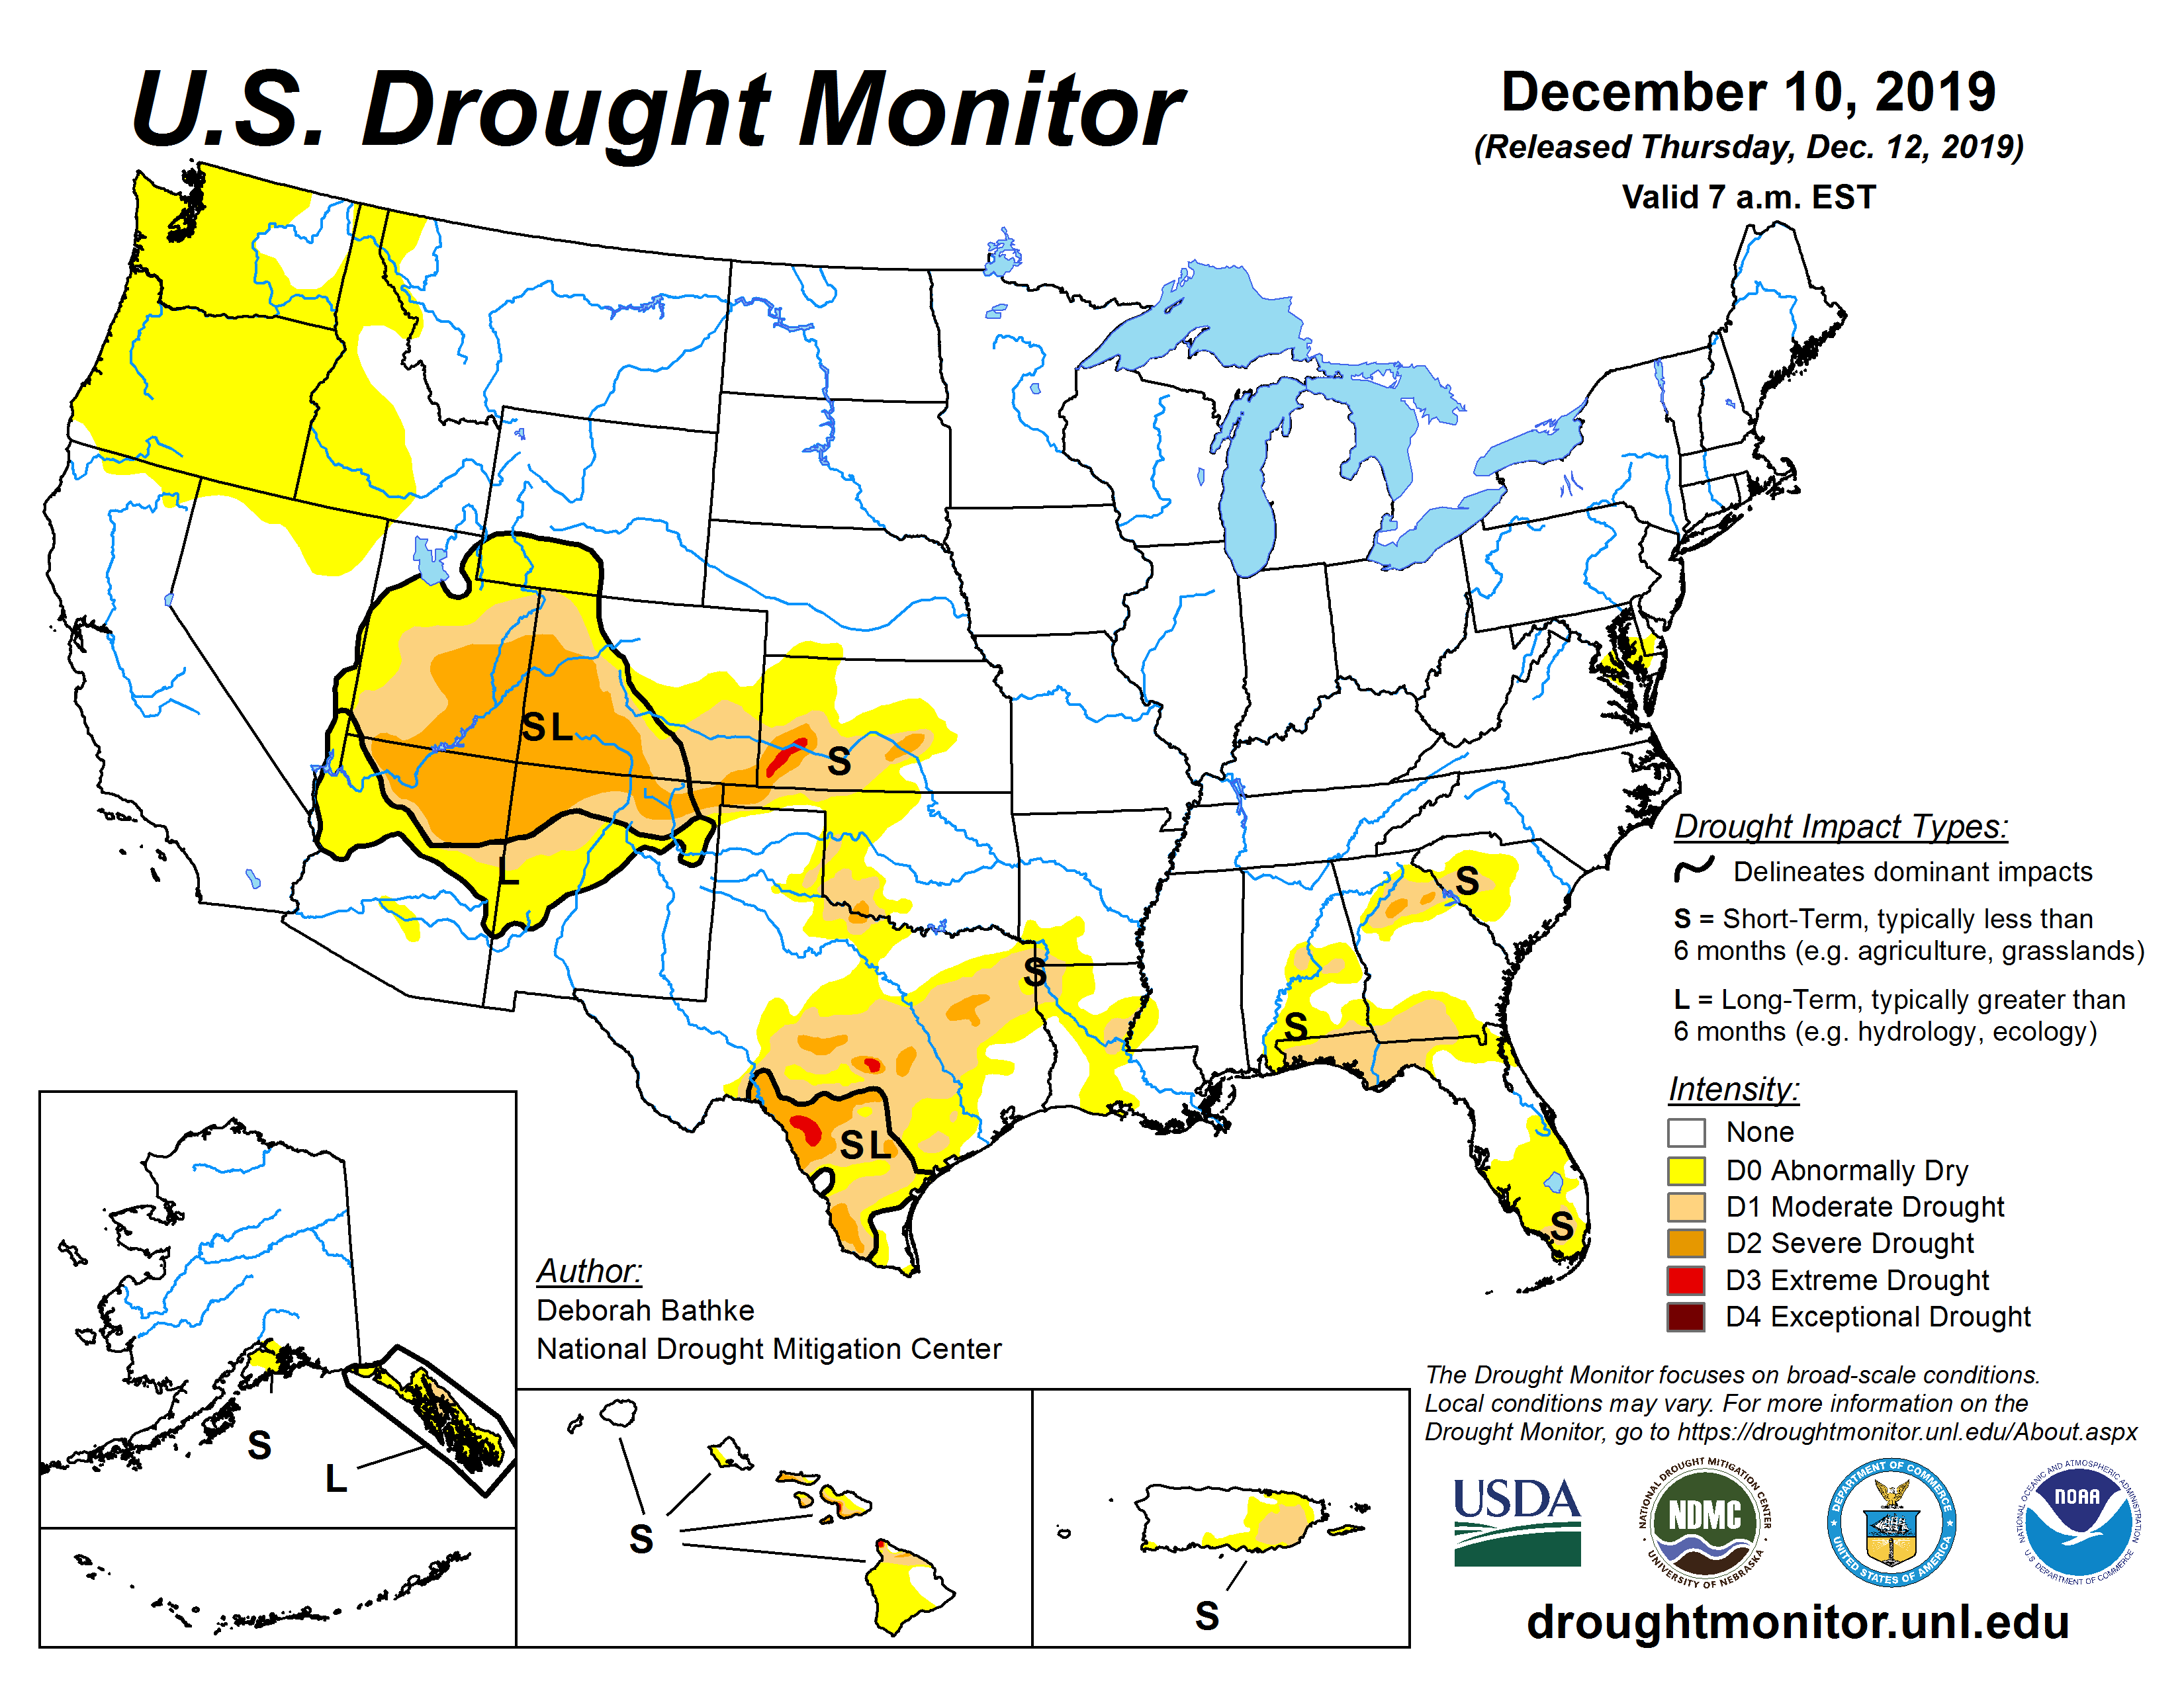
Last year at this time…..

Slide 4
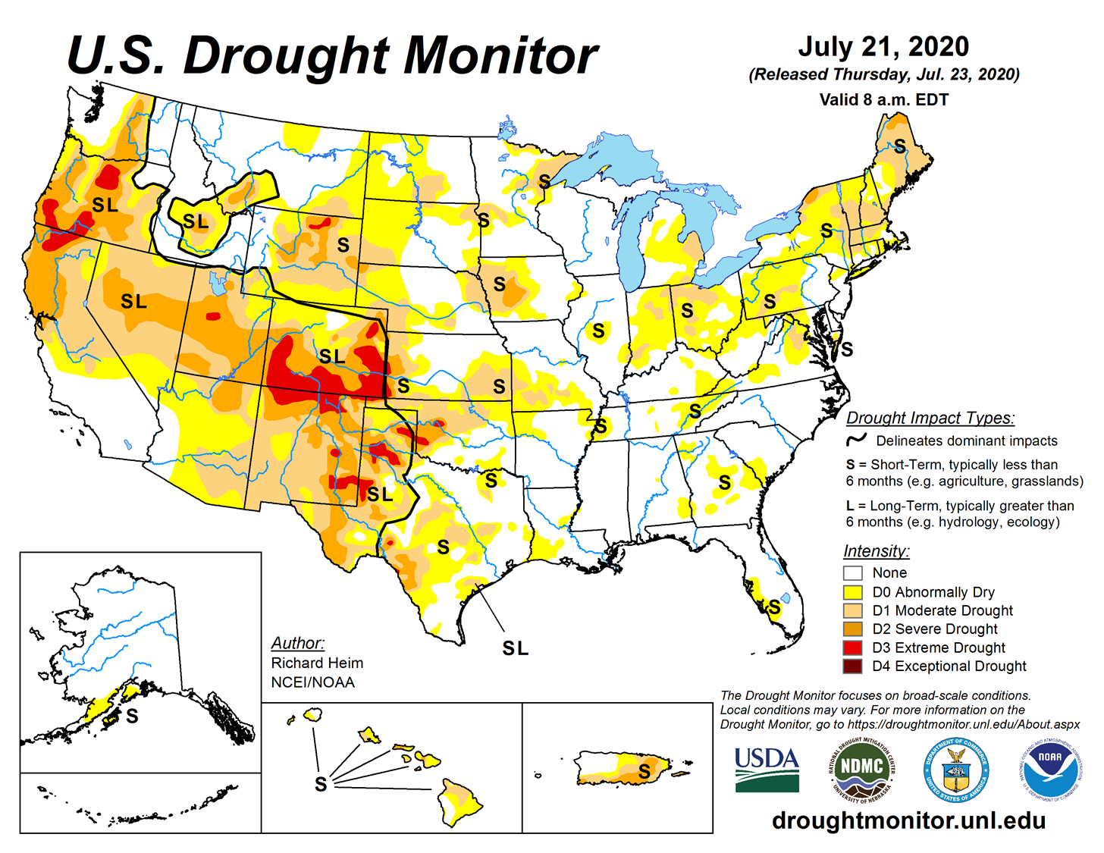
Last CARC Meeting…..

Slide 5
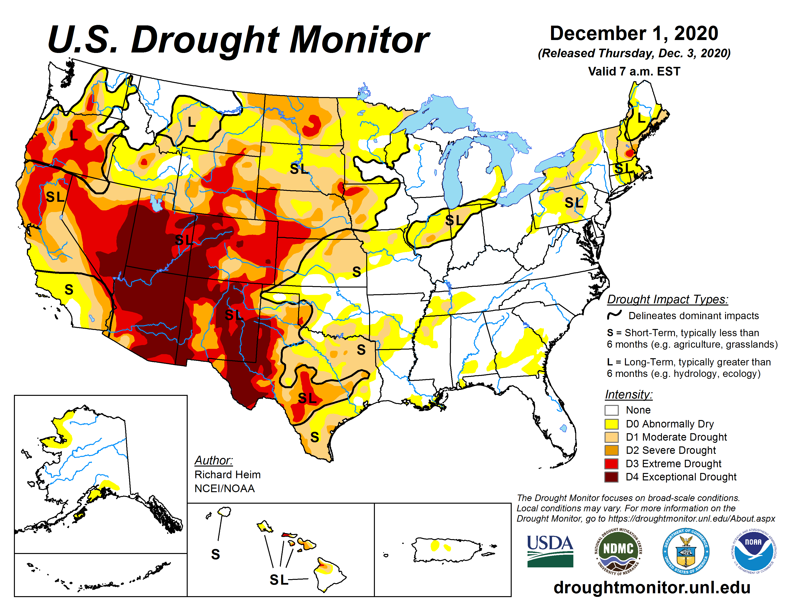

Slide 6
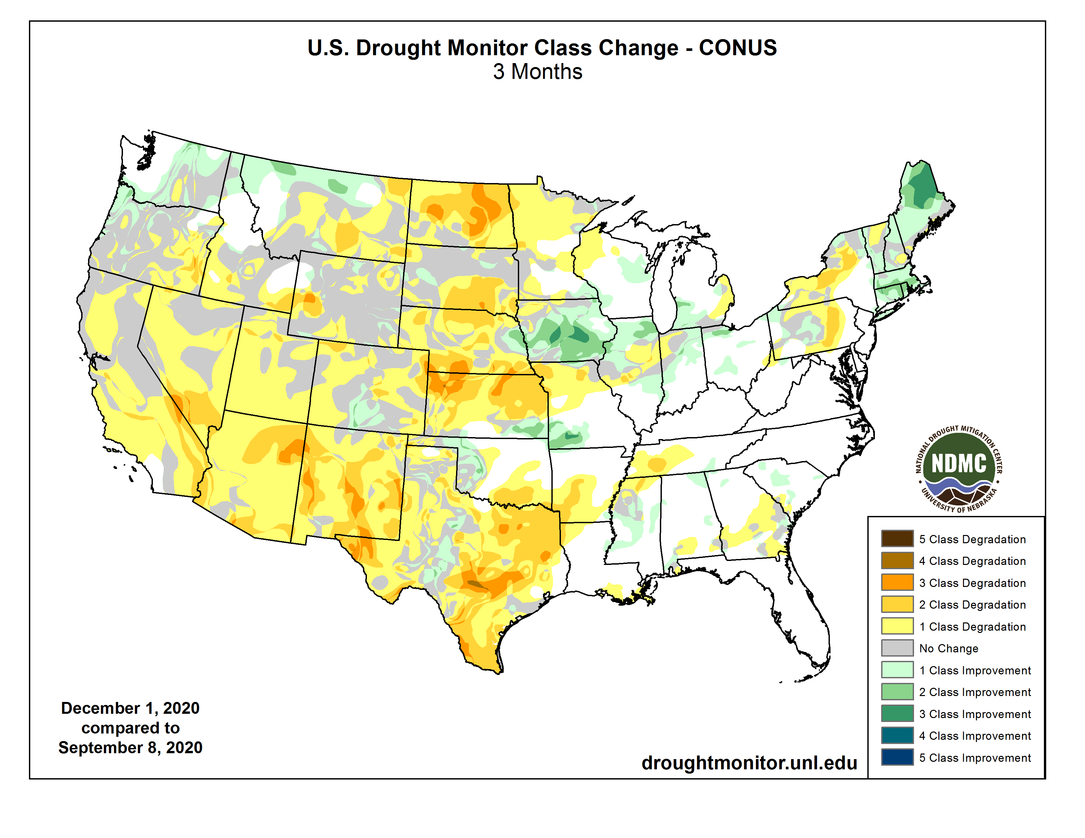

Slide 7
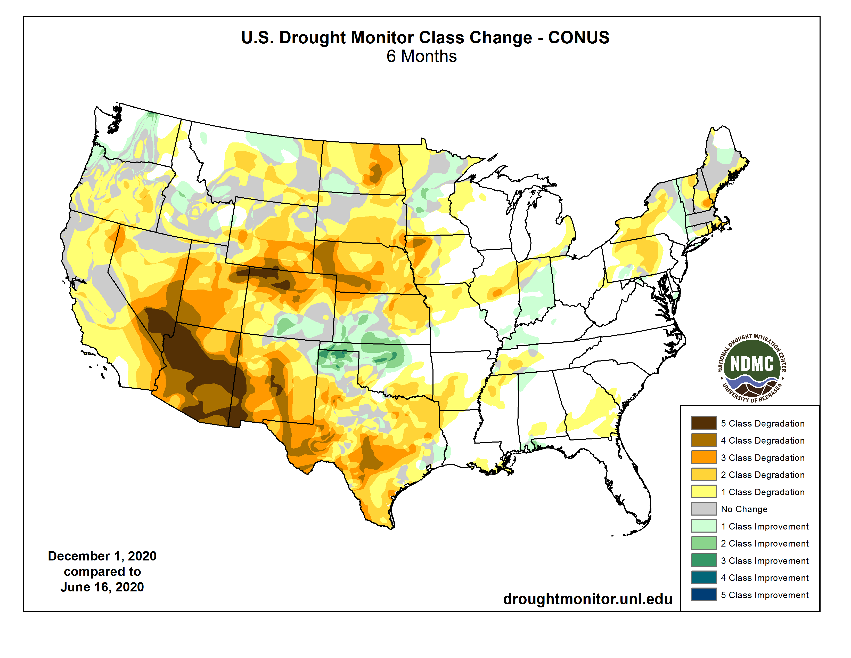

Slide 8
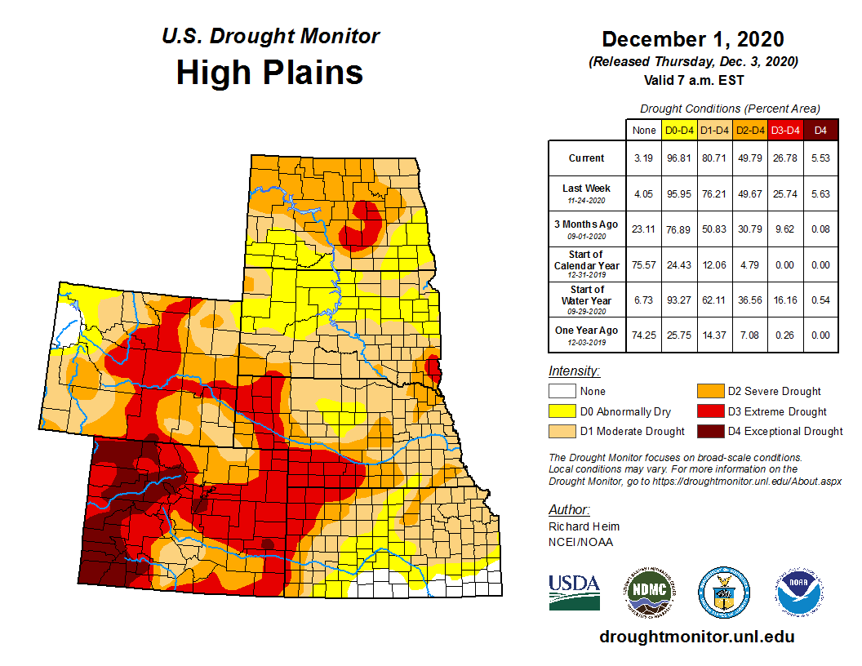


Slide 9
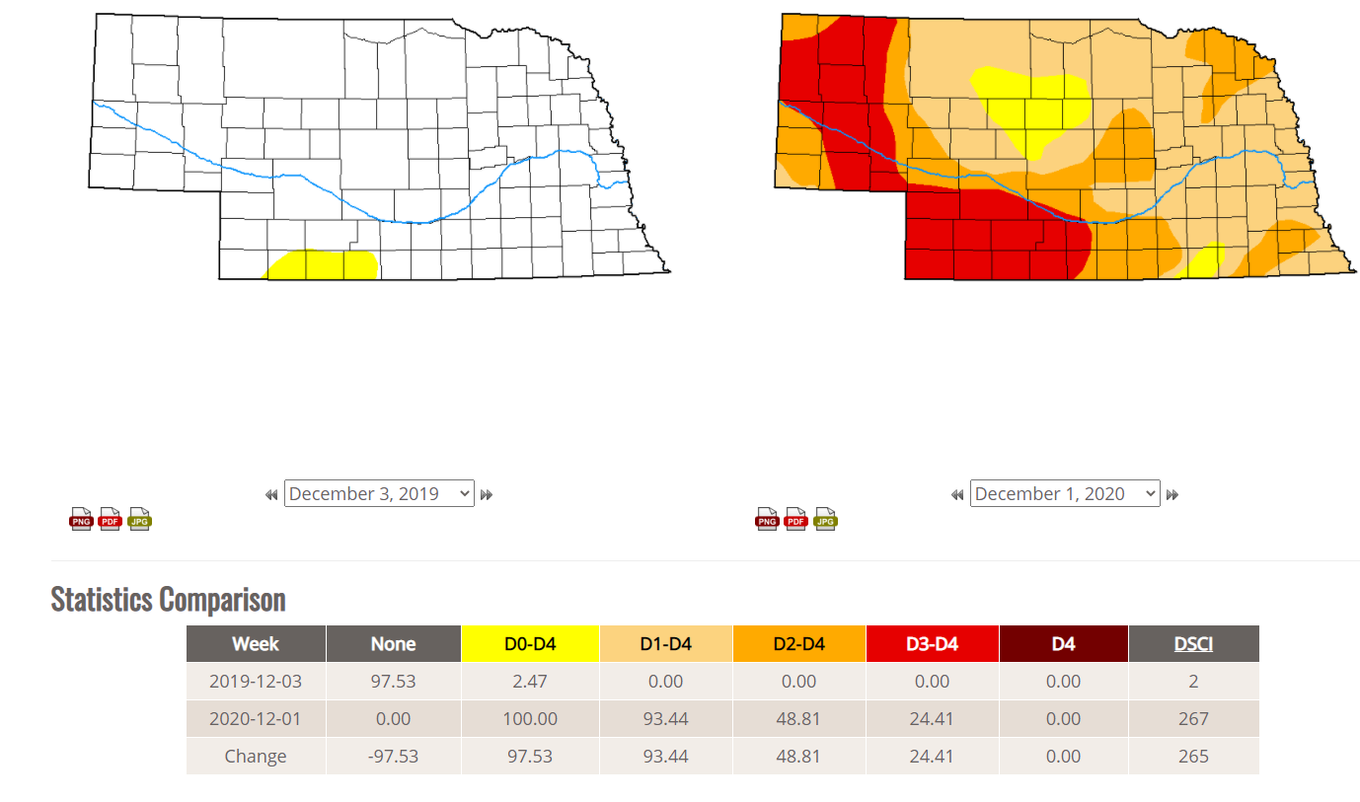

Slide 10
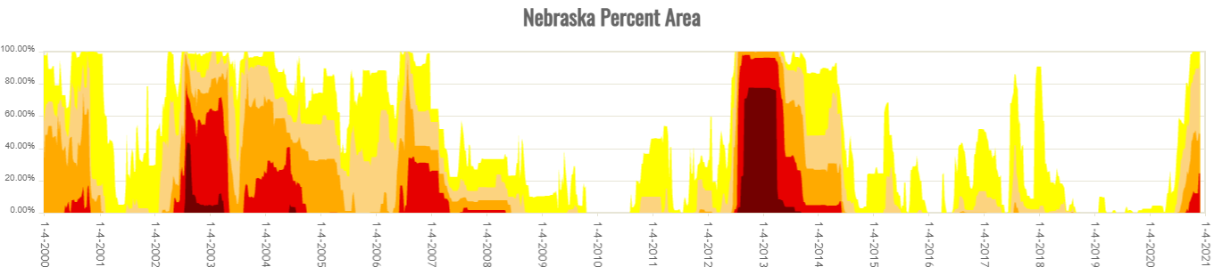
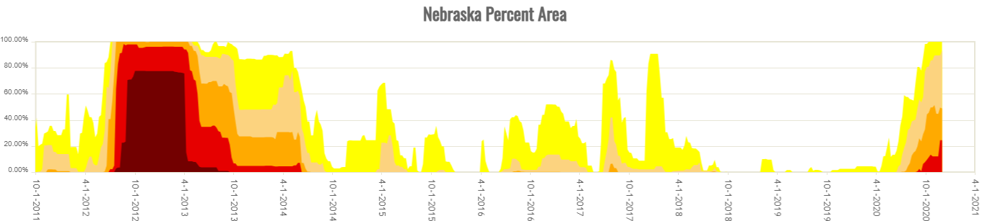
History is showing that Nebraska traditionally does not go this long between drought episodes, when is the next one ?

Slide 11
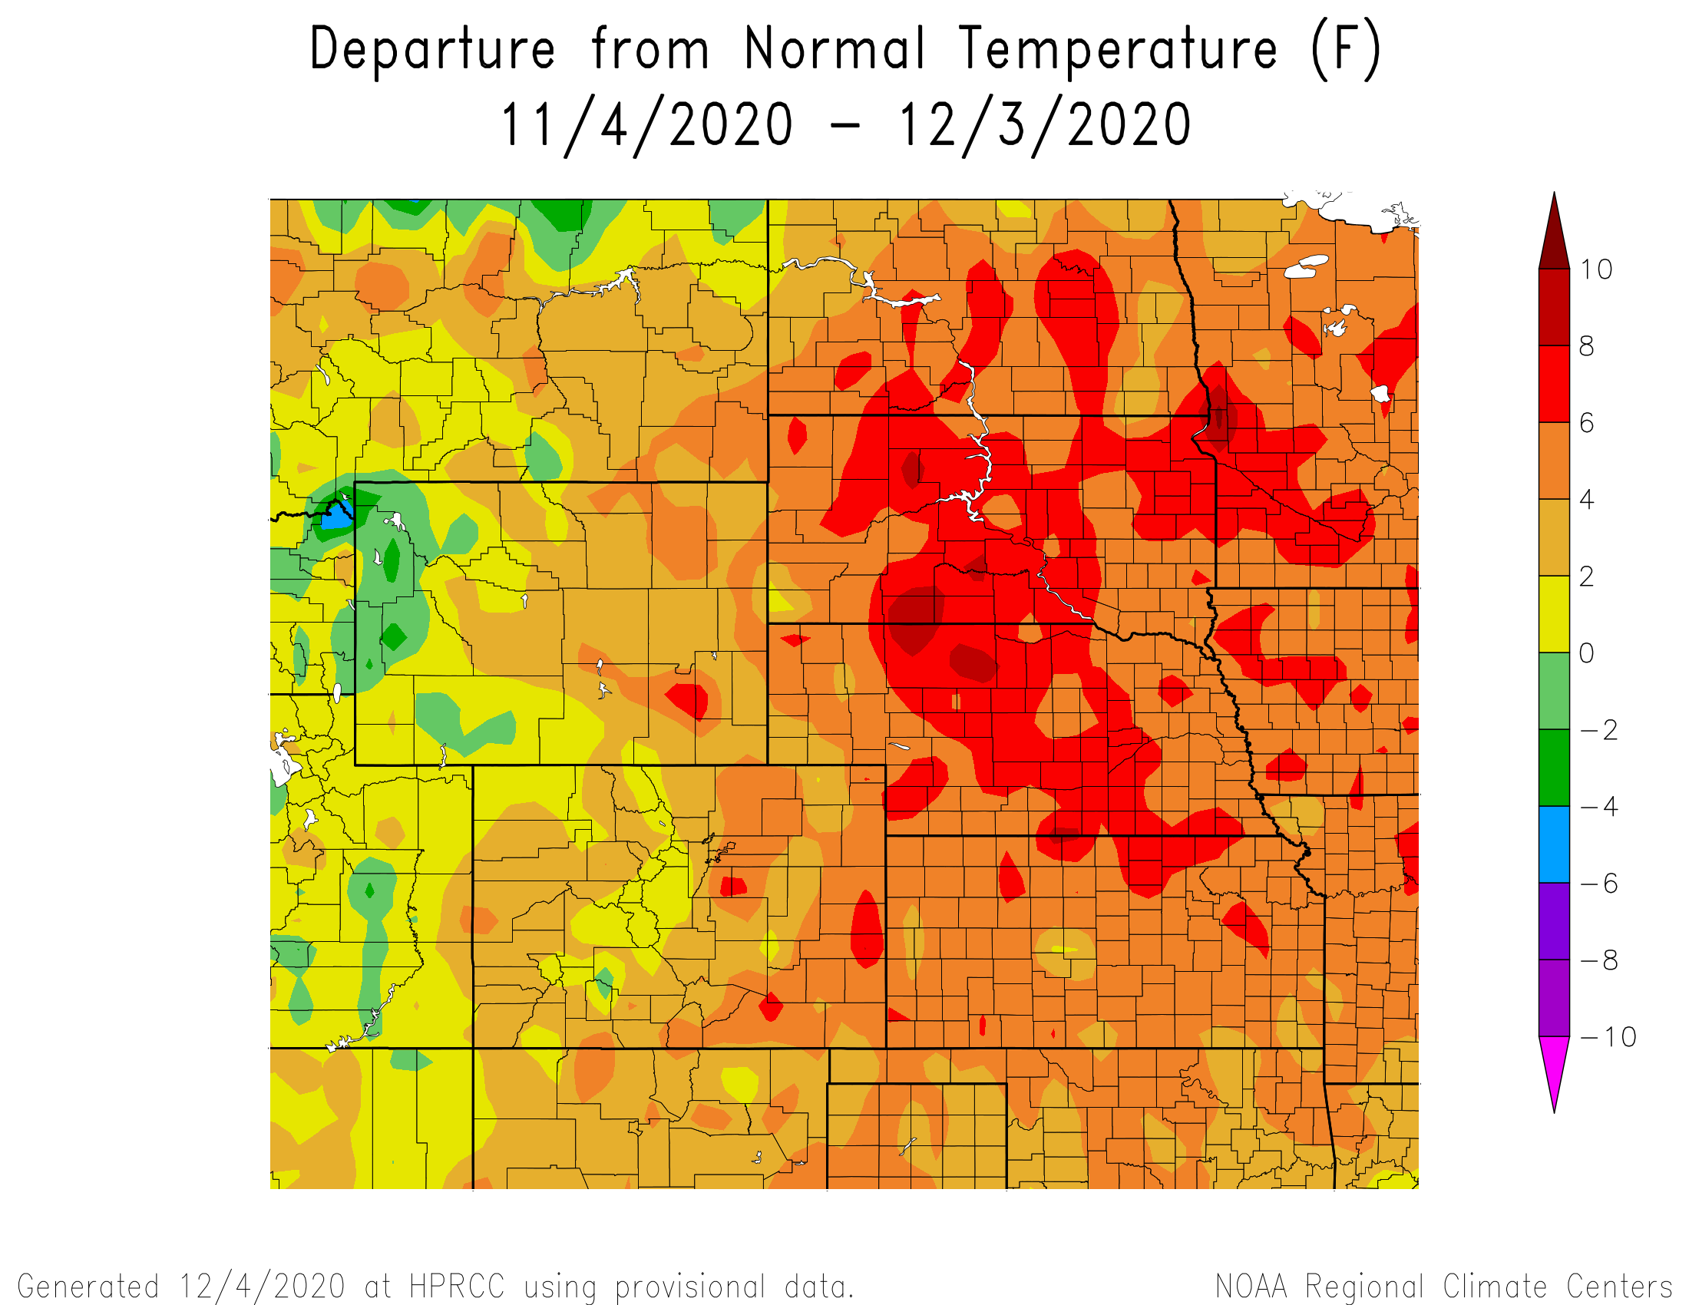
Departure from Normal Temperatures over the last 30 days

Slide 12
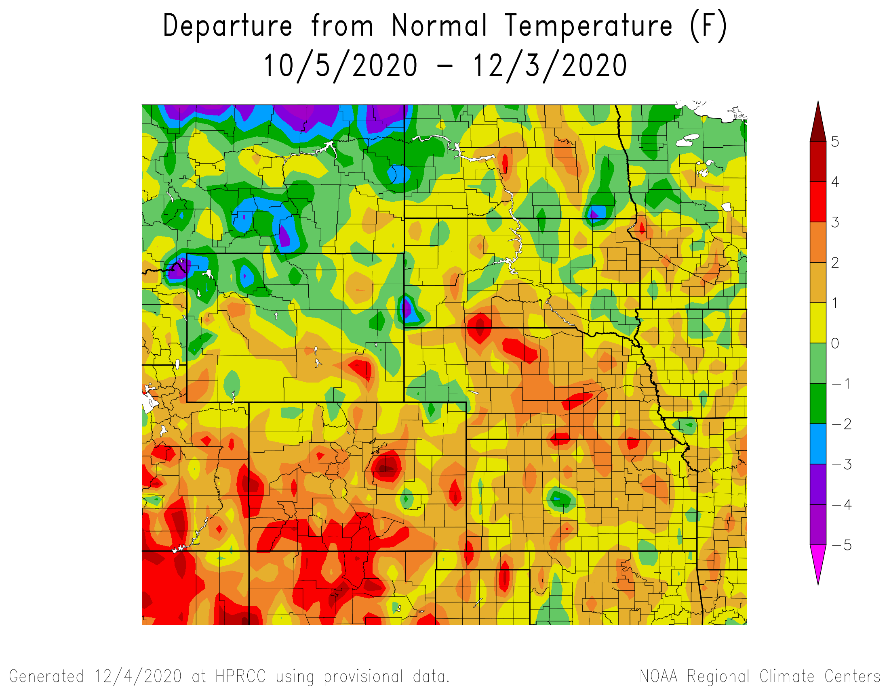
Departure from Normal Temperatures over the last 60 days

Slide 13
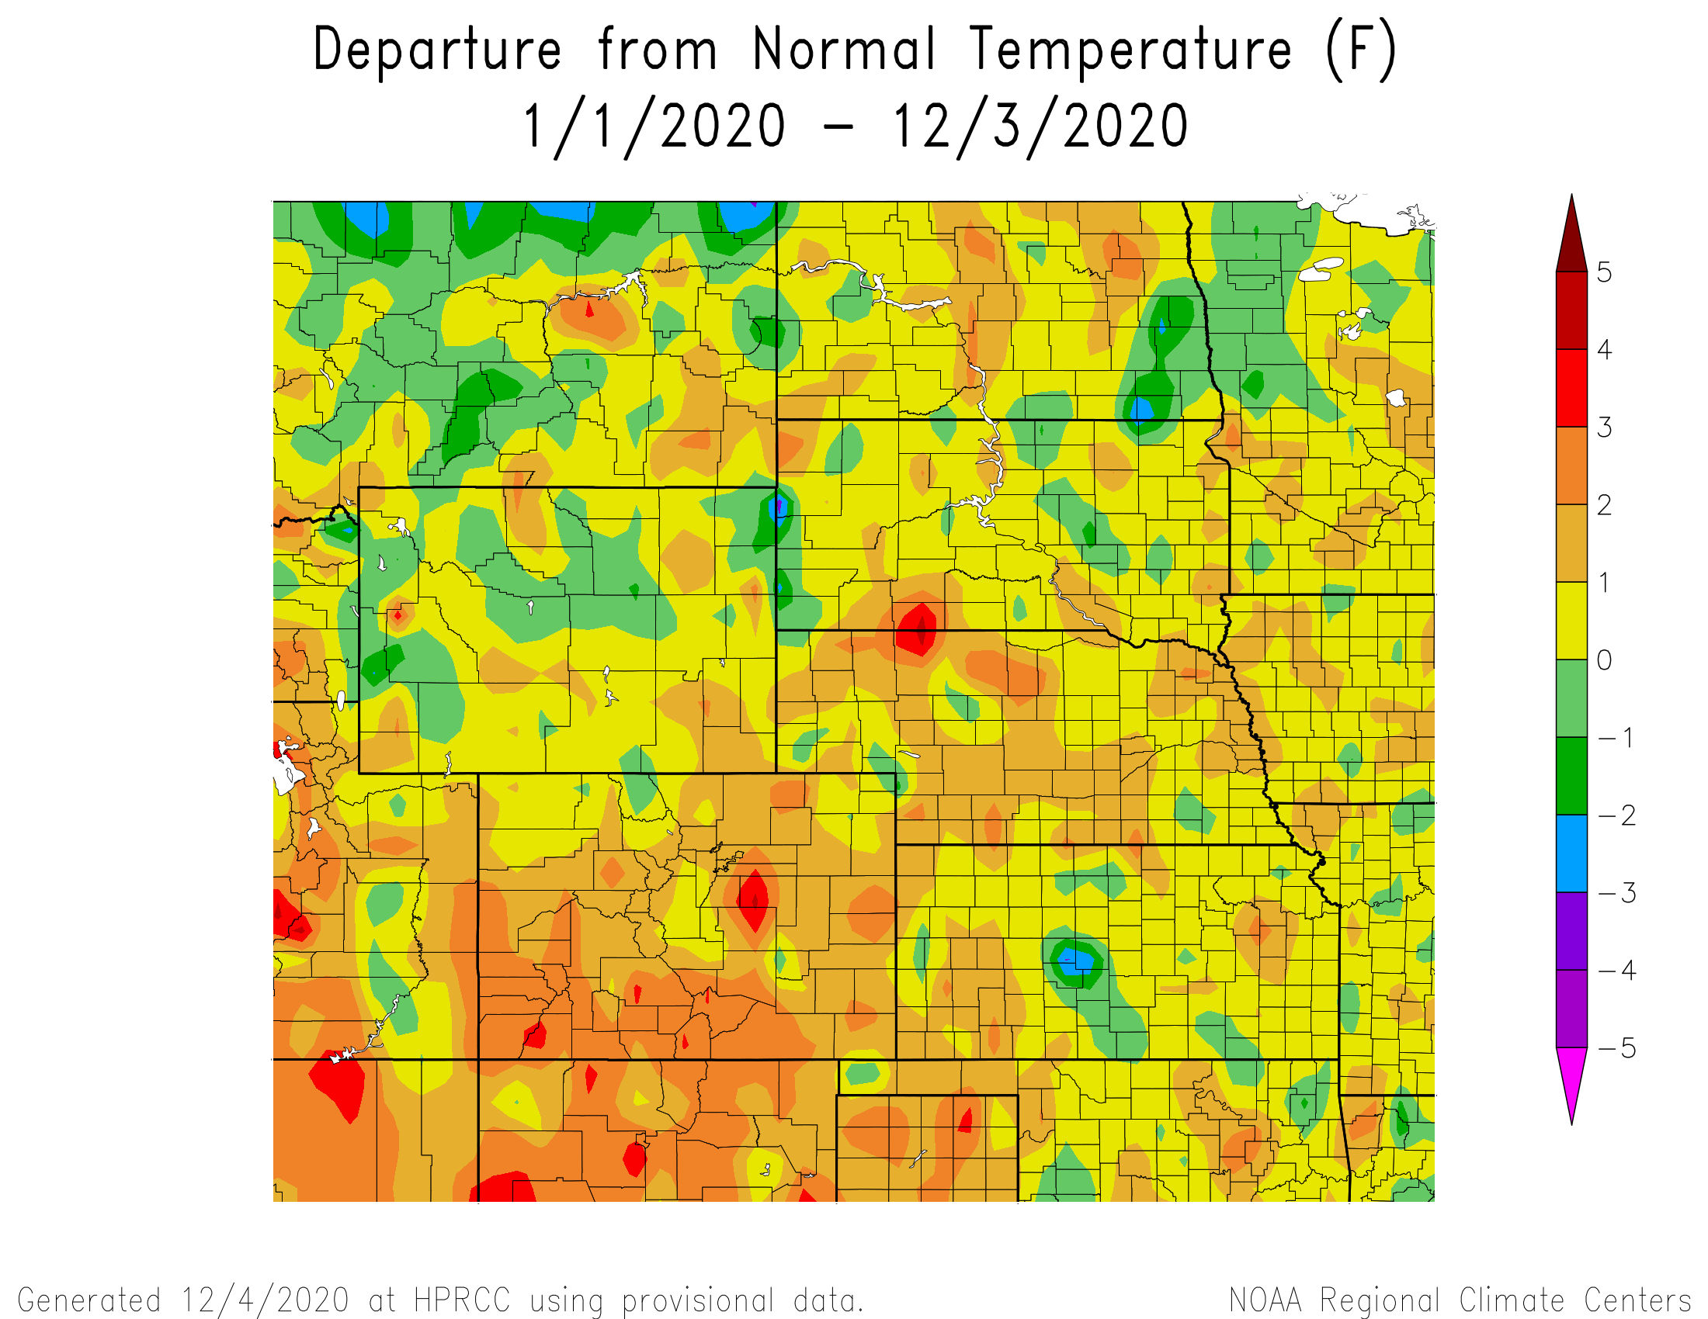
Departure from Normal Temperatures for the Calendar Year

Slide 14
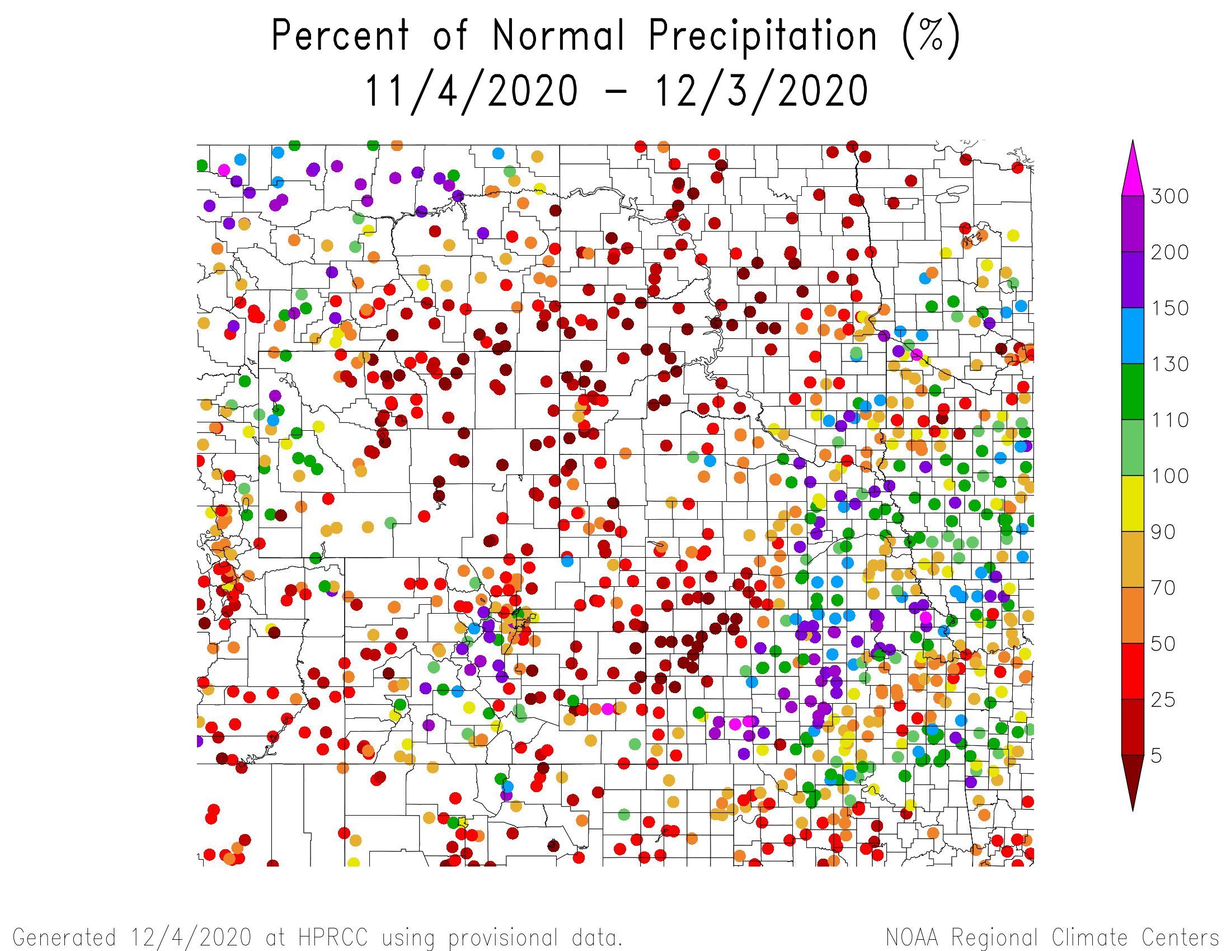
Percent of Normal Precipitation over the last 30 days

Slide 15
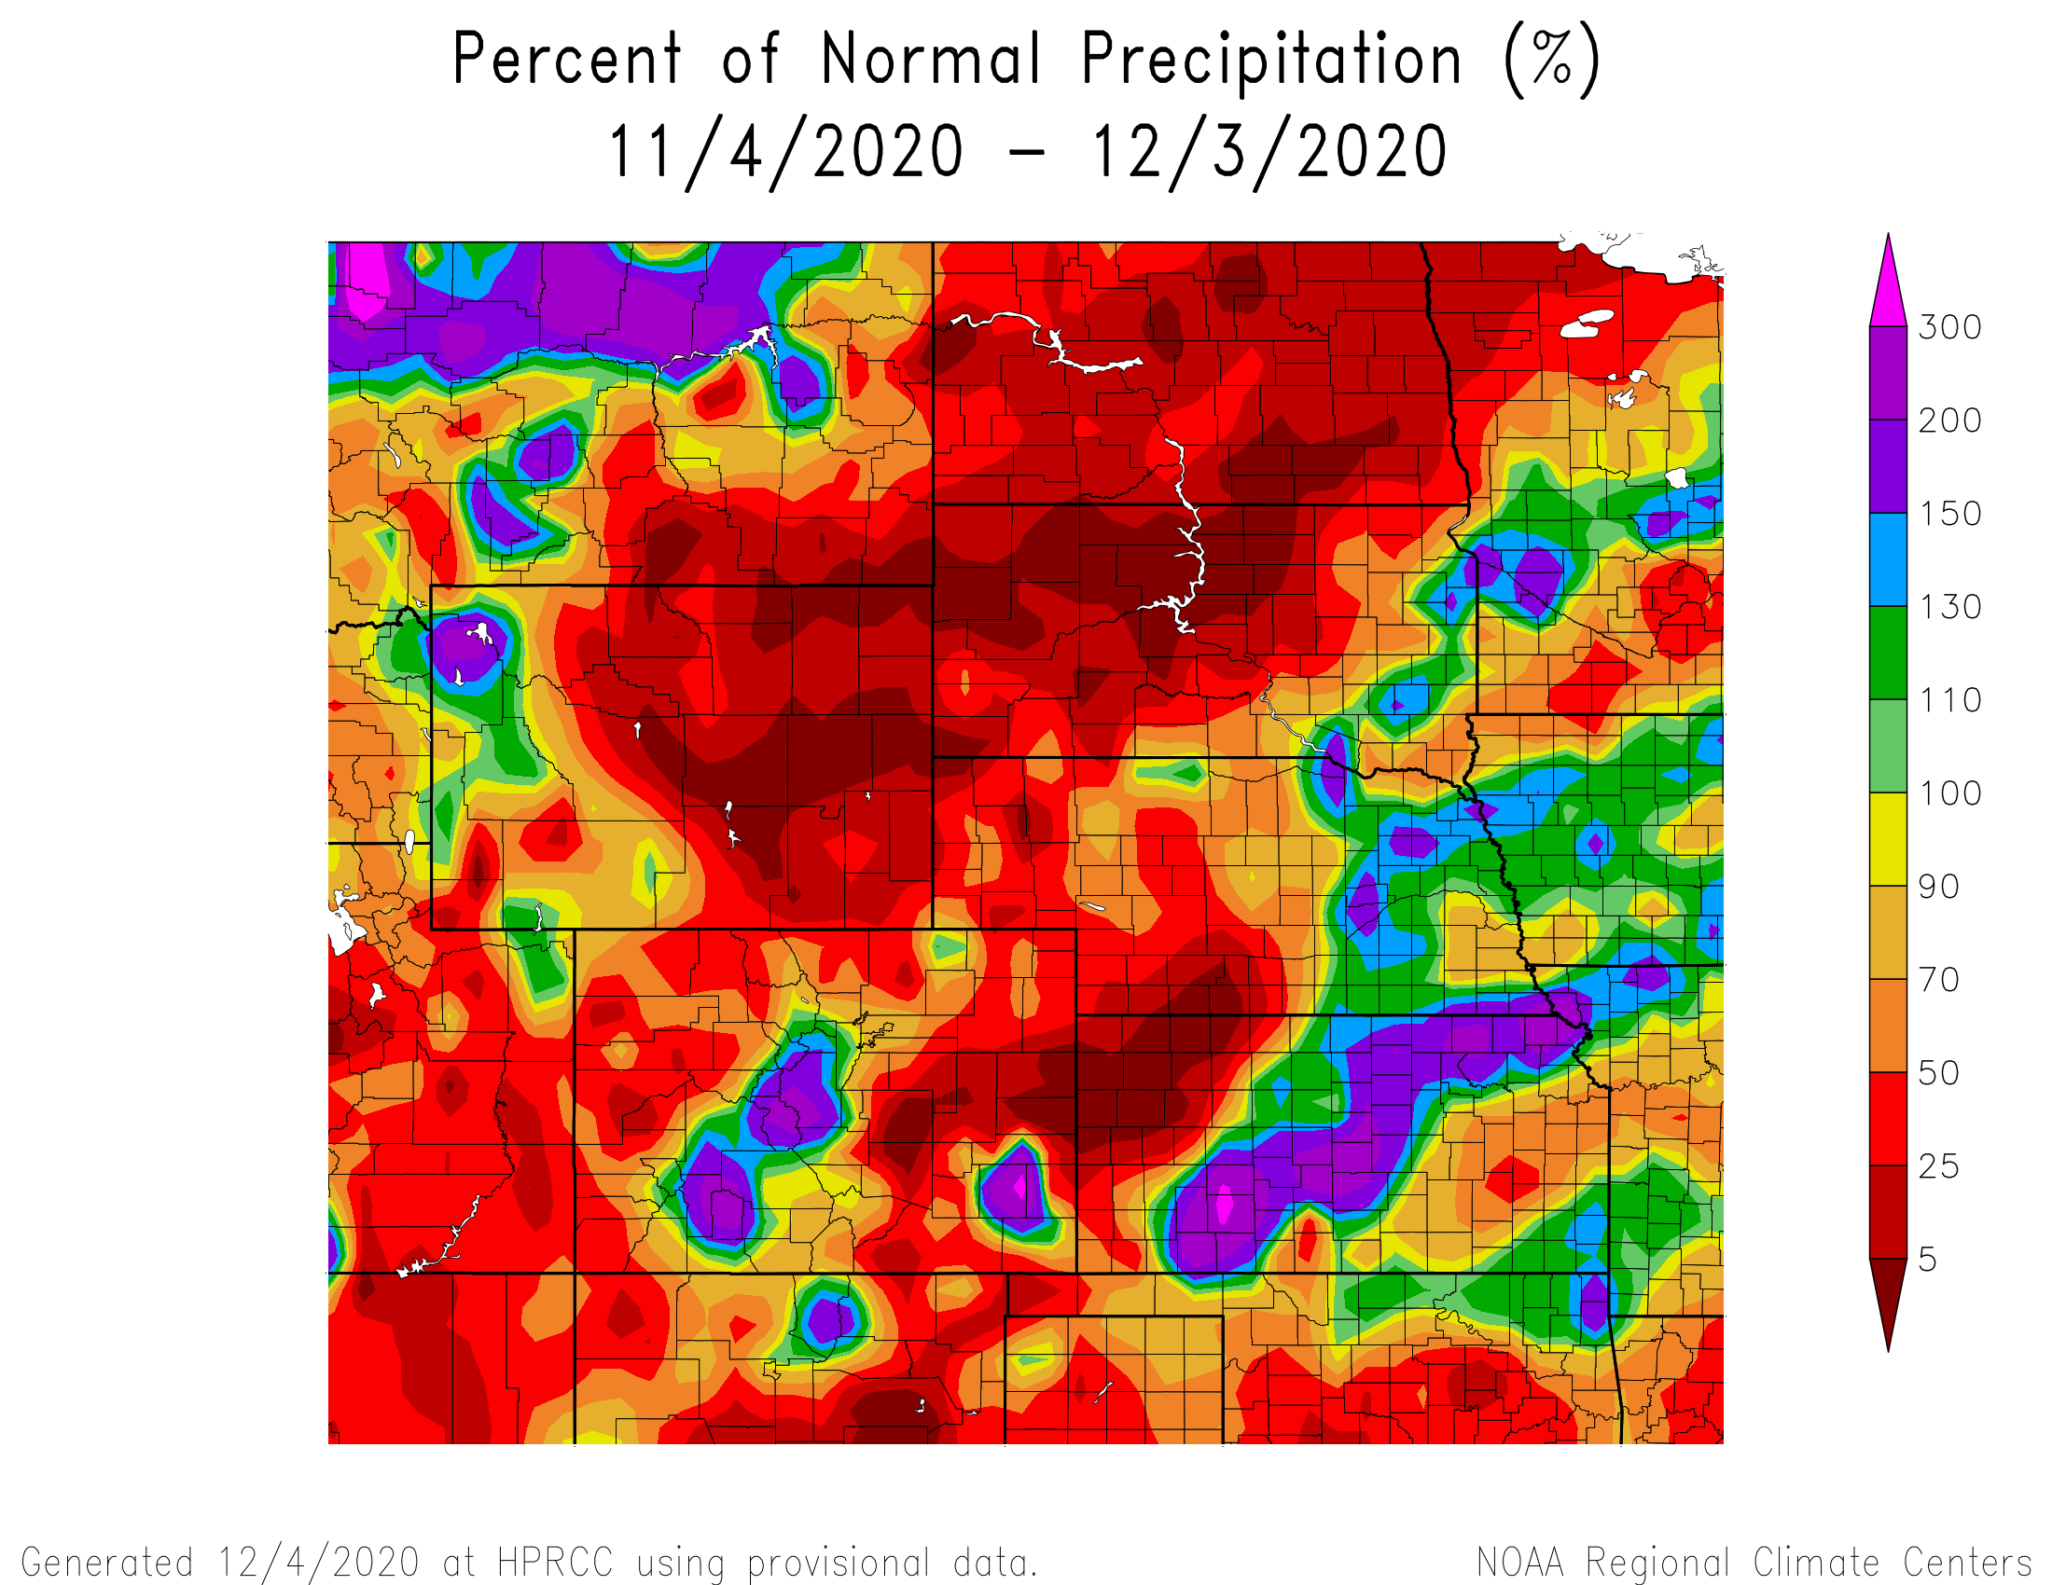
Percent of Normal Precipitation over the last 30 days

Slide 16
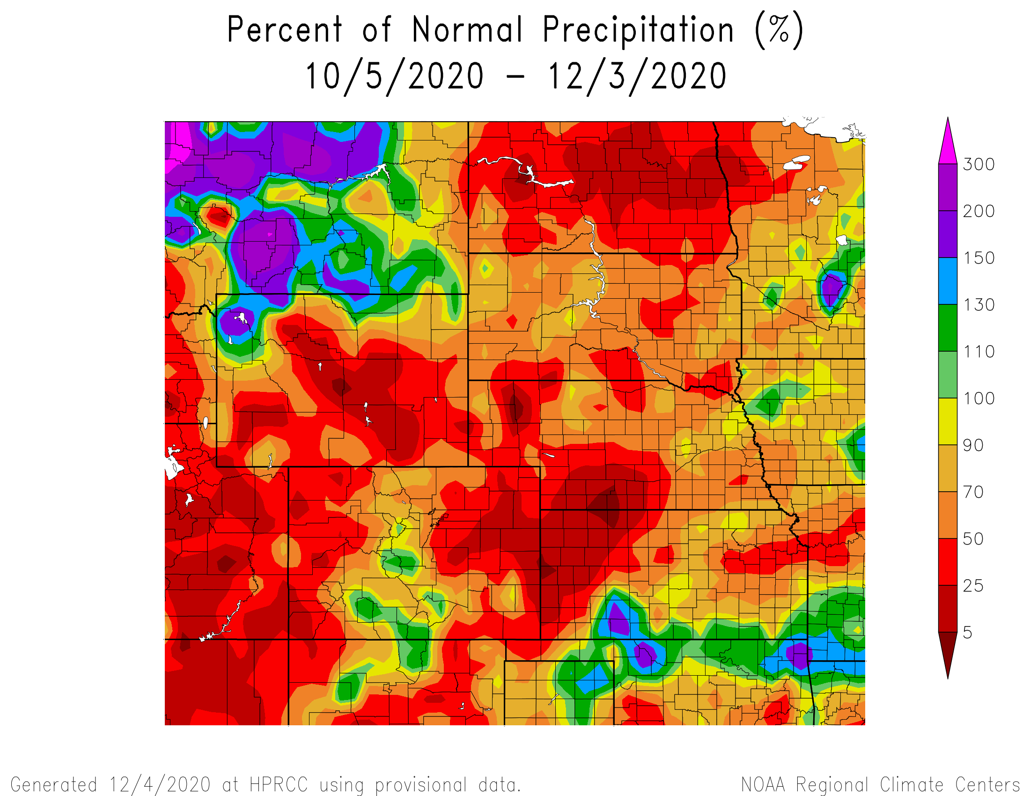
Percent of Normal Precipitation over the last 60 days

Slide 17
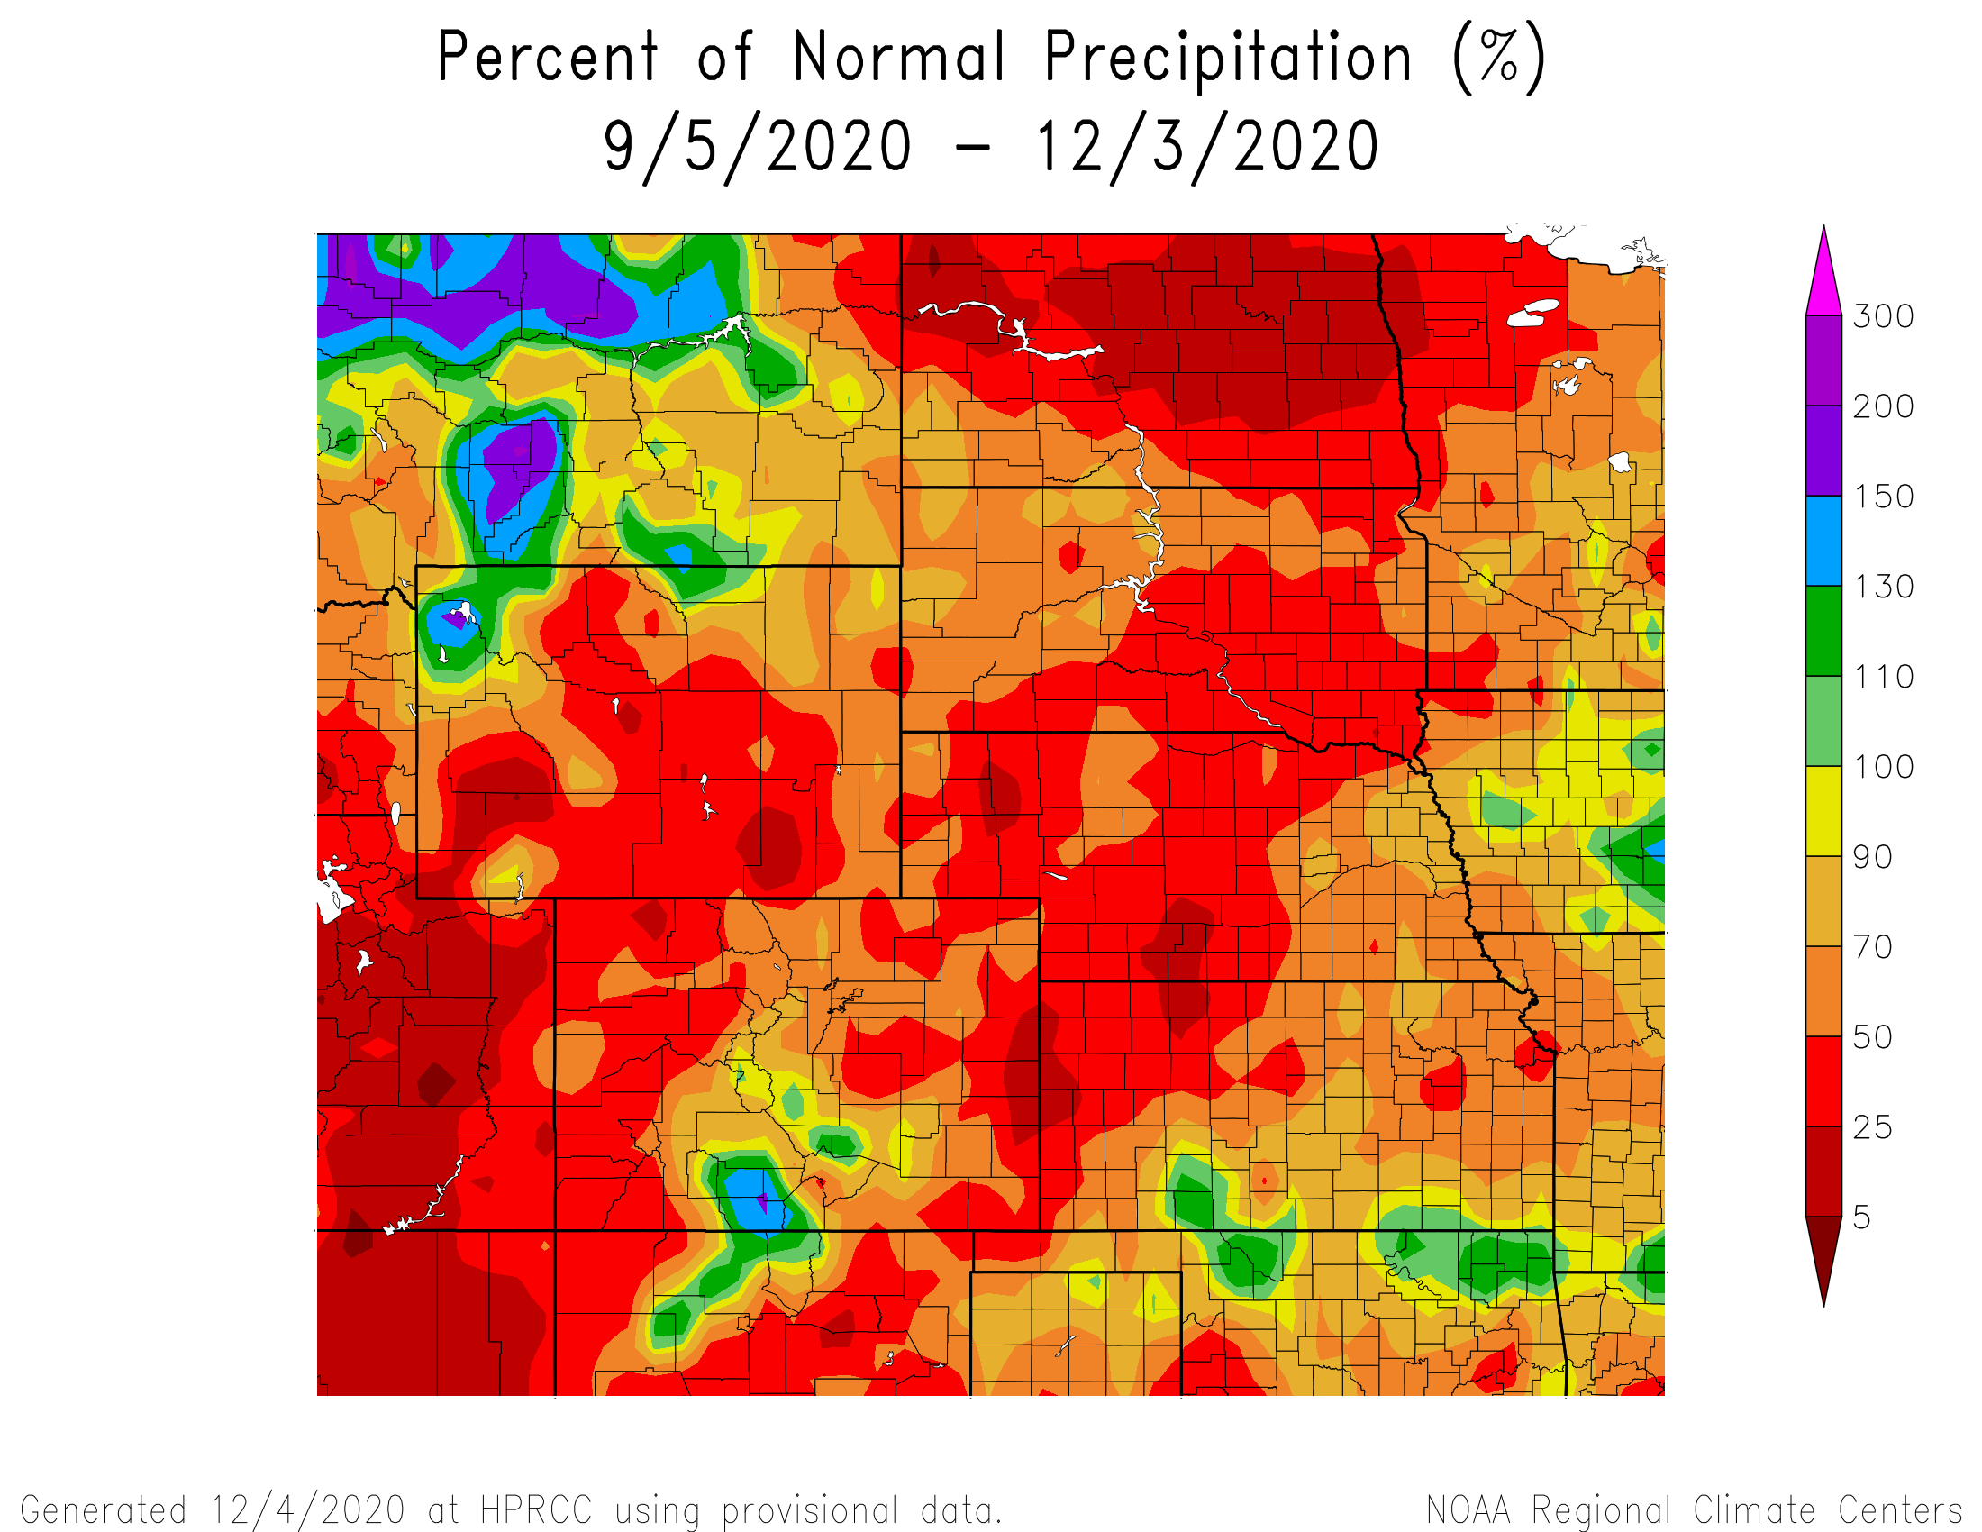
Percent of Normal Precipitation over the last 90 days

Slide 18
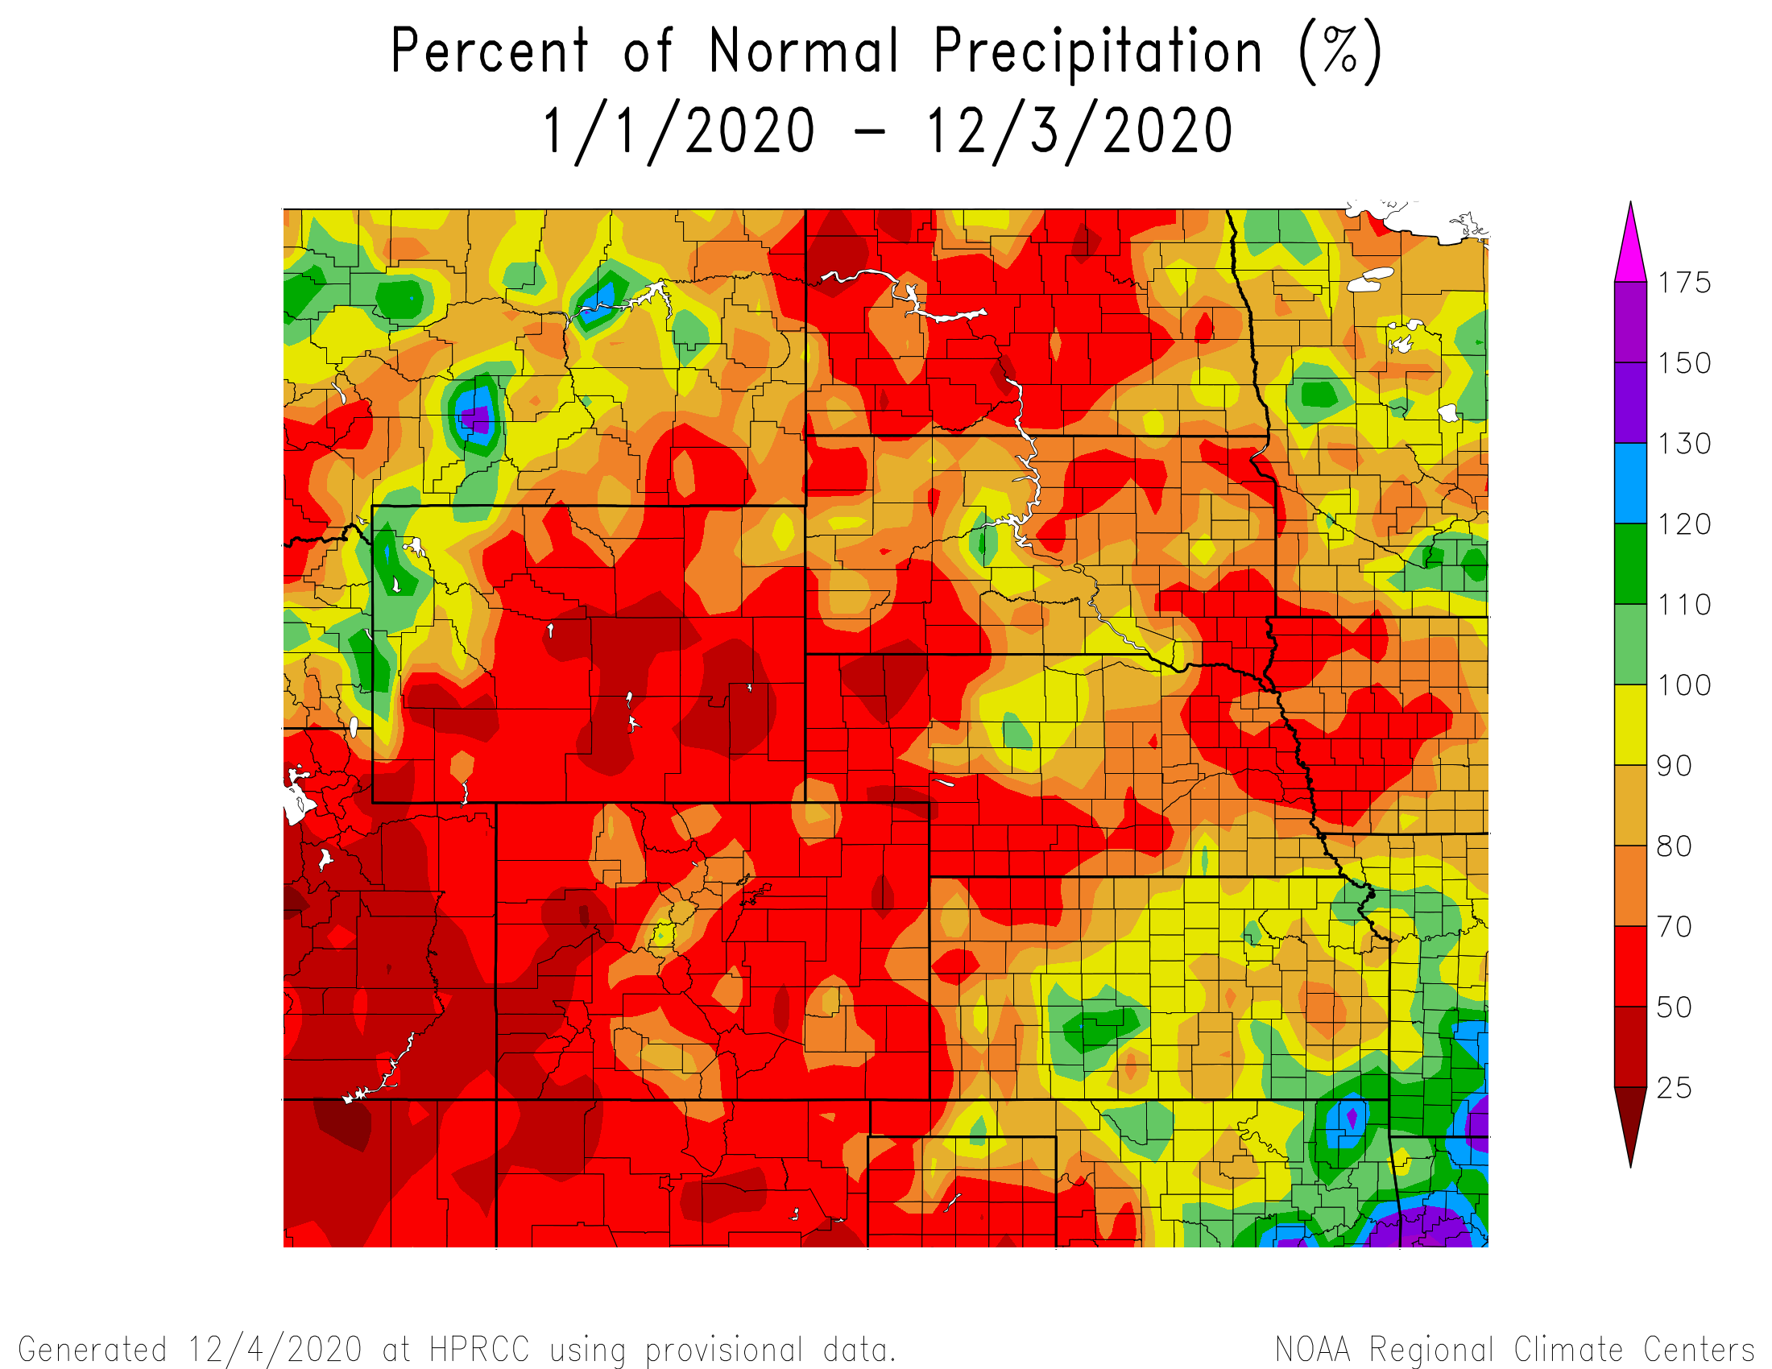
Percent of Normal Precipitation for the calendar year

Slide 19
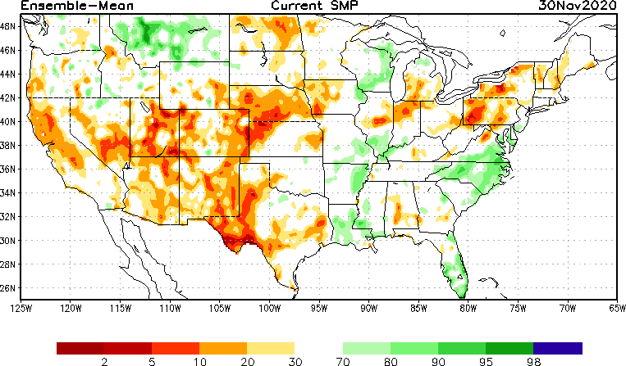
NLDAS Soil Moisture Model: Current Soil Moisture Anomaly

Slide 20
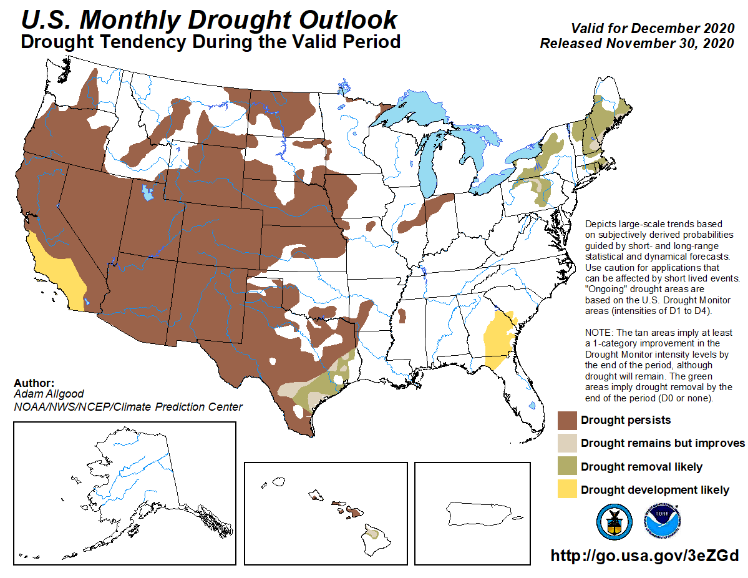

Slide 21
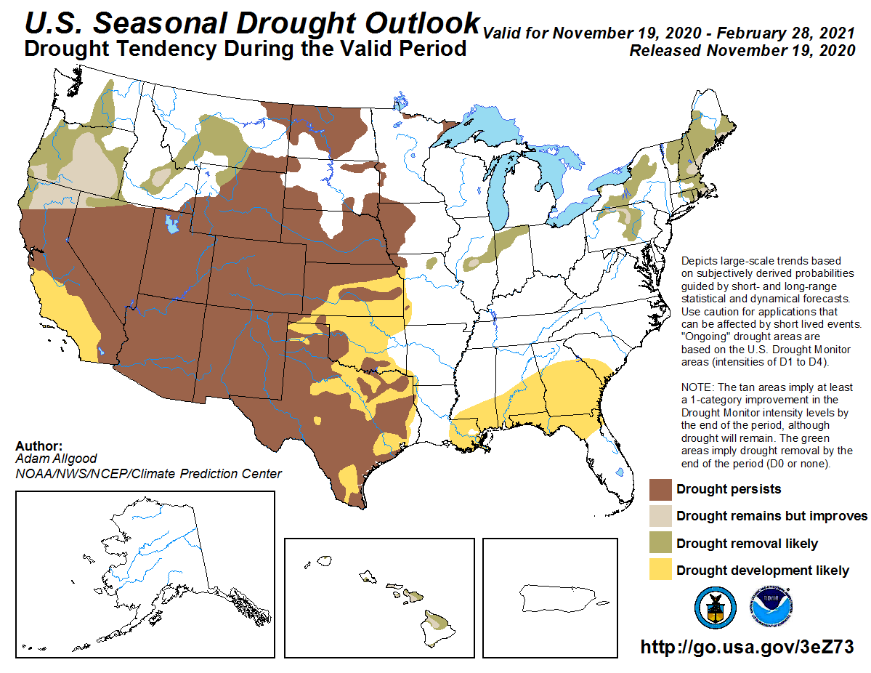

Slide 22
Climate/Drought Summary
Warmer than normal conditions have dominated the state and region recently with regional temperatures averaging about 1-3 degrees F above normal the last 60 days.
Almost the entire state of Nebraska has recorded below normal precipitation for 2020 so far with areas of northcentral being the only area of the state at or near normal.
Nebraska is currently showing 93.44 percent of the state in drought and this has been trending upwards over the last 3 months. Most of the drought is severe (D2) or worse with some pockets of extreme (D3) drought in the Panhandle and southwest.
The seasonal drought outlook has drought persisting in Nebraska through the end of February in the areas that are currently in drought.

Slide 23
Nebraska Water Supply Update…

Slide 24
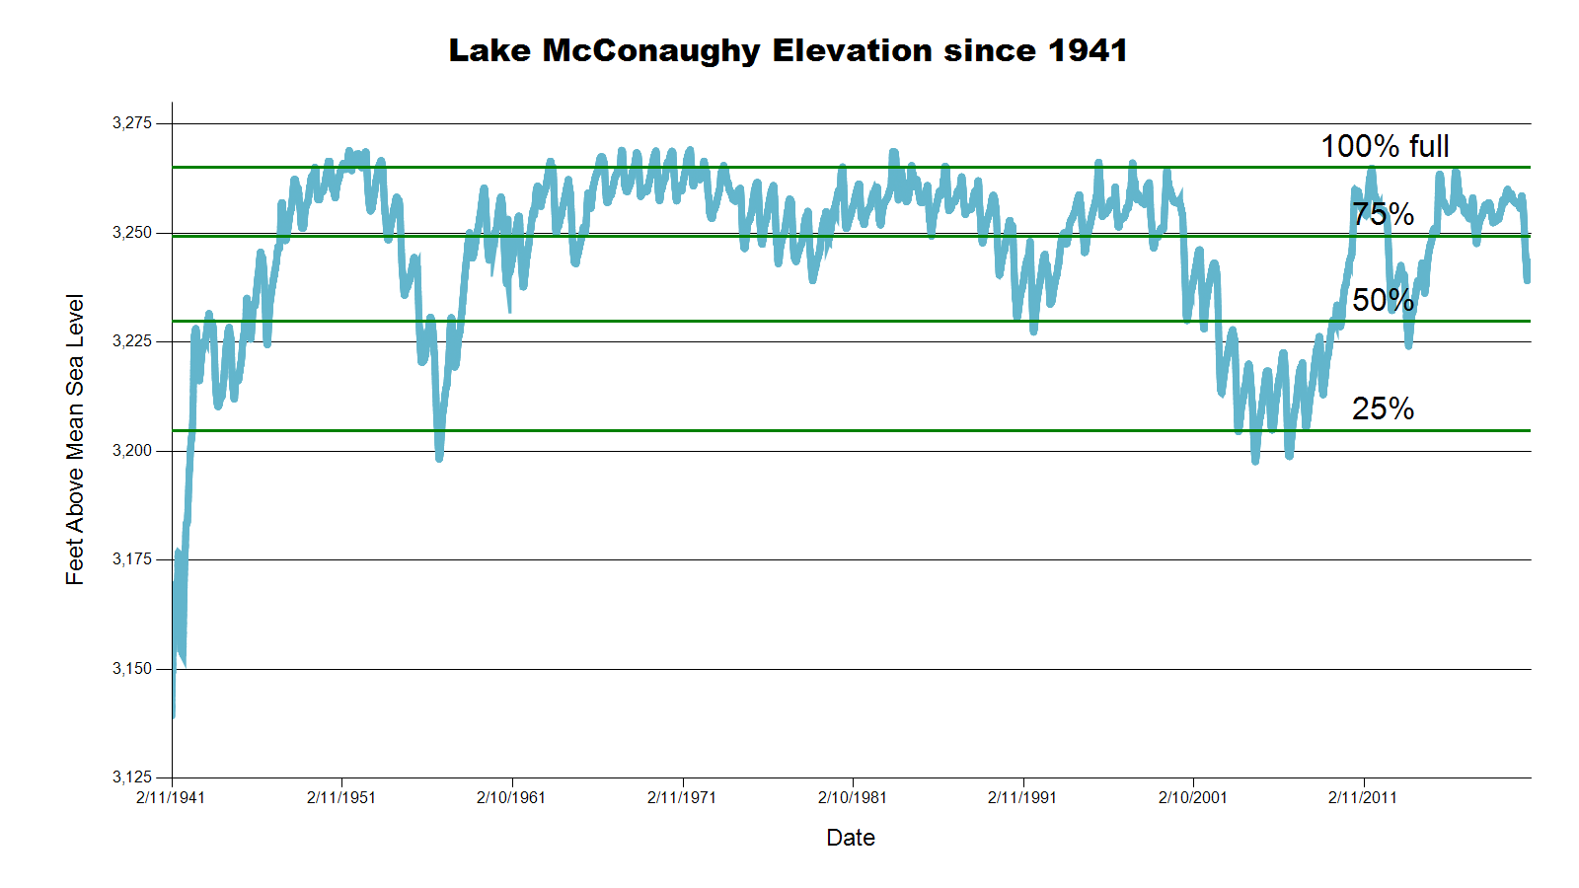
3243.4 feet 66.8% Full
3246.3 feet 70.7% Full
July 2020 CARC meeting
SOURCE: CNPPID www.cnppid.com

Slide 25
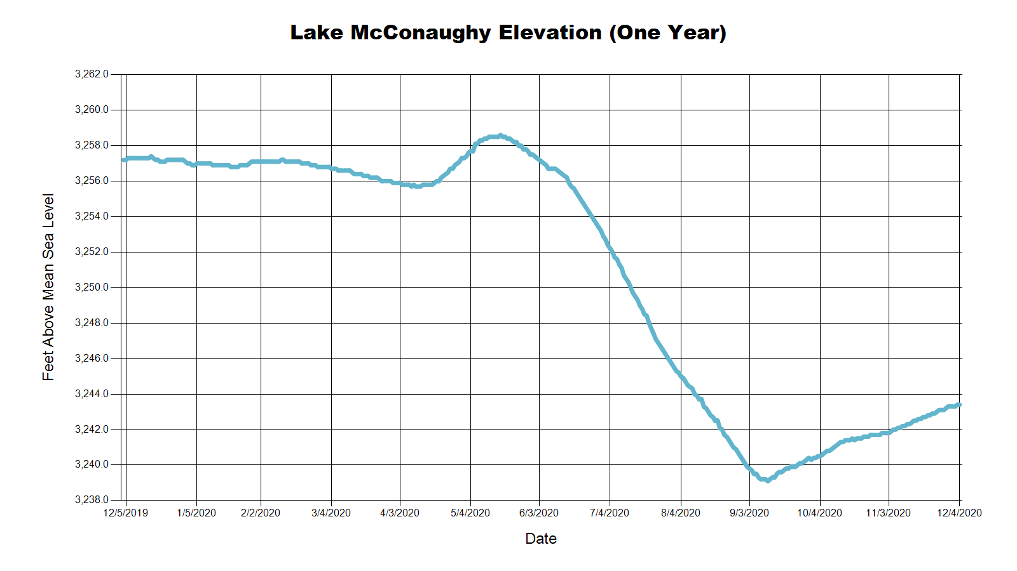
3257.7 Feet
88.0% of Max
November 2019
3246.3 Feet
70.7% of Max
July 2020
3243.4 Feet
68.8% of Max
December 2020
SOURCE: CNPPID www.cnppid.com

Slide 26
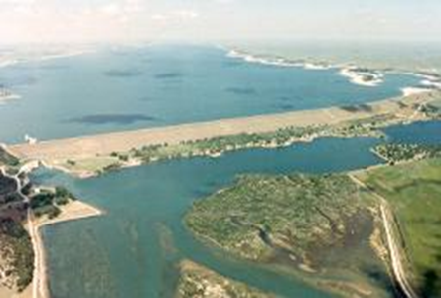
December 2020 CARC Meeting
SOURCE: CNPPID www.cnppid.com

Slide 27
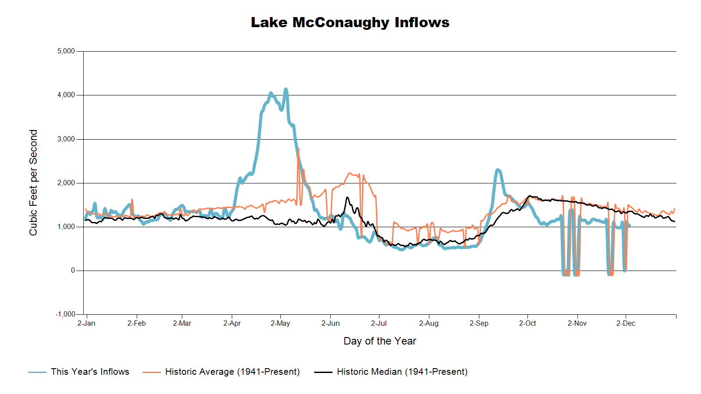

Slide 28
Lake McConaughy
Civil Engineer Tyler Thulin reported that Lake McConaughy is at elevation of 3241.9 feet above sea level, with storage at about 65 percent of capacity. Inflows to the lake have been around 1,200 cubic feet per second, about 300 cfs below normal for this time of year. Thulin also reported that hydrocycling of the J-2 Hydroplant ended on Nov. 10 and normal winter operations began the following day. Hydrocycling takes place each spring and fall as required by an agreement with the U.S. Fish & Wildlife Service to improve conditions on the Platte River during endangered whooping cranes’ migratory seasons. During the hydrocycling period, Johnson Lake’s level typically fluctuates from two to three feet as operations are adjusted to minimize the chance of significant flow changes in the Platte River that might affect roosting cranes. More information about hydrocycling is available on Central’s web site at www.cnppid.com/operations/johnson-lake-operations-2/.
SOURCE: CNPPID News Release, November 2, 2020
www.cnppid.com

Slide 29
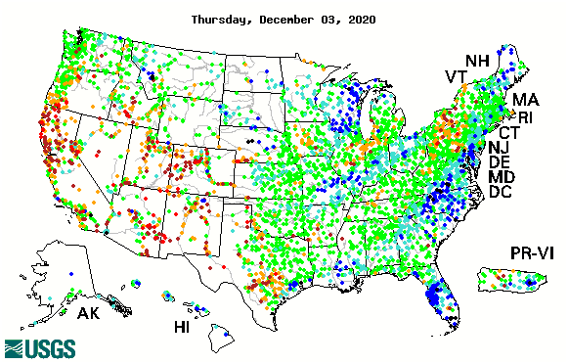

14-day average streamflow compared to historical streamflow for the day of year

Slide 30
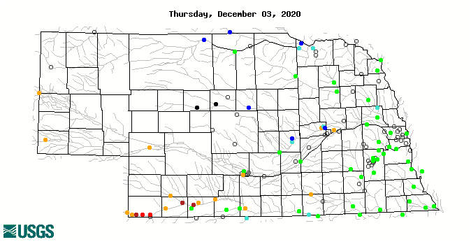
14-day average streamflow compared to historical streamflow for the day of year
95th Percentile
12th Percentile
21^{ts} Percentile
8th Percentile
18thPercentile
1stPercentile

Slide 31
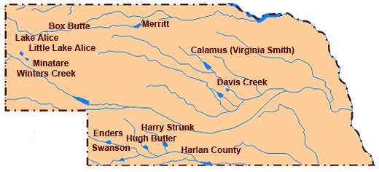
Republican River Basin
Hugh Butler: 49.9%(59.0%) of conservation pool
Enders: 19.9% (22.5%) of conservation pool
Harry Strunk: 67.2%(74.2%) of conservation pool
Swanson: 49.4% (57.4%) of conservation pool
*values in red are from the last CARC meeting in July 2020.
Source: BOR http://www.usbr.gov/gp/lakes_reservoirs

Slide 32
Republican River Basin
Harlan County Current Conditions
Conservation Pool is 88.0% full (98.7%)
276,399 Acre-Feet in storage compared to 309,877 Acre-Feet (AF) of water in storage during July 2020
Last year at this time, 359,314 AF was in storage (December 2020)
Historical average storage for this time of the year is 347,004 AF
*values in red are from the last CARC meeting in July 2020
Source: BOR http://www.usbr.gov/gp/lakes_reservoirs/

Slide 33
Water Supply Summary
Lake McConaughy is currently 68.8 percent of capacity and has been rising slowly since the end of the irrigation season.
The Republican River basin reservoirs are lower than they were in July 2020 as water levels stabilized and in some cases rising after the irrigation season.
Harlan County Reservoir is holding about 33,478 acre-feet less water now than in July 2020.
Harlan County about 70,605 acre-feet above average for this time of year.

Slide 34
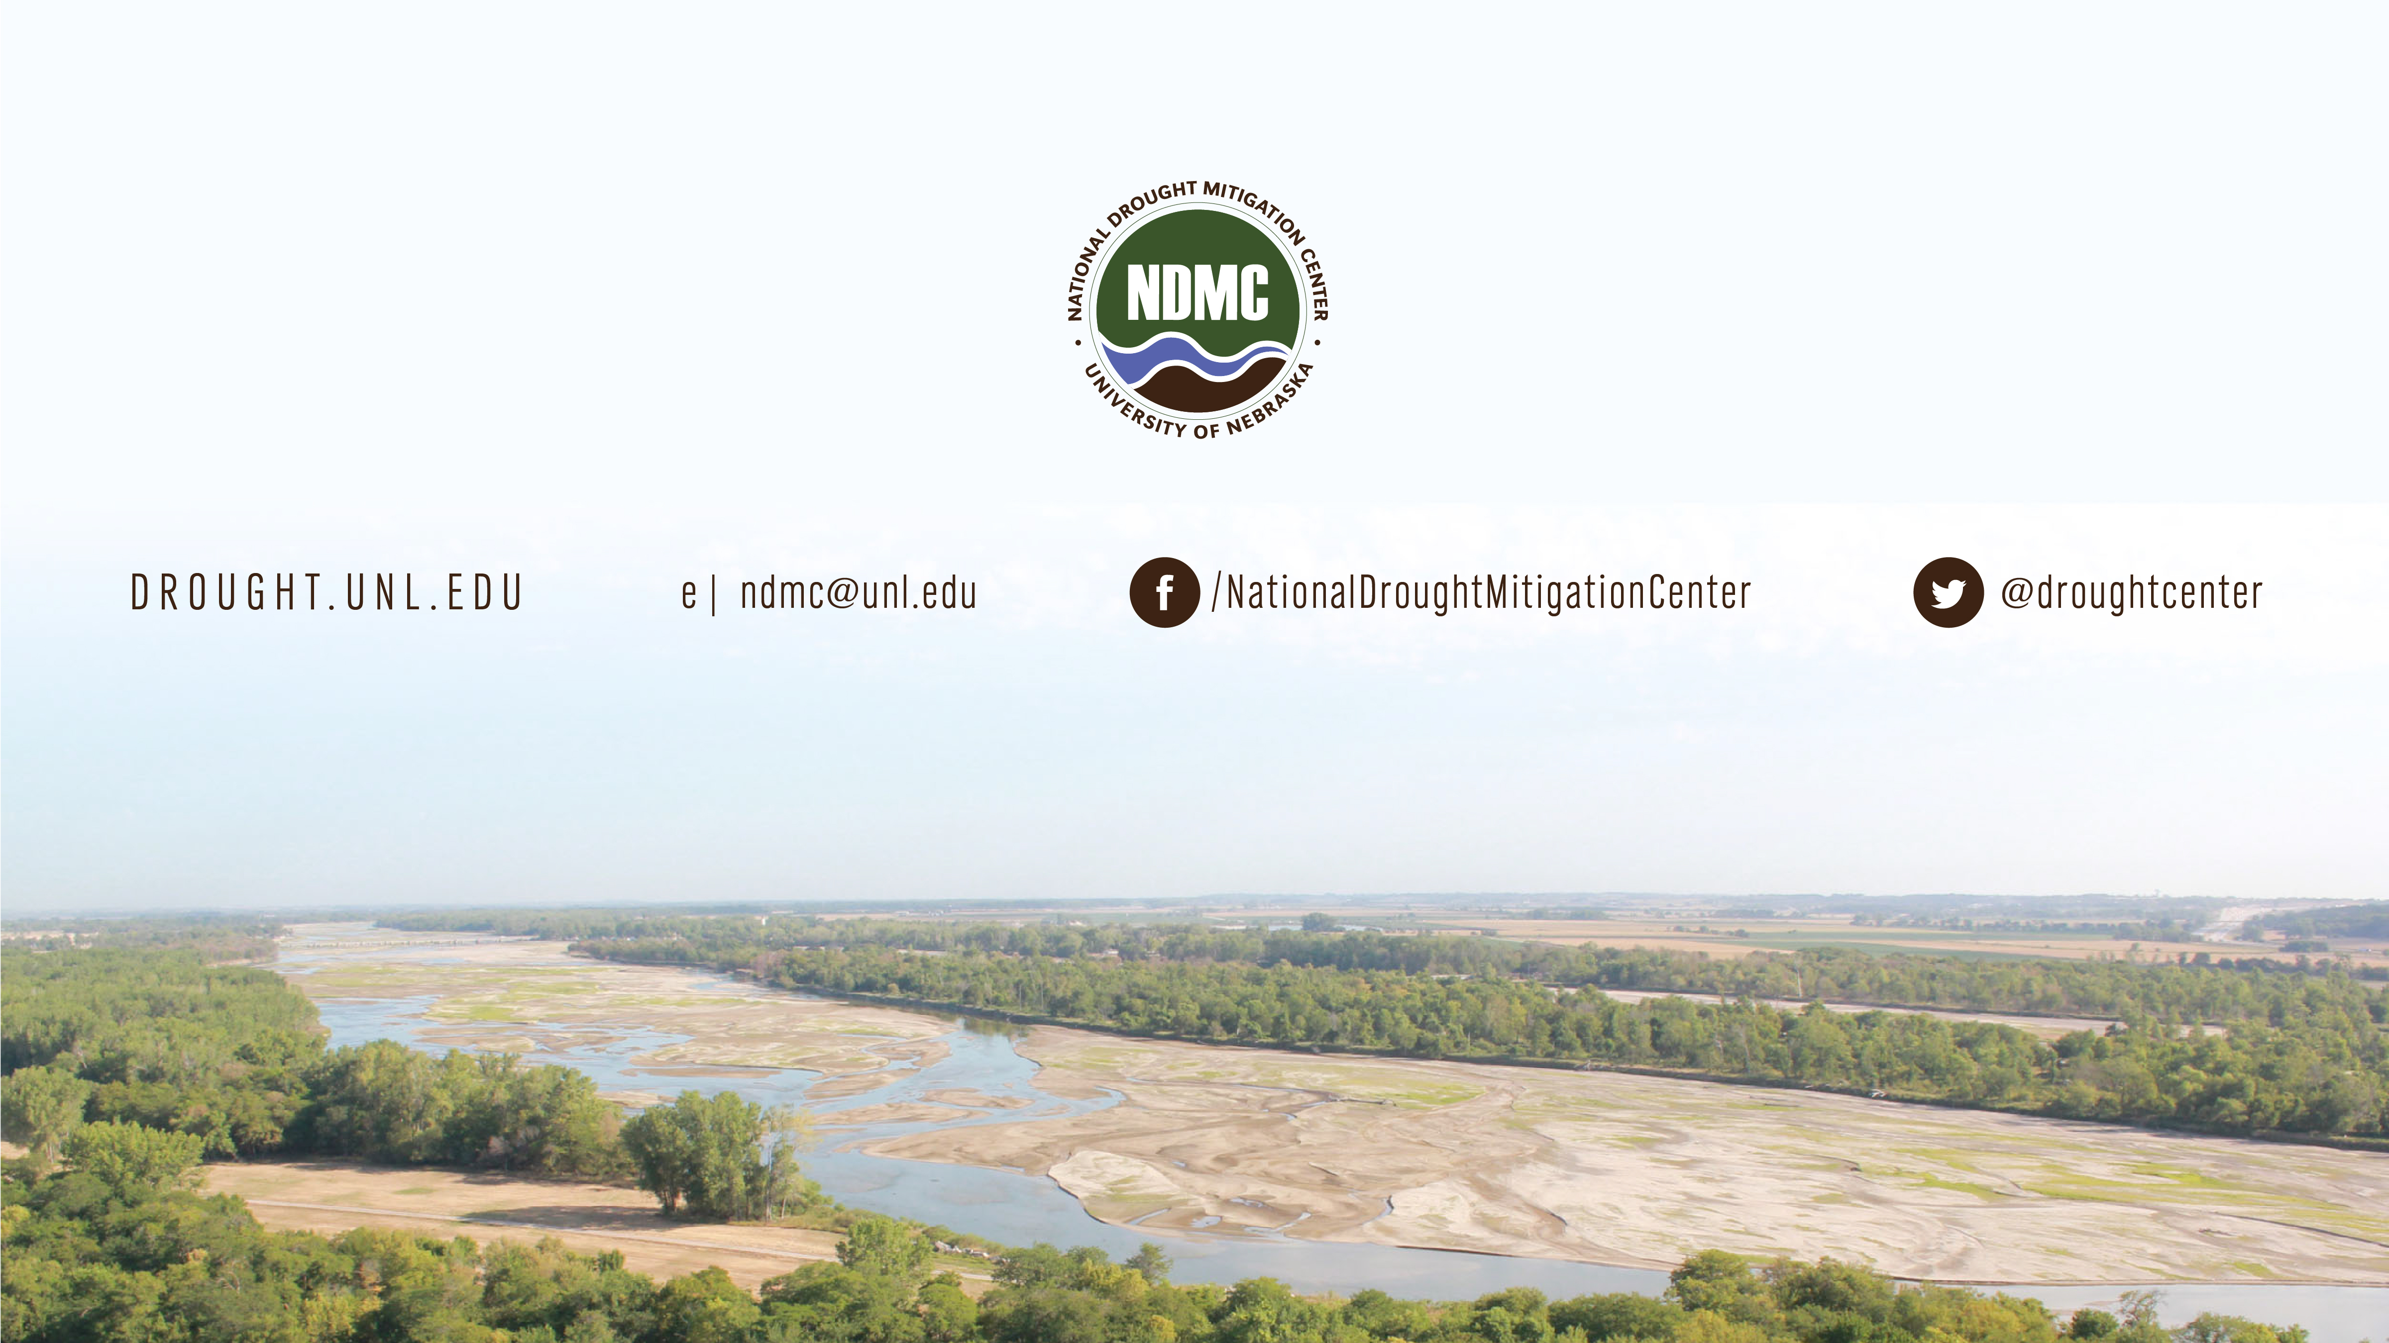
Brian Fuchs
bfuchs2@unl.edu
402-472-6775
National Drought Mitigation Center
School of Natural Resources
University of Nebraska-Lincoln

