Slide 1
Nebraska Climate Update
Martha D shulski
mshulski3@unl.edu
402-472-6711
School of natural resources
University of Nebraska LIncoln
CARC Meeting
8 April, 2022

Slide 2
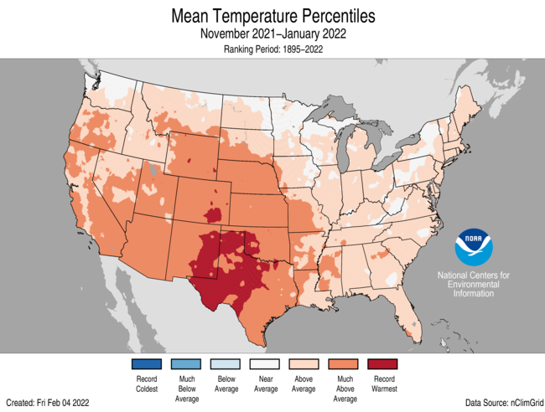
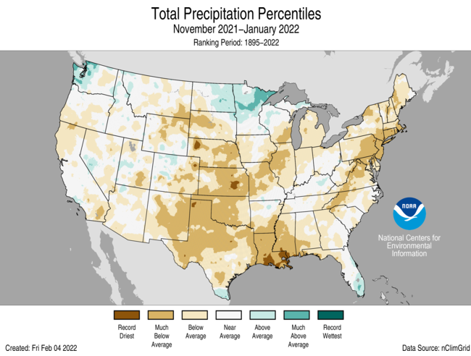
Recap
Nov – Jan | 5th warmest and 7th driest on record for Nebraska; dryness during our dry time of year; La Niña type of pattern
Source: https://ncdc.noaa.gov/temp-and-precip/us-maps/
Notes:
Here I outlined the similar trends for the Nebraska and global annual average temperature. I also point out the high variability in Nebraska and difference in regional vs. global scales. I use the analogy that global change is like an escalator that is increasing at an accelerating rate. The variability is like we jump up or down a few steps while still going up.

Slide 3
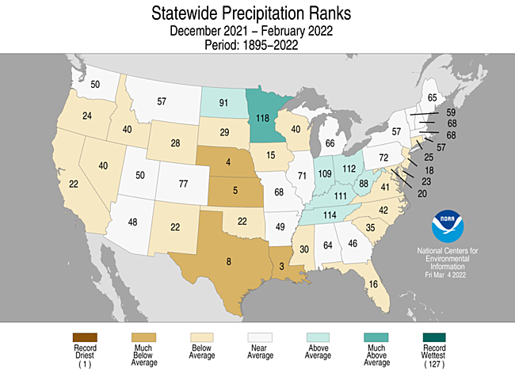
Recap
Winter (Dec – Feb) Precipitation
- Very dry in central and southern Plains.
- 4th driest for Nebraska (0.65” statewide avg, -1.17 below normal).
- Winter is our driest season (~8% annual total precipitation).
Source: https://ncdc.noaa.gov/temp-and-precip/us-maps/
Notes:
Here I outlined the similar trends for the Nebraska and global annual average temperature. I also point out the high variability in Nebraska and difference in regional vs. global scales. I use the analogy that global change is like an escalator that is increasing at an accelerating rate. The variability is like we jump up or down a few steps while still going up.

Slide 4
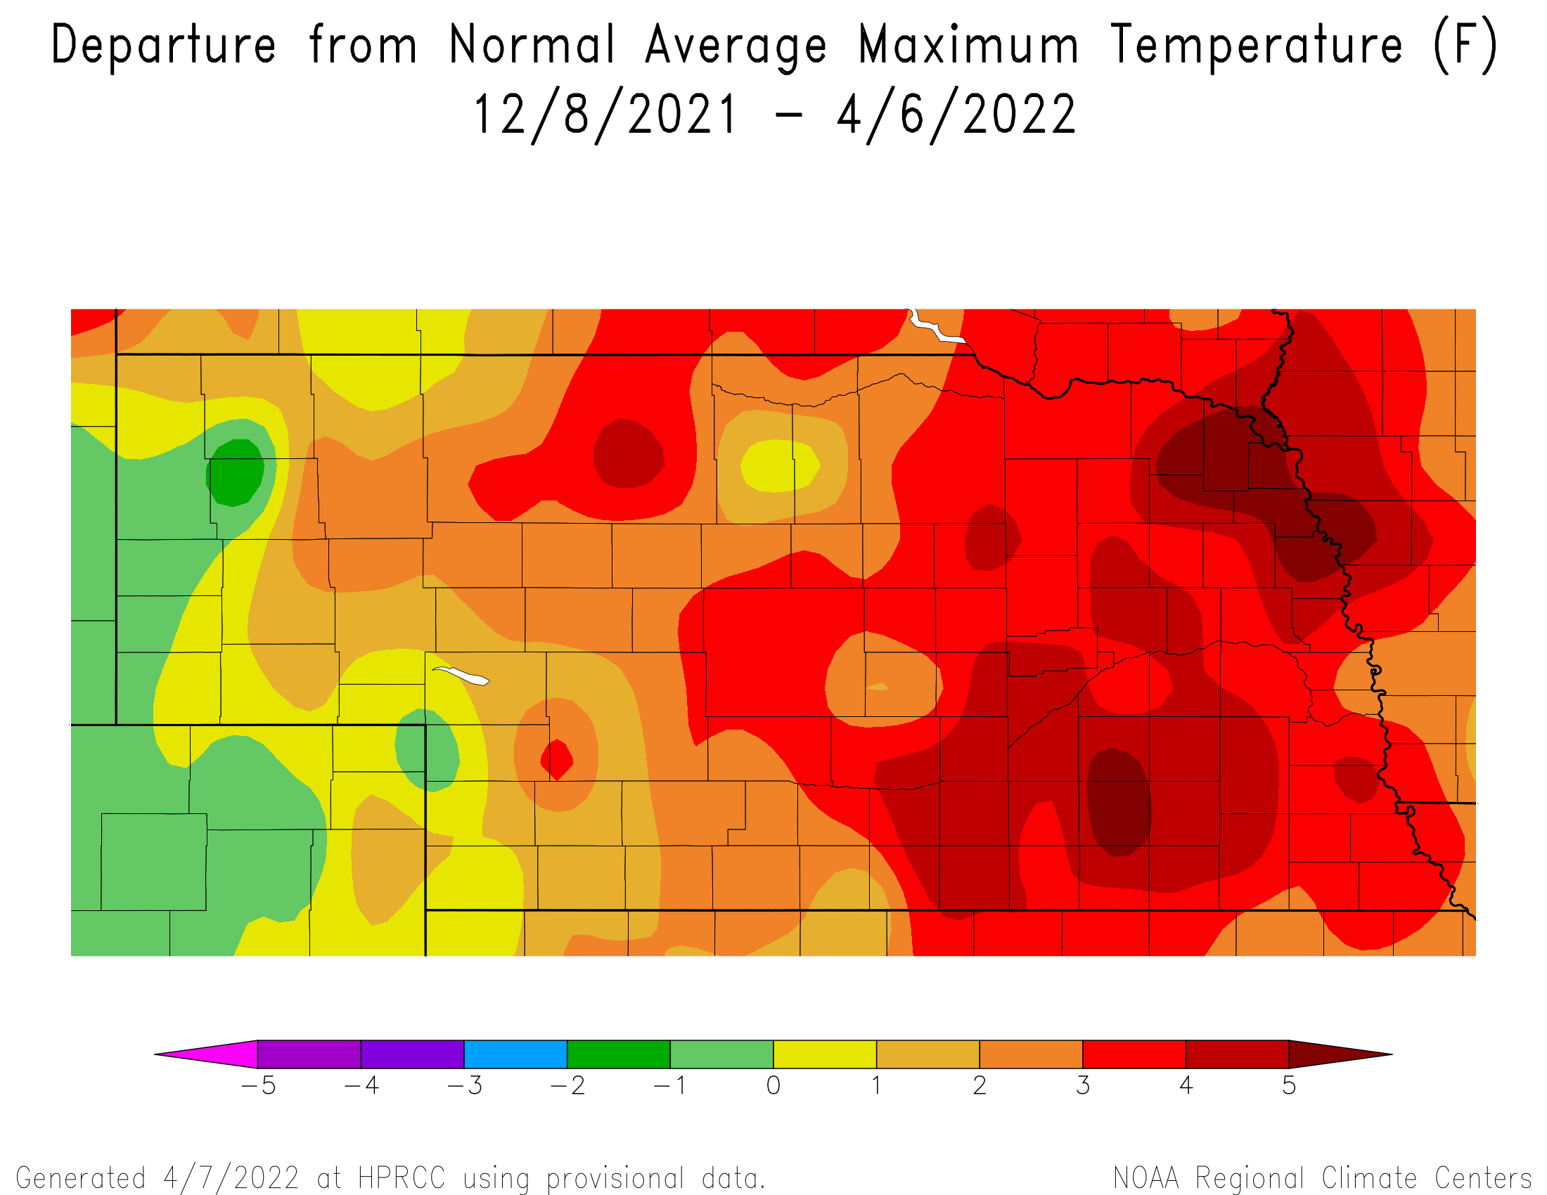
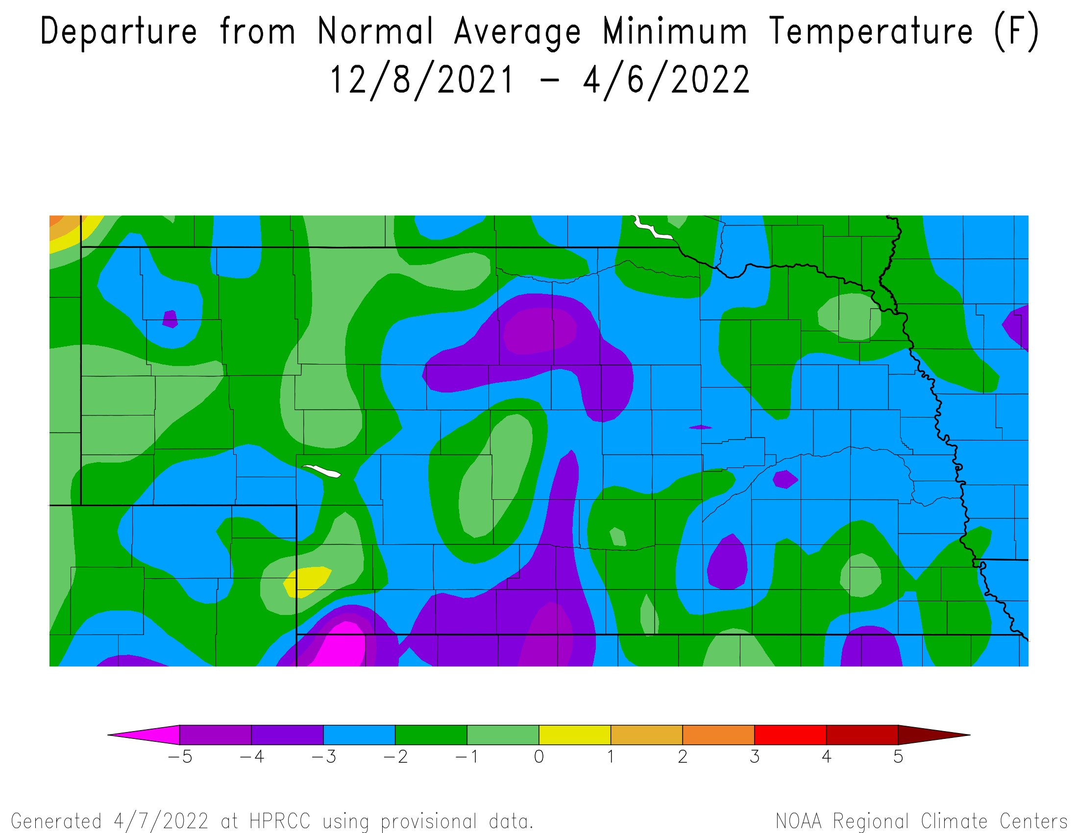
Recap
Temperatures – higher than normal highs and lower lows
Source: https://hprcc.unl.edu/maps.php?map=ACISClimateMaps
Notes:
Here I outlined the similar trends for the Nebraska and global annual average temperature. I also point out the high variability in Nebraska and difference in regional vs. global scales. I use the analogy that global change is like an escalator that is increasing at an accelerating rate. The variability is like we jump up or down a few steps while still going up.

Slide 5
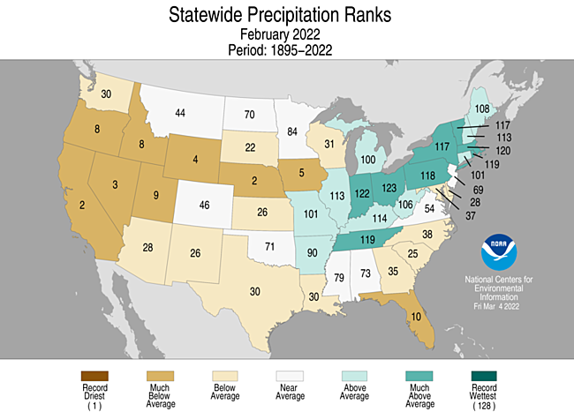
Recap
February precipitation
- Dry across much of the west.
- 2nd driest for Nebraska (0.11” statewide avg, ~0.5” departure).
Source: https://ncdc.noaa.gov/temp-and-precip/us-maps/
Notes:
Here I outlined the similar trends for the Nebraska and global annual average temperature. I also point out the high variability in Nebraska and difference in regional vs. global scales. I use the analogy that global change is like an escalator that is increasing at an accelerating rate. The variability is like we jump up or down a few steps while still going up.

Slide 6
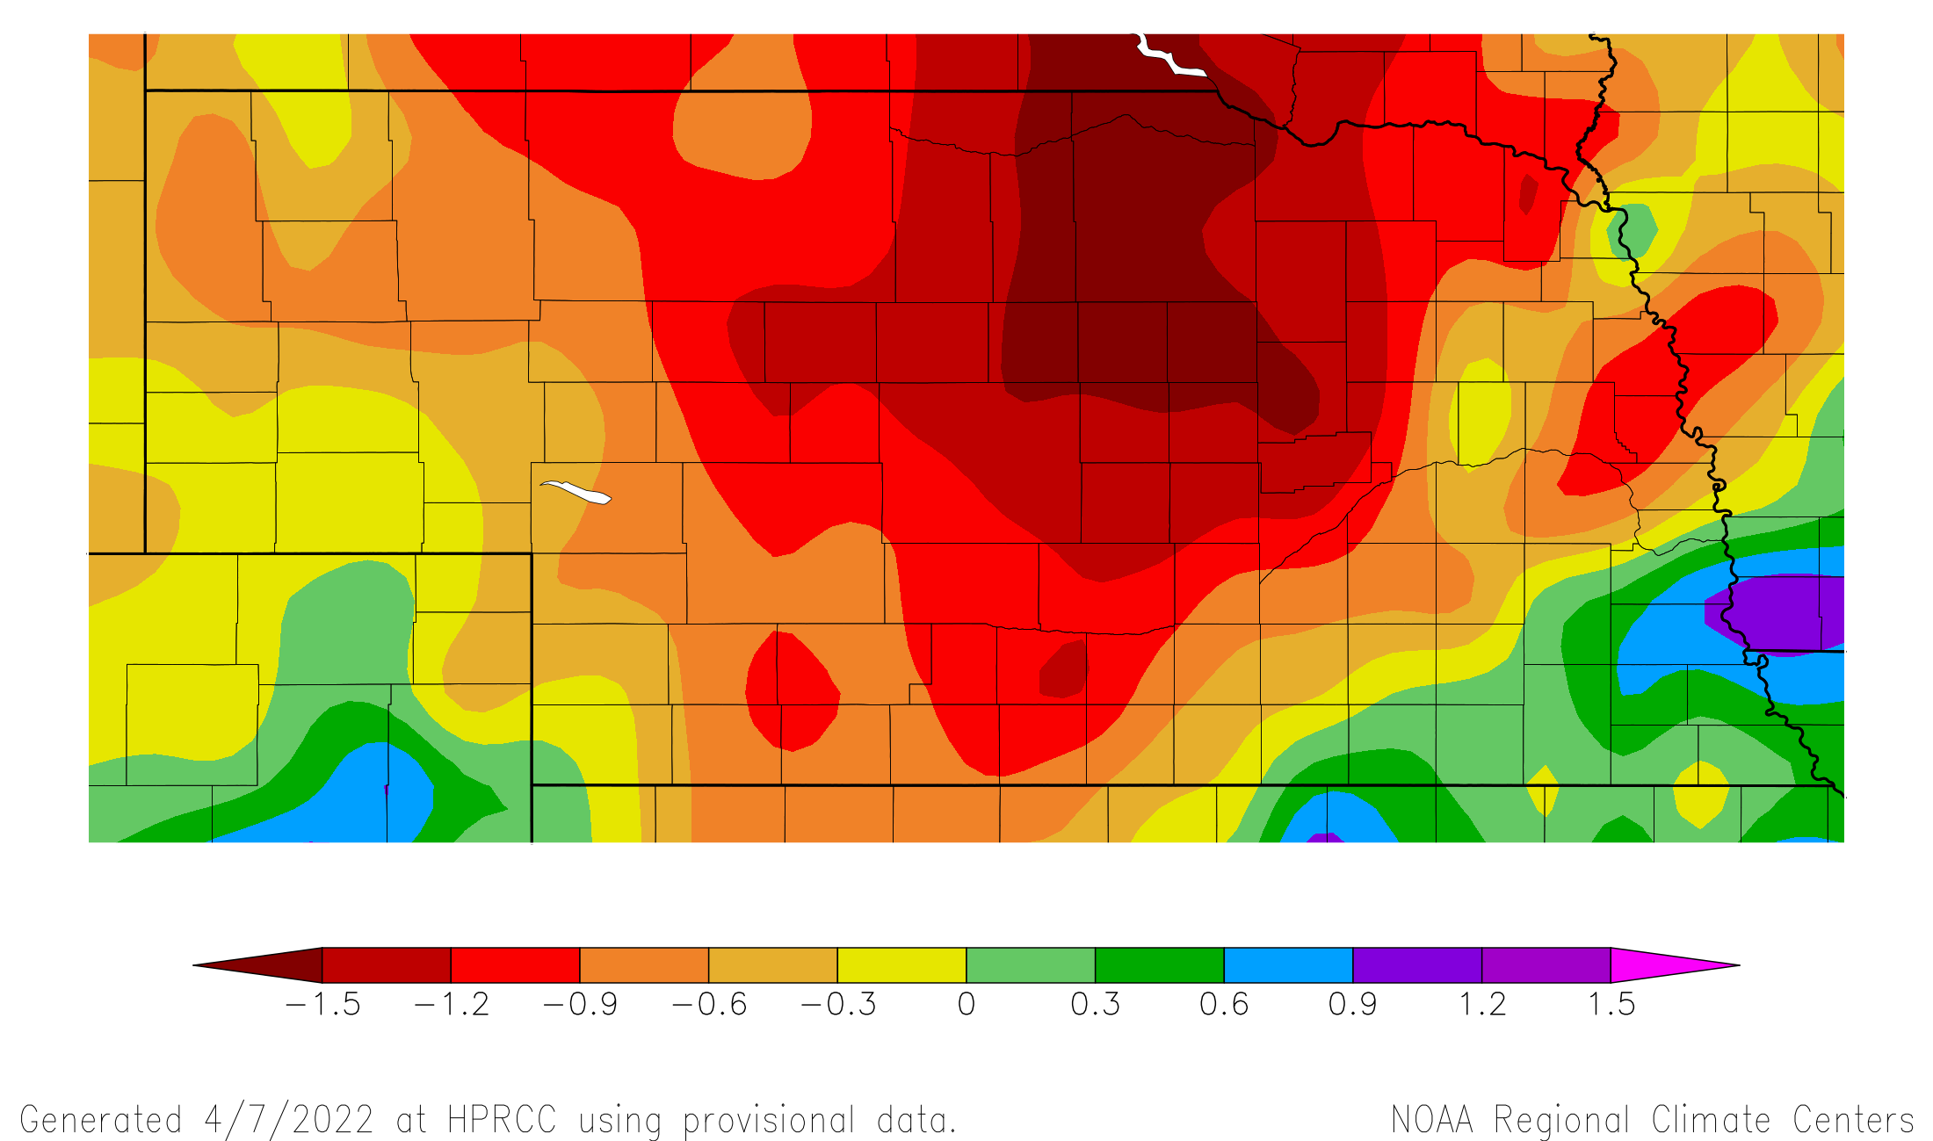
Recap
Precipitation | 1 month departure
30 day precipitation departure from normal
8 Mar – 6 Apr
Source: https:// hprcc.unl.edu/maps.php?map=ACISClimateMaps
Notes:
Here I outlined the similar trends for the Nebraska and global annual average temperature. I also point out the high variability in Nebraska and difference in regional vs. global scales. I use the analogy that global change is like an escalator that is increasing at an accelerating rate. The variability is like we jump up or down a few steps while still going up.

Slide 7
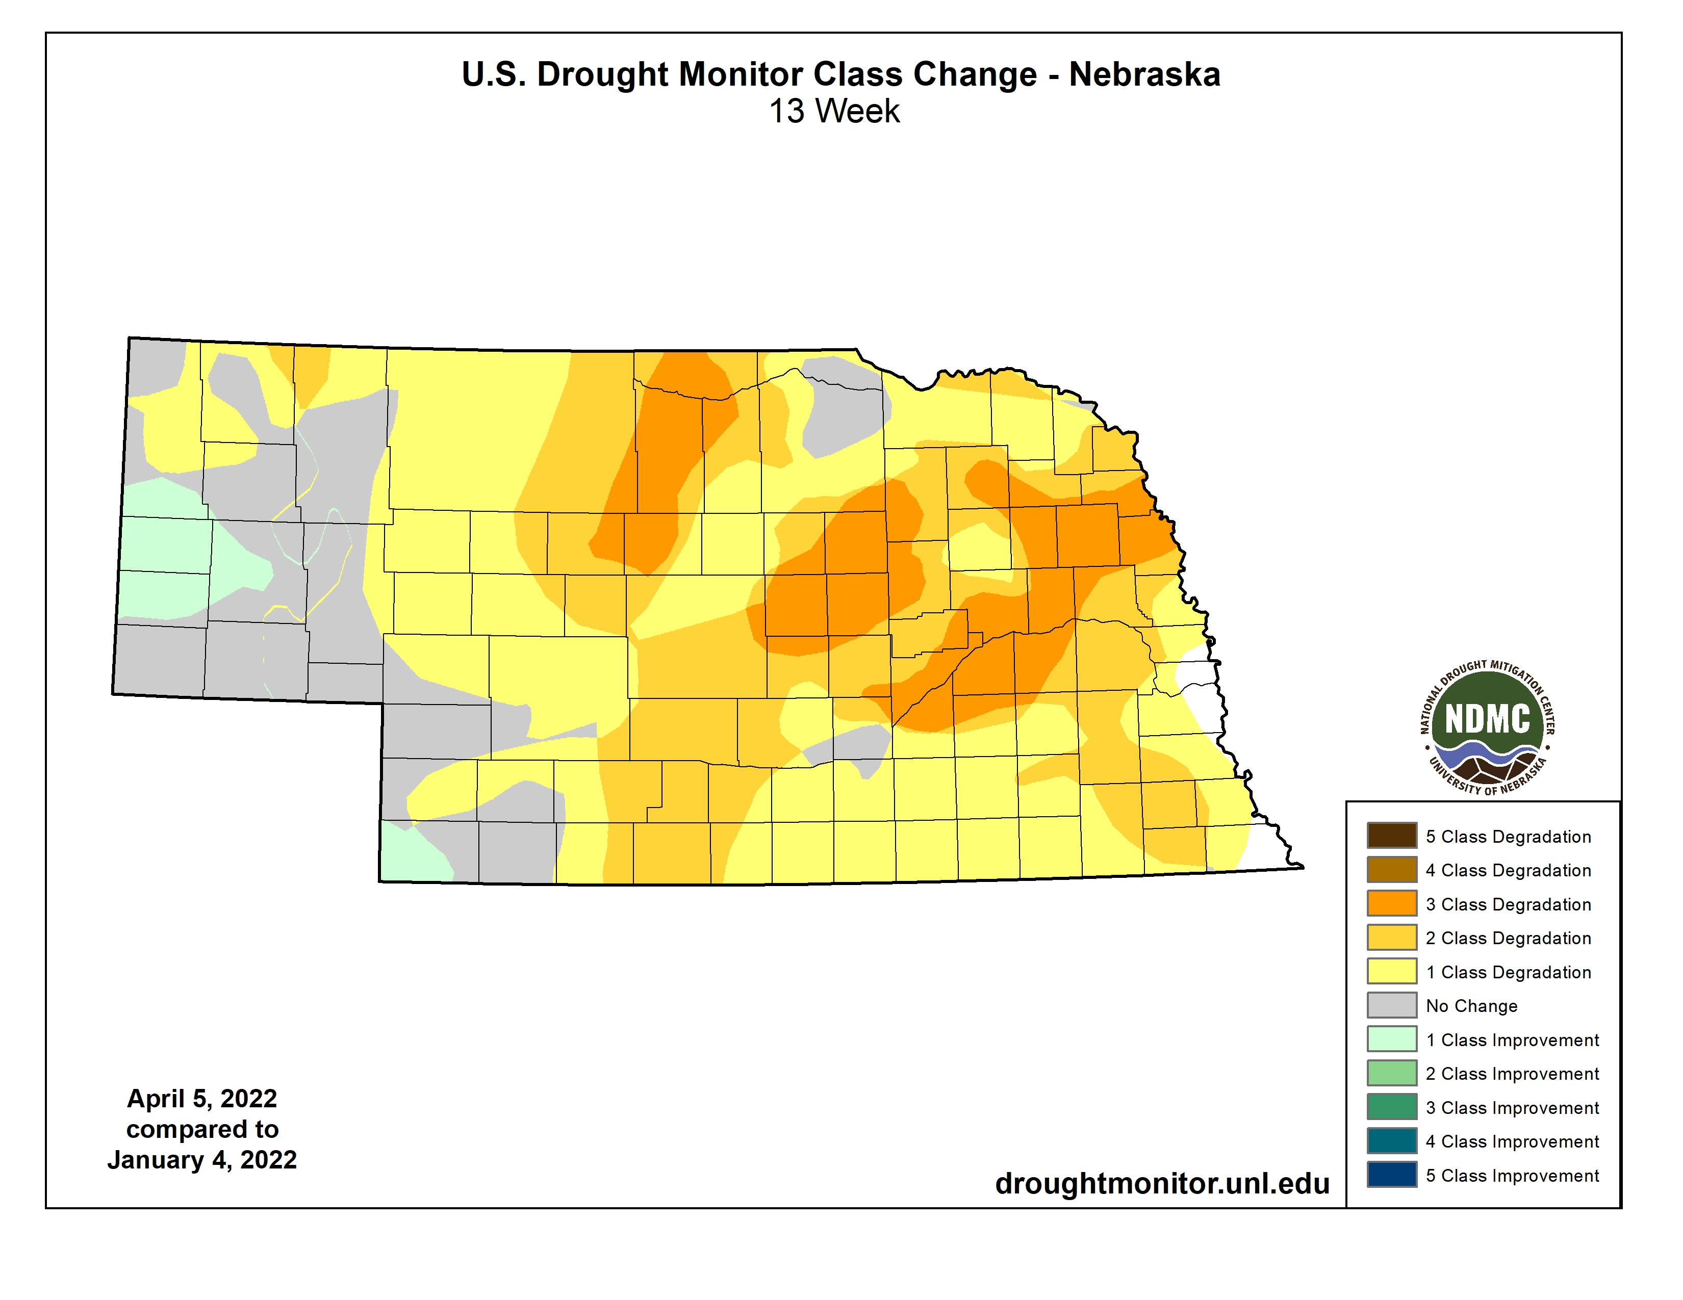
Drought history
Most severe degradations concentrated in east central.
Product of a dry winter.
Longer-term dryness issues in Panhandle, southwest, northeast.
Source: https://droughtmonitor.unl.edu/maps/
Notes:
Here I outlined the similar trends for the Nebraska and global annual average temperature. I also point out the high variability in Nebraska and difference in regional vs. global scales. I use the analogy that global change is like an escalator that is increasing at an accelerating rate. The variability is like we jump up or down a few steps while still going up.

Slide 8
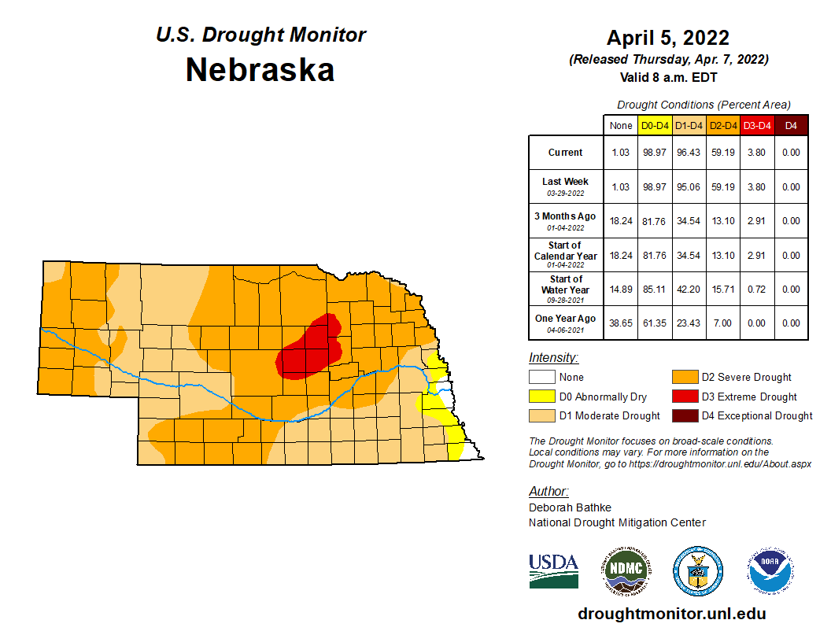
Drought
96% of state in drought conditions.
Both longer-term and shorter-term dryness.
Source: https://droughtmonitor.unl.edu/maps/
Notes:
Here I outlined the similar trends for the Nebraska and global annual average temperature. I also point out the high variability in Nebraska and difference in regional vs. global scales. I use the analogy that global change is like an escalator that is increasing at an accelerating rate. The variability is like we jump up or down a few steps while still going up.

Slide 9
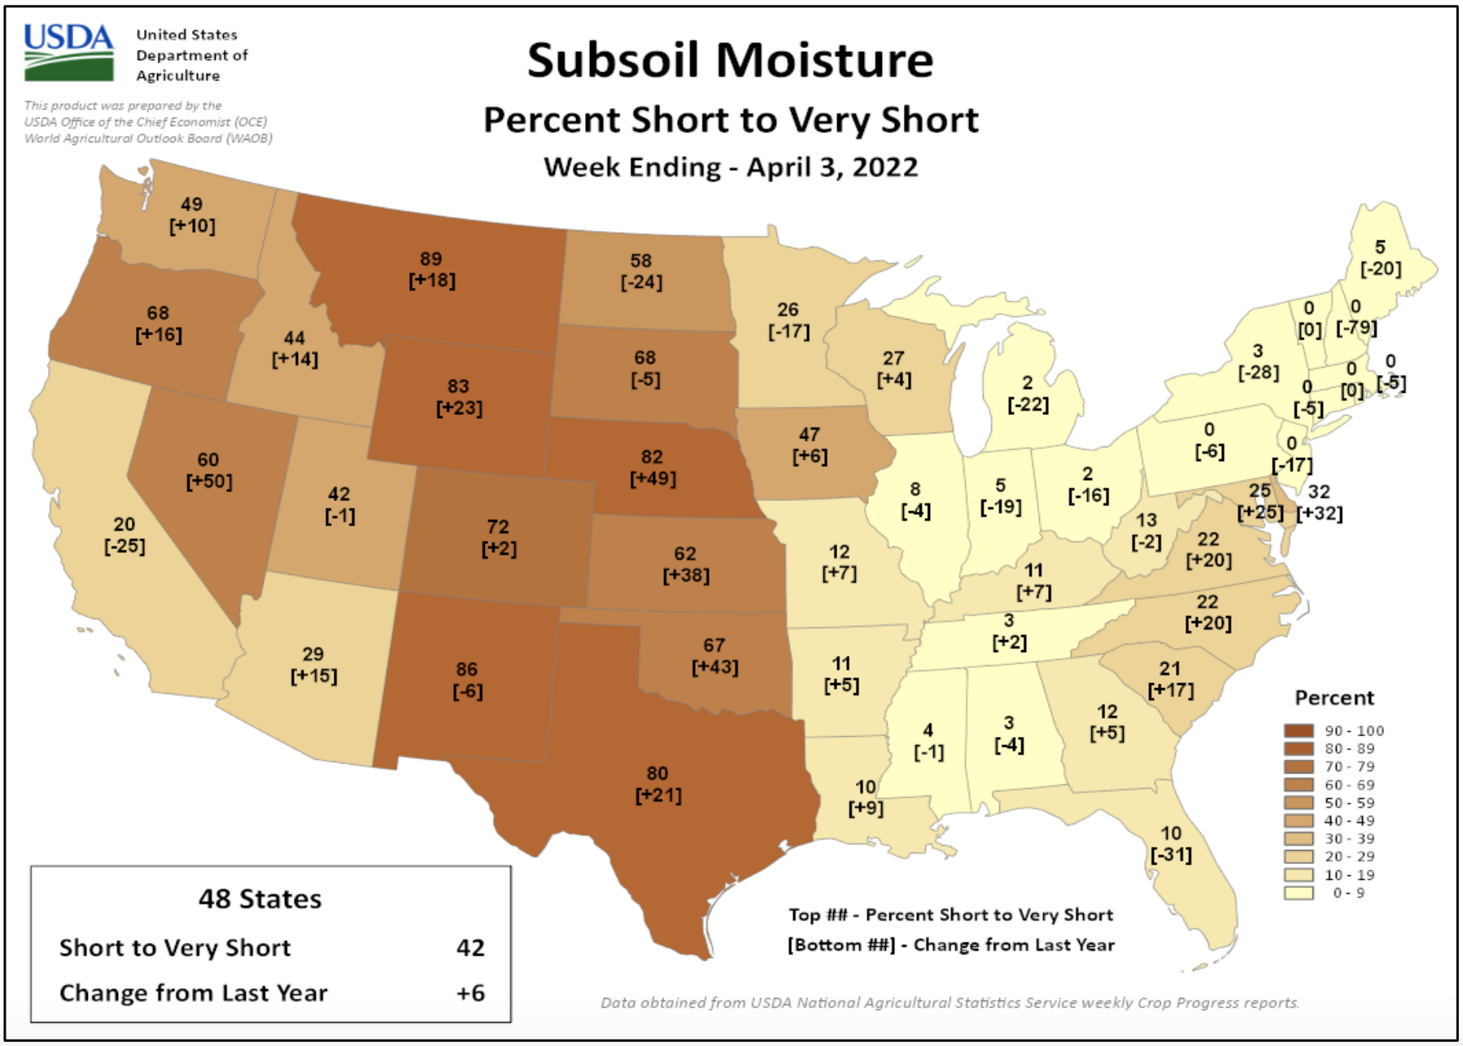
Soils
Soil moisture |
topsoil (6”) moisture 81% short to very short
subsoil 82% short to very short)
* short-very short: normal crop growth curtailed visible signs of stress
https:// www.usda.library.cornell.edu/concern/publications/cj82k728n?locale=en
Notes:
Here I outlined the similar trends for the Nebraska and global annual average temperature. I also point out the high variability in Nebraska and difference in regional vs. global scales. I use the analogy that global change is like an escalator that is increasing at an accelerating rate. The variability is like we jump up or down a few steps while still going up.

Slide 10
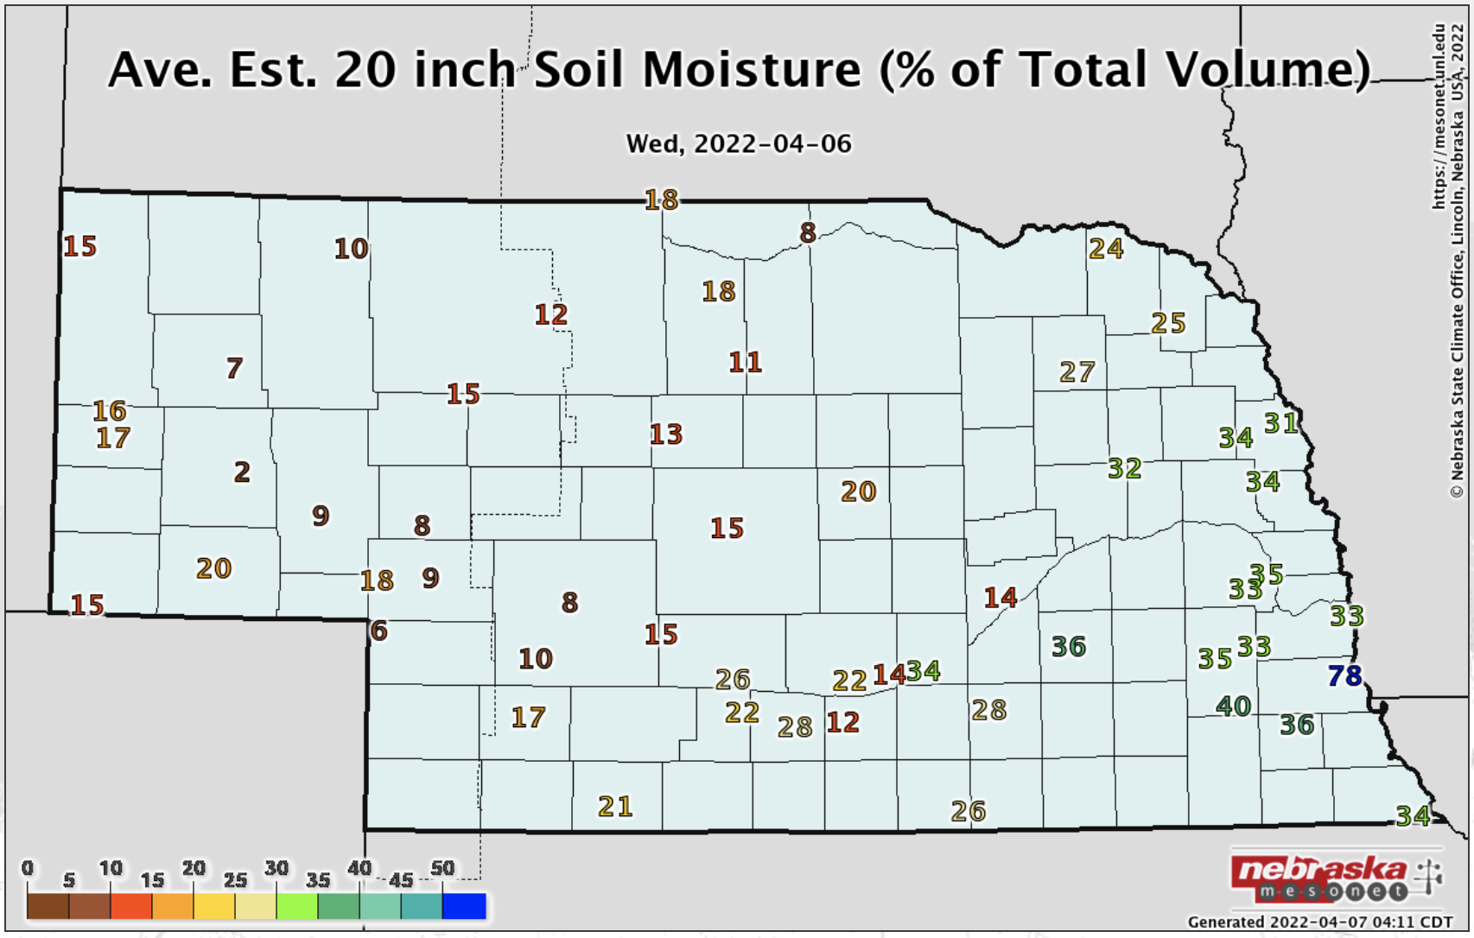
Soils
Soil moisture | Profiles for portions of south central and eastern Nebraska are not in bad shape. Much of state shows the dry conditions.
Notes:
Here I outlined the similar trends for the Nebraska and global annual average temperature. I also point out the high variability in Nebraska and difference in regional vs. global scales. I use the analogy that global change is like an escalator that is increasing at an accelerating rate. The variability is like we jump up or down a few steps while still going up.

Slide 11
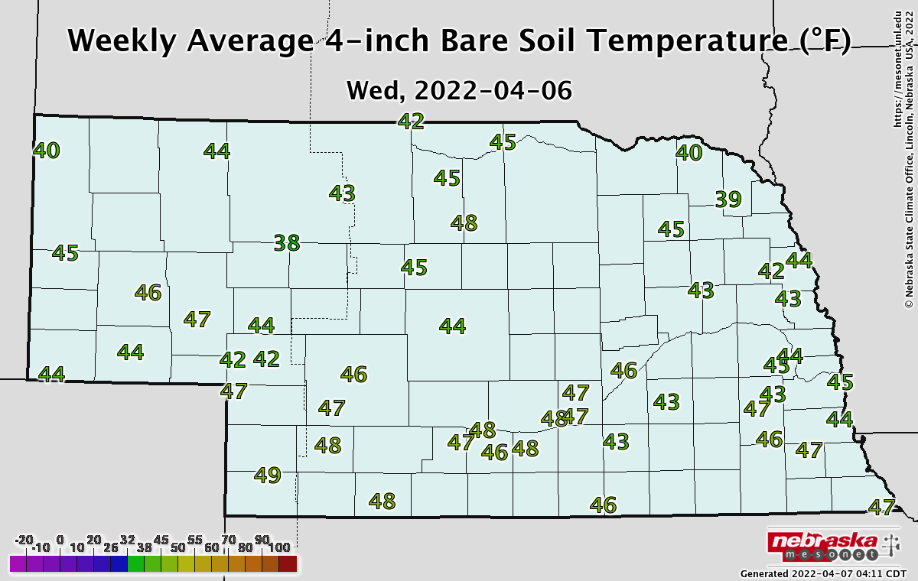
Soils
Soil temperature
- Weekly average temperatures in the 40s.
Notes:
Here I outlined the similar trends for the Nebraska and global annual average temperature. I also point out the high variability in Nebraska and difference in regional vs. global scales. I use the analogy that global change is like an escalator that is increasing at an accelerating rate. The variability is like we jump up or down a few steps while still going up.

Slide 12
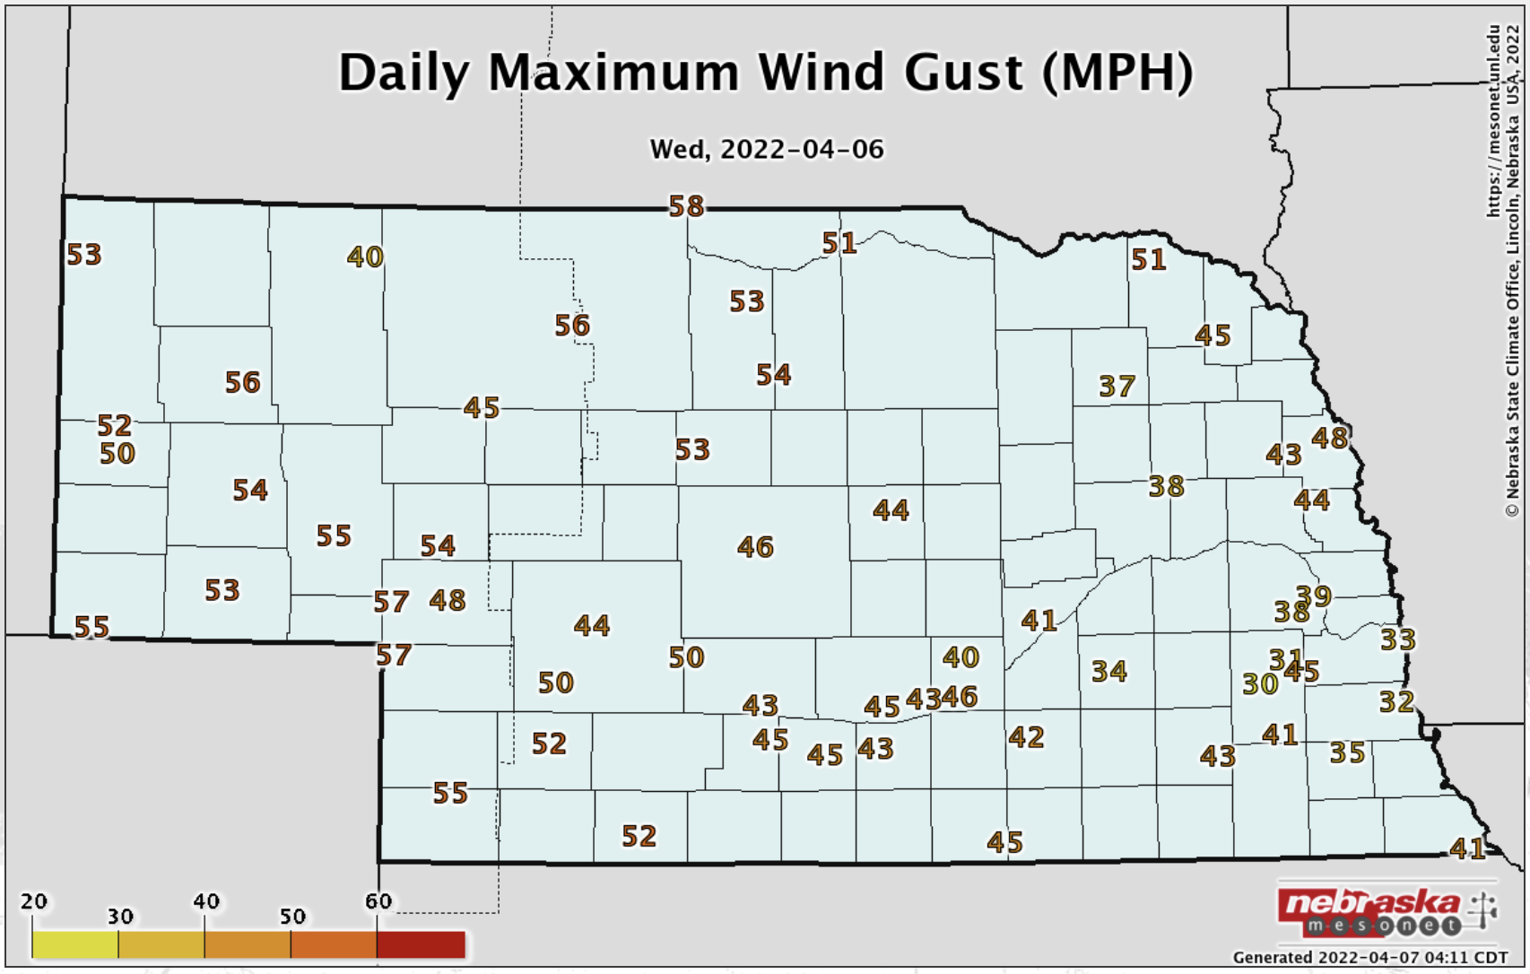
Wind
- High wind events are occurring when there are dry/very dry conditions.
Notes:
Here I outlined the similar trends for the Nebraska and global annual average temperature. I also point out the high variability in Nebraska and difference in regional vs. global scales. I use the analogy that global change is like an escalator that is increasing at an accelerating rate. The variability is like we jump up or down a few steps while still going up.

Slide 13
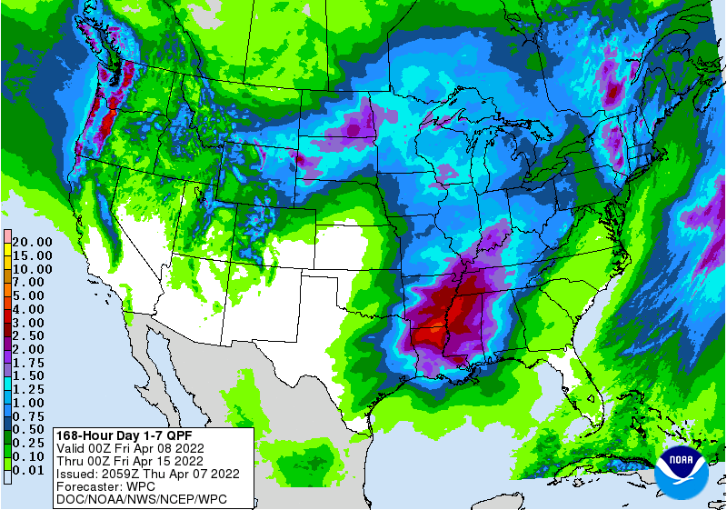
Precipitation outlook (Apr 8-15)
Some relief is possible, particularly for northwest quarter of the state.
https:// www.wpc.ncep.noaa.gov/qpf/day1-7.shtml
Notes:
Here I outlined the similar trends for the Nebraska and global annual average temperature. I also point out the high variability in Nebraska and difference in regional vs. global scales. I use the analogy that global change is like an escalator that is increasing at an accelerating rate. The variability is like we jump up or down a few steps while still going up.

Slide 14
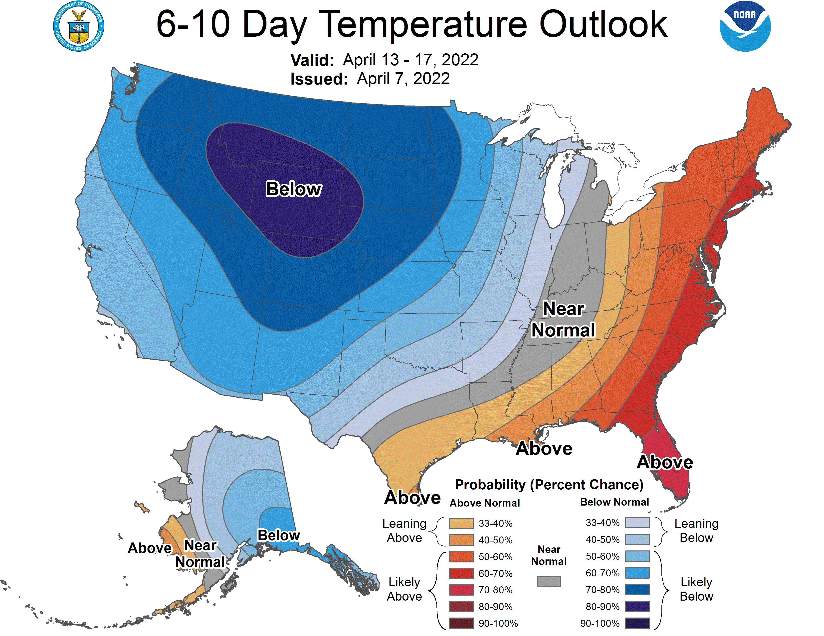
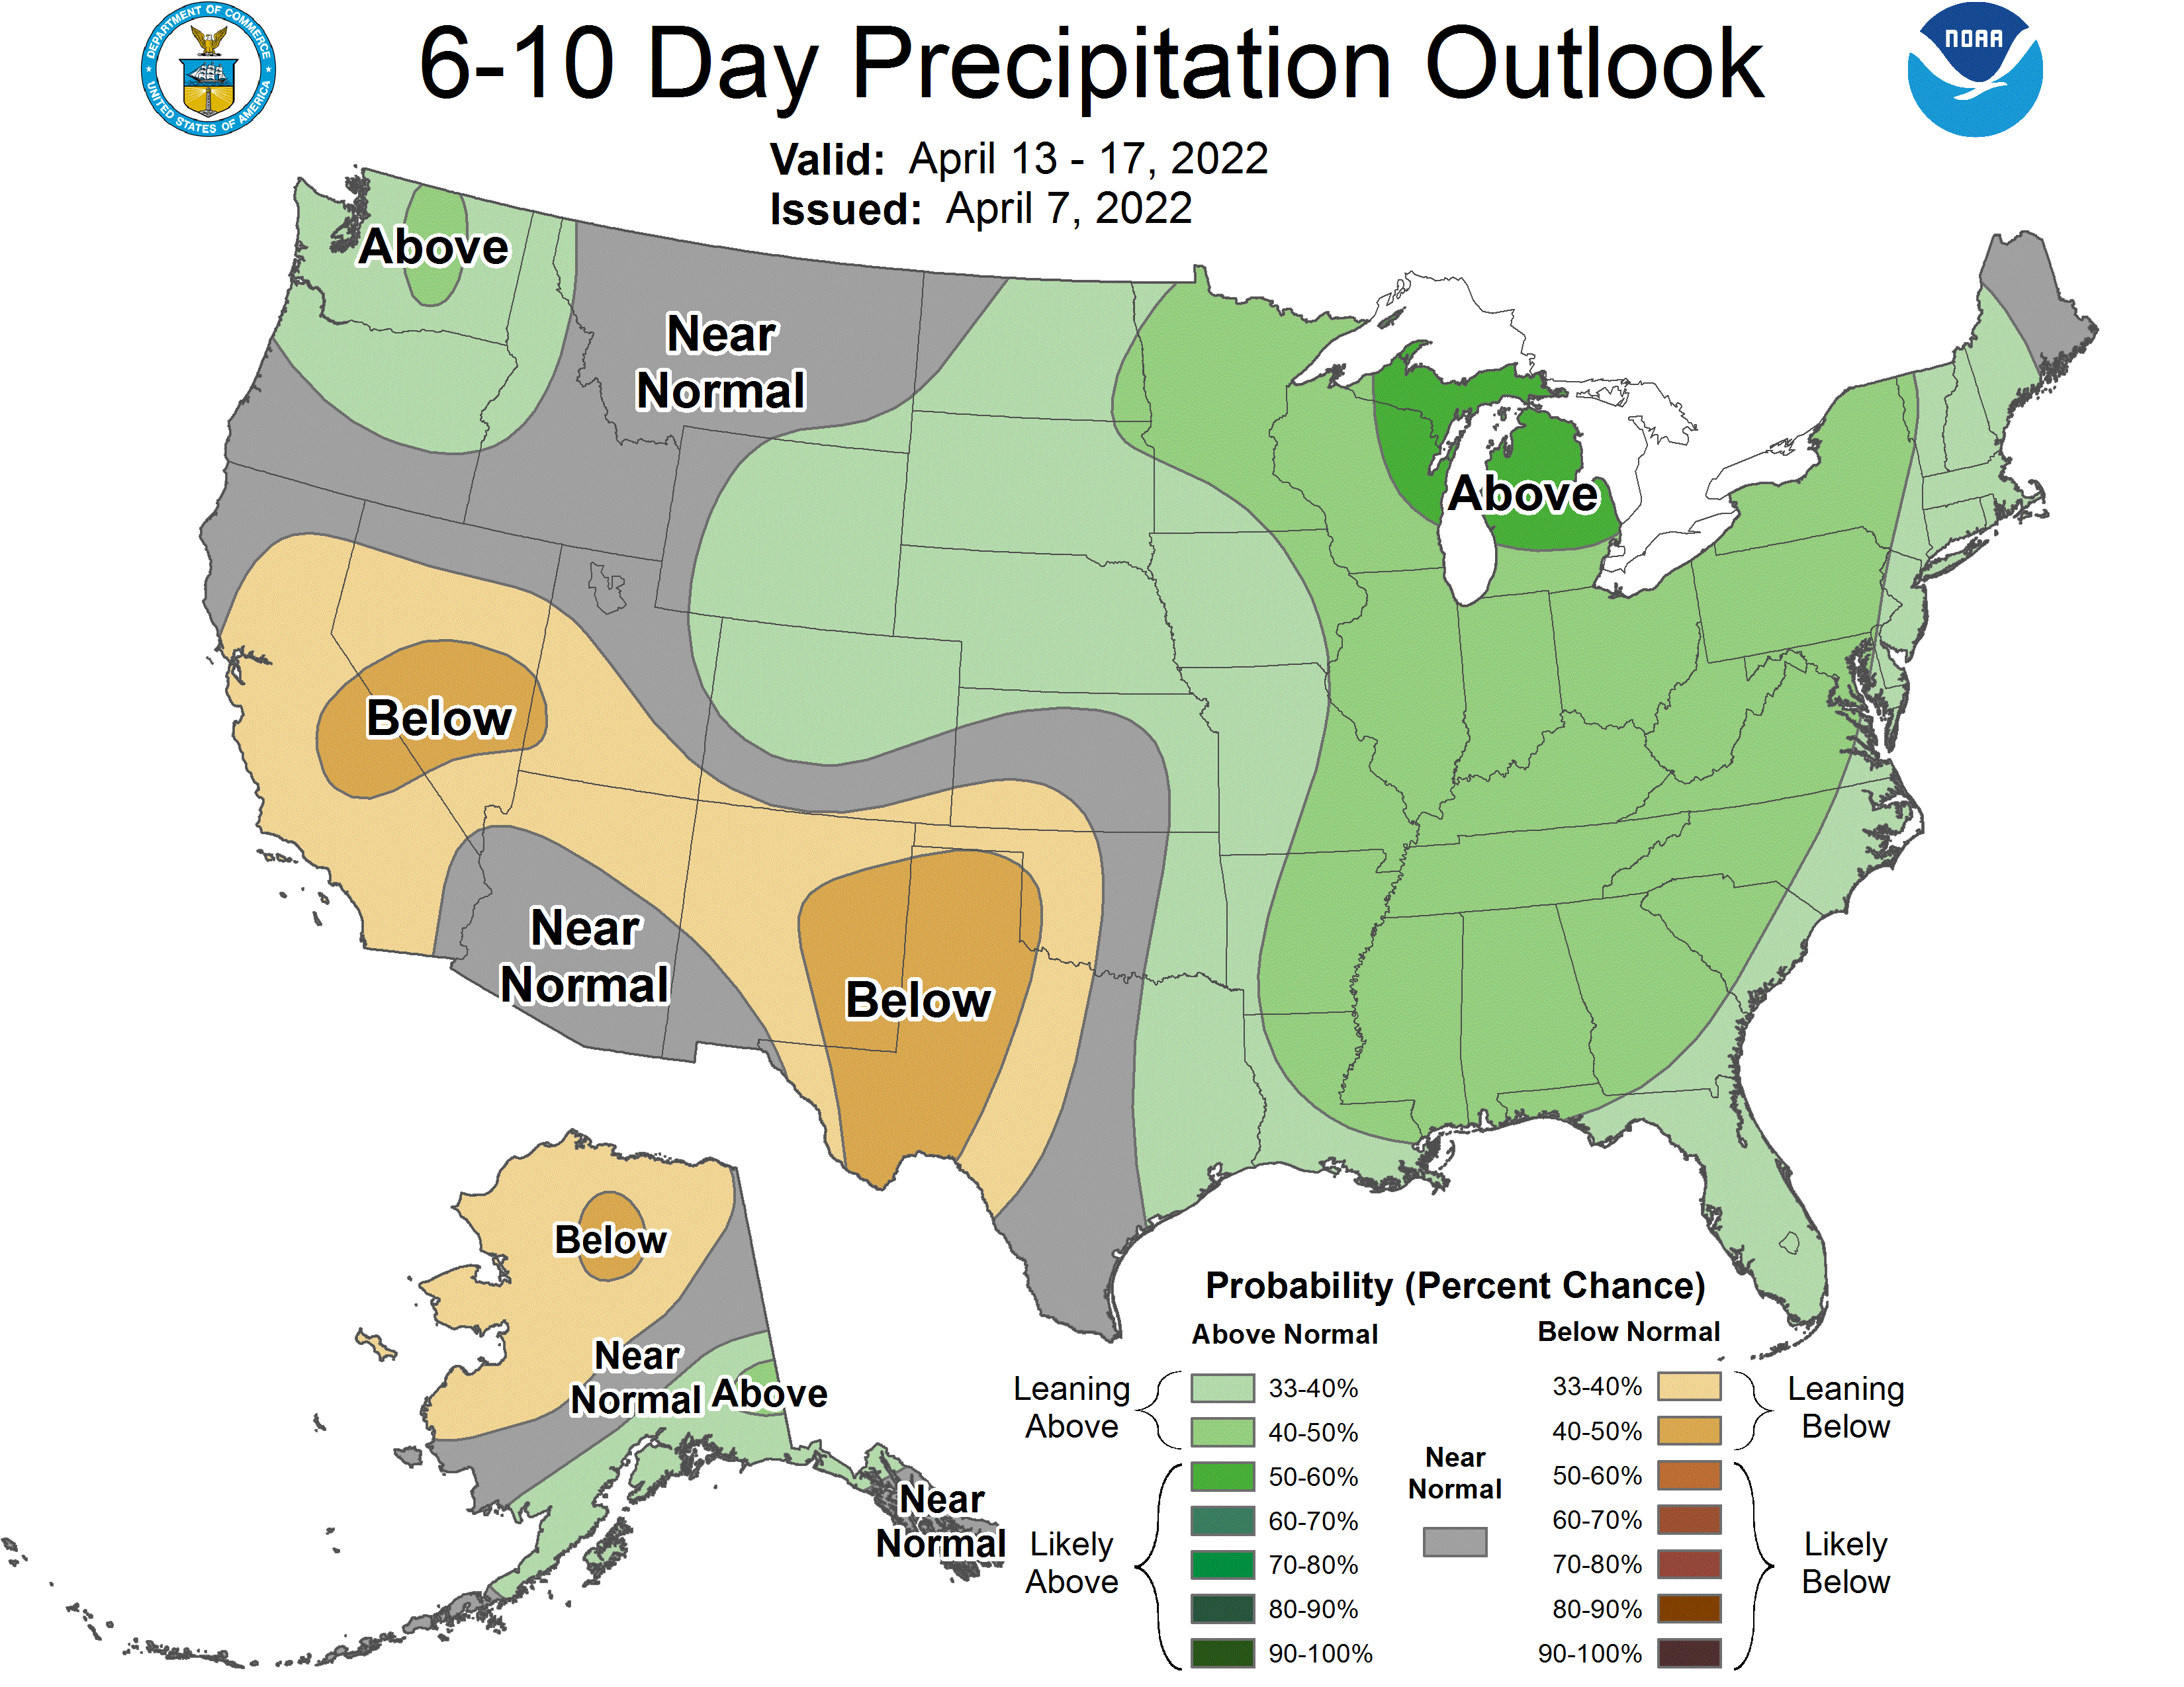
Short-term outlook
Good indication of below normal temperatures. Slight probability for wetter than normal.
Notes:
Here I outlined the similar trends for the Nebraska and global annual average temperature. I also point out the high variability in Nebraska and difference in regional vs. global scales. I use the analogy that global change is like an escalator that is increasing at an accelerating rate. The variability is like we jump up or down a few steps while still going up.

Slide 15
Agricultural implications
Reports of low stock ponds around the state.
Some considerations of herd culling due to grass concerns.
Doesn’t appear that warm planting weather will develop until the 17th.
The slow grass growth and dry vegetation will continue to be supportive of high fire danger for the next several weeks, minimum.
Notes:
Here I outlined the similar trends for the Nebraska and global annual average temperature. I also point out the high variability in Nebraska and difference in regional vs. global scales. I use the analogy that global change is like an escalator that is increasing at an accelerating rate. The variability is like we jump up or down a few steps while still going up.

Slide 16
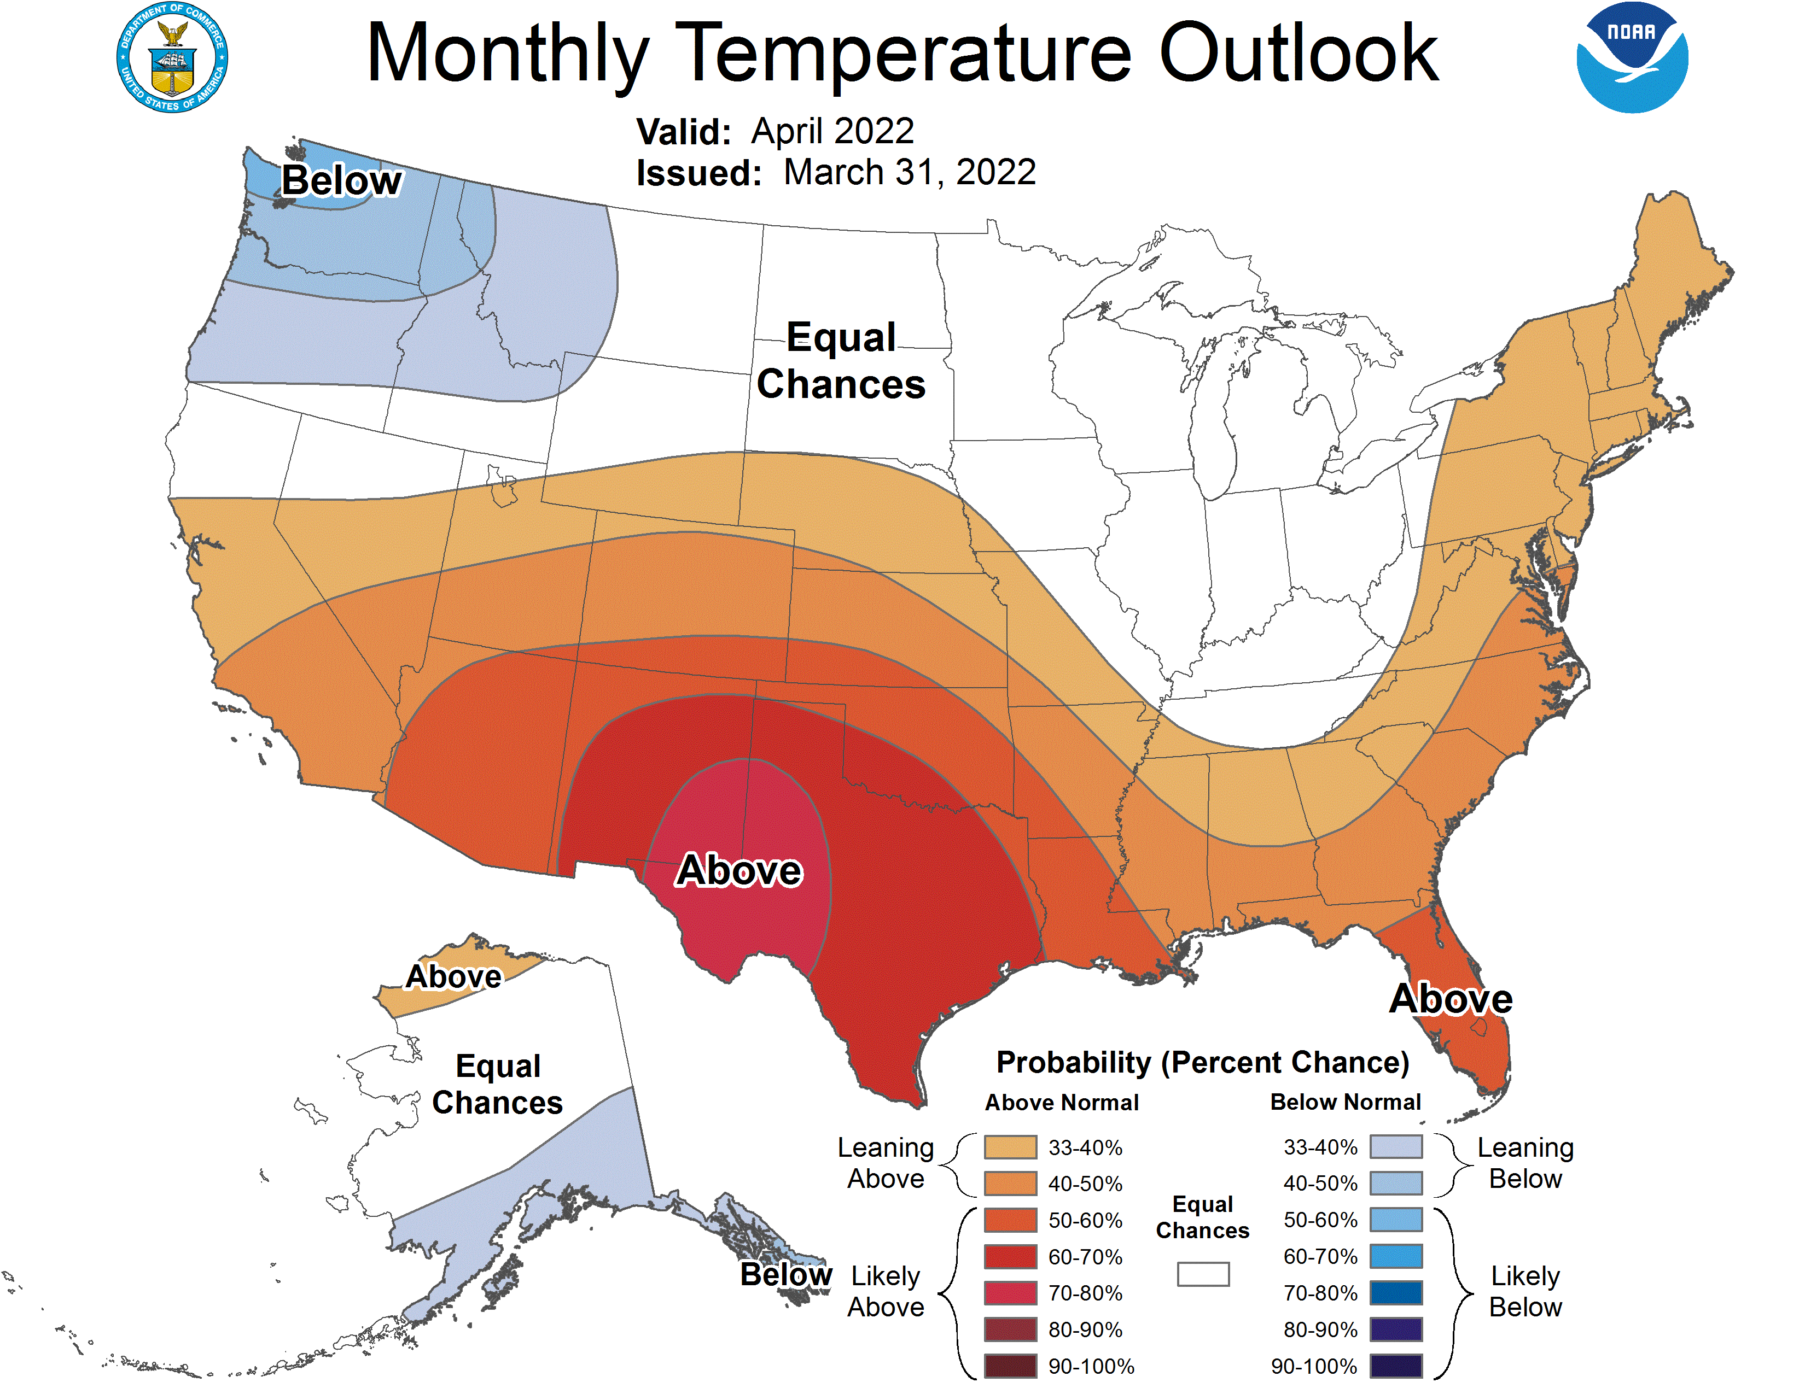
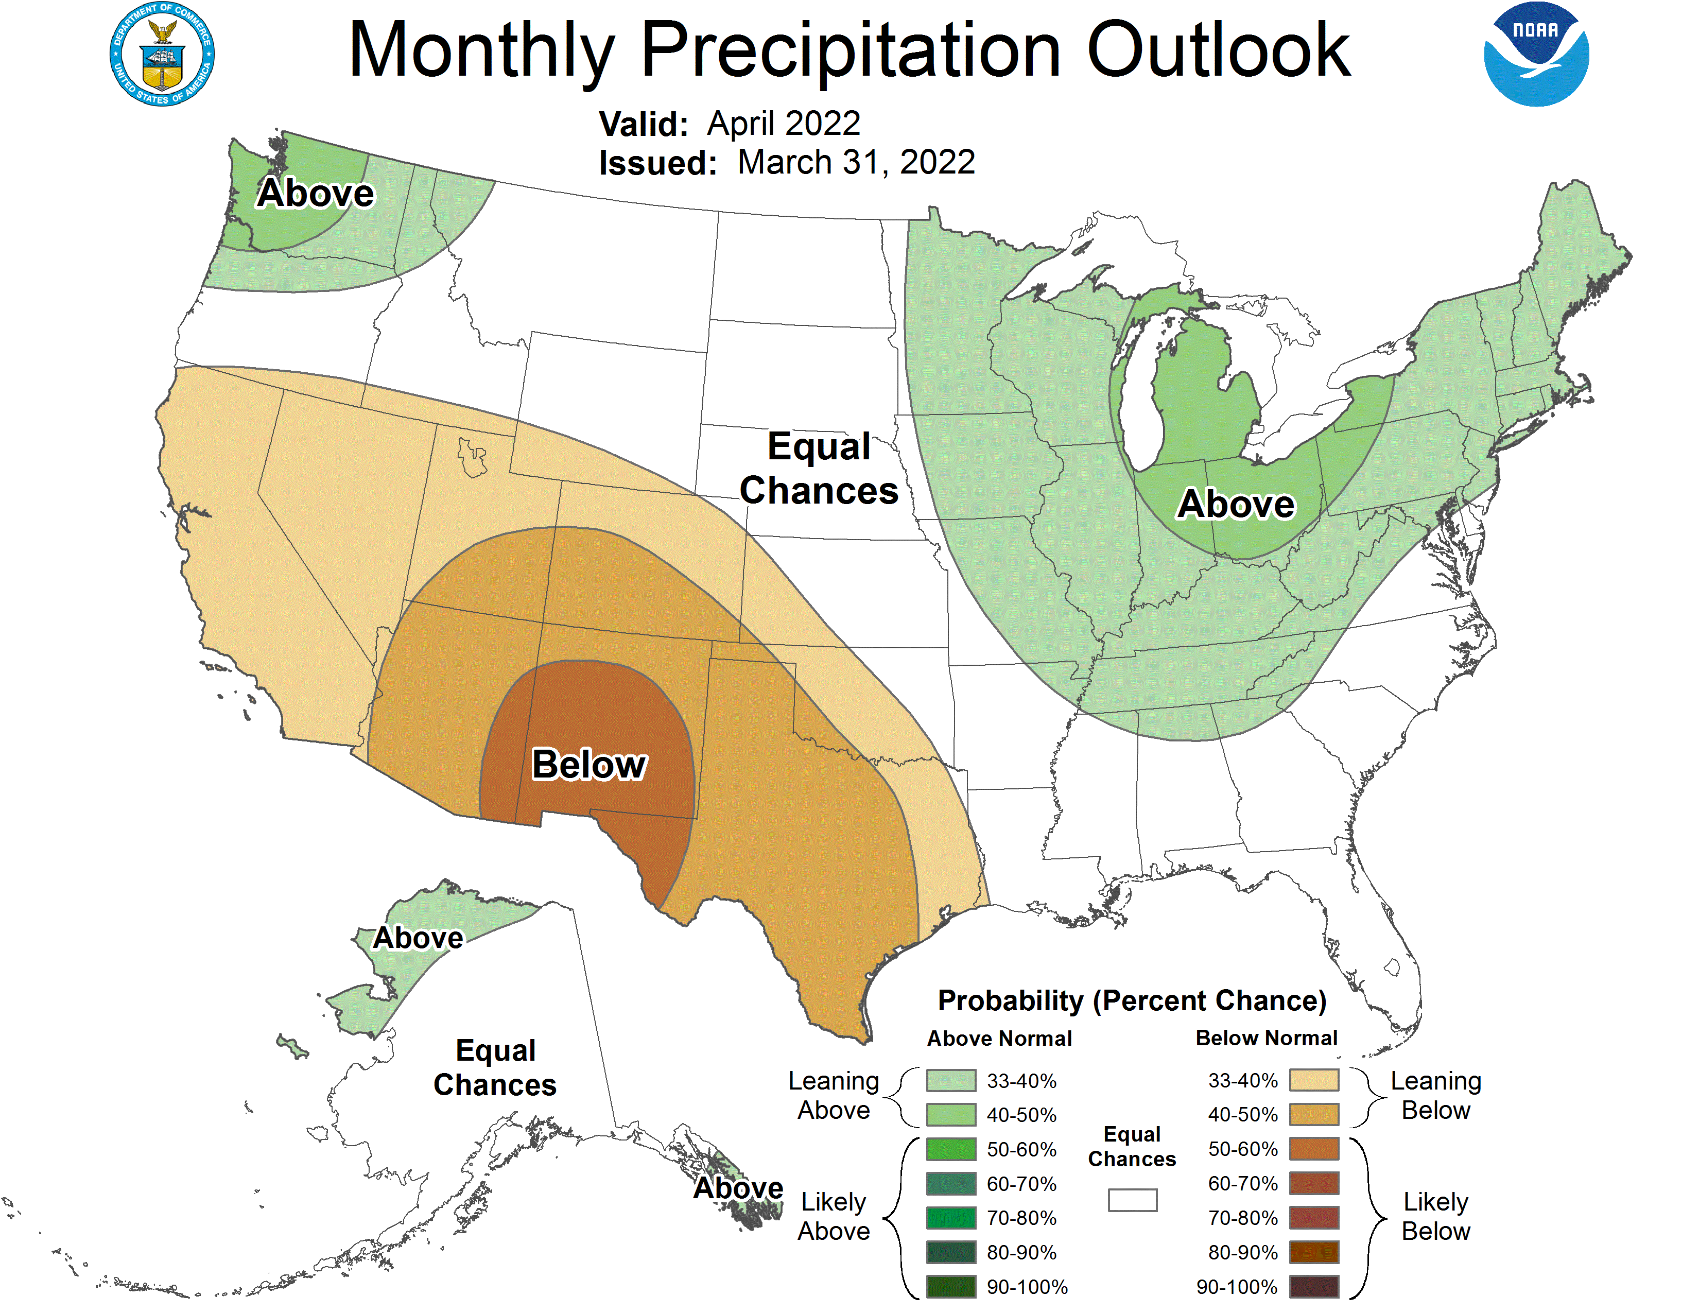
April climate outlook
- Above normal temperature probabilities for Nebraska. Equal chances of above / below normal precipitation.
https://www.cpc.ncep.noaa.gov/
Notes:
Here I outlined the similar trends for the Nebraska and global annual average temperature. I also point out the high variability in Nebraska and difference in regional vs. global scales. I use the analogy that global change is like an escalator that is increasing at an accelerating rate. The variability is like we jump up or down a few steps while still going up.

Slide 17
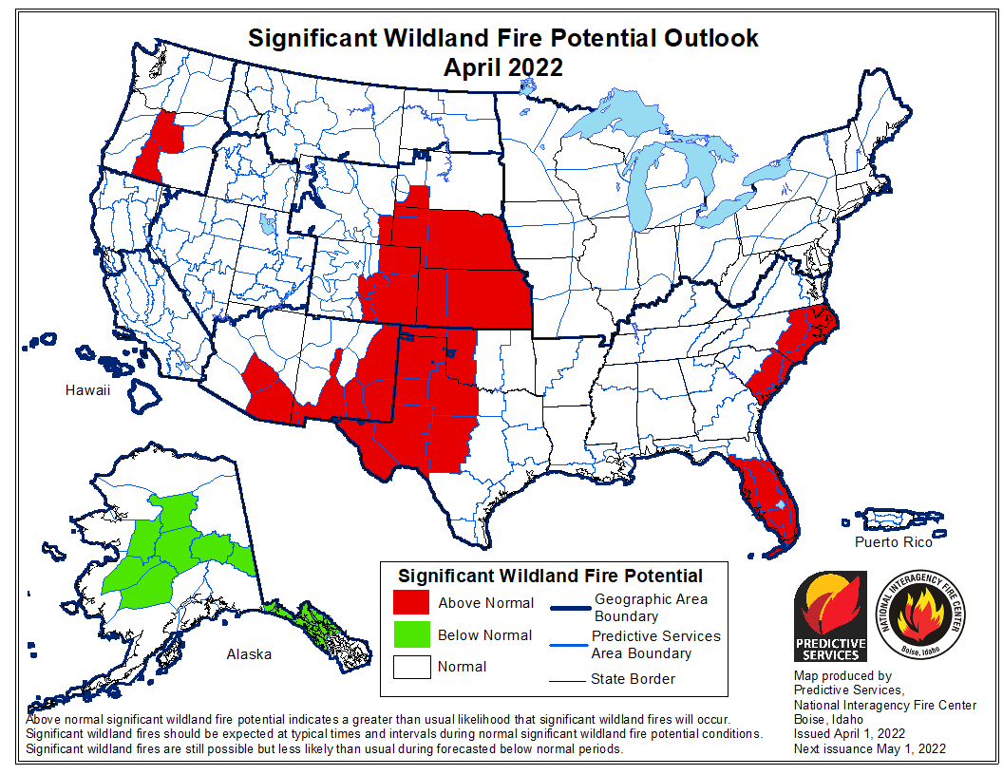
Wildfire risk outlook - April
Nebraska is in the above normal category.
Indicates a greater than usual likelihood that significant wildland fires will occur.
https://www.predictiveservices.nifc.gov/outlooks/outlooks.htm
Notes:
Here I outlined the similar trends for the Nebraska and global annual average temperature. I also point out the high variability in Nebraska and difference in regional vs. global scales. I use the analogy that global change is like an escalator that is increasing at an accelerating rate. The variability is like we jump up or down a few steps while still going up.

Slide 18
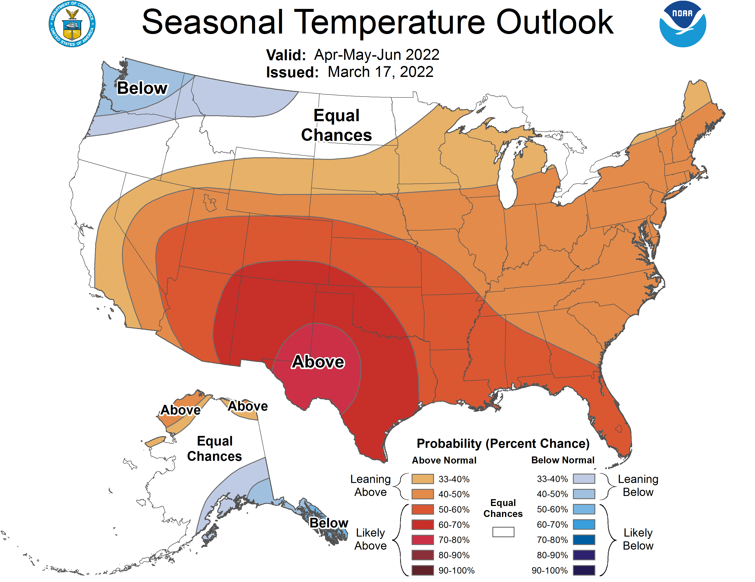
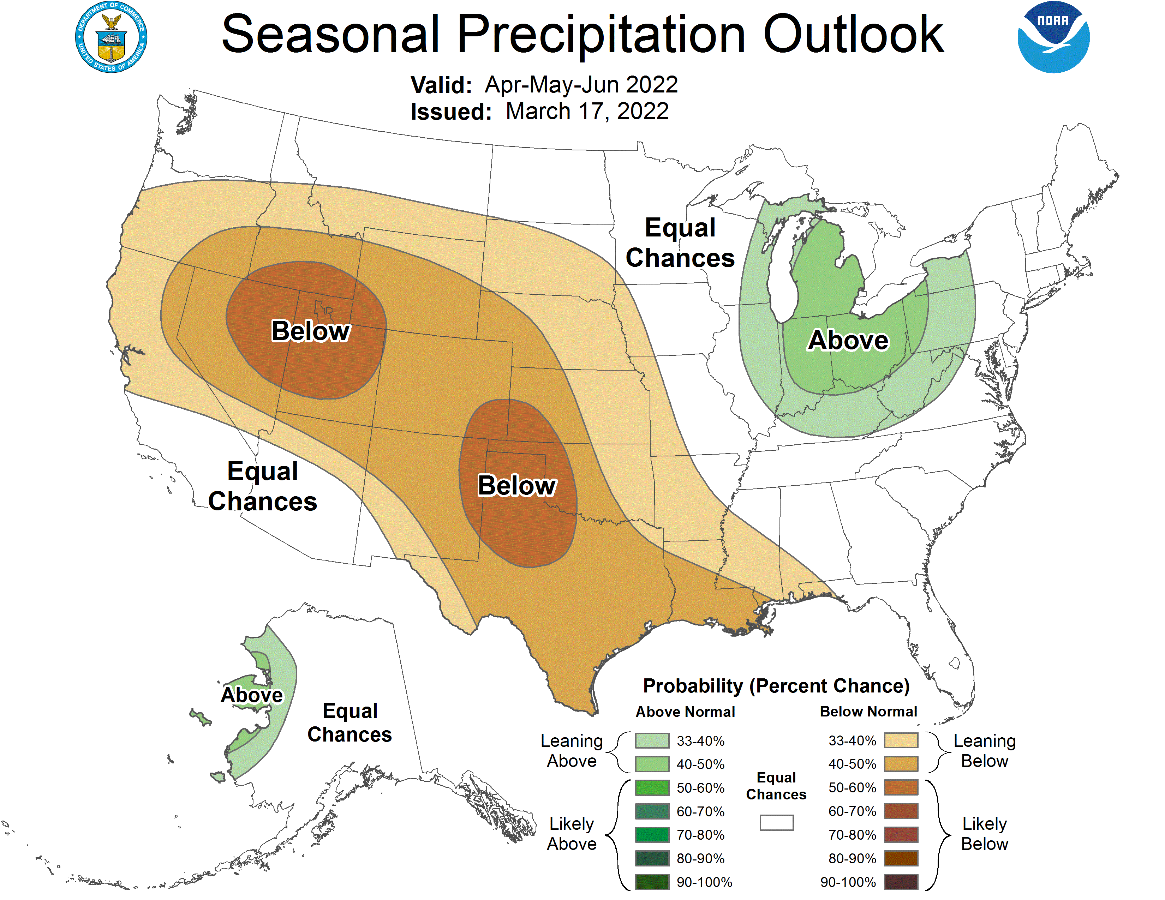
Apr-May-Jun outlook
- Warmer, drier than normal conditions favored for three-month period.
Notes:
Here I outlined the similar trends for the Nebraska and global annual average temperature. I also point out the high variability in Nebraska and difference in regional vs. global scales. I use the analogy that global change is like an escalator that is increasing at an accelerating rate. The variability is like we jump up or down a few steps while still going up.

Slide 19
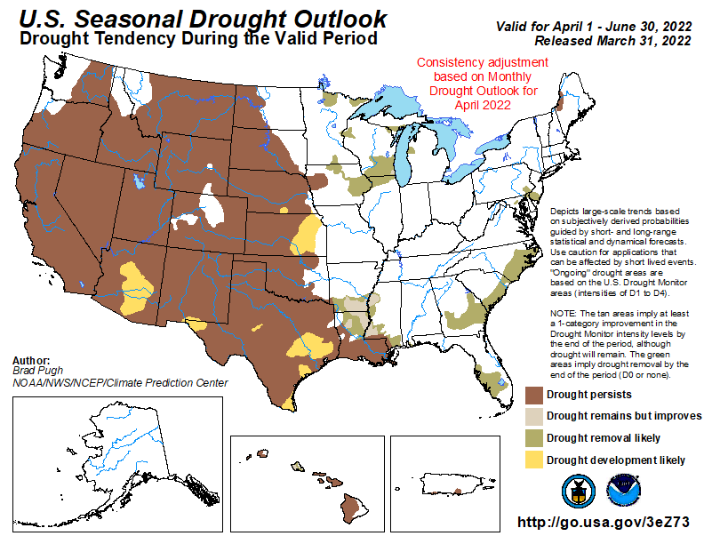
Seasonal drought outlook
Persistence or development across Nebraska and much of the region.
Notes:
Here I outlined the similar trends for the Nebraska and global annual average temperature. I also point out the high variability in Nebraska and difference in regional vs. global scales. I use the analogy that global change is like an escalator that is increasing at an accelerating rate. The variability is like we jump up or down a few steps while still going up.

Slide 20
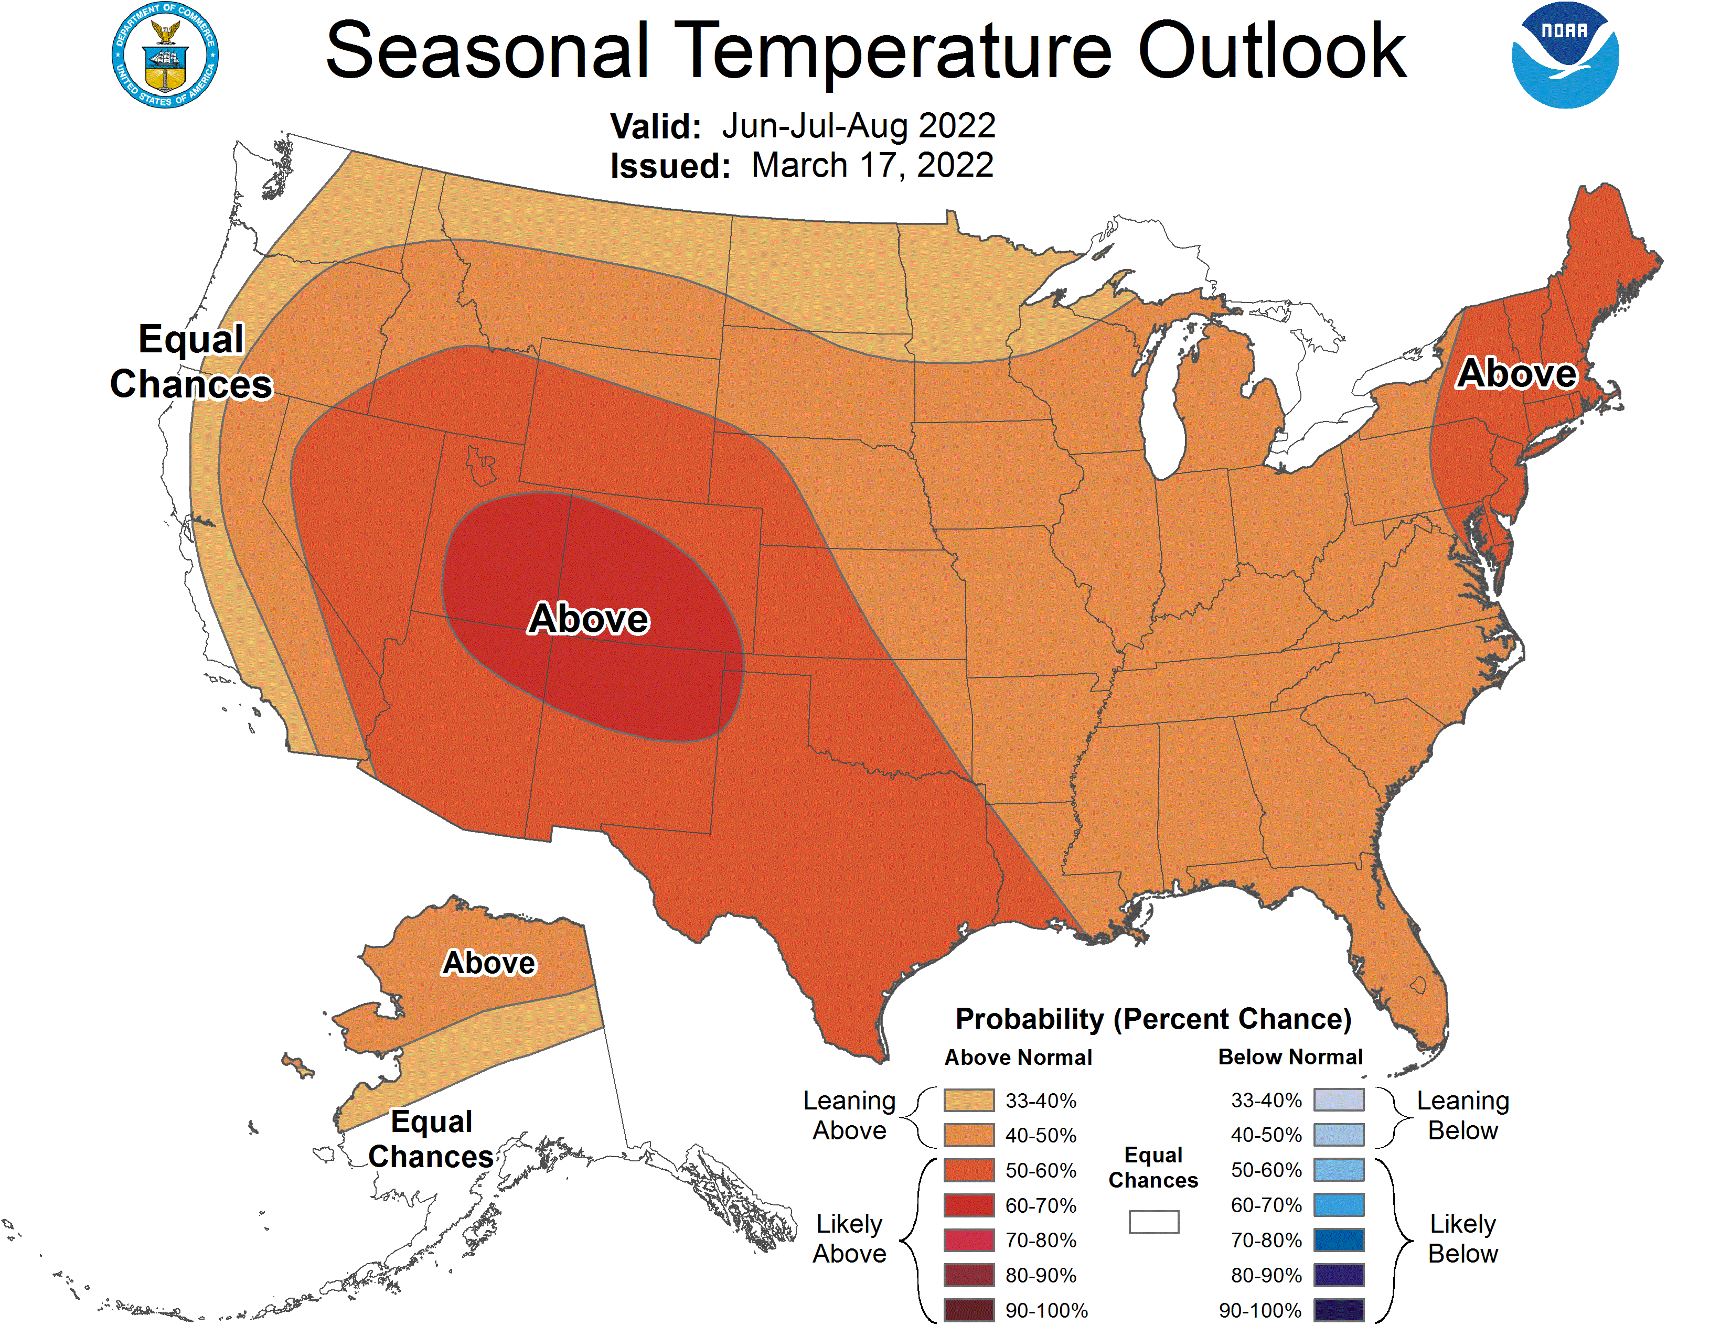
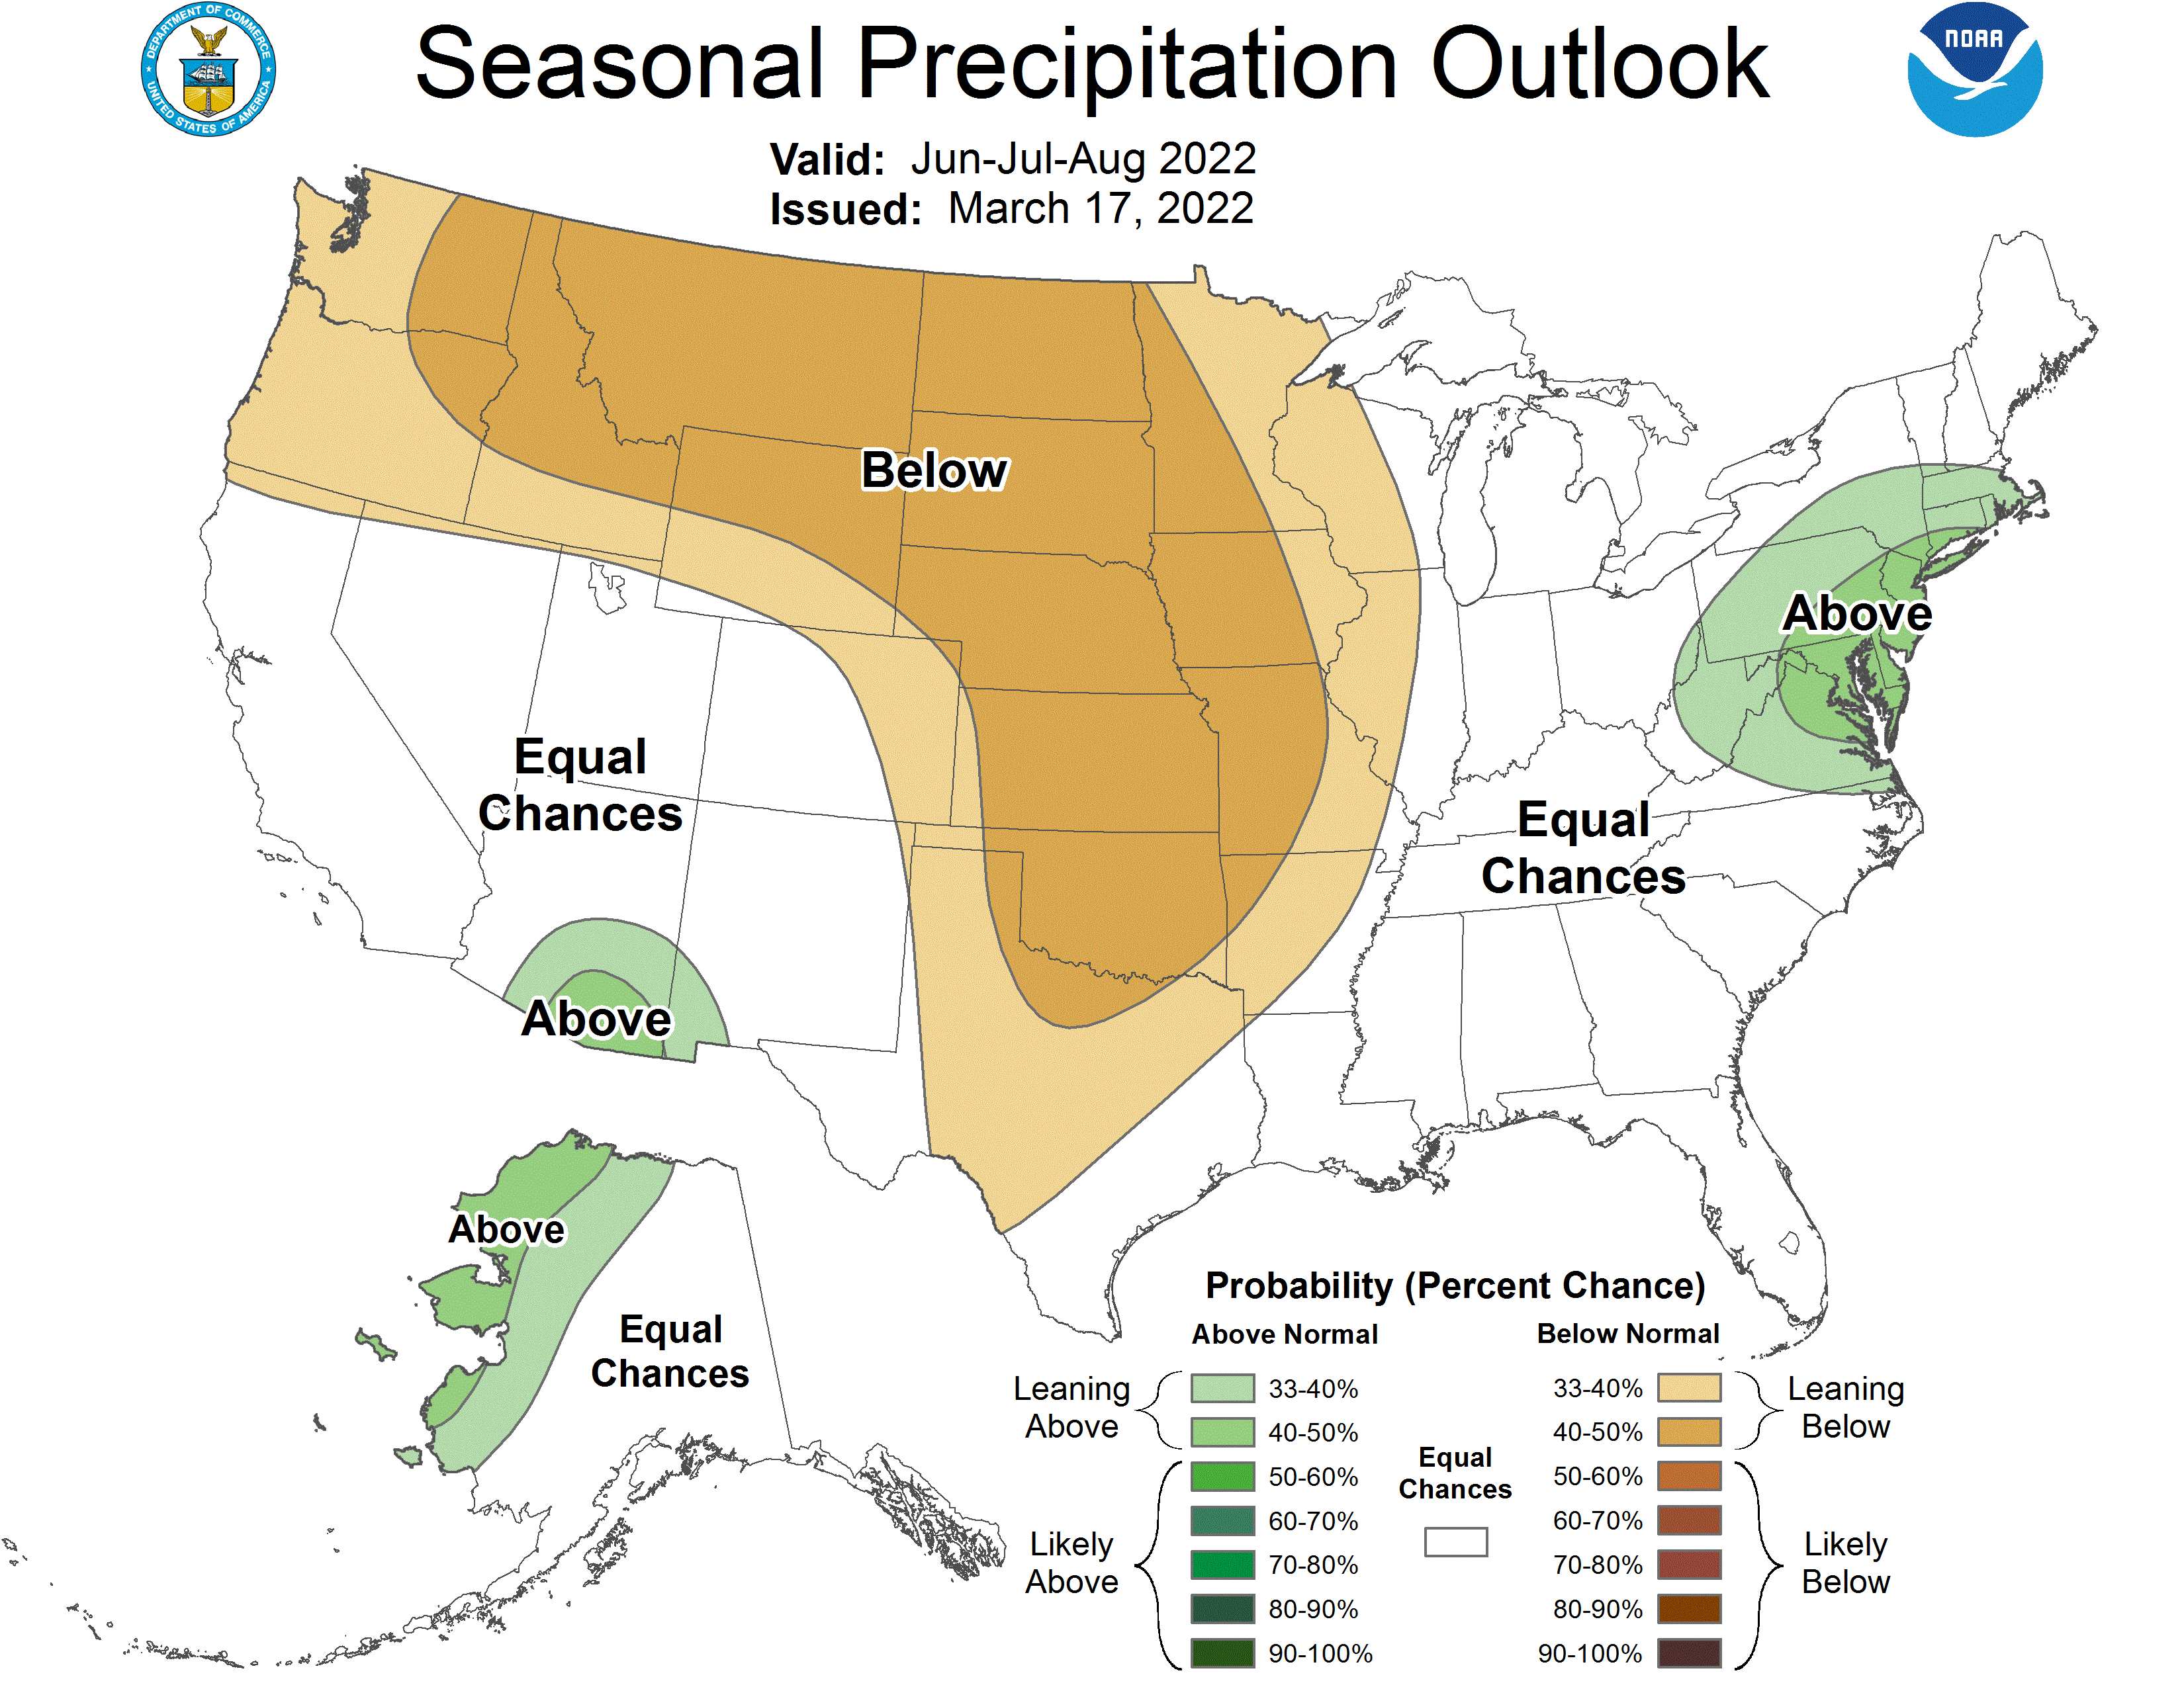
Jun-Jul-Aug outlook
- Summer conditions leaning warmer and drier than normal.
Notes:
Here I outlined the similar trends for the Nebraska and global annual average temperature. I also point out the high variability in Nebraska and difference in regional vs. global scales. I use the analogy that global change is like an escalator that is increasing at an accelerating rate. The variability is like we jump up or down a few steps while still going up.

Slide 21
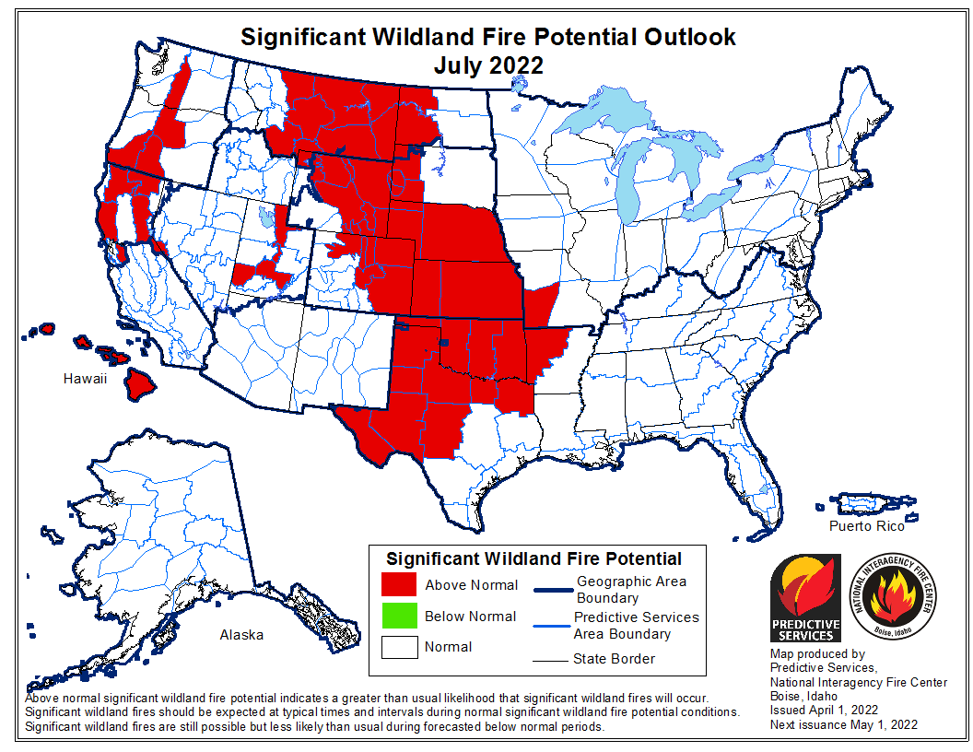
Wildfire risk outlook - July
Nebraska is in the above normal category.
Much of the dry areas remain at potential high fire risk.
Notes:
Here I outlined the similar trends for the Nebraska and global annual average temperature. I also point out the high variability in Nebraska and difference in regional vs. global scales. I use the analogy that global change is like an escalator that is increasing at an accelerating rate. The variability is like we jump up or down a few steps while still going up.

Slide 22
Outlook summary
We are entering our wet season and need at least normal rainfall going forward.
However, climate outlooks suggest otherwise with warm/dry pattern.
Expect general drought persistence, with potential for worsening.
Wildland fire will be a high risk scenario.
Notes:
Here I outlined the similar trends for the Nebraska and global annual average temperature. I also point out the high variability in Nebraska and difference in regional vs. global scales. I use the analogy that global change is like an escalator that is increasing at an accelerating rate. The variability is like we jump up or down a few steps while still going up.

Slide 23
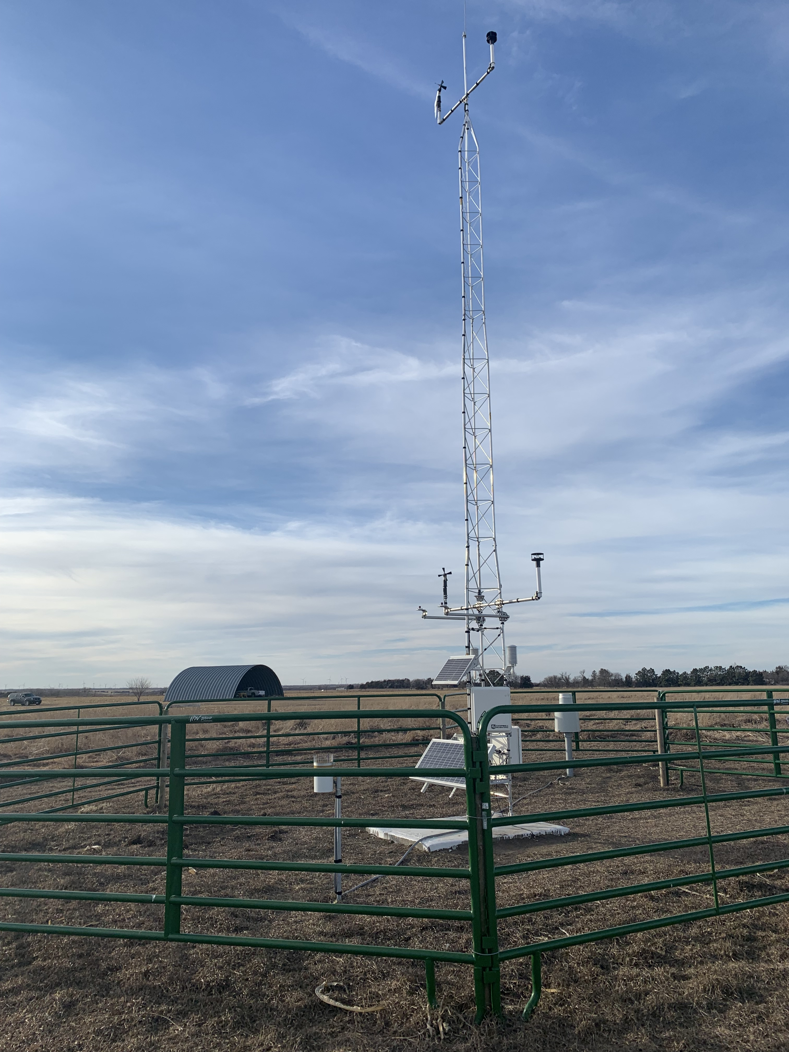
Questions
Martha Shulski mshulski3@unl.edu 402-472-6711
New Nebraska Mesonet station
Wilber (Saline Co.)
Notes:
Here I outlined the similar trends for the Nebraska and global annual average temperature. I also point out the high variability in Nebraska and difference in regional vs. global scales. I use the analogy that global change is like an escalator that is increasing at an accelerating rate. The variability is like we jump up or down a few steps while still going up.

