Slide 1
Nebraska Climate Update
Martha D shulski
mshulski3@unl.edu
402-472-6711
School of natural resources
University of Nebraska LIncoln
CARC Meeting
22 July, 2021

Slide 2
Today’s presentation
Recap of spring and recent conditions
Impacts – local perspectives prove key as conditions vary, critical stage for corn occurring now
Outlook – warmth and dryness to continue
Notes:
Here I outlined the similar trends for the Nebraska and global annual average temperature. I also point out the high variability in Nebraska and difference in regional vs. global scales. I use the analogy that global change is like an escalator that is increasing at an accelerating rate. The variability is like we jump up or down a few steps while still going up.

Slide 3
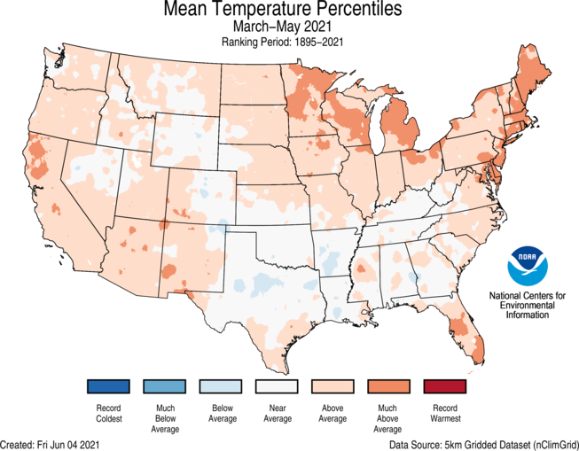
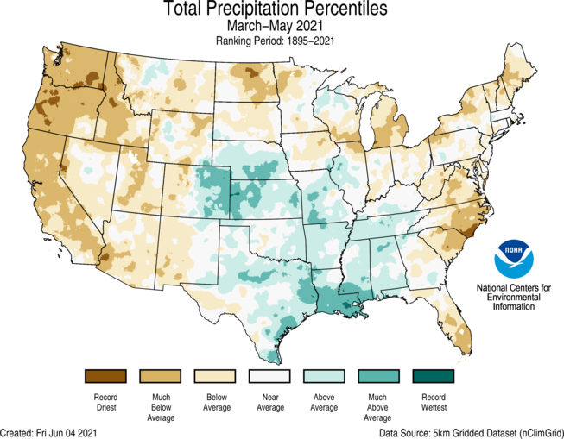
Recap
Mar-Apr-May | mostly warm and wet spring, except dry for NW Panhandle
Source: https://ncdc.noaa.gov/temp-and-precip/us-maps/
Notes:
Here I outlined the similar trends for the Nebraska and global annual average temperature. I also point out the high variability in Nebraska and difference in regional vs. global scales. I use the analogy that global change is like an escalator that is increasing at an accelerating rate. The variability is like we jump up or down a few steps while still going up.

Slide 4
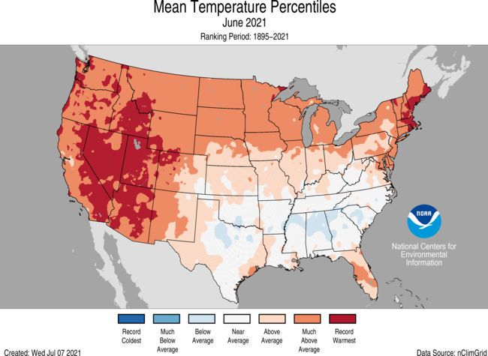
Recap
June temperature |
Nebraska was much above average (72.8°F, +4.5°F), ranks as 12th warmest
Warmest on record for U.S.
Source: https://ncdc.noaa.gov/temp-and-precip/us-maps/
Notes:
Here I outlined the similar trends for the Nebraska and global annual average temperature. I also point out the high variability in Nebraska and difference in regional vs. global scales. I use the analogy that global change is like an escalator that is increasing at an accelerating rate. The variability is like we jump up or down a few steps while still going up.

Slide 5
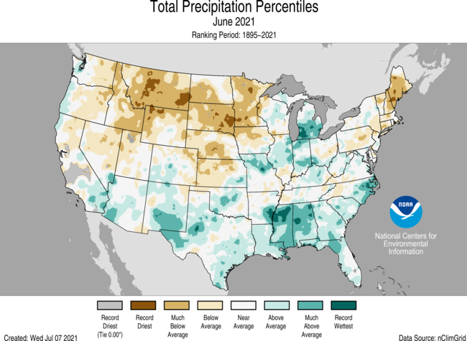
Recap
June precipitation |
Below to much below average (2.11”, -1.58), 13th driest on record.
Wet in far southeast corner.
Source: https://ncdc.noaa.gov/temp-and-precip/us-maps/
Notes:
Here I outlined the similar trends for the Nebraska and global annual average temperature. I also point out the high variability in Nebraska and difference in regional vs. global scales. I use the analogy that global change is like an escalator that is increasing at an accelerating rate. The variability is like we jump up or down a few steps while still going up.

Slide 6
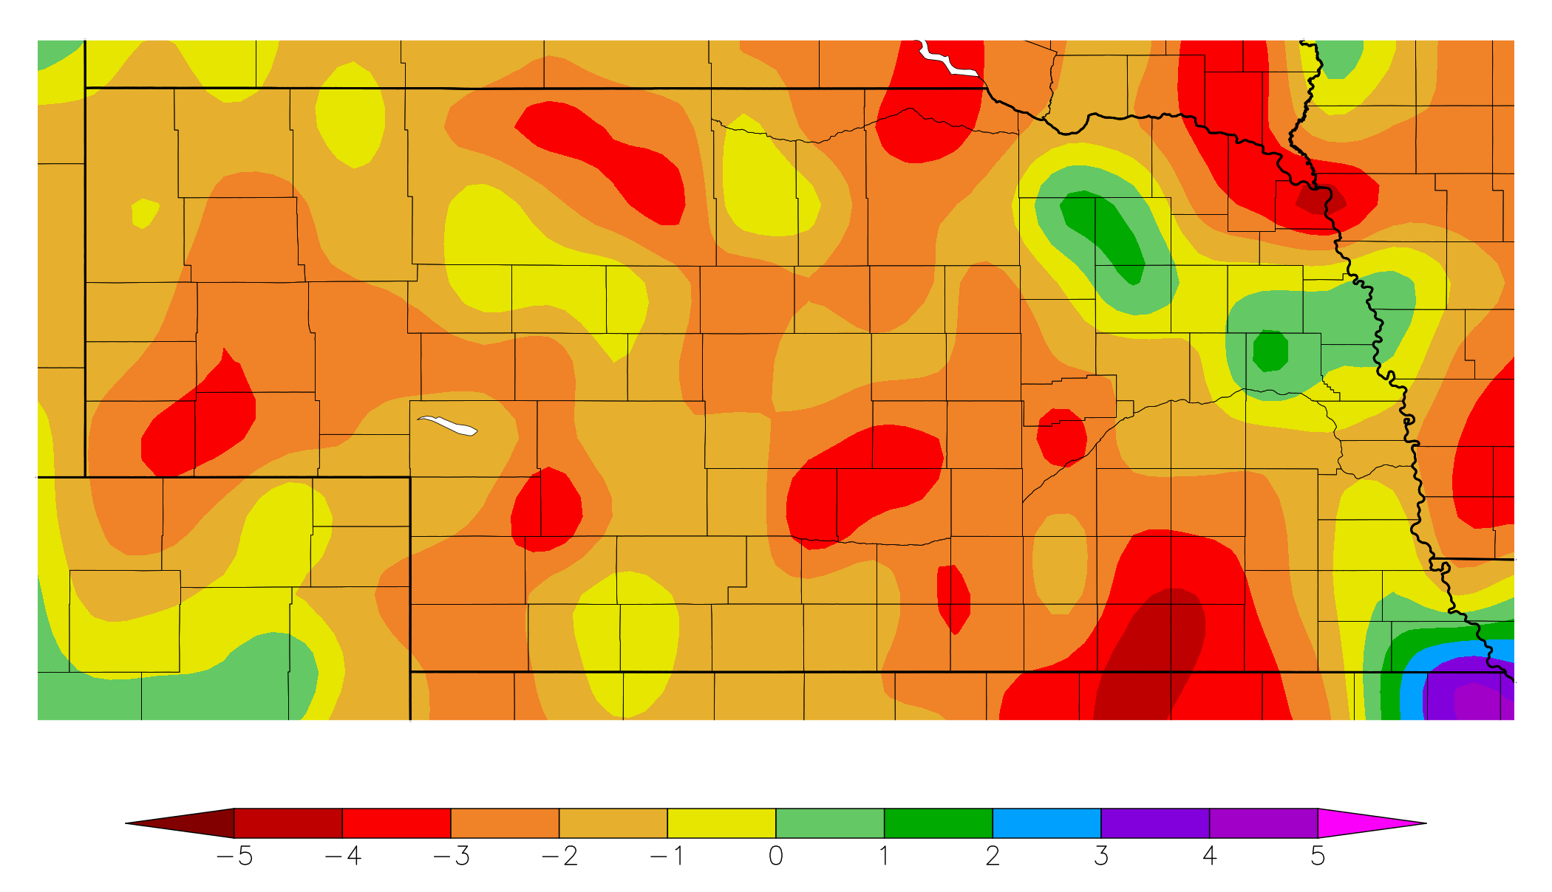
Recap
Precipitation | 2 month departures > 3 inches in some areas
60 day precipitation departure from normal
20 May – 18 Jul
Source: https:// hprcc.unl.edu/maps.php?map=ACISClimateMaps
Notes:
Here I outlined the similar trends for the Nebraska and global annual average temperature. I also point out the high variability in Nebraska and difference in regional vs. global scales. I use the analogy that global change is like an escalator that is increasing at an accelerating rate. The variability is like we jump up or down a few steps while still going up.

Slide 7
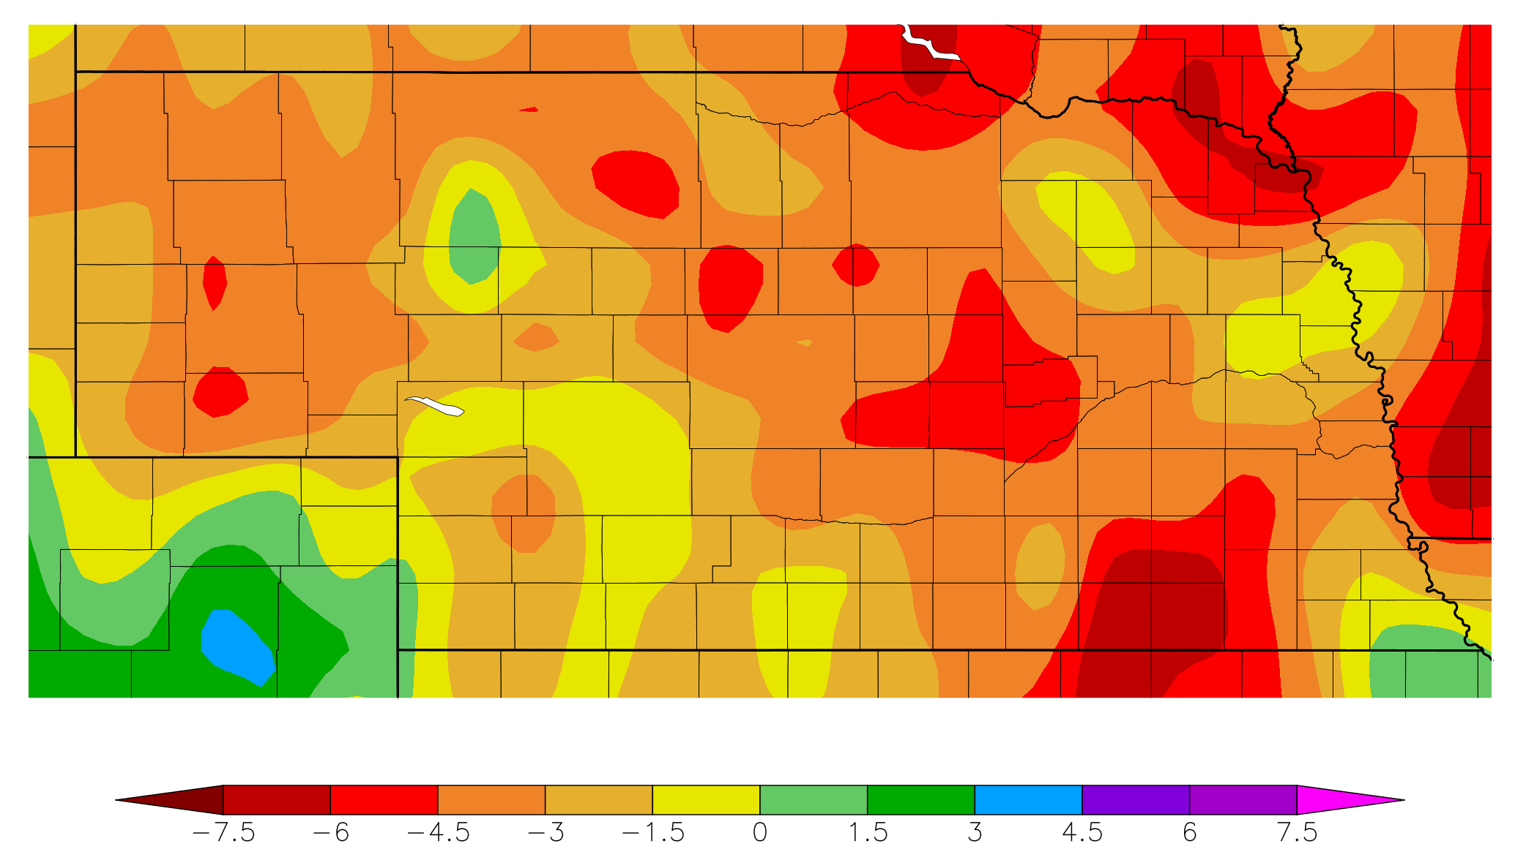
Recap
Precipitation | 3 month departures greater than 4.5 inches for pockets of the state
90 day precipitation departure from normal
20 Apr – 18 Jul
Source: https:// hprcc.unl.edu/maps.php?map=ACISClimateMaps
Notes:
Here I outlined the similar trends for the Nebraska and global annual average temperature. I also point out the high variability in Nebraska and difference in regional vs. global scales. I use the analogy that global change is like an escalator that is increasing at an accelerating rate. The variability is like we jump up or down a few steps while still going up.

Slide 8
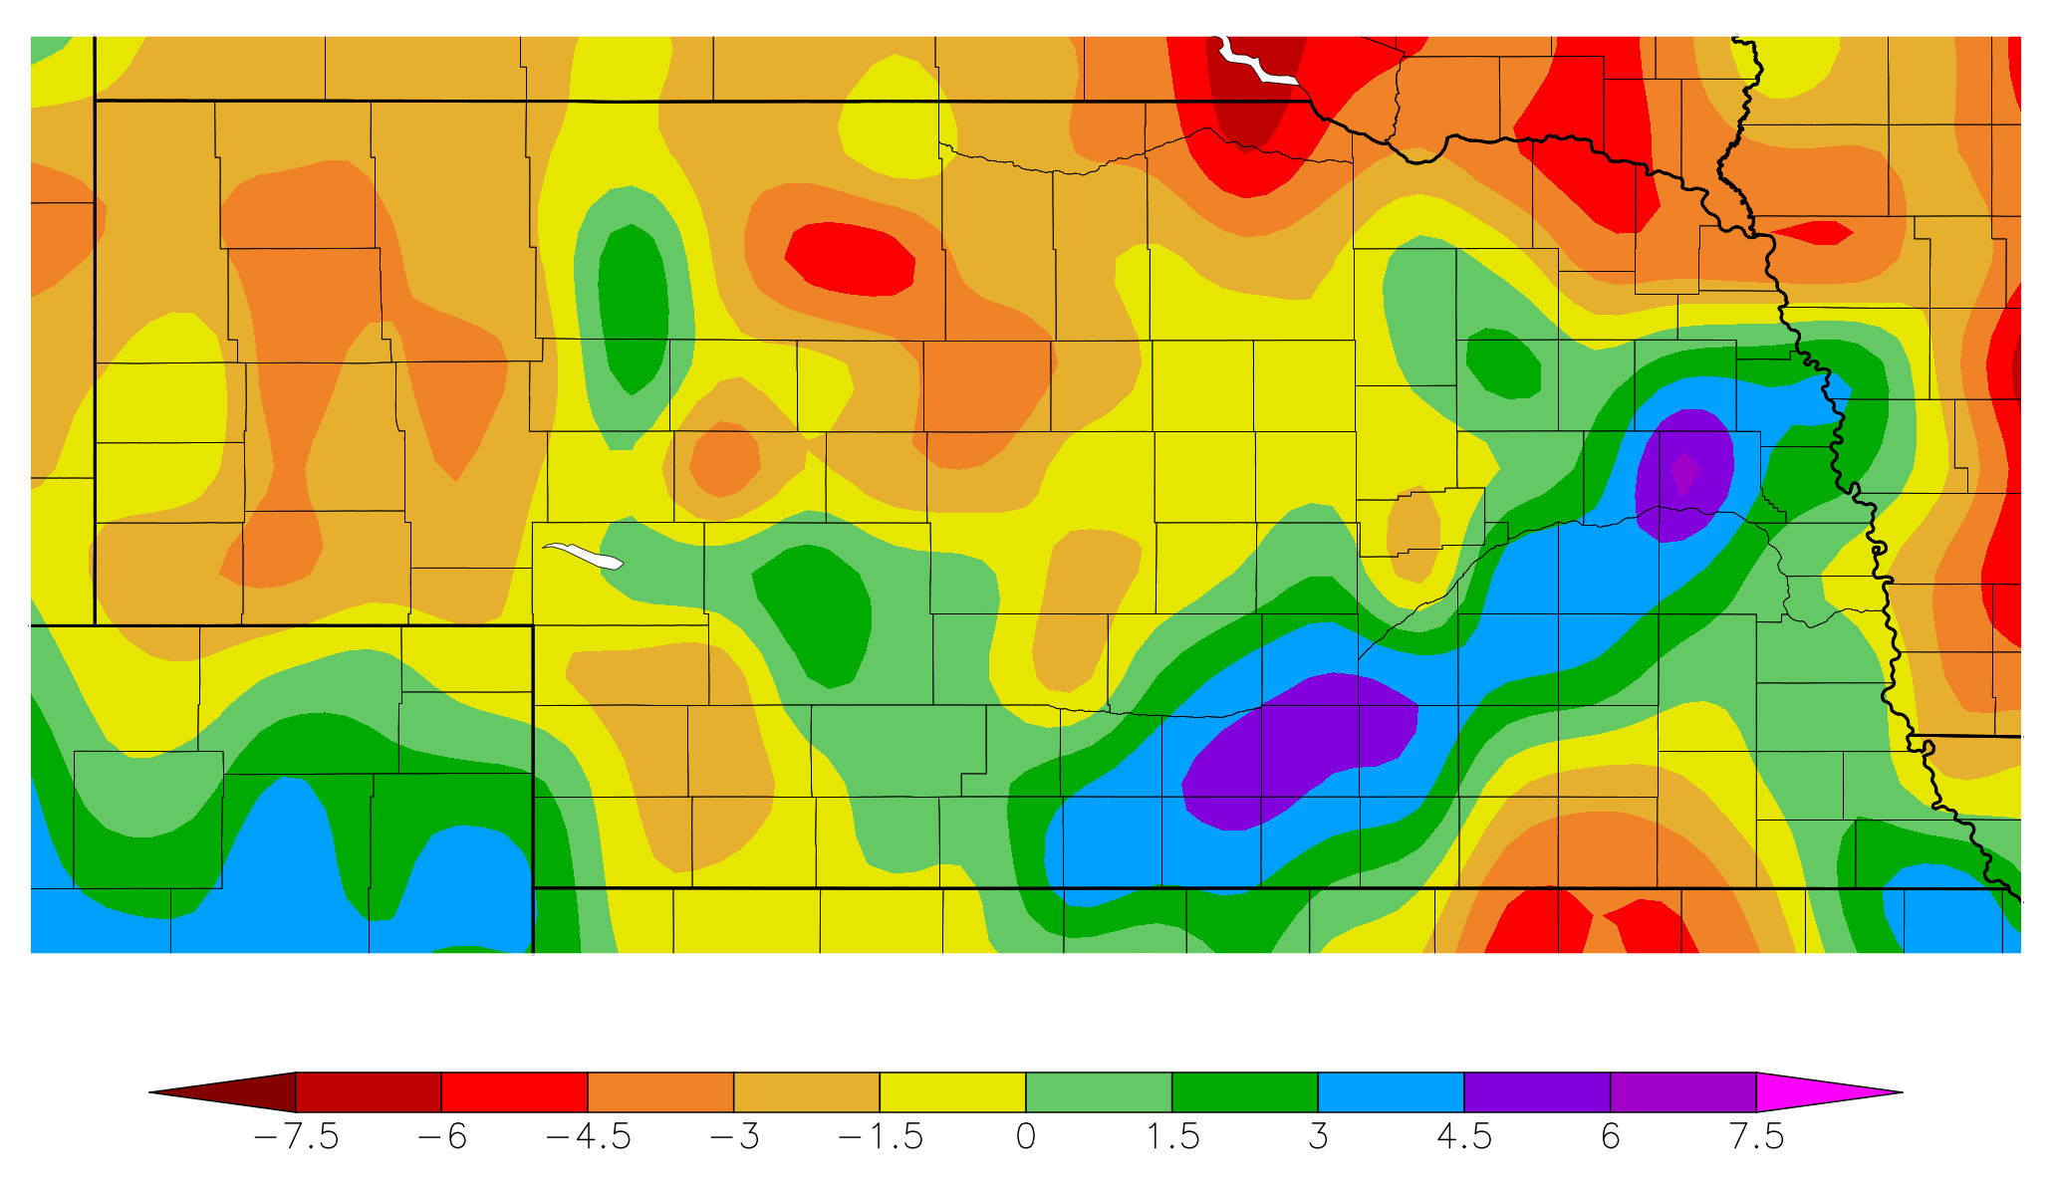
Recap
Precipitation | YTD departures highest in northeast, northcentral
120 day precipitation departure from normal
1 Jan – 18 Jul
Source: https:// hprcc.unl.edu/maps.php?map=ACISClimateMaps
Notes:
Here I outlined the similar trends for the Nebraska and global annual average temperature. I also point out the high variability in Nebraska and difference in regional vs. global scales. I use the analogy that global change is like an escalator that is increasing at an accelerating rate. The variability is like we jump up or down a few steps while still going up.

Slide 9
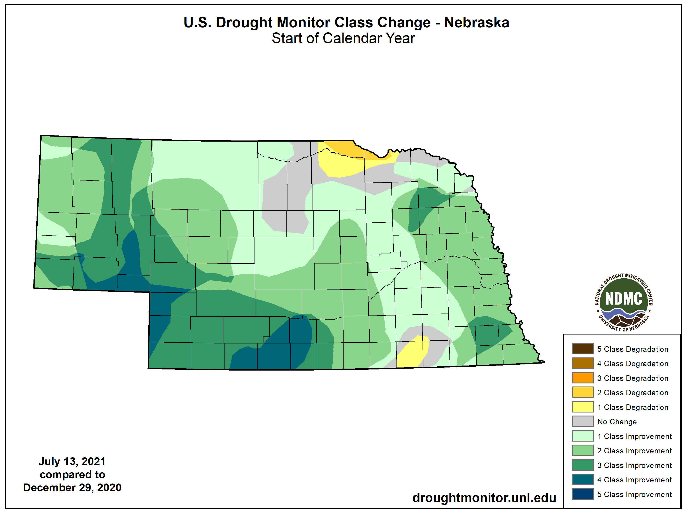
Recap
Drought |
one to four class improvements since start of the year for much of Nebraska.
degradation in the northeast and small pocket of southeast
Source: https://droughtmonitor.unl.edu/maps/
Notes:
Here I outlined the similar trends for the Nebraska and global annual average temperature. I also point out the high variability in Nebraska and difference in regional vs. global scales. I use the analogy that global change is like an escalator that is increasing at an accelerating rate. The variability is like we jump up or down a few steps while still going up.

Slide 10
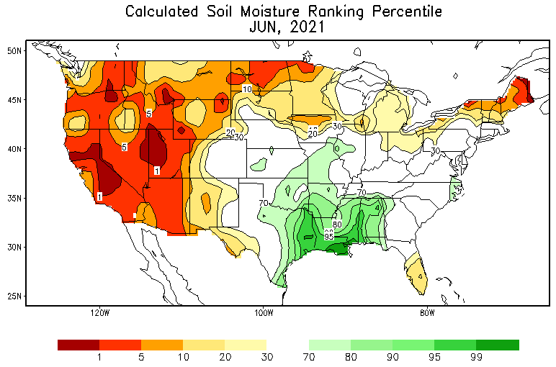
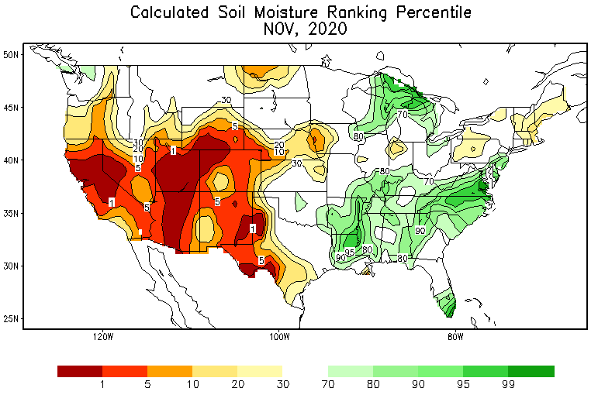
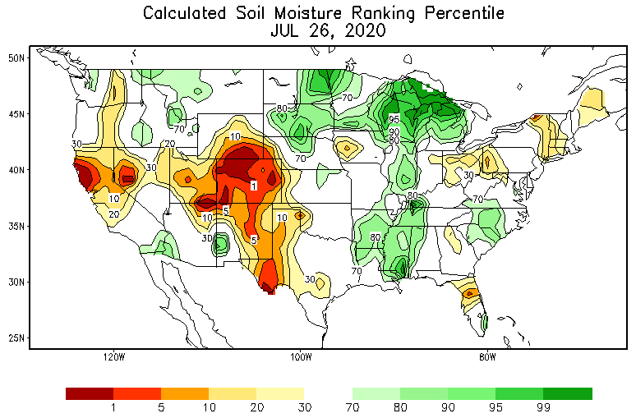
Soils
Soil moisture | Modeled data picking up dryness in northeast and Panhandle.
https://www.cpc.ncep.noaa.gov/products/Soilmst_Monitoring/US/Soilmst/Soilmst.shtml
Notes:
Here I outlined the similar trends for the Nebraska and global annual average temperature. I also point out the high variability in Nebraska and difference in regional vs. global scales. I use the analogy that global change is like an escalator that is increasing at an accelerating rate. The variability is like we jump up or down a few steps while still going up.

Slide 11
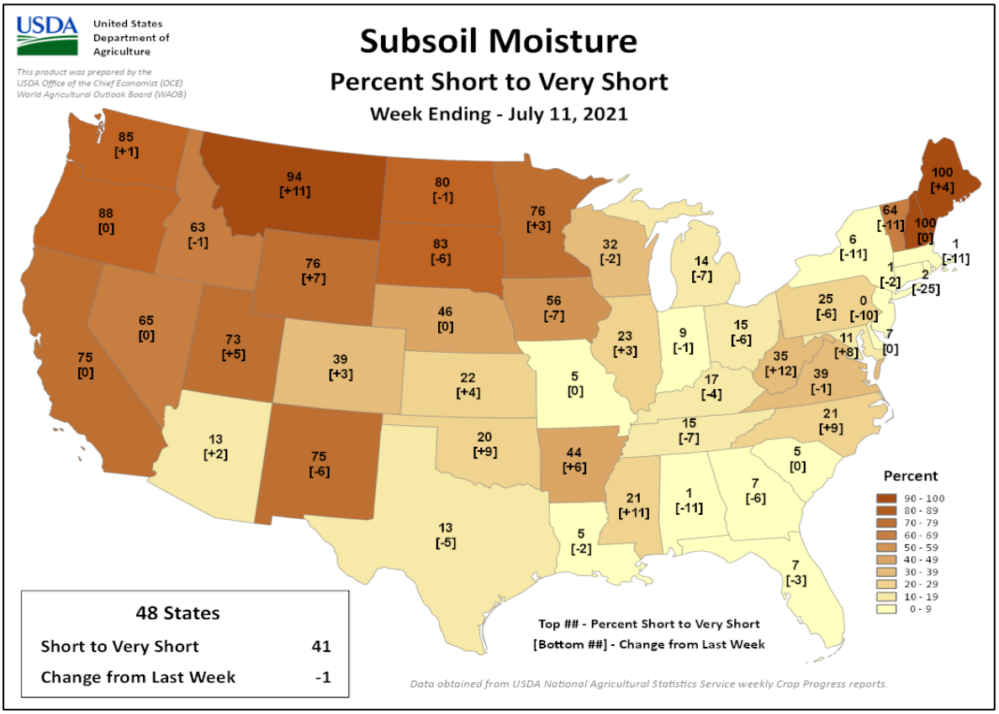
Soils
Soil moisture |
topsoil (6”) moisture 39% short to very short
subsoil at 46% short to very short)
* short-very short: normal crop growth curtailed visible signs of stress
Thank you to Brad Rippey and USDA-OCE
https:// www.usda.library.cornell.edu/concern/publications/cj82k728n?locale=en
Notes:
Here I outlined the similar trends for the Nebraska and global annual average temperature. I also point out the high variability in Nebraska and difference in regional vs. global scales. I use the analogy that global change is like an escalator that is increasing at an accelerating rate. The variability is like we jump up or down a few steps while still going up.

Slide 12
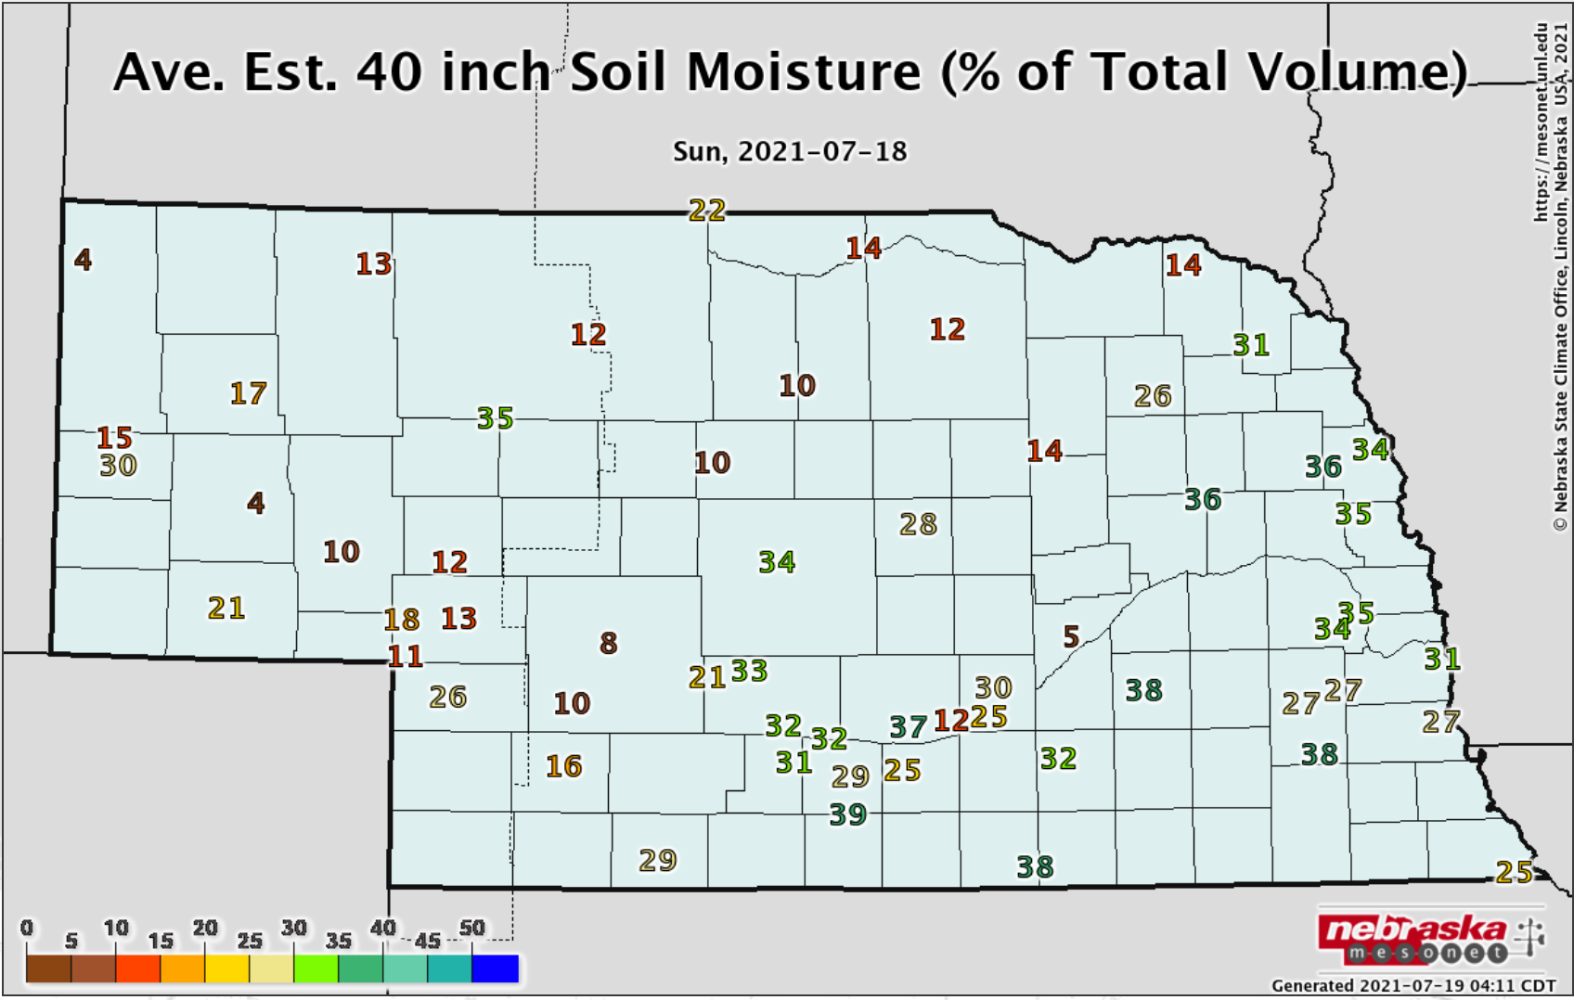
Soils
Soil moisture | Deep soil moisture a concern for some areas.
dry
dry
dry
Notes:
Here I outlined the similar trends for the Nebraska and global annual average temperature. I also point out the high variability in Nebraska and difference in regional vs. global scales. I use the analogy that global change is like an escalator that is increasing at an accelerating rate. The variability is like we jump up or down a few steps while still going up.

Slide 13
Agriculture
Impacts |
Extension reports indicate conditions are very dire in Boyd county, especially for pastures.
Panhandle – Calls from MT ranchers seeking hay and winter grazing. Excess hay currently moving south to CO dairies.
Northcentral – getting calls from SD ranchers looking for winter grazing areas.
Sandhills – haying prairie grass slightly below normal and in need of good Aug/Sep rains. Population and movement should be monitored.
Notes:
Here I outlined the similar trends for the Nebraska and global annual average temperature. I also point out the high variability in Nebraska and difference in regional vs. global scales. I use the analogy that global change is like an escalator that is increasing at an accelerating rate. The variability is like we jump up or down a few steps while still going up.

Slide 14
Agriculture
Impacts |
Severe weather – significant hail damage around Alliance, bin and pivot damage around York, so far green snap not as prevalent
Disease – light thus far, southern rust showing up in southeast KS
Southeast – Reports of very good to excellent corn and soybean conditions
Dryland corners likely to see water/heat stress
Notes:
Here I outlined the similar trends for the Nebraska and global annual average temperature. I also point out the high variability in Nebraska and difference in regional vs. global scales. I use the analogy that global change is like an escalator that is increasing at an accelerating rate. The variability is like we jump up or down a few steps while still going up.

Slide 15
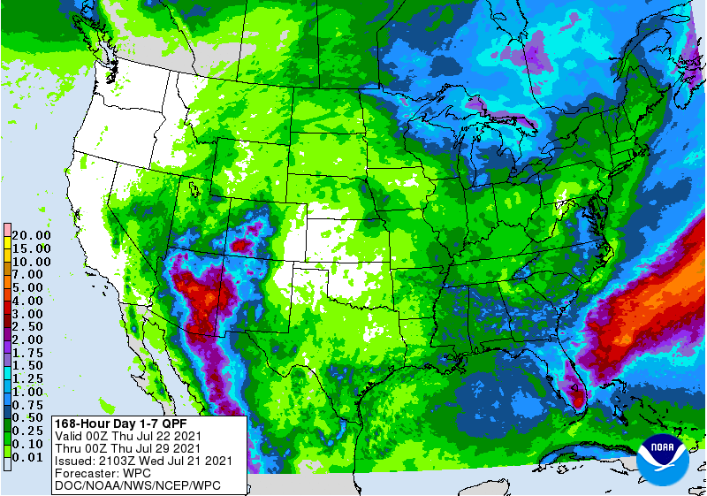
Precipitation outlook
Only very light precipitation in the forecast period over the next week.
https:// www. wpc.ncep.noaa.gov/qpf/day1-7.shtml
Notes:
Here I outlined the similar trends for the Nebraska and global annual average temperature. I also point out the high variability in Nebraska and difference in regional vs. global scales. I use the analogy that global change is like an escalator that is increasing at an accelerating rate. The variability is like we jump up or down a few steps while still going up.

Slide 16
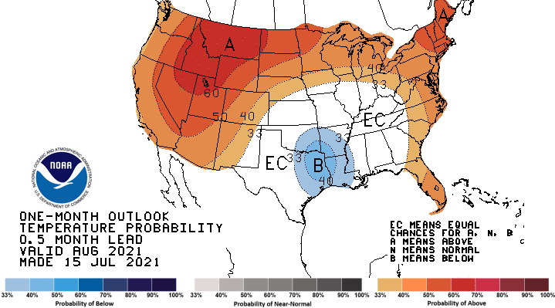
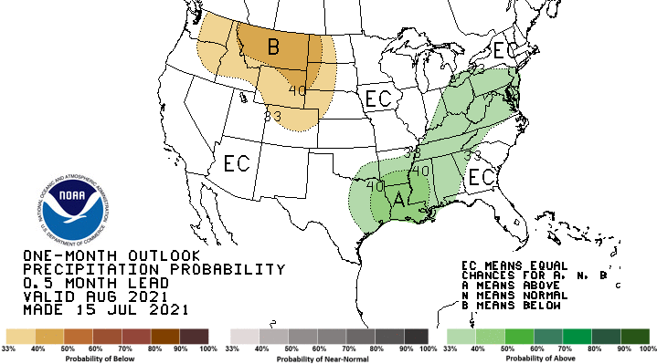
August outlook
- Warmth predominates much of the country and dry signal for portions of west, including western third of Nebraska.
Notes:
Here I outlined the similar trends for the Nebraska and global annual average temperature. I also point out the high variability in Nebraska and difference in regional vs. global scales. I use the analogy that global change is like an escalator that is increasing at an accelerating rate. The variability is like we jump up or down a few steps while still going up.

Slide 17
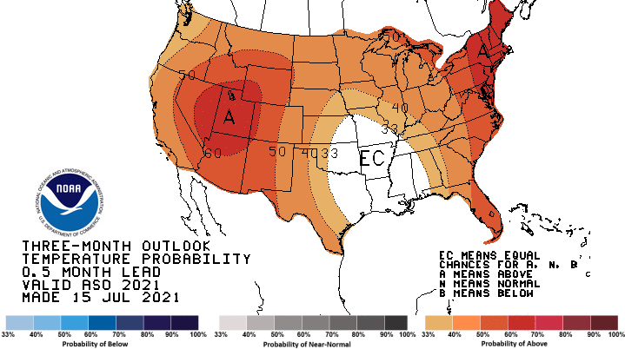
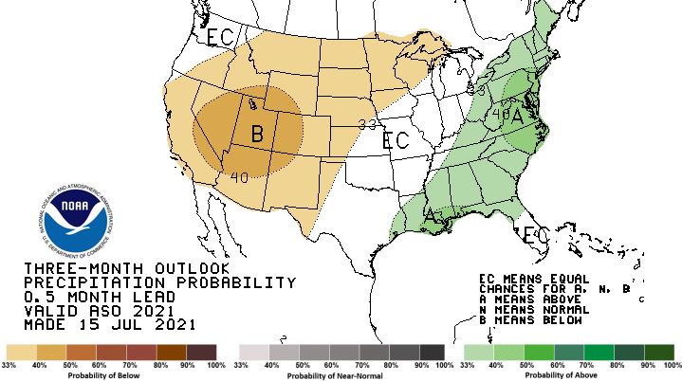
Aug-Sep-Oct outlook
- Warm/dry continuation for Nebraska.
Notes:
Here I outlined the similar trends for the Nebraska and global annual average temperature. I also point out the high variability in Nebraska and difference in regional vs. global scales. I use the analogy that global change is like an escalator that is increasing at an accelerating rate. The variability is like we jump up or down a few steps while still going up.

Slide 18
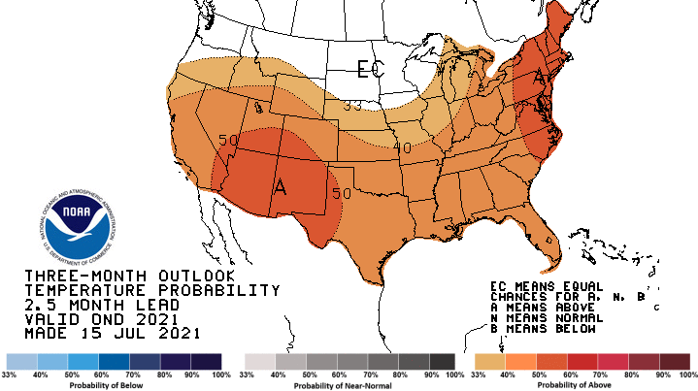
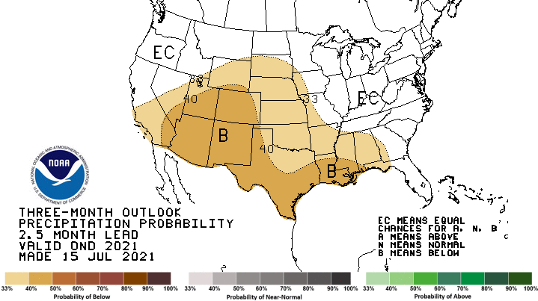
Oct-Nov-Dec outlook
- Warm/dry signal continues in early winter.
Notes:
Here I outlined the similar trends for the Nebraska and global annual average temperature. I also point out the high variability in Nebraska and difference in regional vs. global scales. I use the analogy that global change is like an escalator that is increasing at an accelerating rate. The variability is like we jump up or down a few steps while still going up.

Slide 19
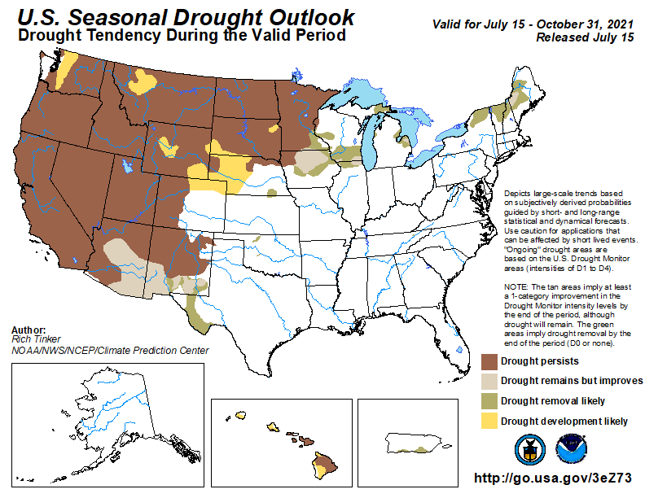
Seasonal drought outlook
Persistence and development across central, western, northern Nebraska
Notes:
Here I outlined the similar trends for the Nebraska and global annual average temperature. I also point out the high variability in Nebraska and difference in regional vs. global scales. I use the analogy that global change is like an escalator that is increasing at an accelerating rate. The variability is like we jump up or down a few steps while still going up.

Slide 20
Outlook summary
Widespread warm and dry signal for August and fall to early winter.
Drought conditions likely to worsen for western half of state.
Widespread impacts to corn production partially dependent on current and near-term weather conditions (heat) and timely rains going forward.
If Hit or miss precipitation pattern we’ve had thus far persists, would see variable impacts across state.
Notes:
Here I outlined the similar trends for the Nebraska and global annual average temperature. I also point out the high variability in Nebraska and difference in regional vs. global scales. I use the analogy that global change is like an escalator that is increasing at an accelerating rate. The variability is like we jump up or down a few steps while still going up.

Slide 21
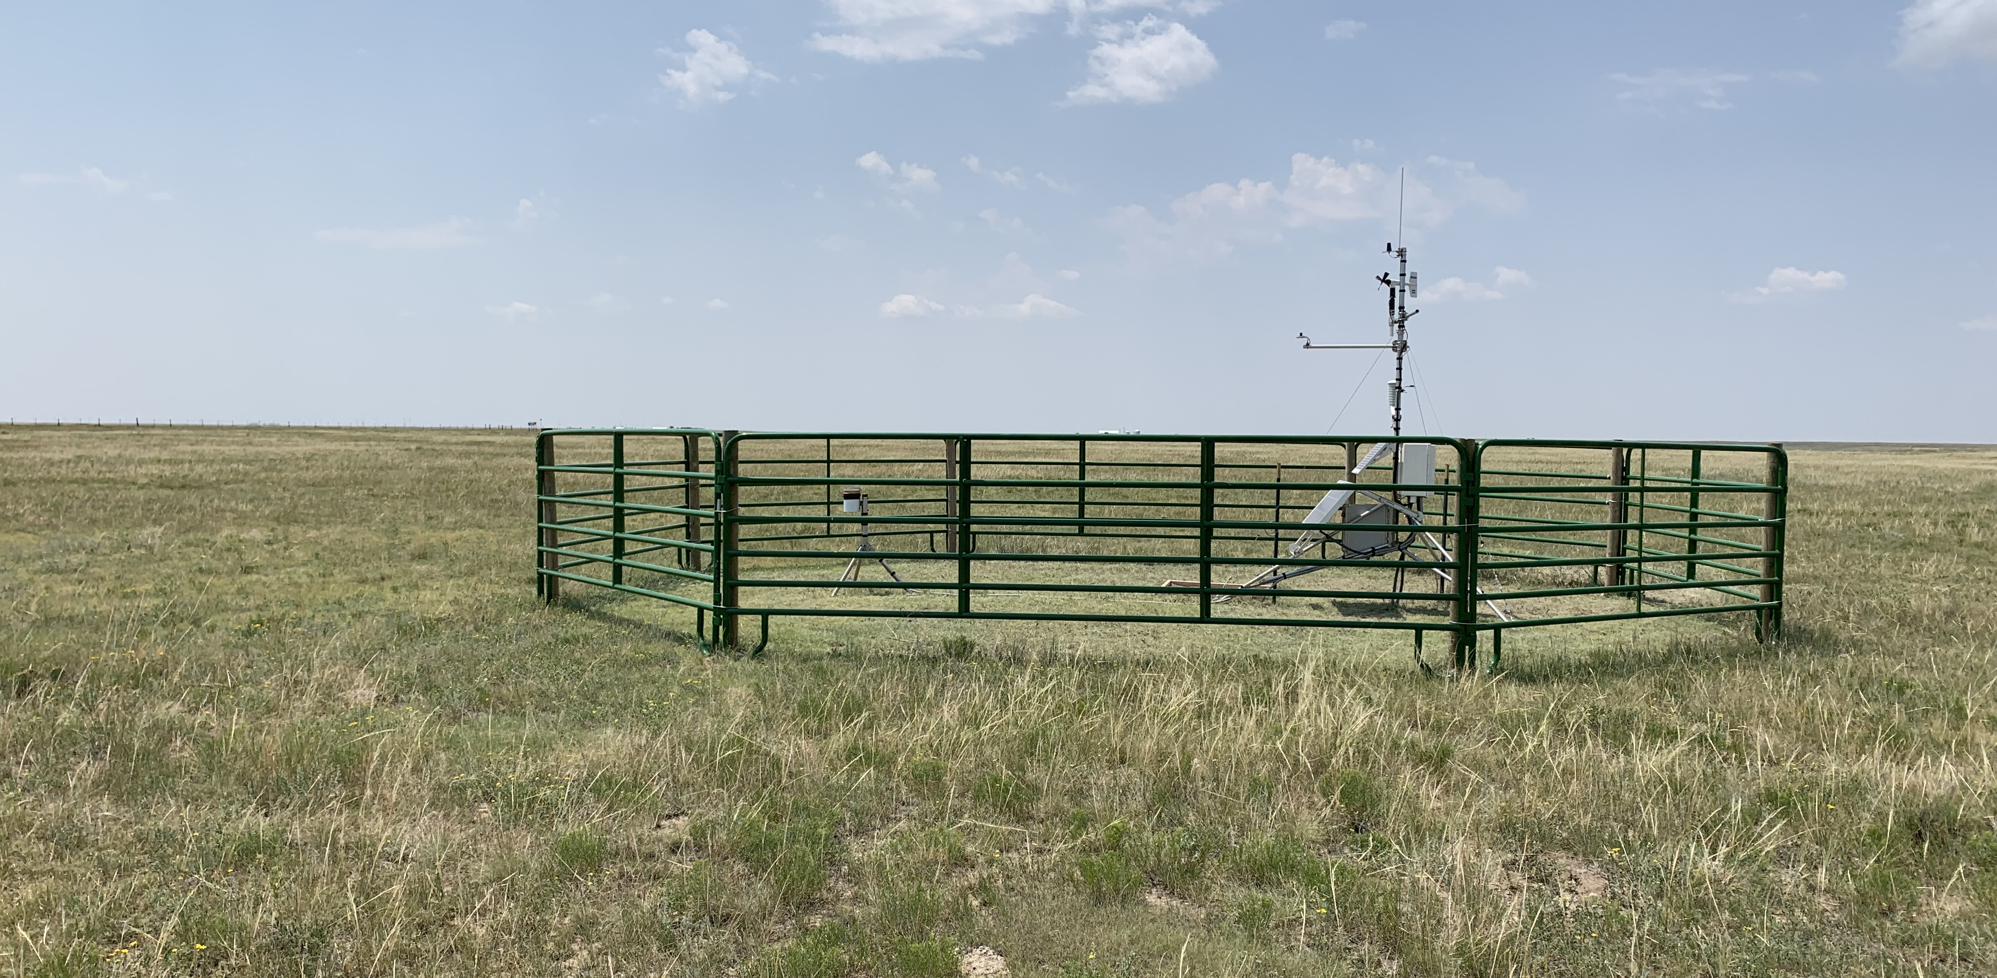
Questions
Please contact me at: mshulski3@unl.edu, 402-472-6711
New Nebraska Mesonet station
Bushnell 12SE (Kimball Co.)
Notes:
Here I outlined the similar trends for the Nebraska and global annual average temperature. I also point out the high variability in Nebraska and difference in regional vs. global scales. I use the analogy that global change is like an escalator that is increasing at an accelerating rate. The variability is like we jump up or down a few steps while still going up.

