Slide 1
United States Department of Agriculture
National Agricultural Statistics Service
November Crop Report
November 29 Crop Progress and Condition
Nick Streff
USDA NASS
December 8, 2020

Slide 2
Notes:
Harvest progressed ahead of normal this year which is quite a change from last year.
As of 11/15, corn was 96% harvested.

Slide 3
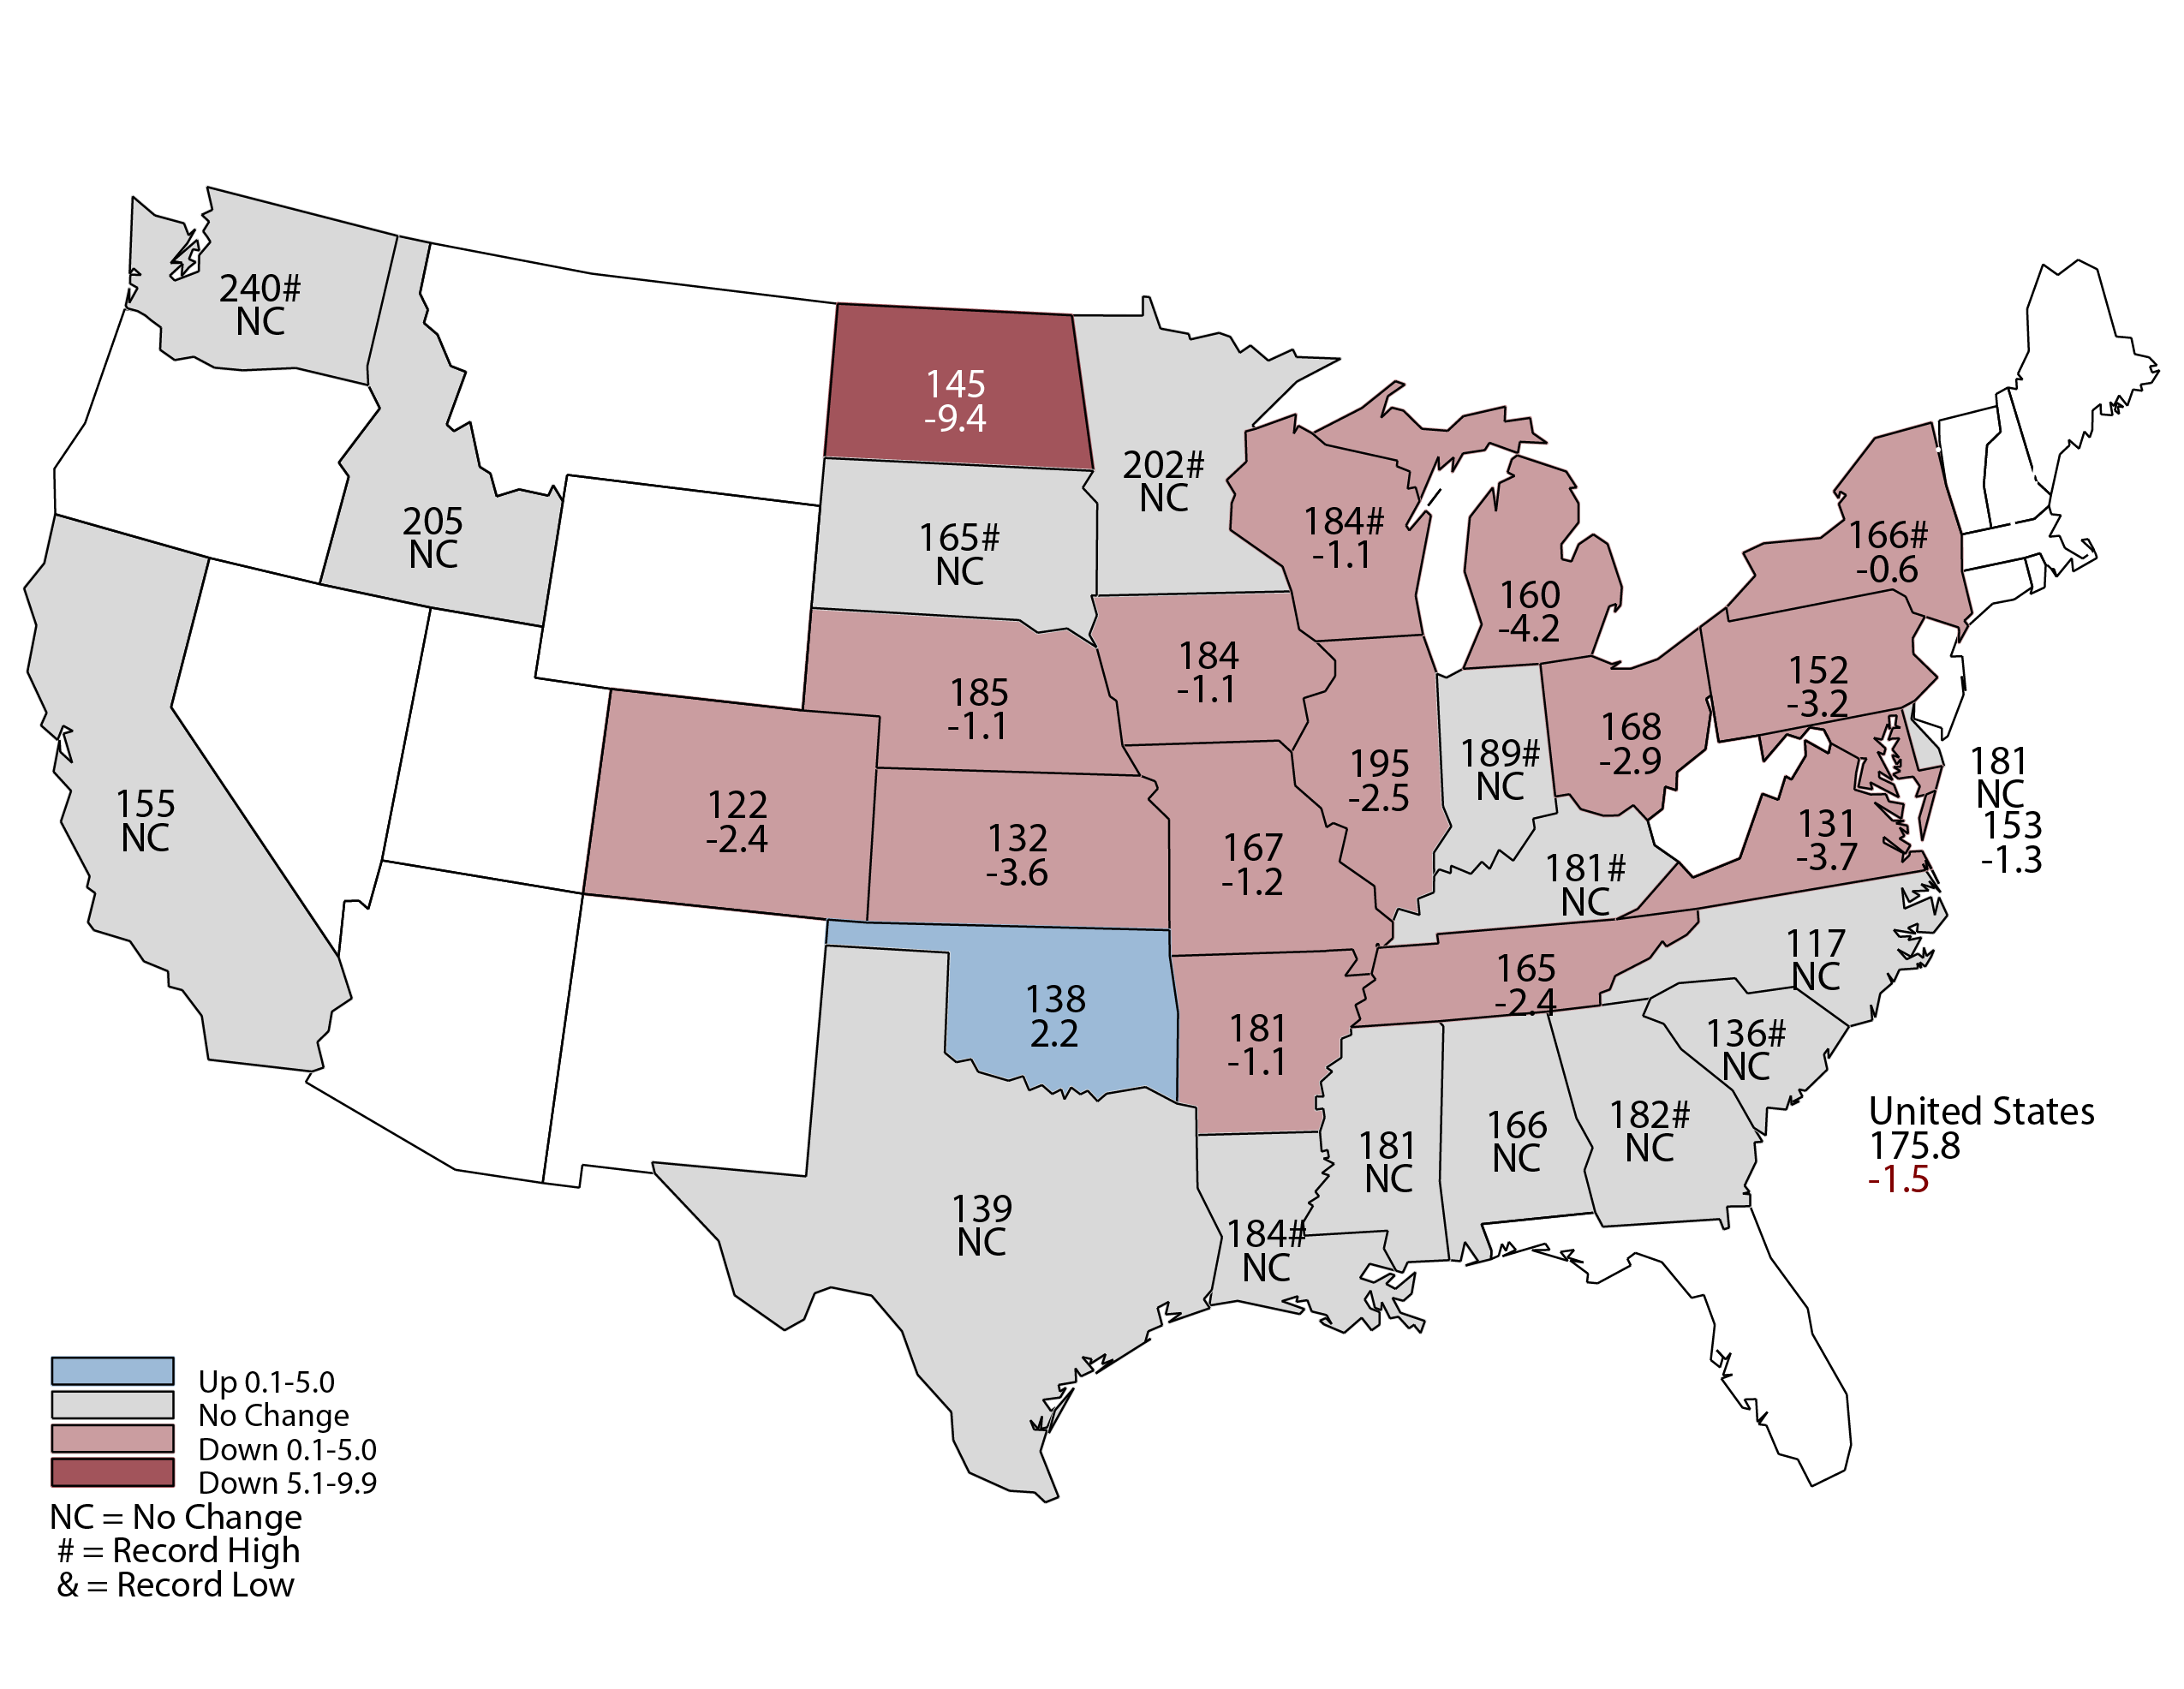
November 2020 Corn Yield
Bushels and Percent Change from Previous Month
Notes:
Corn Yield
Record high yield expected in GA, IN, KY, LA, MN, NY. SC, SD, WA , WI
Sept freeze in ND – impact not realized until farmers got into harvest
Based on November 1 conditions, Nebraska's 2020 corn crop yield is forecast at 185 bushels per acre, up 3 bushels from last year. Map is showing the November yield forecast is 2 bushels from last month.
Record yield is 192 set in 2018.

Slide 4
November 2020 Corn Production
Nebraska
Billion Bushels
Notes:
Corn Production
Nebraska's 2020 corn crop is forecast at a record 1.82 billion bushels, up 2% from last year's production, according to the USDA's National Agricultural Statistics Service. Area to be harvested for grain, at 9.83 million acres, is up slightly from a year ago.

Slide 6
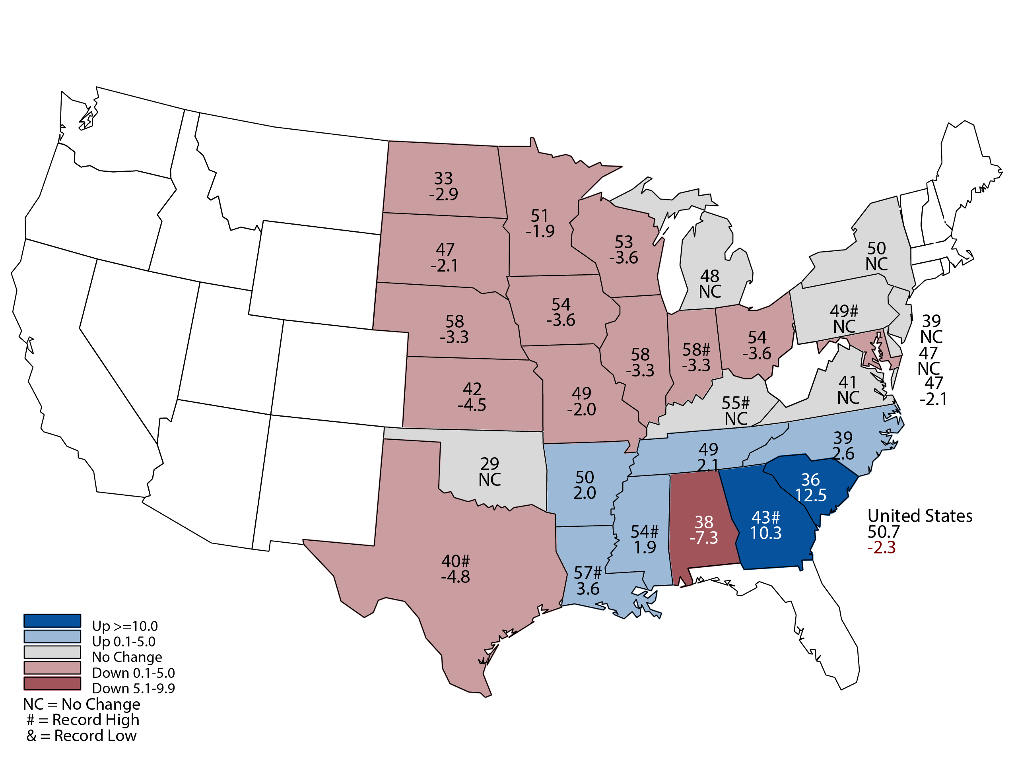
November 2020 Soybean Yield
Bushels and Percent Change from Previous Month
Notes:
Soybean Yield
Record highs expected in GA, IN, KY, LA, MS, PA, TX
Dry conditions across much of Corn Belt
Nebraska Soybean yield is forecast at 58 bushels per acre, down 0.5 bushel from last year and 2 bushels from last month.

Slide 7
November 2020 Soybean Production
Nebraska
Million Bushels
Notes:
Nebraska Soybean production is forecast at 299 million bushels, up 5% from last year. Area for harvest, at 5.15 million acres, is up 6% from 2019.

Slide 8
October 2020 Crop Production
Nebraska
Alfalfa hay production, at 3.78 million tons, is up 5% from last year. Area for harvest, at 970,000 acres, is up 2% from a year ago. Yield of 3.90 tons per acre is up 0.10 ton from 2019.
All other hay production, at 2.21 million tons, is down 11% from last year. Area for harvest, at 1.70 million acres, is up 13% from a year ago. Yield of 1.30 tons per acre is down 0.35 ton from 2019.

Slide 9
Crop Progress and Condition Report November 29, 2020
 | Very Short | Short | Adequate | Surplus
Topsoil Moisture | 24% | 41% | 34% | 1%
Subsoil Moisture | 31% | 40% | 28% | 1%
 | Very Poor | Poor | Fair | Good | Excellent
Winter Wheat Condition | 6% | 20% | 39% | 33% | 2%

Slide 10
Upcoming Events
Release Date | Title
December 10 | Small Grain County Estimates
December 16 | Cattle on Feed
December 23 | Hogs and Pigs
January 12 | Annual Crop Production
January 29 | Cattle

Slide 11
United States Department of Agriculture
National Agricultural Statistics Service
All Reports Available At
www.nass.usda.gov
For Questions
402-437-5541
800-582-6443

