Slide 1
Climate Assessment Response Committee November 17, 2015 Update Nebraska Conditions
Allen Dutcher
Nebraska State Climatologist
402-472-5206
adutcher1@unl.edu

Slide 2
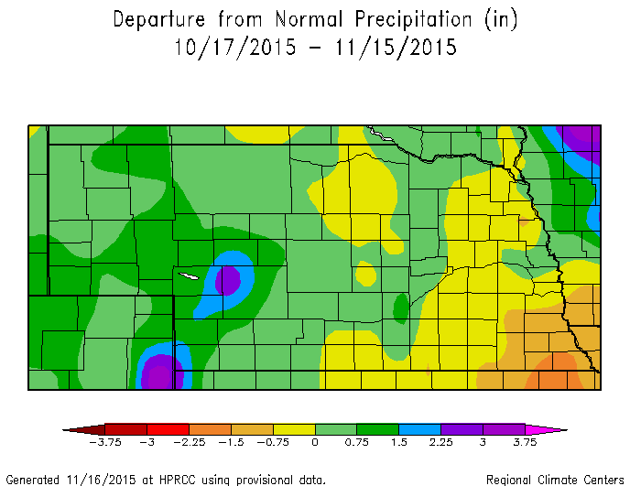
Nebraska Precipitation Trend 30 Day Departures

Slide 3
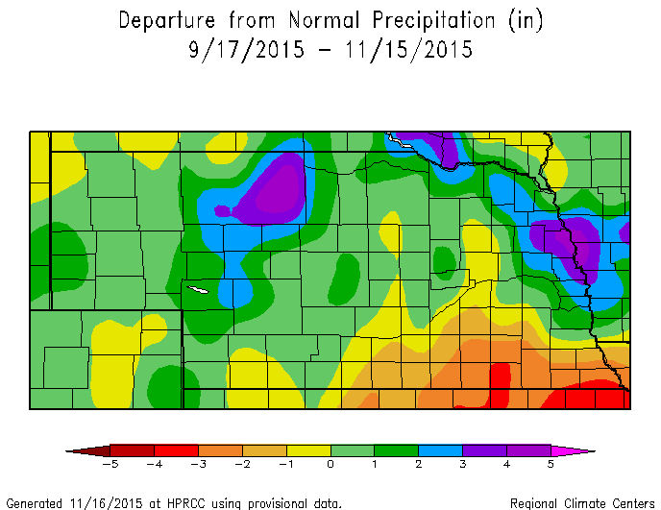
Nebraska Precipitation Trend 60 Day Departures

Slide 4
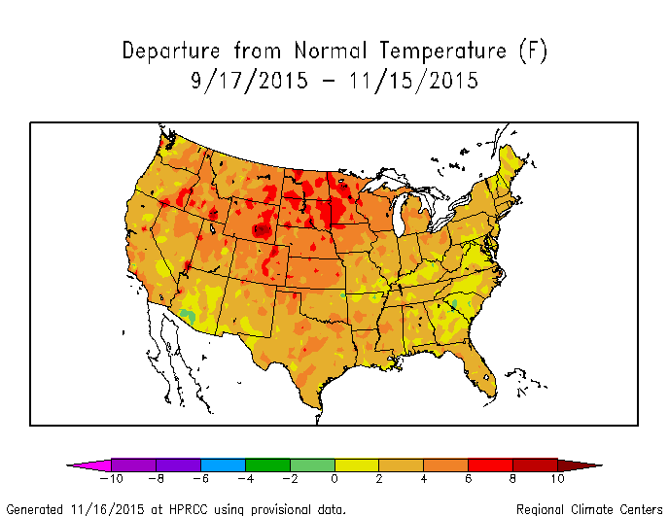
National Temperature Trend 60 Day Departures

Slide 5
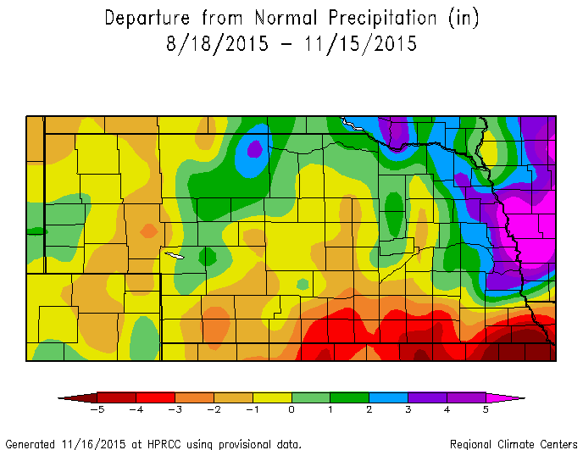
Nebraska Precipitation Trend 90 Day Departures

Slide 6
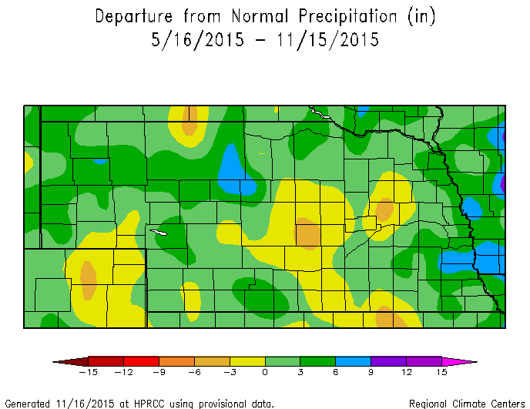
Nebraska Precipitation Trend 6 Month Departures

Slide 7
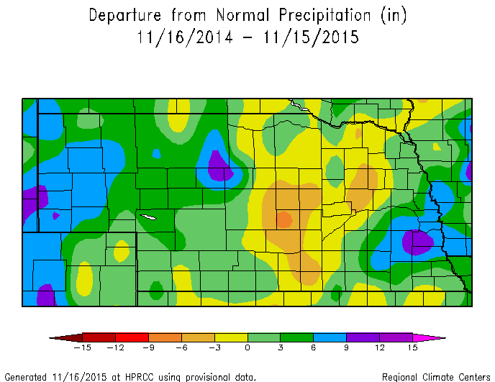
Nebraska Precipitation Trend 12 Month Departures

Slide 8
Important Precipitation Trends
Development of positive short term (30 and 60 day) for western ½ of the state. Positive for soil moisture recharge.
Negative precipitation trend (30 and/or 60 day) for south central and southeast Nebraska. Negative for soil moisture recharge (doesn’t include current storm).
Still a strong 90 day dry signal for south central and southeast Nebraska. Short term dry trend for the Panhandle, southwest, and west central Nebraska has been reduced 50% or greater in last 30 days.
A dry pattern still exists for central Nebraska at 6 and 12 month time scales. May signal hydrological and deep soil moisture dryness (below 4 feet)

Slide 9
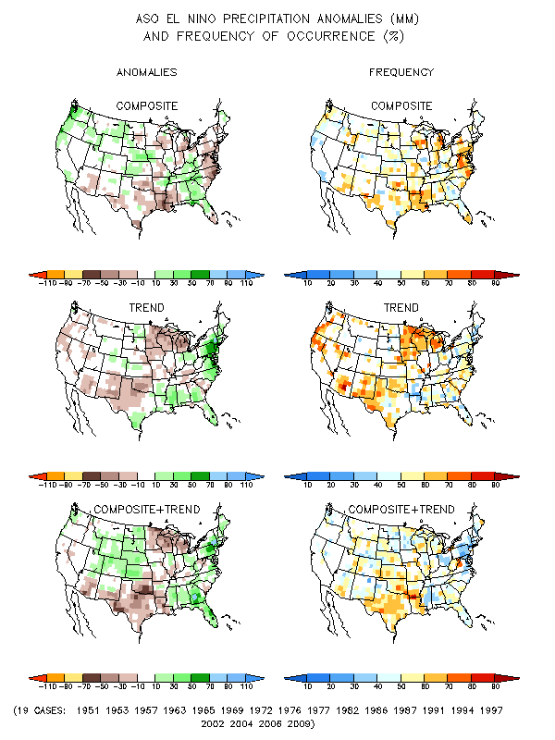
El Nino Precipitation Response August - October

Slide 10
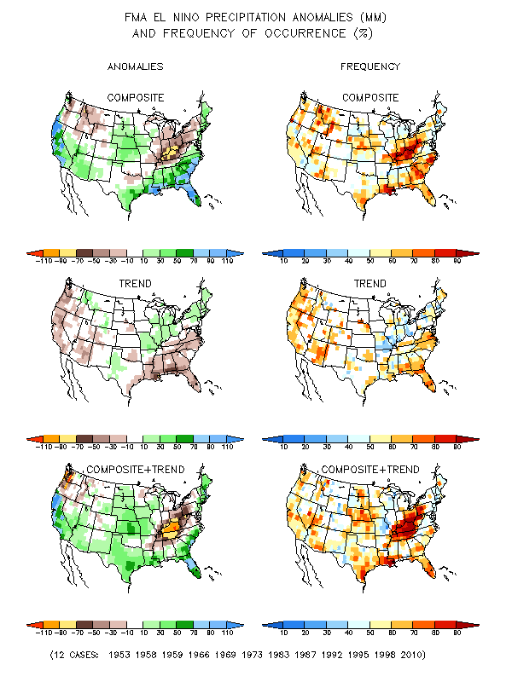
El Nino Precipitation Response February - March

Slide 11
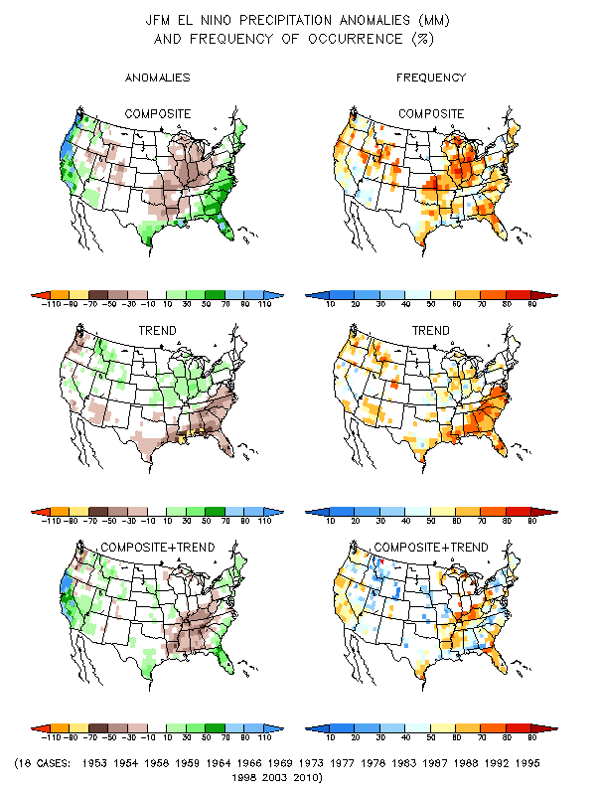
El Nino Precipitation Response January - March

Slide 12
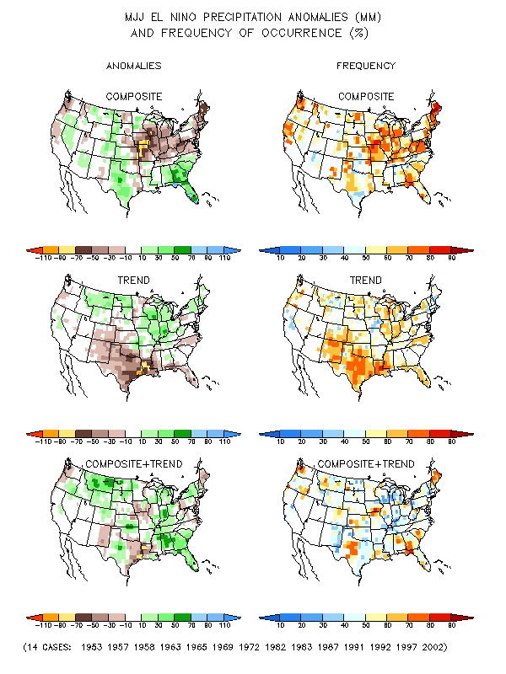
El Nino Precipitation Response May - July

Slide 13
El Nino Trends and Potential Impacts for Nebraska during 2016
Strong fall – early winter low pressure systems
Higher snow water equivalent storms (wetter snow events)
Unfrozen ground could result in above normal recharge during winter months
Split flow during winter, above normal temperatures, light storm activity (Jan-Feb)?
Heavy mountain snows – Platte watershed reservoir storage ?
Tendency for wet and cool conditions during late winter through mid-Spring.
Dry trend if El Nino still going into early Summer
4 o 5 moderate and strong events revert to La Nina after El Nino ends

