Slide 1
NE Drought Conditions CARC Update: November 17, 2015
Brian Fuchs
National Drought Mitigation Center
University of Nebraska-Lincoln
School of Natural Resources

Slide 2
Current Conditions around
Nebraska and the region…

Slide 3
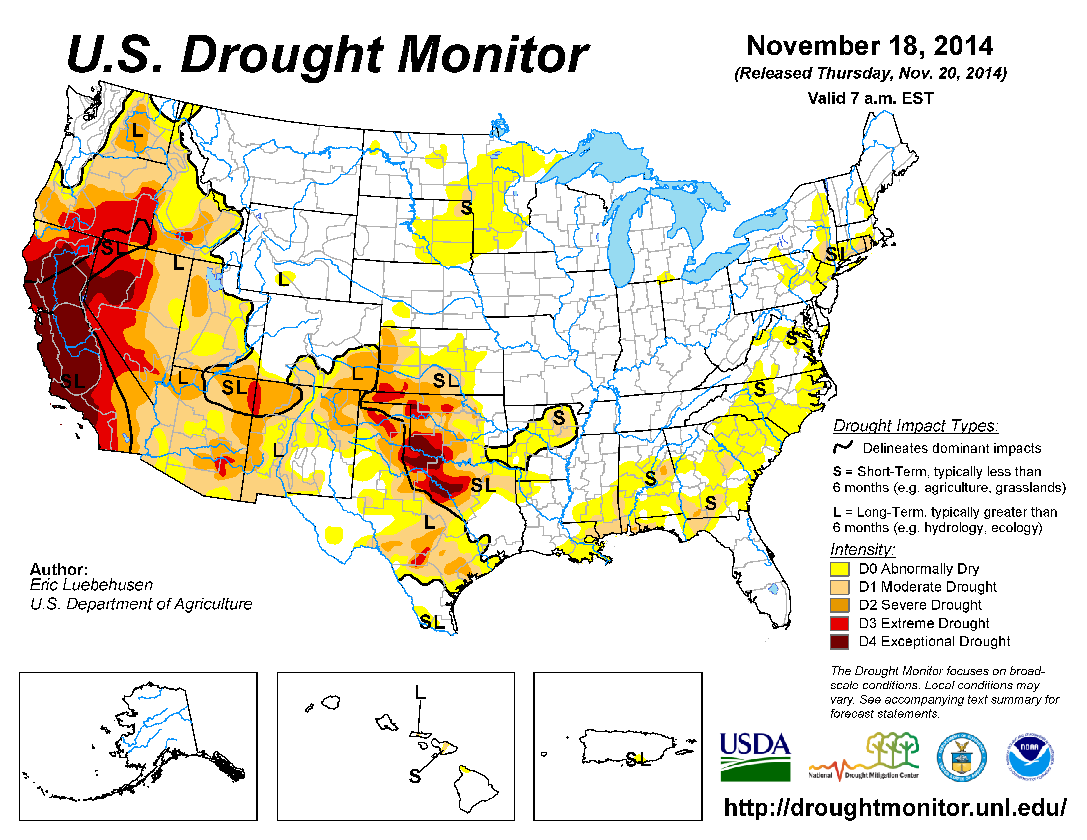

Slide 4
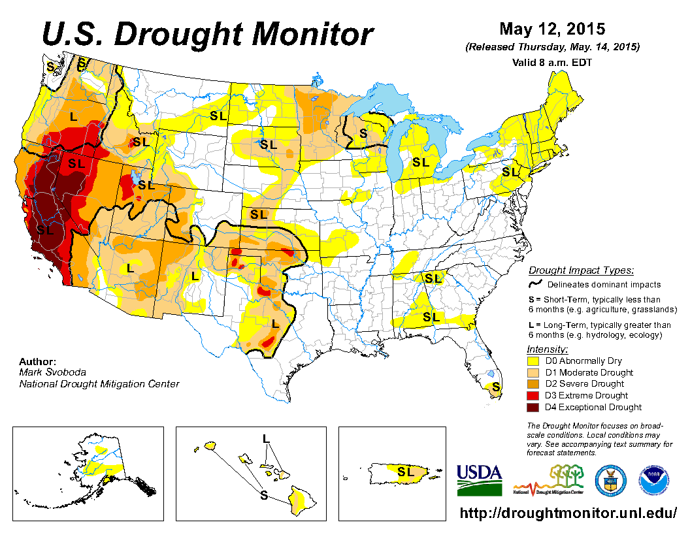

Slide 5
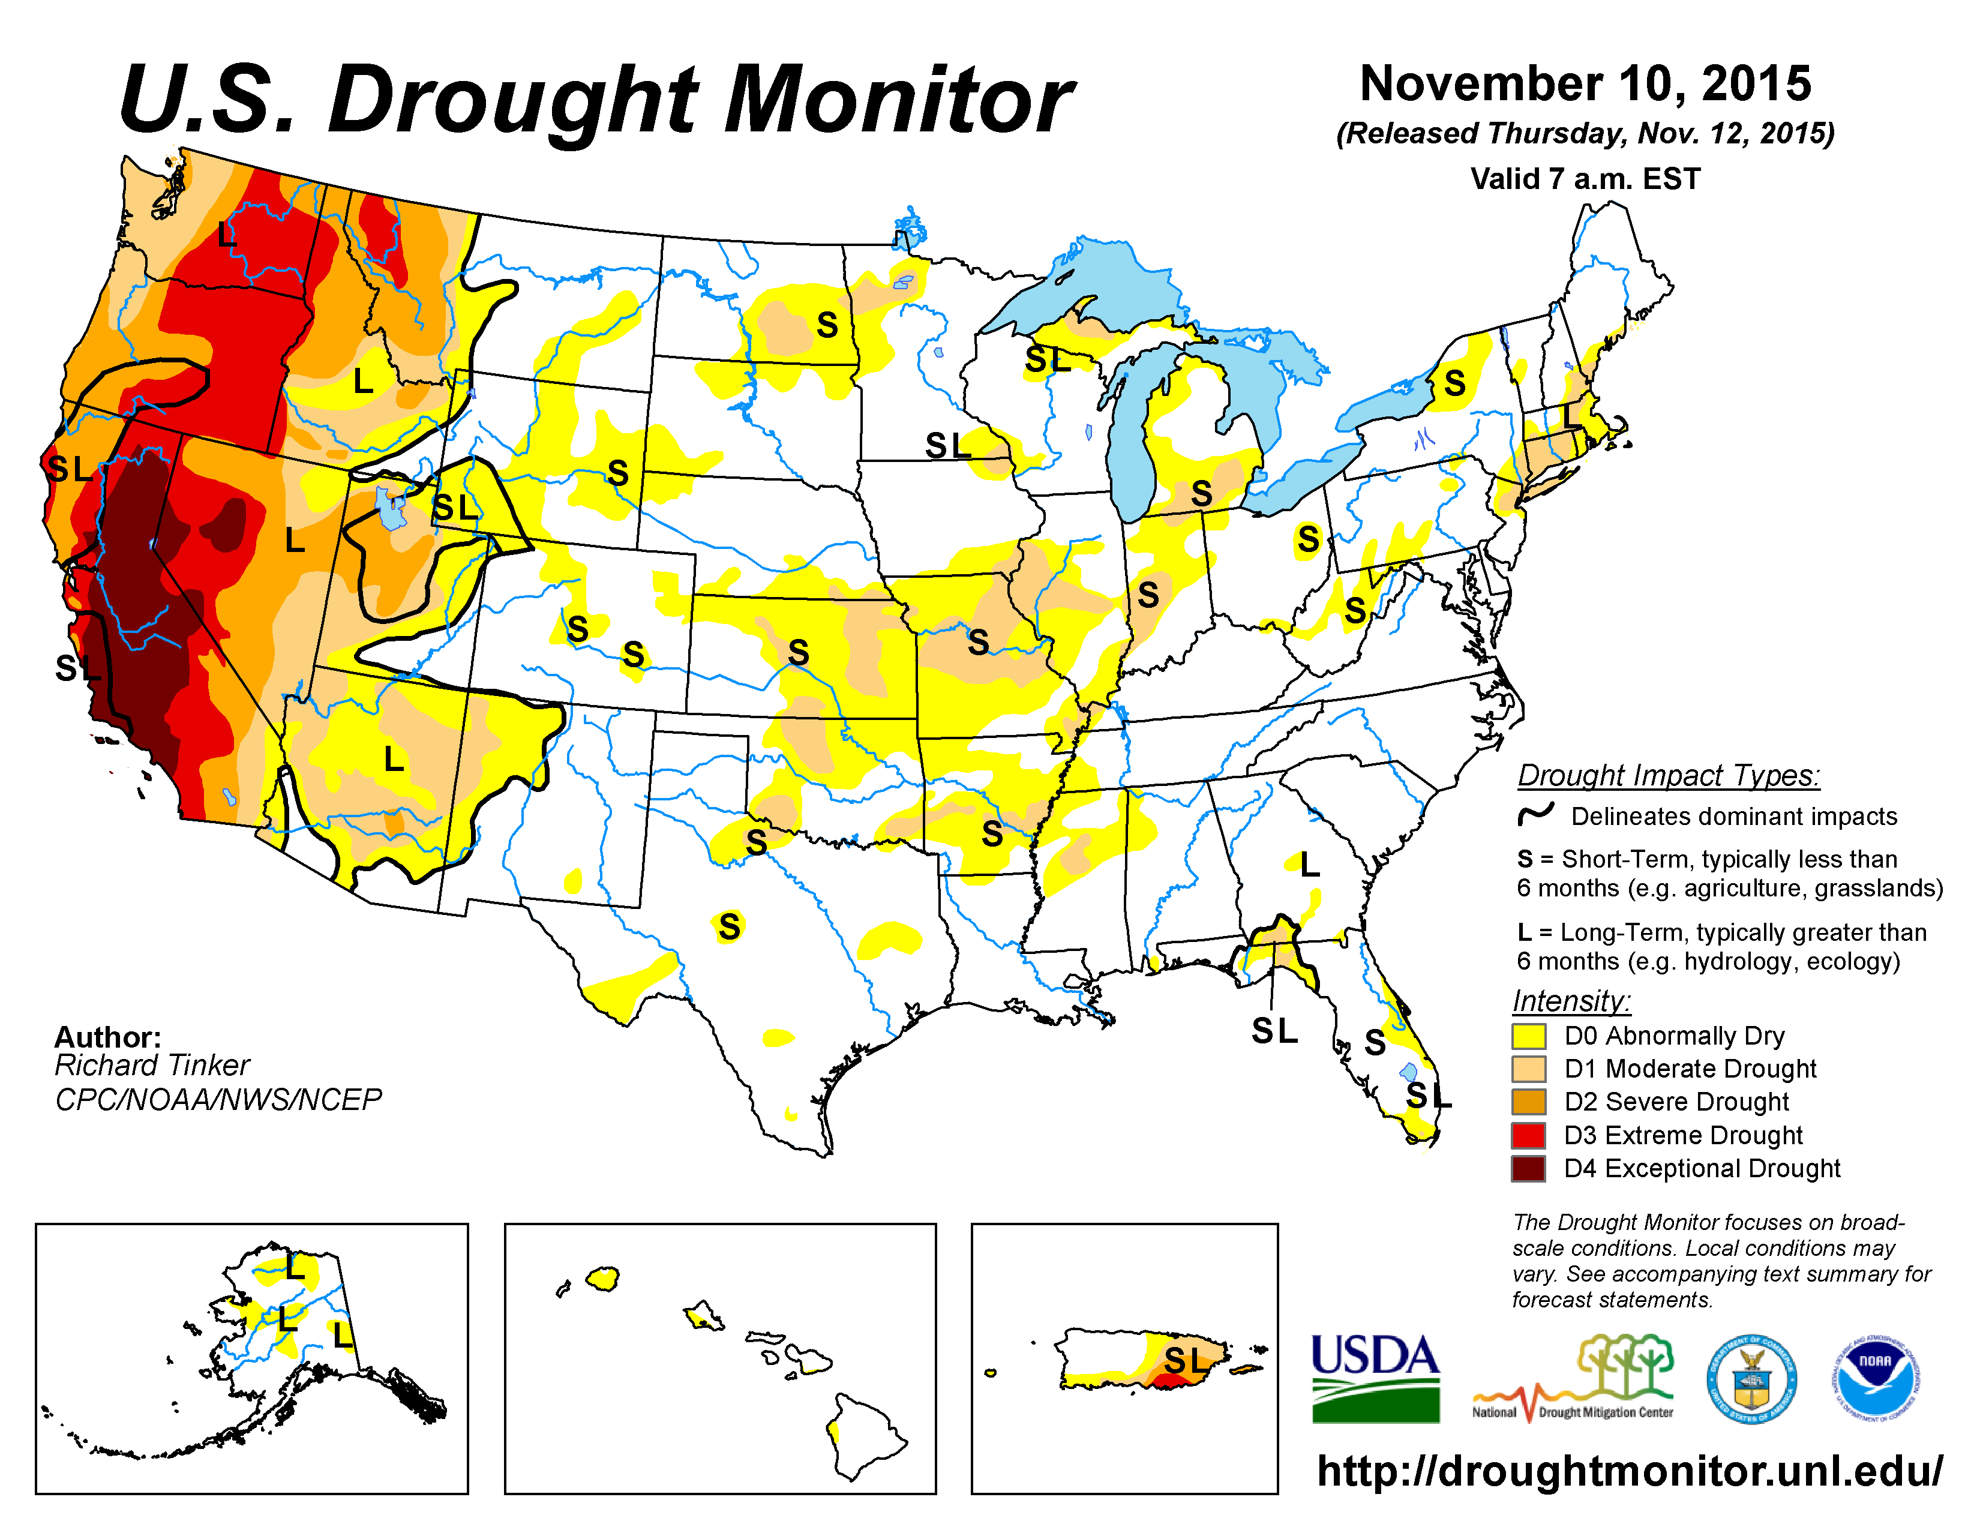

Slide 6
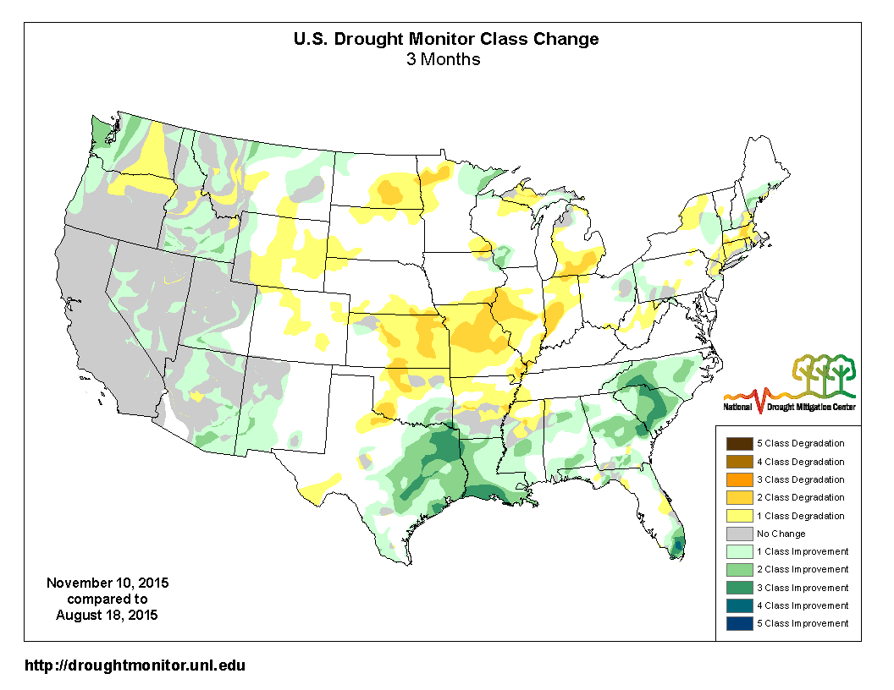

Slide 7
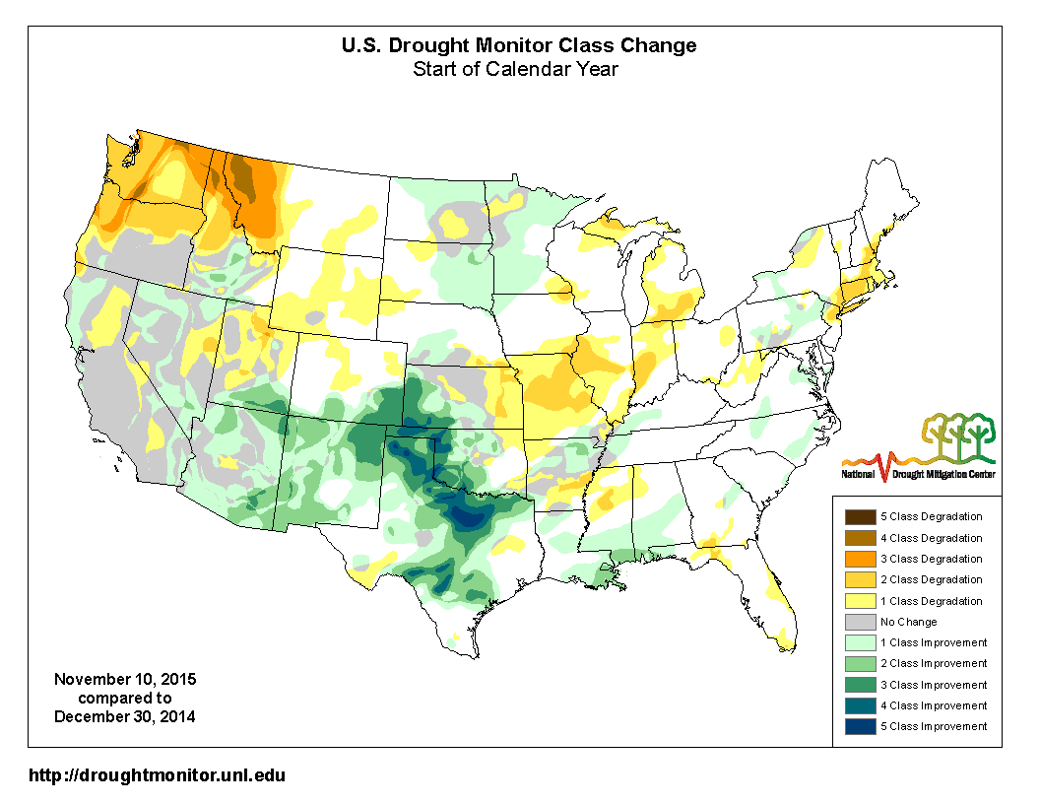

Slide 8
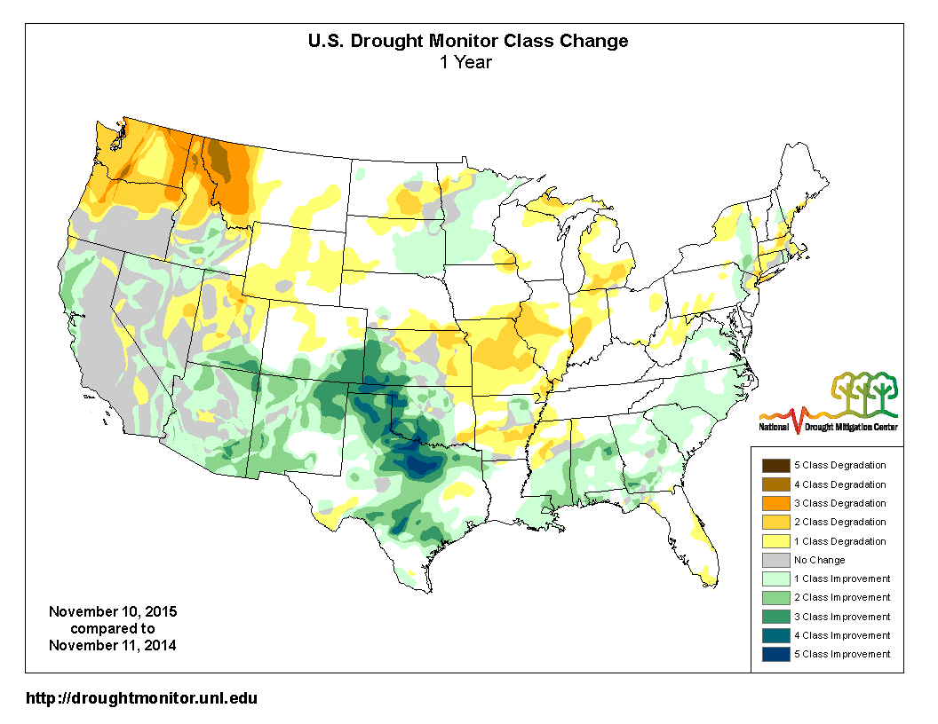

Slide 9
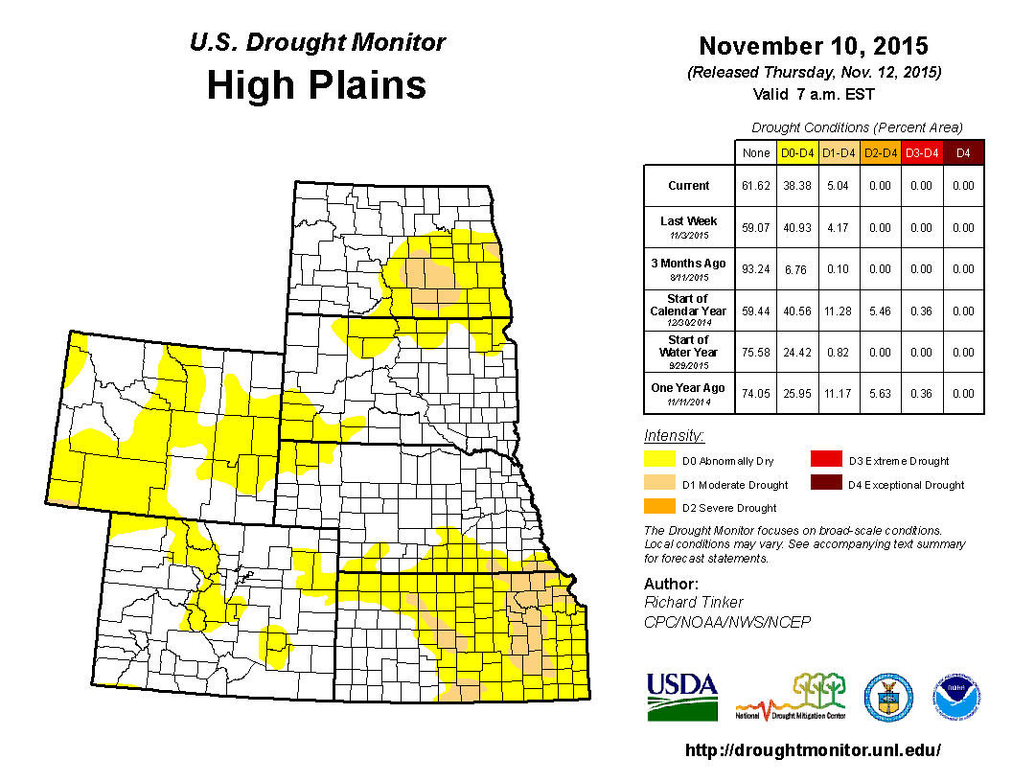

Slide 10
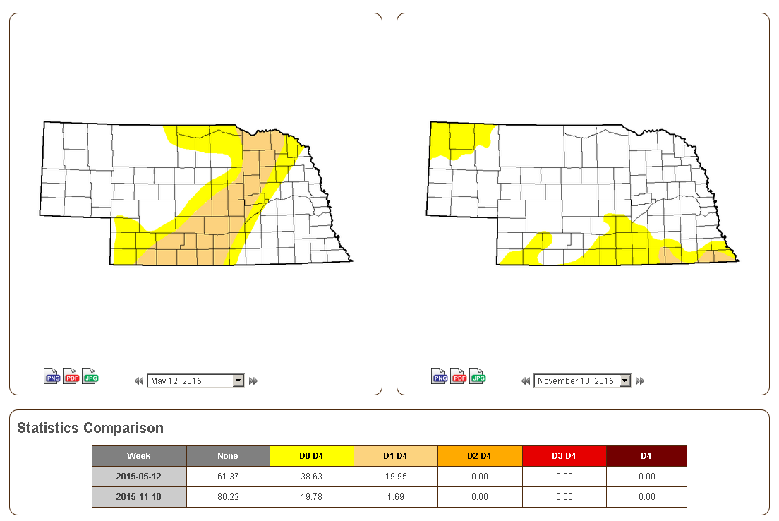

Slide 11
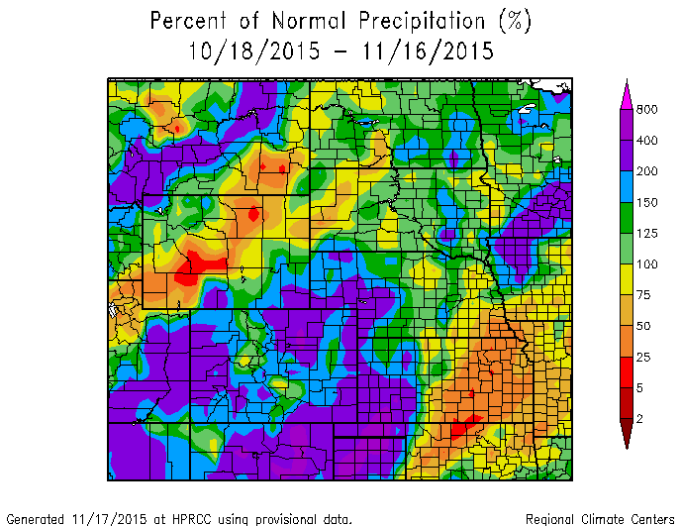

Slide 12
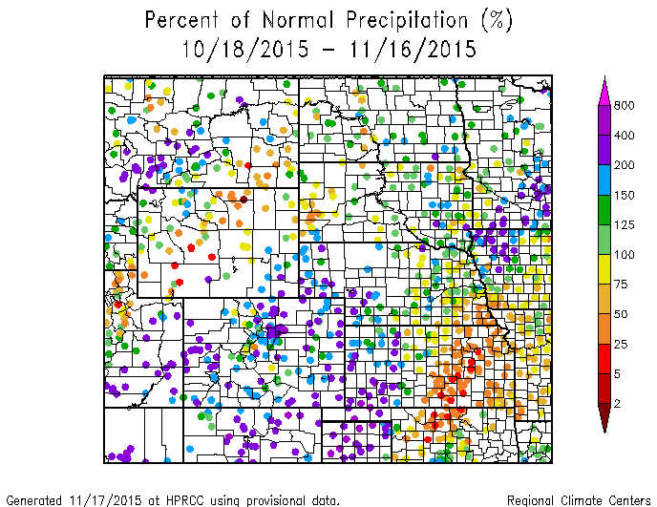

Slide 13
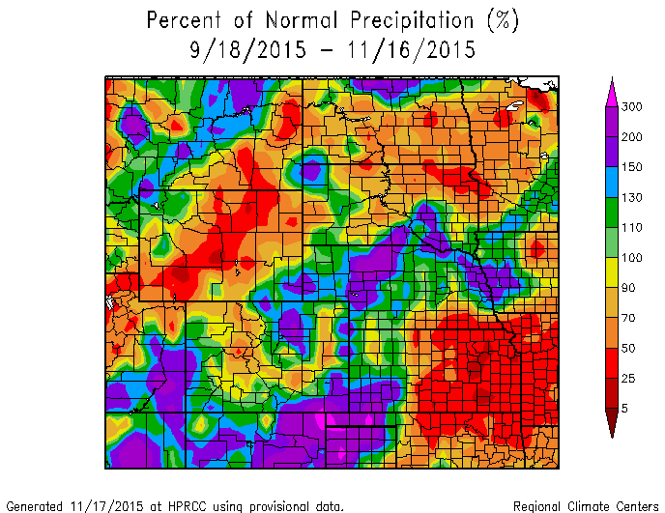

Slide 14
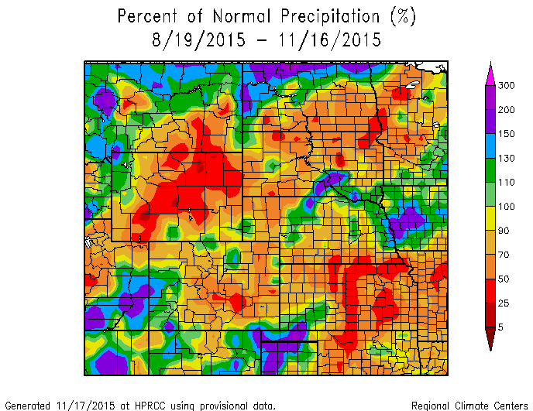

Slide 15
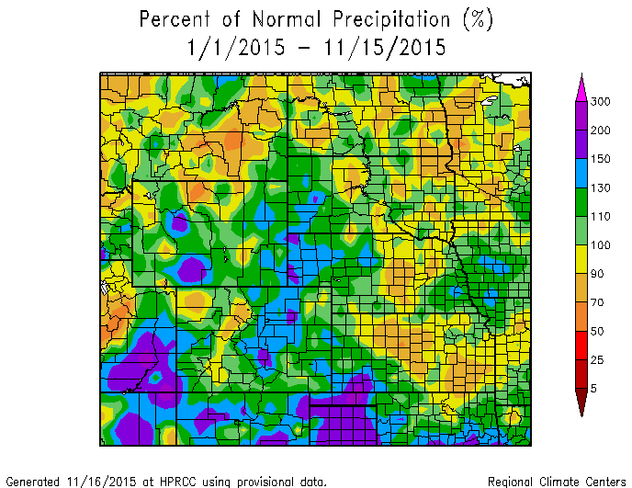

Slide 16
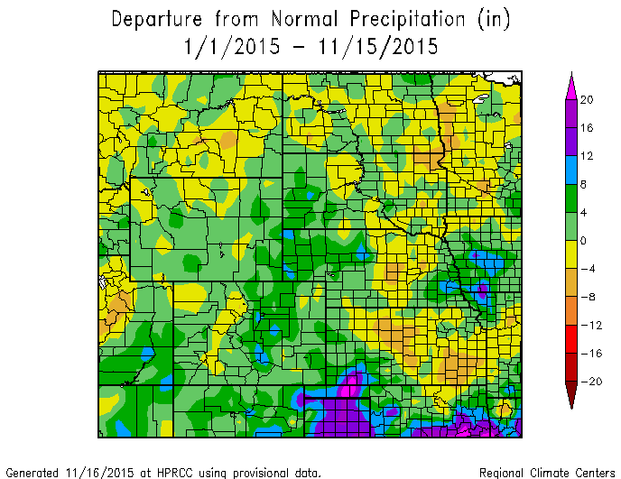

Slide 17
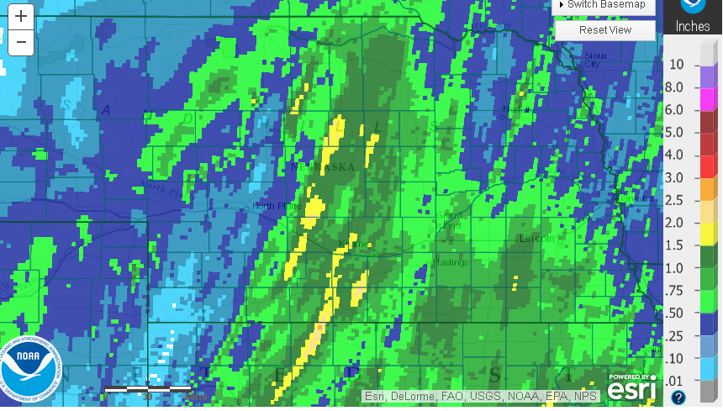

Slide 18
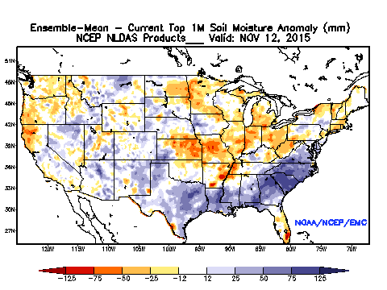

Slide 19
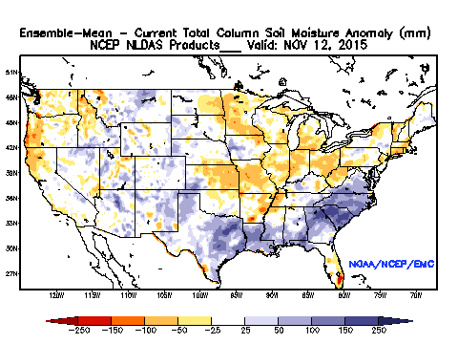

Slide 20
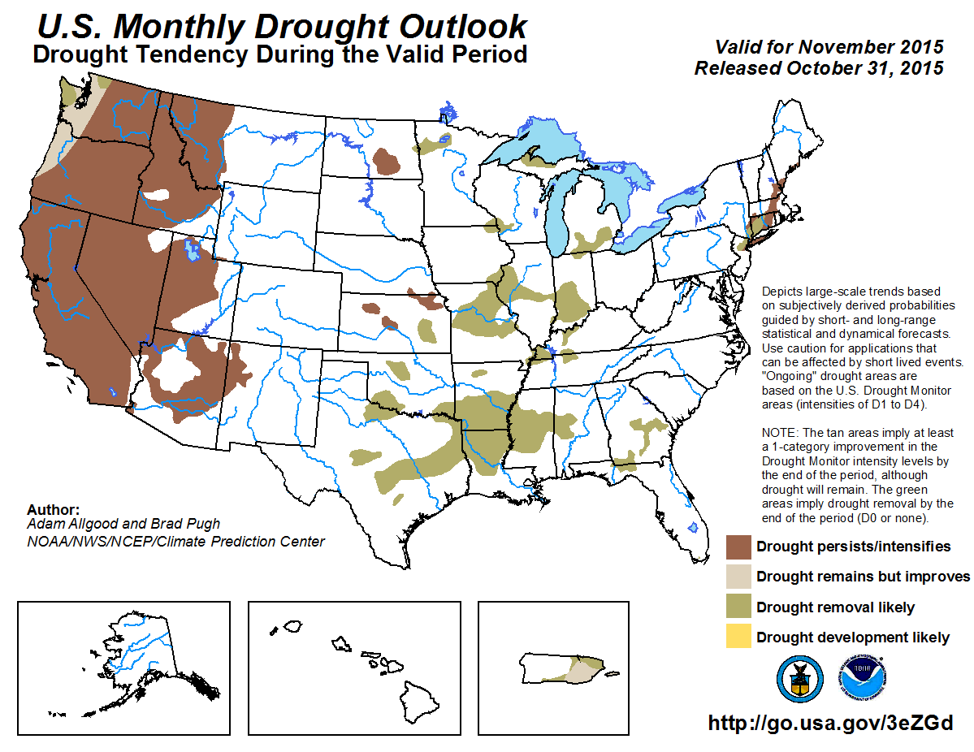

Slide 21
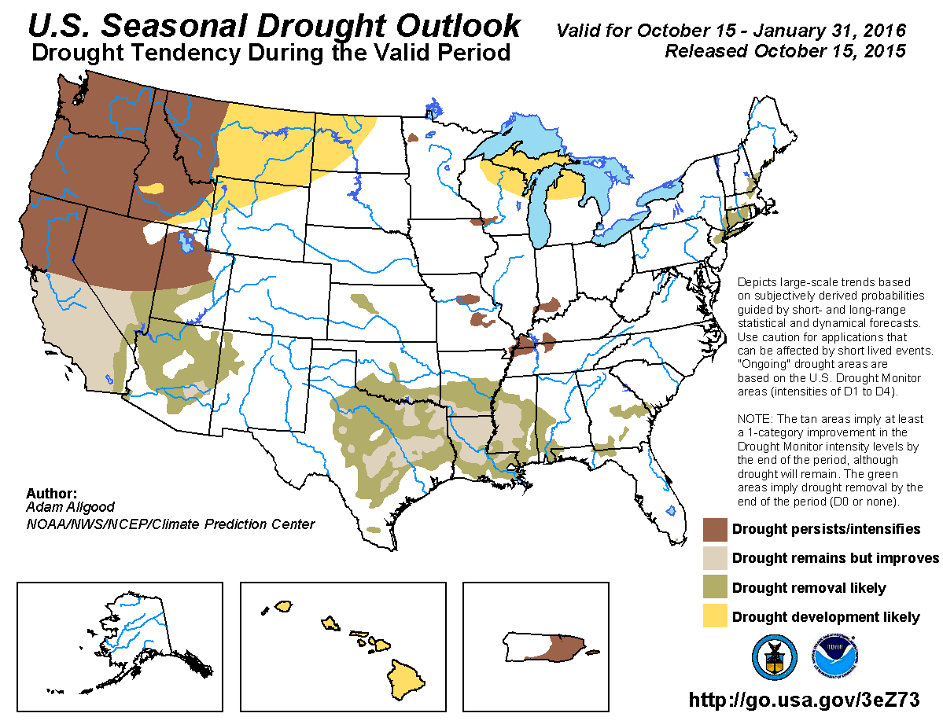

Slide 22
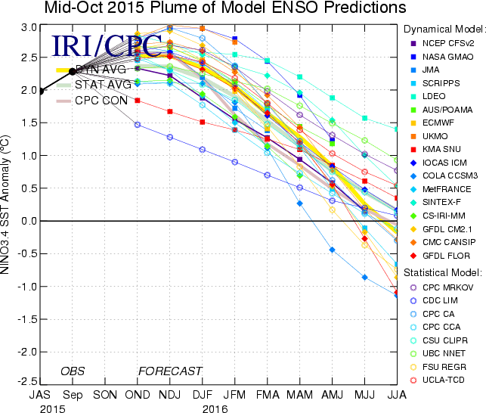

Slide 23
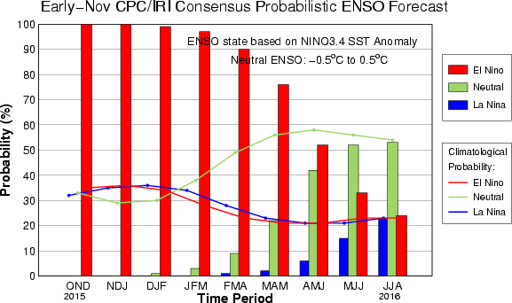

Slide 24
Climate/Drought Summary
Even with the good/great rains in late spring and early summer, some areas are below normal for the year.
25.18% of the contiguous U.S. is currently in drought (D1 or worse) as of 11/10/2015
This time last year it was at 29.59%.
Down nearly 3.5% Year-to-Date (28.68% on Dec. 30, 2014)
Current USDM (11/10/2015) for NE shows 1.7% of the state in drought (D1 only), up from 0% on January 1, 2015

Slide 25
Climate/Drought Summary
The Climate Prediction Center’s Seasonal Drought Outlook calls for improvement or removal of drought across the Central and Southern Plains by the end of January
CPC/IRI ENSO Alert System Status: El Niño Advisory
Synopsis: There is an approximately 95% chance that a moderate to strong El Niño will continue through Northern Hemisphere winter of 2015-16, and a gradual decline during the spring of 2016.
More important for southern Plains in winter with a typical El Nino winter pattern expected

Slide 26
Nebraska Water Supply Update…

Slide 27
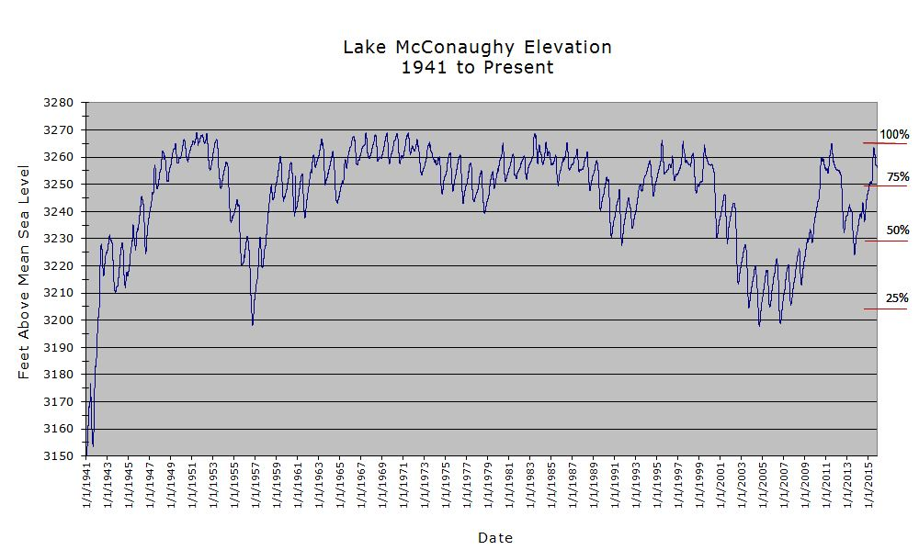
85.1% Full
SOURCE: CNPPID www.cnppid.com

Slide 28
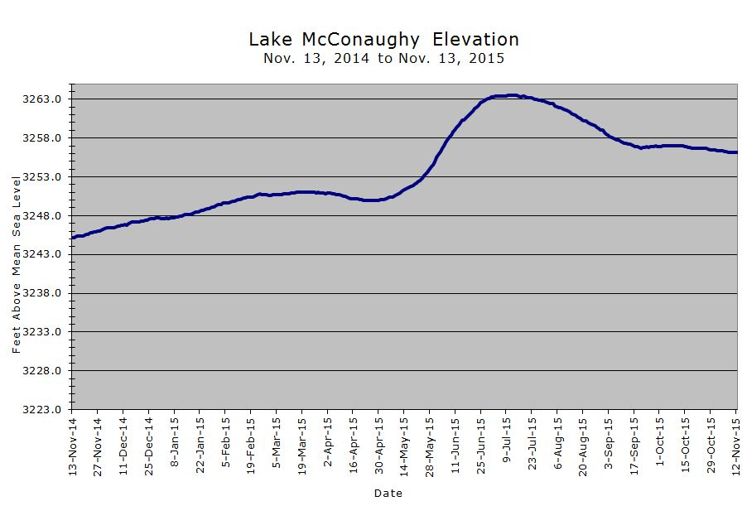
3256.1 Feet
85.1% of Max
November 2015
3251.4 Feet
77.9% of Max
May 2015
SOURCE: CNPPID www.cnppid.com

Slide 29
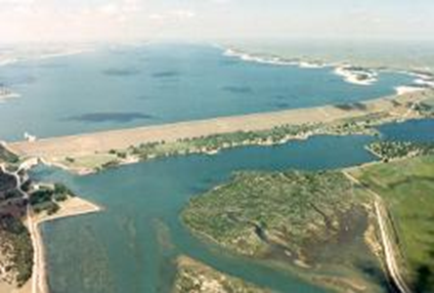
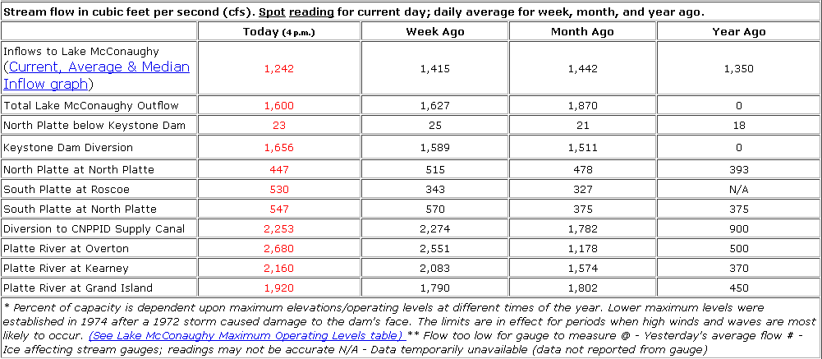
November 2015 CARC Meeting
SOURCE: CNPPID www.cnppid.com

Slide 30
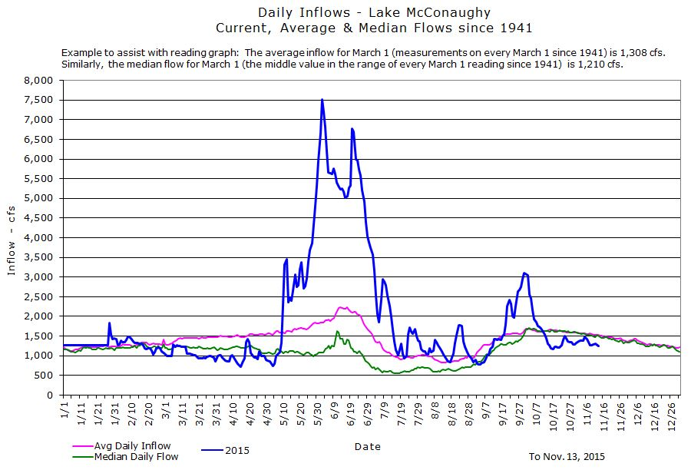
SOURCE: CNPPID www.cnppid.com

Slide 31
Lake McConaughy
At Lake McConaughy has 1.484 million acre-feet in storage (85.1% of capacity). Inflows have decreased recently and ranged from 1,242 cubic feet per second (currently) to 1,442 cubic feet per second a month ago, which is slightly below normal for historical inflows for this time of year.
Snowpack in the upper North Platte River Basin is just starting to accumulate with the new water year beginning on October 1.
SOURCE: CNPPID www.cnppid.com

Slide 32
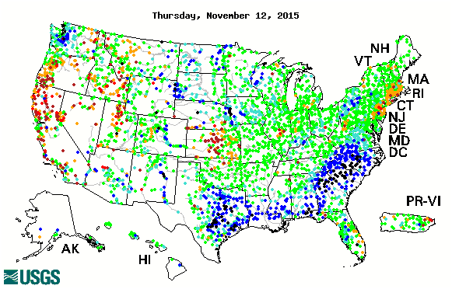
14-day average streamflow compared
to historical streamflow for the day of year

Slide 33
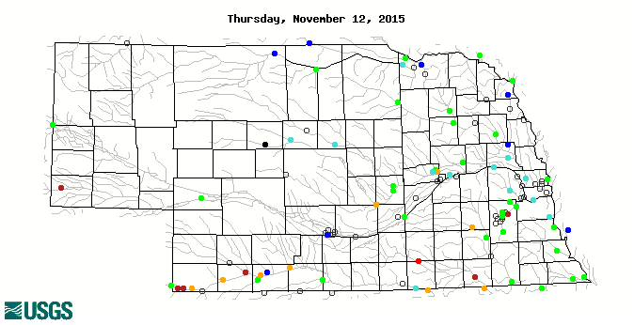
14-day average streamflow compared
to historical streamflow for the day of year
91st Percentile
40th Percentile
1st Percentile
3rd Percentile
9th Percentile
4th Percentile

Slide 34
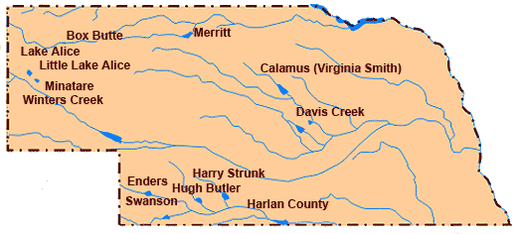
Republican River Basin
Hugh Butler: 33.6%(28.6%) of conservation pool
Enders: 23.1% (24.2%) of conservation pool
Harry Strunk: 92.4%(100%) of conservation pool
Swanson: 36.8% (40.8%) of conservation pool
*values in red are from the last CARC meeting in May 2015.
Source: BOR http://www.usbr.gov/gp/lakes_reservoirs

Slide 35
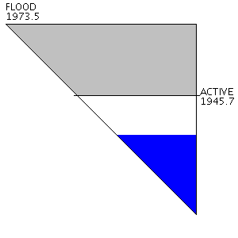
Republican River Basin
Harlan County Current Conditions
Conservation Pool is 48.3% full (60.3%)
151,824 Acre-Feet in storage compared to 189,484 Acre-Feet (AF) of water in storage during May 2015.
Last year at this time, 143,496 AF was in storage.
Historical average storage for this time of the year is 213,720 AF
Source: BOR http://www.usbr.gov/gp/lakes_reservoirs/

Slide 36
Water Supply Summary
No hydrological issues in the state as we go into winter. Low flows are noticeable in the Republican River Basin.
Lake McConaughy is currently:
4.7 feet higher than it was during the last CARC meeting in May 2015.
The inflows have decreased over the last few weeks and are currently about 85% of normal for this time of year.
Elevation is about 12 feet higher than at this time last year.
Overall, storage in the Republican River basin has declined since the last CARC meeting due to the impact of seasonal irrigation.
Harlan County is currently:
37,660 Acre-Feet lower than in May 2015 (last CARC meeting)
61,896 AF lower than the historical average for this time of year

Slide 37
Any Questions ?

Slide 38
Contact Information:
Brian Fuchs
bfuchs2@unl.edu
402-472-6775
Mark Svoboda
msvoboda2@unl.edu
402-472-8238
National Drought Mitigation Center
School of Natural Resources
University of Nebraska-Lincoln

